Slide 1
Good Cyber Hygiene Habits Alex Boyd Polsinelli PC aboyd@polsinelli.com
August 15, 2019

Slide 2
Agenda
Expanding reach of cyber
Cybersecurity trends and legal implications
Learning from common data security scenarios
Ways to protect yourself and your organization

Slide 3
What is Cyber Hygiene and Why Does it Matter?
Practices to protect yourself, your organization, and your data
Financial fraud and identity theft
Legal compliance
Business operations
Reputation and trust

Slide 4
Expanding Scope of Cyber
At work
At home or while traveling
Types of data
Your own personal information
Employee personal information
Business data
Customer data

Slide 5
Data Privacy and Cyber Security
Data privacy
What information is collected
How that information is used
To whom that information is disclosed
Cybersecurity
Policies and procedures designed to avoid the loss or unauthorized disclosure of collected information

Slide 6
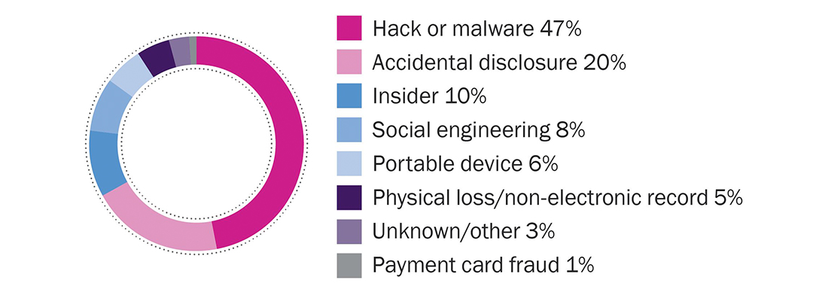
Cybersecurity Threat Trends
Cause of incidents, 2018

Slide 7
Email Compromise: Motivation for Threat Actors
Wire transfers (lead to losses due to fraudulent wire and lawsuits)
Reconnaissance/targeted spam
Payroll redirect
Access sensitive information in the inbox

Slide 8
Ransomware & Cyber Extortion
Ransomware
Business disruption
Loss of customers
Often deployed after unauthorized access
Potential breach notification obligations
True Extortion
Theft or Destruction of Digital Assets
Demand for payment

Slide 9
Potential Legal Obligations
Legal obligations arising from the unauthorized access of personal information
Statutory data breach notification obligations to individuals, regulators and business partners
State or federal law
This may include notification to investors, key customers, unfriendly parties (e.g., litigation adversaries)
Contractual obligations to third parties

Slide 10
Data Breach Response
Have you mitigated the security risk?
Was “personal information” involved in a “security breach?”
Do you need to notify impacted persons?
Do you need to notify state regulators?
Do you need to notify any federal regulators?

Slide 11
Learning from Common Scenarios
How should you respond if the incident occurs?
How could the incident have been prevented?
How could the impact have been minimized?

Slide 12
Email Compromise Example 1
From: jsmith@ABC.com
To: jdoe@companyx.com
Sent: June 1, 9:30 a.m.
Subject: Secure Message
Dear John Doe,
This is a secured message for you. You can access it by logging onto the following secure website: Link.
Jane Smith Director of Finance ABC Company

Slide 13
Email Compromise Example 1 (Contact)
No compromise at your company, yet.
Don’t click the link, enter any passwords, or open any attachments.
Was the sender from a known contact? Were you expecting this email?

Slide 14
Email Compromise (2)
From: Jane Smith
To: jdoe@ABC.com
Sent: June 1, 9:30 a.m.
Subject: URGENT
Please complete the attached survey ASAP. You will need to login to the site using your company email address and password. We need this for insurance purposes.
Jane Smith Director of Finance ABC Company

Slide 15
Email Compromise (2) (Impersonation)
From: Jane Smith (jsmith99@gmail.com)
To: jdoe@ABC.com
Sent: June 1, 9:30 a.m.
Subject: URGENT
Please complete the attached survey ASAP. You will need to login to the site using your company email address and password. We need this for insurance purposes.
Jane Smith Director of Finance ABC Company

Slide 16
Email Compromise (2) (Impersonation)
Always confirm the identity of the sender and beware of impersonators.
Add an “External Email” banner
Train employees regularly

Slide 17
Email Compromise (3)
From: jsmith@ABC.com
To: jdoe@ABC.com
Sent: June 1, 9:30 a.m.
Subject: Survey
Please complete the attached survey ASAP. You will need to login to the site using your company email address and password. We need this for insurance purposes.
Jane Smith Director of Finance ABC Company

Slide 18
Email Compromise (3) (Active Compromise)
Now we know we have a problem.
Additional facts learned upon investigation:
Employee clicked a link in a phishing email and entered their username and password for their work email account.
Threat actor accessed the account
Searched for emails with wire instructions for outstanding invoices and emailed the customer with changes to the instructions.
Established rules that deleted incoming emails from that customer.
Established forwarding rules to send emails to an external account.
Later sent further phishing emails to contacts inside and outside the organization.
Several employees clicked on the links and entered credentials, including employees who routinely send spreadsheets containing employee information.

Slide 19
Email Compromise (3) (Active Compromise)
How should you respond if the incident occurs?
Follow your incident response plan
Remediation
Password changes
Remove rules
Detect any fraudulent wire transfers
Investigation
Determine if any personal information may have been accessed or acquired
Notification
Comply with any applicable notification requirements
Notify customers or contacts who may be at risk
Prevention
Mitigate the risk that led to the compromise

Slide 20
Email Compromise (3) (Active Compromise)
How could the incident have been prevented?
Methods to prevent the first compromise
External banner
Training
Multifactor authentication
Blocking certain foreign IP addresses or unapproved IP addresses

Slide 21
Email Compromise (3) (Active Compromise)
How could the impact have been minimized?
Earlier detection
Alerts when rules are created
Alerts regarding suspicious logins from unknown IP addresses
Regular password changes (and rule removals)
Reduce or eliminate personal information from email accounts
Do not send actual copies of sensitive records.
Send through hyperlinks to internal documents or through links to secure file transfer sites
Delete older emails

Slide 22
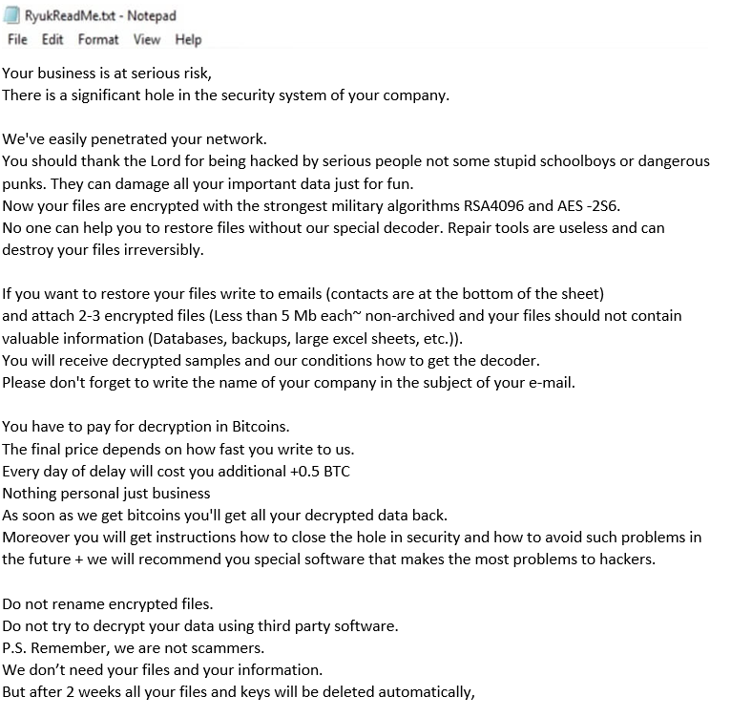
Ransomware Example
After turning on your workstation in the morning, you see that all of your files are encrypted.
A single text file is readable and contains a ransom note.
Other workstations are also encrypted.

Slide 23
Ransomware Example
How should you respond if the incident occurs?
Report to the information security team
Individual employees should not pay the ransom
Balancing operational needs with preserving forensic evidence
Disconnect impacted systems from the network and from the internet
Leave the machine alone.
Do not turn off the machine and do not run any anti-virus scans.
Determining availability of backups
Forensic investigation

Slide 24
Ransomware Example
How could the incident have been prevented?
Forensic investigation is key to determining entry point
Securing remote desktop connections
Multifactor authentication
Blocking foreign or unapproved IP addresses
Stronger network passwords
Ensuring patches and updates are installed

Slide 25
Ransomware Example
How could the impact have been minimized?
Backups
Not encrypted
Up to date
Preserving forensic evidence to aid with legal compliance
Proving no data was exfiltrated from the company’s servers

Slide 26
Avoiding Scams
Calls/texts/emails from:
The IRS
The utility company
Law enforcement or the courts
Tech support
Red flags
Urgent
Payment in gift cards
When in doubt, call the actual entity

Slide 27
Credit Monitoring/Identity Theft Protection
Watch your credit report
Review your bank statements
Fraud alerts
Credit freeze
Take advantage of credit monitoring services when offered

Slide 28
More Tips for Good Cyber Hygiene
Unique passwords
Strong passwords
Do not store passwords in places accessible to others
Sticky notes
Passwords file on your computer
Do not leave your mobile device or laptop unattended or in your car
Do not email or mail unencrypted data
Do not send sensitive information using public WiFi

Slide 29
More Tips for Good Cyber Hygiene
Multifactor authentication whenever possible
Lock down access to email accounts or remote desktop applications that can be accessed anywhere in the world
Have active backups separate from your primary systems
Encrypt laptops, phones, and storage devices (password protection is not enough)

Slide 30
More Tips for Good Cyber Hygiene
Do not install unapproved software
Do not permit automated forwarding of work emails to personal accounts
Obtain verbal confirmation for changes to wire instructions
Maintain antivirus and antimalware software
Policies for ensuring terminated employees cannot access company information
Enable and preserve audit logging for all available systems

Slide 31
More Tips for Good Cyber Hygiene
Keep tabs on your vendors
Conduct periodic risk assessments
Have an incident response plan
Delete data after it is no longer needed. More data more risk.
Cyberinsurance

Slide 32

Polsinelli PC provides this material for informational purposes only. The material provided herein is general and is not intended to be legal advice. Nothing herein should be relied upon or used without consulting a lawyer to consider your specific circumstances, possible changes to applicable laws, rules and regulations and other legal issues. Receipt of this material does not establish an attorney-client relationship.
Polsinelli is very proud of the results we obtain for our clients, but you should know that past results do not guarantee future results; that every case is different and must be judged on its own merits; and that the choice of a lawyer is an important decision and should not be based solely upon advertisements.
© 2019 Polsinelli® is a registered trademark of Polsinelli PC. In California, Polsinelli LLP.
Polsinelli PC, Polsinelli LLP In California | polsinelli.com

