Slide 1
2023 Ethics Update
UT-Battelle Labor & Employment Training
August 2023
Professor Alex Long | University of Tennessee College of Law

Slide 2
Introduction
Program Format & Question Lineup

Slide 3
Today’s Program
Scenarios that Raise Attorney Ethics Issues
Tennessee Rules of Professional Conduct
Polling – Pick the Best Answer
Discussion

Slide 4
Question Lineup
The Duty to Report Another Lawyer’s Misconduct
Choice of Law When a Lawyer Practices in Multiple Jurisdictions
Responsibilities Regarding Non-Lawyer Assistants
The Ethics of Robot Lawyers (AI in the Practice of Law)
Saying Stupid (and Discriminatory) Stuff in Email and Social Media
Ethical Obligations of Departing Attorneys and Their Firms
Office Sharing Arrangements with Other Lawyers

Slide 5
Warmup
(1) Which of the following is not an actual attorney ethics news item from the past year?
(A) Lawyer sentenced to jail for Molotov cocktail attack on police car.
(B) Meigs County judge disciplined for calling a litigant a “tough guy” during a hearing and telling him to “shut up.”.
(C) Knox County judge disciplined for telling a witness to “shut your big fat yap” during a hearing.
(D) Lawyer suspended for engaging in billing fraud by billing the Public Defenders Service Corp. for more than 24 hours of work in one day.

Slide 6
Rule 8.3: The Duty to Report Another Lawyer’s Misconduct

Slide 7
TRPC Rule 8.3(a)
(a) A lawyer who knows that another lawyer has committed a violation of the Rules of Professional Conduct that raises a substantial question as to that lawyer's honesty, trustworthiness, or fitness as a lawyer in other respects, shall inform the Disciplinary Counsel of the Board of Professional Responsibility.

Slide 8
Rule 8.3: The Duty to Report Another Lawyer’s Misconduct
General counsel for a corporation discovered that outside counsel was engaged in overbilling of the corporation over a period of 5 years and to the amount of $1 million. General counsel informed the corporate executives, and they discharged the law firm after it reimbursed corporation all of the overbillings. General counsel raised the possibility of reporting the outside lawyers to the state disciplinary authorities with the executives, but the executives believed that the reputation of the corporation would be injured if this information became public. Thus, the general counsel decided not to report the overbilling to the state disciplinary authorities.
Photo Credit: Rolling Stone

Slide 9
(2) Question: Did the general counsel’s decision not to report the outside lawyers overbilling to the state disciplinary authorities comply with the rules of professional conduct? (A) Yes, because the information about the overbilling was information relating to the representation of the corporation, and the corporation had the right to decide not to reveal the information to the disciplinary authorities. (B) Yes, because overbilling does not rise to the level of conduct that calls into question the lawyer’s honesty, trustworthiness, and fitness to practice law. (C) No, because the general counsel as an inside lawyer has a duty to follow the Model Rules requirement to report other lawyer’s misconduct. (D) No, because the matter involved overbilling, a clear violation of the law.

Slide 10
Rule 8.3: The Duty to Report Another Lawyer’s Misconduct
Rule 8.3(c): This Rule does not require disclosure of information otherwise protected by RPC 1.6 …
Cmt. 2: A report about misconduct is not required where it would involve violation of RPC 1.6. However, a lawyer should encourage a client to consent to disclosure where prosecution would not substantially prejudice the client's interests.

Slide 11
Rule 8.3: The Duty to Report Another Lawyer’s Misconduct
Hoover v. Board of Professional Responsibility of Supreme Court, 395 S.W.3d 95 (Tenn. 2012).

Slide 12
Hoover v. Board of Professional Responsibility of Supreme Court, 395 S.W.3d 95 (Tenn. 2012).
Lawyer A represented a client in a lawsuit filed pro se by Lawyer B.
The judge determined the pro se lawsuit was frivolous and sanctioned Lawyer B.
Lawyer A learned around the same time that Lawyer B had recently been sanctioned for similar misconduct by a different judge in another matter.

Slide 13
Hoover v. Board of Professional Responsibility of Supreme Court, 395 S.W.3d 95 (Tenn. 2012).
Lawyer B is currently representing Lawyer A’s ex-wife in an alimony dispute
Lawyer A notifies the Board of Professional Responsibility about the sanctions imposed in the two matters.

Slide 14
Hoover v. Board of Professional Responsibility of Supreme Court, 395 S.W.3d 95 (Tenn. 2012).
TRPC Rule 8.3(a) A lawyer who knows that another lawyer has committed a violation of the Rules of Professional Conduct that raises a substantial question as to that lawyer's honesty, trustworthiness, or fitness as a lawyer in other respects, shall inform the Disciplinary Counsel of the Board of Professional Responsibility.
Question: Did Lawyer A have a duty to report Lawyer B’s misconduct in the second matter if he wasn’t involved in that matter?

Slide 15
(3) Question: Did Lawyer A have a duty to report Lawyer B’s misconduct in the second matter if he wasn’t involved in that matter? (A) Yes, if he knew of the misconduct. (B) No.

Slide 16
Hoover v. Board of Professional Responsibility of Supreme Court, 395 S.W.3d 95 (Tenn. 2012).
”Because RPC 8.3 provides that a lawyer with knowledge of conduct by another lawyer that meets these criteria “shall inform” the BPR, Neuenschwander was not only authorized to report the misconduct in Edwards, he was obligated to do so, irrespective of whether he was involved in the case. As a result, the contention that Neuenschwander's lack of involvement in Edwards precluded the Panel from considering Hoover's misconduct in that case is without merit.” Hoover v. Board of Professional Responsibility of Supreme Court, 395 S.W.3d 95, 104 (Tenn. 2012).

Slide 17
TRPC Rule 8.3(a)
TRPC Rule 1.0(f): "Knowingly," "known," or "knows" denotes actual awareness of the fact in question. A person's knowledge may be inferred from circumstances.
“The supporting evidence must be such that a reasonable lawyer under the circumstances would have formed a firm opinion that the conduct in question had more likely than not occurred and that the conduct, if it did occur, raises a substantial question as to the purported offender’s honesty, trustworthiness or fitness to practice law in other respects.” Attorney U v. Mississippi Bar, 678 So.2d 963, 972 (Miss. 1996).

Slide 18
Hoover v. Board of Professional Responsibility of Supreme Court, 395 S.W.3d 95 (Tenn. 2012).
TRPC Rule 8.3(a) A lawyer who knows that another lawyer has committed a violation of the Rules of Professional Conduct that raises a substantial question as to that lawyer's honesty, trustworthiness, or fitness as a lawyer in other respects, shall inform the Disciplinary Counsel of the Board of Professional Responsibility.
Question: Lawyer B claims that the BPR should not consider Lawyer A’s complaint because it was filed for the sole purpose of having Lawyer B disqualified from representing Lawyer A’s ex-wife in an alimony dispute.

Slide 19
(4) Question: Should the BPR consider the complaint against Lawyer B if it was filed for the purpose of causing Lawyer B’s disqualification? (A) Yes. (B) No.

Slide 20
TRPC Rule 8.3(a)
“We likewise reject Hoover's claim that consideration of his misconduct in Edwards was improper because Neuenschwander lodged the complaint in an effort to disqualify Hoover from representing his wife in an alimony dispute. The Panel based its findings of misconduct regarding the matters reported by Neuenschwander exclusively on court records and properly concluded that any possible motive for filing his complaint was irrelevant to the determination of whether the misconduct resulted in violations of the Rules of Professional Conduct.” Hoover v. Board of Professional Responsibility of Supreme Court, 395 S.W.3d 95, 104 (Tenn. 2012).

Slide 21
TRPC Rule 8.3(a)
“Members of the Board, district committee members, Disciplinary Counsel, staff, and practice monitors shall be immune from civil suit for any conduct in the course of their official duties. Complainants and witnesses shall be immune from civil suit with respect to any communications to the Board, district committee members, Disciplinary Counsel or staff relating to attorney misconduct or disability or any testimony in the proceedings regarding the same, unless the information which the complainant or witness provides in such communication or such testimony is false and the complainant or witness had actual knowledge of the falsity. The immunity granted in this Section shall not be construed to limit any other form of immunity available to any covered person.” Tennessee Supreme Court Rules, Rule 9, §Rule 17.

Slide 22
Ethical Obligations of Departing Attorneys and Their Firms When an Attorney Leaves a Firm

Slide 23
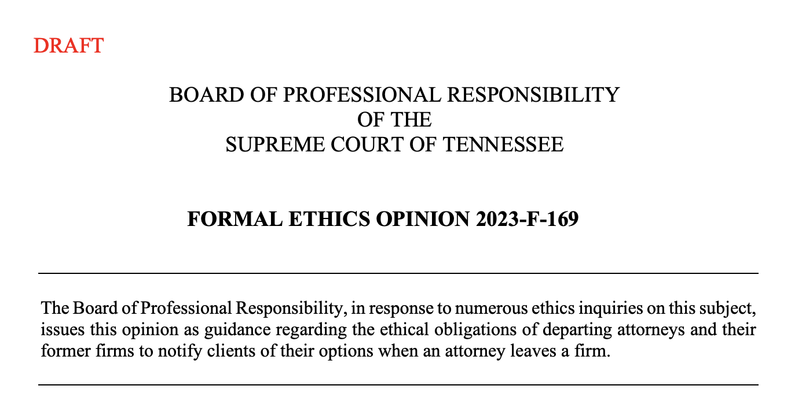

Slide 24
Whose Client?

Slide 25
Question (5): Who does the client belong to? (A) The firm. (B) The departing lawyer. (C) Neither (D) Both

Slide 26
TRPC Rule 5.6 – Restrictions on the Right to Practice
A lawyer shall not participate in offering or making:
(a) a partnership, shareholders, operating, employment, or other similar type of
agreement that restricts the right of a lawyer to practice after termination of
the relationship, except an agreement concerning benefits upon retirement.

Slide 27
Who has an obligation to notify the client that the lawyer is leaving?

Slide 28
Question (6): Who has an obligation to notify the client that the lawyer is leaving? (A) The firm. (B) The departing lawyer. (C) Neither (D) Both

Slide 29
Who has an obligation to notify the client that the lawyer is leaving?
“When a lawyer’s employment with a firm is terminated, both the firm and the departing lawyer have ethical obligations to notify affected clients, avoid prejudice to those clients, and share information as necessary to facilitate continued representation and avoid conflicts.”
TRPC Rule 1.4. Communication
(a) A lawyer shall:
(2) reasonably consult with the client about the means by which the client's objectives are to be accomplished;
(3) keep the client reasonably informed about the status of the matter; …
(b) A lawyer shall explain a matter to the extent reasonably necessary to permit the client to make informed decisions regarding the representation.

Slide 30
Responsibilities Regarding Non-Lawyer Assistants

Slide 31
Responsibilities Regarding Non-Lawyer Assistants
TRPC Rule 5.3(a): a partner, and a lawyer who individually or together with other lawyers possesses comparable managerial authority in a law firm, shall make reasonable efforts to ensure that the firm has in effect measures giving reasonable assurance that the nonlawyer's conduct is compatible with the professional obligations of the lawyer;

Slide 32
Responsibilities Regarding Non-Lawyer Assistants
TRPC Rule 5.3(b): a lawyer having direct supervisory authority over a nonlawyer shall make reasonable efforts to ensure that the nonlawyer's conduct is compatible with the professional obligations of the lawyer
- cmt. 2: “A lawyer must give such assistants appropriate instruction and supervision concerning the ethical aspects of their employment …”

Slide 33
Responsibilities Regarding Non-Lawyer Assistants
TRPC Rule 5.5(a): A lawyer shall not practice law in a jurisdiction in violation of the regulation of the legal profession in that jurisdiction, or assist another in doing so.

Slide 34
Responsibilities Regarding Non-Lawyer Assistants
ABA Formal Opinion 506 (2003): Responsibilities Regarding Non-Lawyer Assistants

Slide 35
Responsibilities Regarding Non-Lawyer Assistants
Permissible: “trained intake personnel may check for conflicts of interest, collect basic information from prospective plaintiffs or class members for lawyers to ascertain their eligibility to make a claim, and explain how fees and costs are charged in such cases. If the prospective client meets the eligibility criteria and specifics set forth by the lawyers, then the intake personnel send the prospective clients the standard fee agreement for consideration.” ABA Formal Op. 506

Slide 36
Responsibilities Regarding Non-Lawyer Assistants
Permissible: “a lawyer may delegate to the nonlawyer obtaining initial information about the matter, performing an initial conflict check, determining whether the assistance sought is in an area of law germane to the lawyer’s practice, answering general questions about the fee agreement or process of representation, and even obtaining the prospective client’s signature on the fee agreement as long as the prospective client is offered an opportunity to communicate with the lawyer to discuss the matter.” ABA Formal Op. 506

Slide 37
Responsibilities Regarding Non-Lawyer Assistants
Permissible?
What legal services the client should obtain from the lawyer to address the client’s objectives?

Slide 38
Responsibilities Regarding Non-Lawyer Assistants
Permissible?
What legal services the client should obtain from the lawyer to address the client’s objectives?
No

Slide 39
Responsibilities Regarding Non-Lawyer Assistants
Permissible?
An interpretation of the rights and responsibilities set forth in the fee agreement?

Slide 40
Responsibilities Regarding Non-Lawyer Assistants
Permissible?
An interpretation of the rights and responsibilities set forth in the fee agreement?
No

Slide 41
Responsibilities Regarding Non-Lawyer Assistants
TRPC Rule 5.5(a): A lawyer shall not practice law in a jurisdiction in violation of the regulation of the legal profession in that jurisdiction, or assist another in doing so.

Slide 42
Office Sharing Arrangements with Other Lawyers

Slide 43
Office Sharing Arrangements with Other Lawyers
ABA Formal Opinion 507 (2023): Office Sharing Arrangements with Other Lawyers

Slide 44
Office Sharing Arrangements with Other Lawyers
Protecting Client Information

Slide 45
Office Sharing Arrangements with Other Lawyers
Clear Communication About the Relationship

Slide 46
Office Sharing Arrangements with Other Lawyers
Conflict of Interest Considerations
- Imputed conflicts
- Representing clients with adverse interests
- Consultations between office sharing lawyers

Slide 47
Which of the following is not an actual attorney ethics news item from 2023?
Texas judge was arrested for cattle theft.
New Jersey judge faces ethics charges for posting Tik Tok videos of judge lip synching to racy songs.
Florida lawyer suspended for attempting to frame his father for misappropriating funds.
Illinois lawyer barred from courthouse after sexually harassing court employees in courthouse library.

Slide 48
Saying Stupid (and Discriminatory) Stuff Online and in Emails

Slide 49
Morgan v. Board of Professional Responsibility of the Supreme Court of Tennessee, 63 F.4th 510, 515 (6th Cir. 2023)

Slide 50
Morgan v. Board of Professional Responsibility of the Supreme Court of Tennessee, 63 F.4th 510, 515 (6th Cir. 2023)

Slide 51
Saying Stupid (and Discriminatory) Stuff Online and in Emails
TRPC Rule 8.4: It is professional misconduct for a lawyer to:
(d) engage in conduct that is prejudicial to the administration of justice;
Cmt. 3: [3] A lawyer who, in the course of representing a client, knowingly manifests, by words or conduct, bias or prejudice based on race, sex, religion, national origin, disability, age, sexual orientation, or socio-economic status violates paragraph (d) when such actions are prejudicial to the administration of justice. Legitimate advocacy respecting the foregoing factors does not violate paragraph (d).

Slide 52
Saying Stupid (and Discriminatory) Stuff Online and in Emails

Slide 54
ABA Model Rule 8.4(g)
It is professional misconduct for a lawyer to: …
(g) engage in conduct that the lawyer knows or reasonably should know is harassment or discrimination on the basis of race, sex, religion, national origin, ethnicity, disability, age, sexual orientation, gender identity, marital status or socioeconomic status in conduct related to the practice of law. …

Slide 55
Discussion Question: What do you think? (A) I think these lawyers violated Rule 8.4(g). (B) I think these lawyers violated Rule 8.4(g), but I disagree with having this rule in the first place. (C) I don’t think these lawyers violated the rule.

Slide 56
ABA Model Rule 8.4(g)
It is professional misconduct for a lawyer to: …
(g) engage in conduct that the lawyer knows or reasonably should know is harassment or discrimination on the basis of race, sex, religion, national origin, ethnicity, disability, age, sexual orientation, gender identity, marital status or socioeconomic status in conduct related to the practice of law. …
Criticisms of the rule?

Slide 57
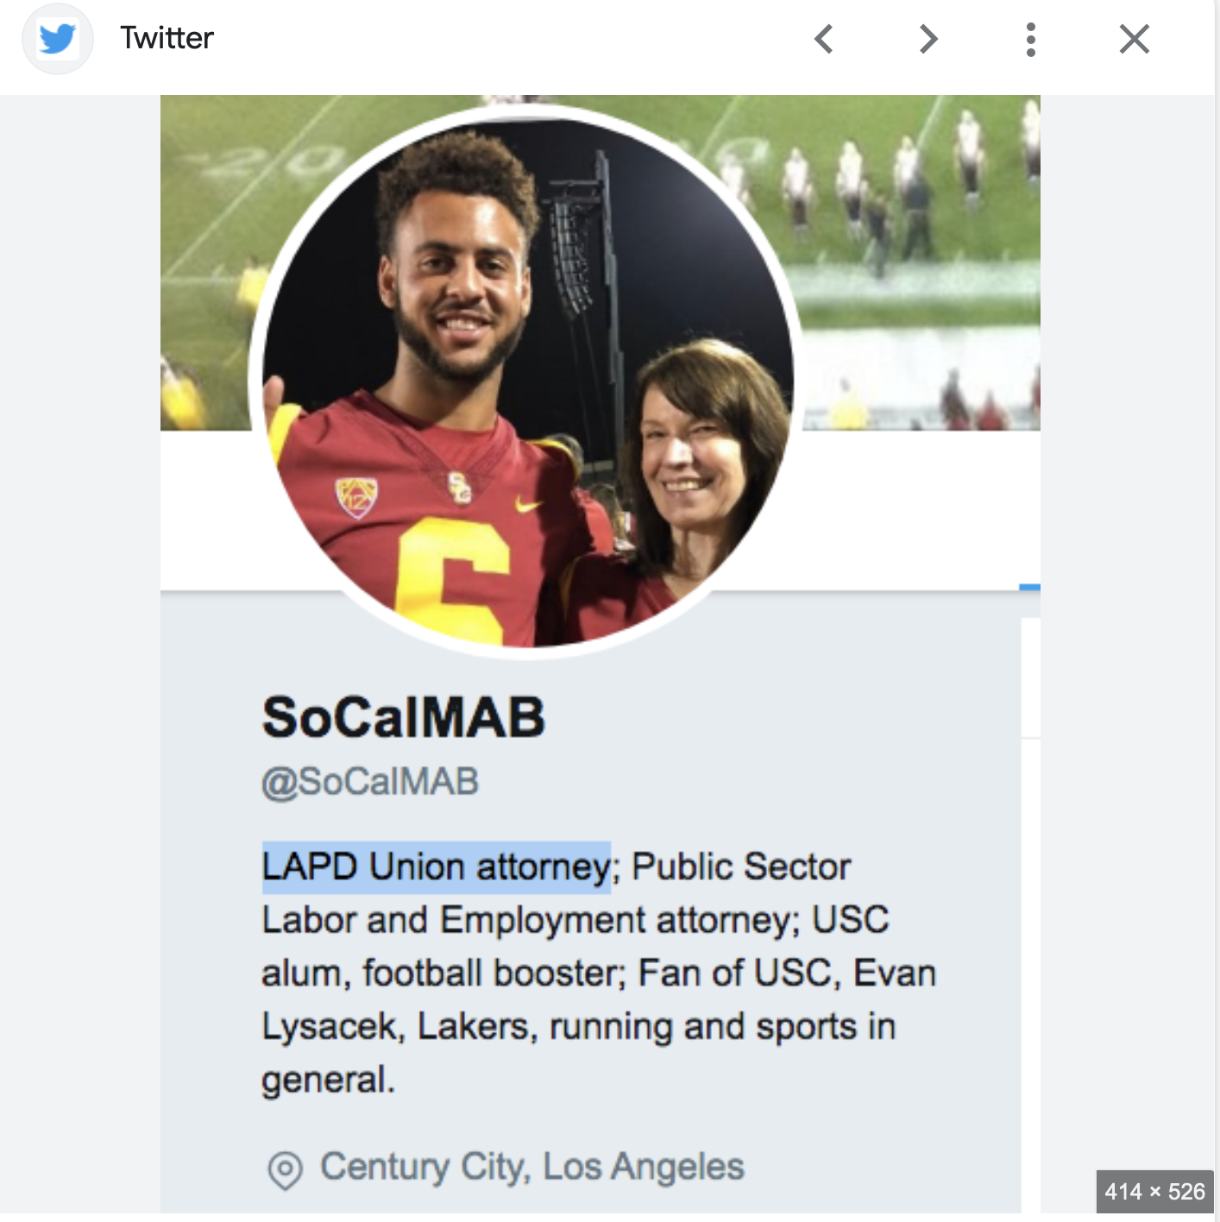

Slide 58
In re Marla Anne Brown (California)
Rule 8.4(c): It is professional misconduct for a lawyer to … engage in conduct involving dishonesty, fraud, deceit or misrepresentation

Slide 59
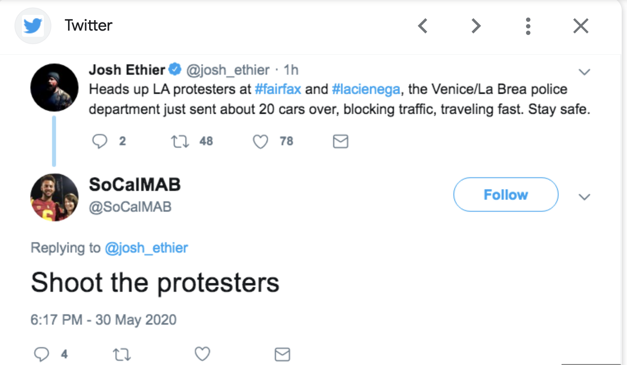

Slide 60
In re Marla Anne Brown (California)
Rule 8.4(b): It is professional misconduct for a lawyer to … commit a criminal act that reflects adversely on the lawyer’s honesty, trustworthiness, or fitness as a lawyer in other respect.

Slide 61
Discussion Question: What do you think? (A) I think this lawyer violated Rule 8.4(b) (C) I don’t think this lawyer violated the rule.

Slide 63
Commonwealth of Massachusetts v. Dew
Rule 1.7(a)(2): (a) Except as provided in paragraph (b), a lawyer shall not represent a client if the representation involves a concurrent conflict of interest. A concurrent conflict of interest exists if:
…
(2) there is a significant risk that the representation of one or more clients will be materially limited by the lawyer's responsibilities to another client, a former client or a third person or by a personal interest of the lawyer.

Slide 64
ABA Model Rule 8.4(g)
It is professional misconduct for a lawyer to: …
(g) engage in conduct that the lawyer knows or reasonably should know is harassment or discrimination on the basis of race, sex, religion, national origin, ethnicity, disability, age, sexual orientation, gender identity, marital status or socioeconomic status in conduct related to the practice of law. …

Slide 65
In re Sitton, 618 S.W.3d 288 (Tenn. 2021)

Slide 66
Mr. Sitton maintained a Facebook page. His Facebook profile identified him as a lawyer.

Slide 67
If you want to kill him, then lure him into your house and claim he broke in with intent to do you bodily harm and that you feared for your life. Even with the new stand your ground law, the castle doctrine is a far safer basis for use of deadly force.

Slide 68
As a lawyer, I advise you to keep mum about this if you are remotely serious. Delete this thread and keep quiet. Your defense is that you are afraid for your life—revenge or premeditation of any sort will be used against you at trial.

Slide 69
In re Sitton, 618 S.W.3d 288 (Tenn. 2021)
TRPC Rule 8.4: It is professional misconduct for a lawyer to:
(d) engage in conduct that is prejudicial to the administration of justice;

Slide 70
In re Sitton, 618 S.W.3d 288 (Tenn. 2021)
“Giving advice as a lawyer about planning in advance how to claim a defense to killing someone is conduct that is prejudicial to the administration of justice in violation of Rule 8.4(d).”

Slide 71
In re Sitton, 618 S.W.3d 288 (Tenn. 2021)
“[A]ttorneys in any setting—including on social media platforms—remain bound by our Rules of Professional Conduct. Lawyers who choose to post on social media must realize they are handling live ammunition; doing so requires care and judgment.”
“Mr. Sitton's statements to Ms. Houston would have constituted a violation of our ethics rules had they been made in private or in public.”

Slide 72
The Ethics of Robot Lawyers (AI in the Practice of Law)

Slide 73
Artificial Intelligence in the Practice of Law
Machine learning: Algorithms that can learn from data without being programmed
Examples
- Natural language searching in online research
- Predictive coding in e-discovery
- Evaluation of non-disclosure agreements to see if it meets criteria. If so, recommend for approval. If not, flag for lawyer review.

Slide 74
Artificial Intelligence in the Practice of Law
Other possible applications:
Analyzing prior decisions by judges and predicting outcomes
Propose possible resolutions in mediation and ADR
Answering a party’s questions about how the law applies to them.
Speeding
Negligence?
Unconscionability?

Slide 76
Artificial Intelligence in the Practice of Law: Some Potential Ethical Issues

Slide 77
Artificial Intelligence in the Practice of Law: Some Potential Ethical Issues - UPL
Rule 1.1: Competence
A lawyer shall provide competent representation to a client. Competent representation requires the legal knowledge, skill, thoroughness, and preparation reasonably necessary for the representation.

Slide 78
Artificial Intelligence in the Practice of Law: Some Potential Ethical Issues - UPL
Rule 1.1: Competence
A lawyer shall provide competent representation to a client. Competent representation requires the legal knowledge, skill, thoroughness, and preparation reasonably necessary for the representation.
Comment 8: “To maintain the requisite knowledge and skill, a lawyer should keep abreast of changes in the law and its practice, including the benefits and risks associated with relevant technology”

Slide 79
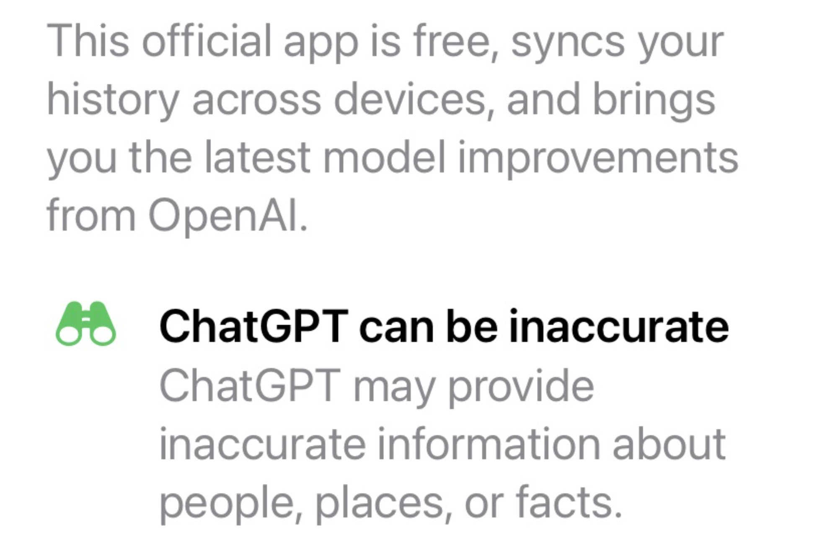

Slide 80
Artificial Intelligence in the Practice of Law: Some Potential Ethical Issues - UPL
Rule 5.3. Responsibilities Regarding Nonlawyer Assistants
With respect to a nonlawyer employed or retained by or associated with a lawyer:
(b) a lawyer having direct supervisory authority over a nonlawyer shall make reasonable efforts to ensure that the nonlawyer's conduct is compatible with the professional obligations of the lawyer;

Slide 81
Artificial Intelligence in the Practice of Law: Some Potential Ethical Issues - UPL
Rule 11, Federal Rules of Civil Procedure: requires a lawyer to certify that, to the best of the lawyer’s knowledge, formed after a reasonable inquiry, the legal contentions contained in a court filing are warranted by existing law.”
Rule 3.1, Meritorious Claims and Contentions: prohibits a lawyer from asserting an issue “unless after reasonable inquiry the lawyer has a basis in law and fact for doing so that is not frivolous.”

Slide 83
Artificial Intelligence in the Practice of Law
Some reason to have some skepticism …
“The judge said one of the fake decisions generated by the chatbot ‘have some traits that are superficially consistent with actual judicial decisions’ but he said other portions contained ‘gibberish’ and were ‘nonsensical.’ "

Slide 84
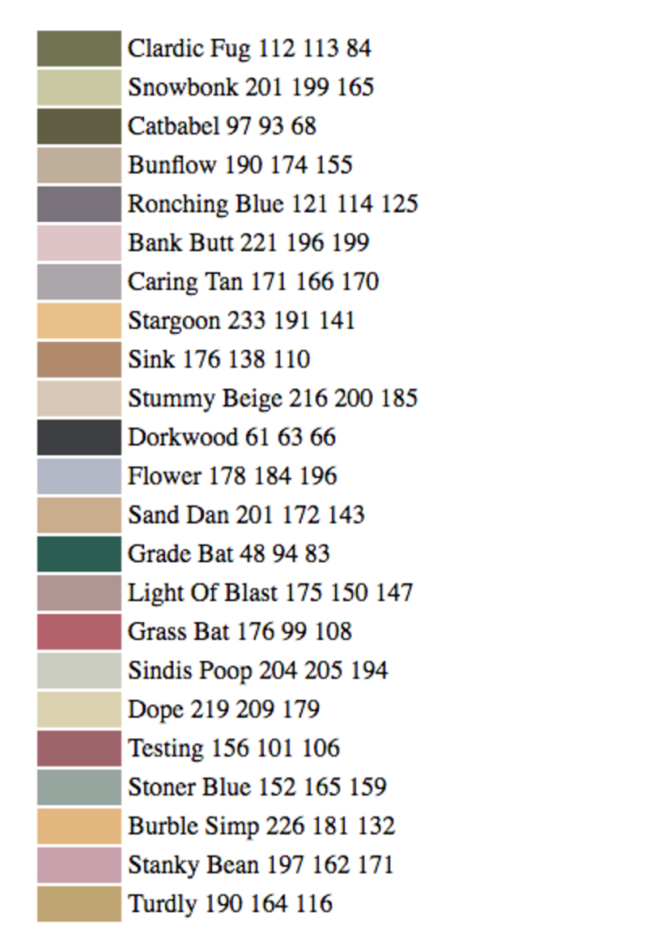

Slide 85
Choice of law When a Lawyer Practices in Multiple Jurisdictions

Slide 86
Choice of law When a Lawyer Practices in Multiple Jurisdictions
ABA Formal Opinion 504 (2023): Choice of Law

Slide 87
Choice of law When a Lawyer Practices in Multiple Jurisdictions
Miguel is licensed in both Tennessee and Virginia. His office is in Tennessee. Miguel and Briana jointly represent a Tennessee client in a matter before a tribunal in Virginia. During the course of representation, Miguel learns that Briana has committed a fraud upon the court. Virginia’s rules of professional conduct require a lawyer to report another lawyer’s serious misconduct to disciplinary authorities even if the client does not consent to the disclosure. In contrast, Tennessee excuses a lawyer from the duty to report if the client refuses to consent to the disclosure. Which state’s rule of professional conduct applies to Miguel’s situation?

Slide 88
Choice of law When a Lawyer Practices in Multiple Jurisdictions
TRPC Rule 8.5(b): Choice of Law. In any exercise of the disciplinary authority of this jurisdiction, the rules of professional conduct to be applied shall be as follows:
(1) for conduct in connection with a matter pending before a tribunal, the rules of the jurisdiction in which the tribunal sits, unless the rules of the tribunal provide otherwise;

Slide 89
Question (8): Which state’s rule of professional conduct applies to Miguel’s situation? (A) Virginia (where the tribunal is located) (B) Tennessee (where Miguel is licensed and his office is located) (C) Both Tennessee and Virginia. (D) Neither.

Slide 90
Choice of law When a Lawyer Practices in Multiple Jurisdictions
Tony pays for an advertisement to run on a radio station in Bristol, Virginia. Tony is only licensed in Tennessee, but his office is located in Bristol, Tennessee close to the Virginia/Tennessee border, so he hopes to attract some clients from both states but provide the services from his Tennessee office. Assume that the advertising rules in the two states differ. Which state’s rule of professional conduct applies to Tony’s situation?

Slide 91
Choice of law When a Lawyer Practices in Multiple Jurisdictions
TRPC Rule 8.5(b): Choice of Law. In any exercise of the disciplinary authority of this jurisdiction, the rules of professional conduct to be applied shall be as follows:
(2) for any other conduct, the rules of the jurisdiction in which the lawyer's conduct occurred, or, if the predominant effect of the conduct is in a different jurisdiction, the rules of that jurisdiction shall be applied to the conduct.

Slide 92
Question (9): Which state’s rule of professional conduct applies to Tony’s situation? (A) Virginia (where the radio station is located) (B) Tennessee (where Tony is licensed and his office is located) (C) Both Tennessee and Virginia. (D) Neither.

Slide 93
Question (10): In which state is Tony subject to discipline if he is found to have violated Virginia’s rules of professional conduct through his advertisement? (A) Virginia (where the misconduct occurred) (B) Tennessee (where he is licensed and his office is located) (C) Both Tennessee and Virginia. (D) Neither.

Slide 94
Choice of law When a Lawyer Practices in Multiple Jurisdictions
TRPC Rule 8.5(a): Disciplinary Authority. A lawyer admitted to practice in this jurisdiction is subject to the disciplinary authority of this jurisdiction, regardless of where the lawyer's conduct occurs. A lawyer not admitted in this jurisdiction is also subject to the disciplinary authority of this jurisdiction if the lawyer provides or offers to provide any legal services in this jurisdiction. A lawyer may be subject to the disciplinary authority of both this jurisdiction and another jurisdiction for the same conduct.

Slide 95
Thank you!
Professor Alex Long (along23@utk.edu)
University of Tennessee College of Law

Slide 96
Tiebreaker Question: What rule addresses a lawyer’s duty of confidentiality? (A) 1.1 (B) 1.6 (C) 1.12 (D) 1.18

