Slide 1
Pagans, Prayers & Preachin’:
How to Deal with Religion in the Workplace
Presented to UT-Battelle, LLC
August 24, 2023
Updated
And
Revised
For
2023
Janet Strevel Hayes
WWW.LEWISTHOMASON.COM
KNOXVILLE | MEMPHIS | NASHVILLE

Slide 2
Religion in the Workplace 101
First Amendment
Title VII of Civil Rights Act
of 1964

Slide 3
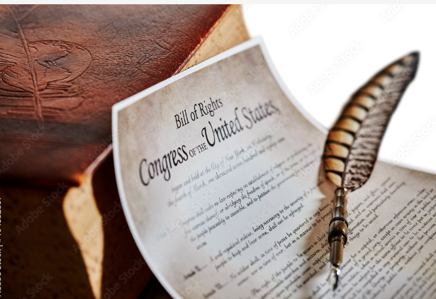
First Amendment
“Congress shall make no law respecting an establishment of religion or prohibiting the free exercise thereof.”

Slide 4
Title VII
Federal law applicable to all employers with more than 15 employees
Prohibits employer discrimination on the basis of religion

Slide 5
1977 Trans World Airlines v Hardison
Facts
Larry Hardison worked for TWA
Hardison was a member of the Worldwide Church of God
Hardison refused to work on his Sabbath (Saturday)
TWA declined his proposal to work a four-day week and ultimately terminated his employment for refusing to work on Saturday.

Slide 6
1977 Trans World Airlines v Hardison
Supreme Court
Employers must reasonably accommodate an employee’s religious practices unless doing so imposes an “undue hardship” on the company.
If the employer must “bear more than a de minimus cost” in order to allow/give an employee “Saturdays off,” it is an undue hardship”

Slide 7
1977 - 2023
Anything more than a
“de minimus” cost = undue hardship for employer
Employers could get by with only a minimal level of accommodation

Slide 8
June 29, 2023 Groff v DeJoy
Facts
Gerald Groff was a rural mail carrier for the United States Postal System
Groff observes the Sabbath every Sunday, and he refused to work Sunday shifts.
USPS disciplined Groff, and he eventually quit.

Slide 9
USPS Arguments
Allowing Groff Sundays off created morale and scheduling problems and created “resentment toward management.”
Another employee filed a grievance that allowing Groff Sundays off violated a collectively bargained agreement.

Slide 10
U.S. District Court for the Eastern District of Pennsylvania
No violation of Title VII
Rationale: Accommodation would be an undue hardship because allowing Groff Sundays off would negatively impact Groff’s co-workers
Third Circuit Court of Appeals
No violation of Title VII
Rationale: Accommodation would be an undue hardship because allowing Groff Sundays off disrupted work flow and diminished employee morale

Slide 11
United States Supreme Court
Not so fast …
To show “undue hardship,” the employer must show “the burden of granting an accommodation would result in substantial increased costs in relation to the conduct of its particular business.”

Slide 12
Key Takeaways
“Undue hardship” now requires that employers present proof of a “substantial burden” much higher threshold than what has been required in the last 45 years
“Substantial burden” is relative and fact specific. Consider the impact given the “nature, size, and operating cost of an employer”

Slide 13
Key Takeaways
In order to demonstrate “undue hardship” employer must show it considered other options
Shift swapping?
Paying incentives for Sunday shifts?
Coordinating with nearby postal facilitates to pull from broader group of workers?
Negative impact on morale is unlikely to be a substantial hardship

Slide 14
Meet my friend,
Patty Pastry

Slide 15
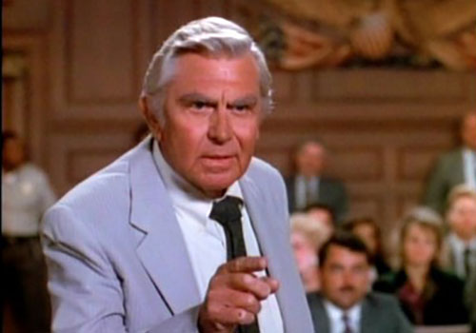
Ben Hatlock

Slide 16
Prohibited Practices
Unlawful for an employer to discriminate with respect to compensation, terms, conditions, or privileges of employment because of employee’s religion. [Disparate treatment]
Unlawful for an employer to limit, segregate, or classify employees or applicants for employment in any way which would deprive or tend to deprive any individual of employment opportunities or adversely affect status because of an individual’s religion. [Disparate impact]

Slide 17
What is Religion?
“Religious practices” include moral or ethical beliefs as to what is right and wrong which are sincerely held with the strength of traditional religious views. (United States v. Seeger (1965) and 29 C.F.R. § 1605.1).
Moral or ethical belief
Sincerely held
Ultimate ideas about life, purpose, and death
Not social, political, or economic philosophies
The term “religion” includes all aspects of religious observances or practices, as well as belief.
• Christianity • Islam • Buddhism
• Judaism • Hinduism • And many more …

Slide 18
“A belief is ‘religious’ if it is ‘religious in the person’s own scheme of things.’”
Whether a practice is religious requires a “situational case-by-case inquiry.”

Slide 19
How do I run a business and respect religion?
Employer’s duty is to “reasonably accommodate” employees’ religious practices and beliefs unless it would cause “undue hardship.”

Slide 20
Reasonable Accommodation
Accommodation = “any adjustment to the work environment that will allow the employee to comply with his or her religious beliefs.”
Reasonable accommodation = Relative term. Cannot be given a hard and fast meaning. Each case requires consideration of the facts and circumstances. Comes down to a determination of whether the employer acted reasonably under the circumstances.
“Undue hardship” = more than minimal burden on business.
***IT NOW MEANS “SUBSTANTIAL BURDEN”***
Undue Hardship

Slide 21
Two Other Laws
Religious Freedom Restoration Act (federal)
Preservation of Religious Freedom Act (state)
Government shall not substantially burden a person’s exercise of religion unless the government can demonstrate the application of the burden to the person is:
In furtherance of a compelling government interest; and
The least restrictive means of furthering that compelling governmental interest.

Slide 22
Patty’s Pastries

Slide 23
Carlie Cash

Slide 24
Scenario 1
Carlie has years of experience running a register. She is definitely the most qualified candidate.
Carlie is a practicing Seventh-Day Adventist and refuses to work on Saturdays. The bakery is open Tuesday-Saturday.
If Patty hires Carlie, she would have to either:
1. hire another employee to work Saturday, or
2. pay an existing employee overtime to cover
the register on Saturday.

Slide 25
Will Patty violate Title VII if she refuses to hire Carlie?
No = 2019
Probably Yes = 2023

Slide 26
Analysis
2023
“Undue hardship” requires proof of a substantial burden on the employer. Negative impact on other employees is unlikely to be a substantial burden
2019
“Undue hardship” is one that results in more than a de minimus cost to the employer, including higher than ordinary administrative costs or safety or security concerns. Both economic and non-economic costs can pose an undue hardship upon employers.

Slide 27
Pierce Schnoz

Slide 28
Scenario 2
Patty gives all of her employees a handbook. It includes a personal grooming policy and prohibits facial jewelry.
Pierce shows up to work with a nose ring. He said it was required as part of his faith. When asked for evidence of his beliefs, he brought a note from his mother.
Patty told Pierce he could:
1. cover the nose ring with a band aid and
2. leave when her investors came by.
Pierce refused and was fired.

Slide 29
Does Pierce have a viable claim for religious discrimination?
Yes = 2019
Yes = 2023

Slide 30
Analysis
Sincerely Held Belief:
Even if it is unorthodox, a belief may be sincerely held.
Willingness to lose a job over it may be compelling evidence that a belief is sincerely held.
Reasonable Accommodation:
“Reasonableness” of the accommodations depends on the circumstances of the employer-employee relationship and will be decided on a case-to-case basis.
Customer Preference: neither co-worker disgruntlement nor customer preference constitutes undue hardship.
Covering: if it would violate the employee’s religious beliefs, requiring an employee’s religious garb, marking, or article of faith to be covered is not a reasonable accommodation.

Slide 31
Daria Devout

Slide 32
Scenario 3
Daria insists she must wear her hijab at work as part of her Muslim faith. Patty remembers reading that Abercrombie and Fitch was sued over refusing to allow an employee to wear a headscarf, so she thinks she must allow it. However, Patty’s friend, who is head of H.R. at the local prison, says they do not allow any employees to wear headscarves.

Slide 33
a) Can Patty refuse to allow the headscarf?
No = 2019
No = 2023
b) Can the prison refuse to allow headscarves?
Yes = 2019
Yes = 2023

Slide 34
Analysis
If an employer has a legitimate workplace safety, security, or health concern, employer may ban an employee’s religious dress or grooming practices if employer can show the circumstance actually pose an undue hardship on the operation of the business.

Slide 35
Monday Management Motivation Meeting

Slide 36
Scenario 4
Patty decides to have a Monday meeting for management employees. Attendance is mandatory, and failure to attend is a violation of the company’s attendance policy. She discusses business strategy, financial updates, and policy matters. She opens the meeting with prayer and a 5-10 minute devotion.
Annie Atheist quits. Then she sues Patty for religious discrimination, claiming she was constructively discharged.

Slide 37
a) Does Annie have a viable claim of constructive discharge?
Yes = 2019
Yes = 2023
b) Does Annie have a viable case of religious discrimination?
Yes = 2019
Yes = 2023

Slide 38
General rule of constructive discharge:
If the employer deliberately makes an employee’s working conditions so intolerable that the employee is forced into an involuntary resignation, the employer has engaged in constructive discharge.

Slide 39
Analysis
Atheism is protected.
Employer has a duty to prevent religious harassment if the employer is aware of the harassment or should have been aware of it.

Slide 40
Analysis
Bible Studies/Prayer Groups
Based on case law, private employers have consistently been allowed to host prayer groups and/or Bible studies. However, an employer cannot force or require employee attendance.
Different rules for governmental entities.
If any employer allows one group or organization to meet, they must allow all other groups to meet.

Slide 41
Occasional Bible References/Prayers
Occasional comments or references to religious principles do not create a hostile work environment.
Severe and pervasive operate inversely.
A few instances of allowing voluntary prayer during required meetings do not necessarily give rise to a hostile work environment.

Slide 42
Scenario 5
Patty is renewing her health insurance and she finds some dated literature suggesting she is required, under the Affordable Care Act, to provide for potential life terminating drugs and devices as part of her health insurance plan. Providing the devices goes against Patty’s sincerely held religious beliefs. Patty believes the law violates her religious freedom.

Slide 43
Is there a law to protect Patty’s business based on Patty’s sincerely held religious beliefs?
Yes

Slide 44
Analysis
Religious Freedom Restoration Act (RFRA) provides that the government cannot substantially burden a person’s exercise of religion, unless it is in furtherance of a compelling governmental interest and it is the least restrictive means of achieving that interest.

Slide 45
Analysis
Burwell v. Hobby Lobby taught us that a closely held for-profit corporation may be exempt from a regulation to which its owners religiously object.
First time Supreme Court has recognized a for-profit corporation’s claim of religious belief.
Limited to closely held corporations.

Slide 46
“The plain terms of the RFRA make it perfectly clear that Congress did not discriminate … against men and women who wish to run their businesses as for-profit corporations in the manner required by their religious beliefs … our responsibility is to enforce RFRA as written.”
-Justice Alito
“Among the reasons the United States is so open, so tolerant, and so free is that no person may be restricted or demeaned by government in exercising his or her religion.”
-Justice Kennedy

Slide 47
TEN COMMANDMENTS FOR AVOIDING LIABILITY FOR RELIGIOUS DISCRIMINATION
thou shalt have a handbook with 1) a religious accommodation policy and 2) a non-discrimination policy.
Thou shalt give attention to any request for religious accommodation.
Thou shalt not assume a religion unknown to you is not a “religion.”
Thou shalt offer reasonable accommodation unless there is an undue hardship.
Thou shalt be careful when enforcing appearance and grooming standards.

Slide 48
TEN COMMANDMENTS FOR AVOIDING LIABILITY FOR RELIGIOUS DISCRIMINATION
thou shalt allow employees the opportunity to participate in religious observances and prayer.
Thou shalt never require that employees participate in religious observances and prayer.
Thou shalt consistently apply office policies regarding religious displays, paraphernalia, and gatherings consistently regardless of the religion.
Thou shalt promptly and thoroughly investigate any employee complaint regarding religious harassment or discrimination.
Thou shalt frequently seek further advice from your favorite employment lawyer.

Slide 49
Questions or Comments?
Janet S. Hayes, Esquire
jhayes@lewisthomason.com
Lewis, Thomason, King, Krieg & Waldrop, P.C.
One Centre Square, 5th Floor
Post Office Box 2425
Knoxville, TN 37901
Phone: (865) 546-4646
Fax: (865) 523-6529
*The contents of this presentation are for informational purposes and should not be considered legal advice. This presentation does not establish an attorney-client relationship.

