Slide 1
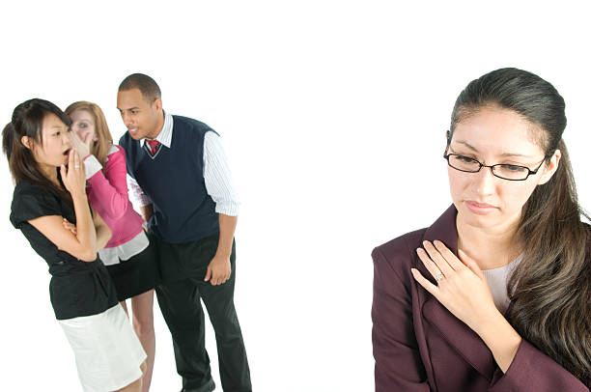
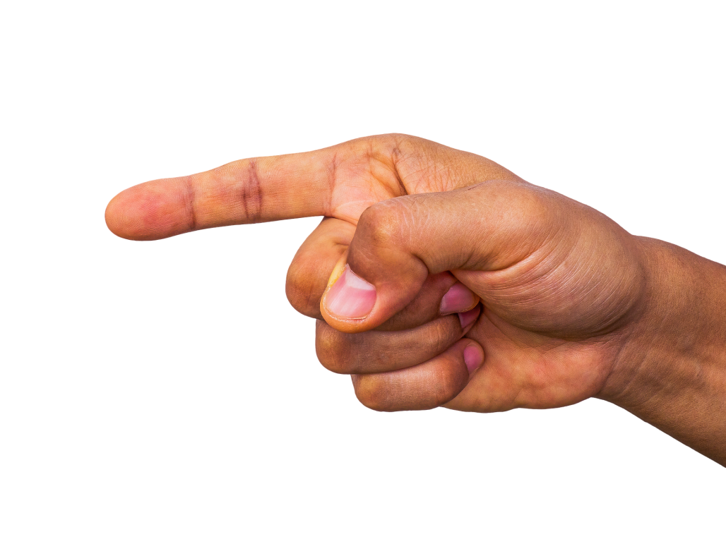
RESPECTFUL WORKPLACE TRAINING
YOU
Be the judge
Lee P. Geiger, Esq. Lgeiger@brickergraydon.com

Slide 3
so why am i
?
HERE

Slide 4
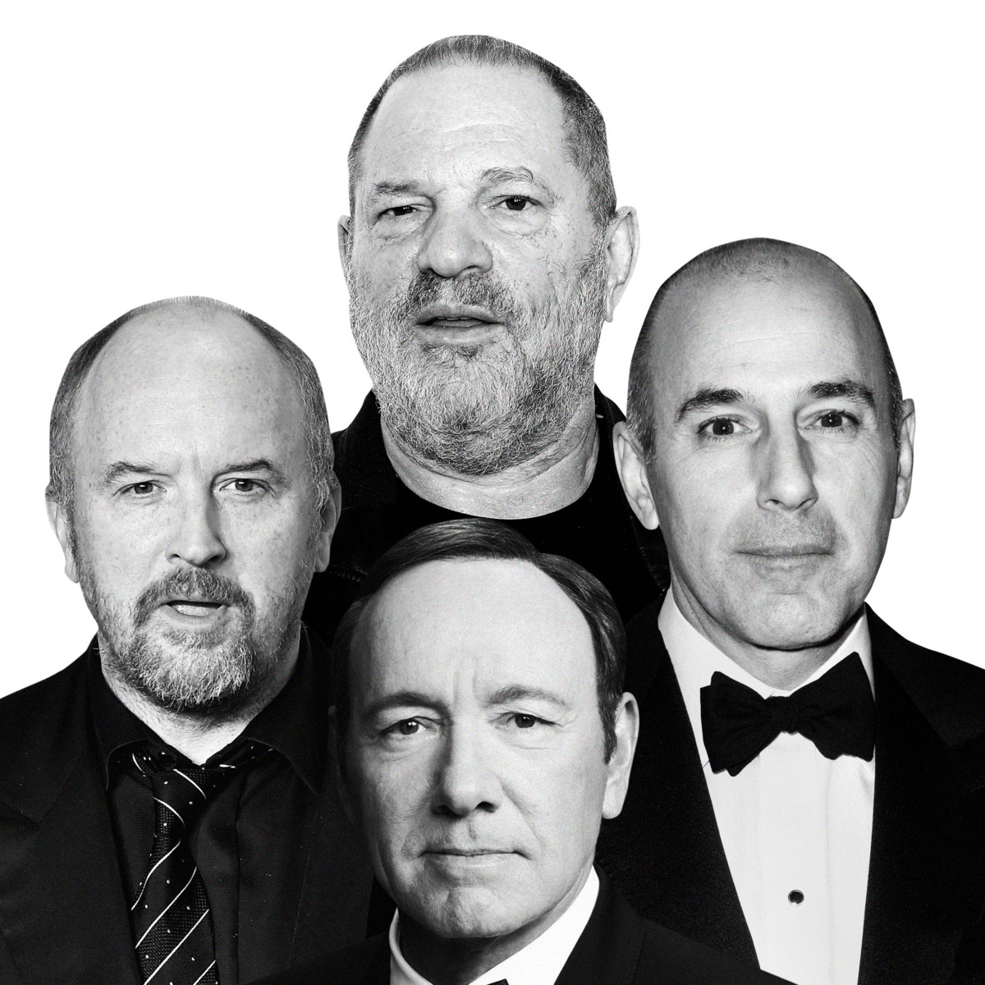

Slide 6
#BLM
#COVID-19
#LGBTQ

Slide 7
#Religious Freedom
#Disability
#Veterans

Slide 8
so why am i
?
HERE

Slide 10
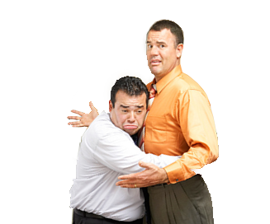
individual liability
Using Racially
Derogatory Language
Doing NOTHING
Failing to PREVENT
or CORRECT

Slide 11
Notes:
Protected classes

Slide 12
COVID-19

Slide 13
Every employee DESERVES to be treated with courtesy and respect
This does not mean that supervisors and employees cannot be firm or critical with each other
However, supervisors must communicate in a constructive and professional manner
Notes:
Presenter Notes:
[[EMPLOYER]'s Business Code of Conduct specifies that all employees are expected to work with one another in a respectful and courteous manner.] Still, abusive conduct may occur in the workplace. This training is intended to provide supervisors with tools for spotting abusive conduct and intervening as necessary.

Slide 14
SEXUAL
HARASSMENT:
The Equal Employment Opportunity Commission (EEOC) defines sexual harassment to include:
Unwelcome sexual advances
Requests for sexual favors
Other verbal or physical conduct of a sexual nature
This conduct violates Title VII if it:
Affects employment
Unreasonably interferes with work performance
Creates an intimidating, hostile, or offensive work environment

Slide 15
WHAT IS Sexual Harassment?
A form of sex discrimination that violates Title VII and equivalent state and local laws.
Any harassment based on someone's sex or gender. Harassment based on a person’s gender identity, gender expression, or sexual orientation is specifically prohibited.
Any unwelcome sexual advance or conduct of a sexual nature, when any of the following is true:
Submission to the advance or conduct is made explicitly or implicitly a condition of employment
Submission to or rejection of the advance or conduct is used as a basis for employment decisions
The advance or conduct unreasonably interferes with an employee's work performance by creating an intimidating, hostile, or offensive work environment

Slide 18
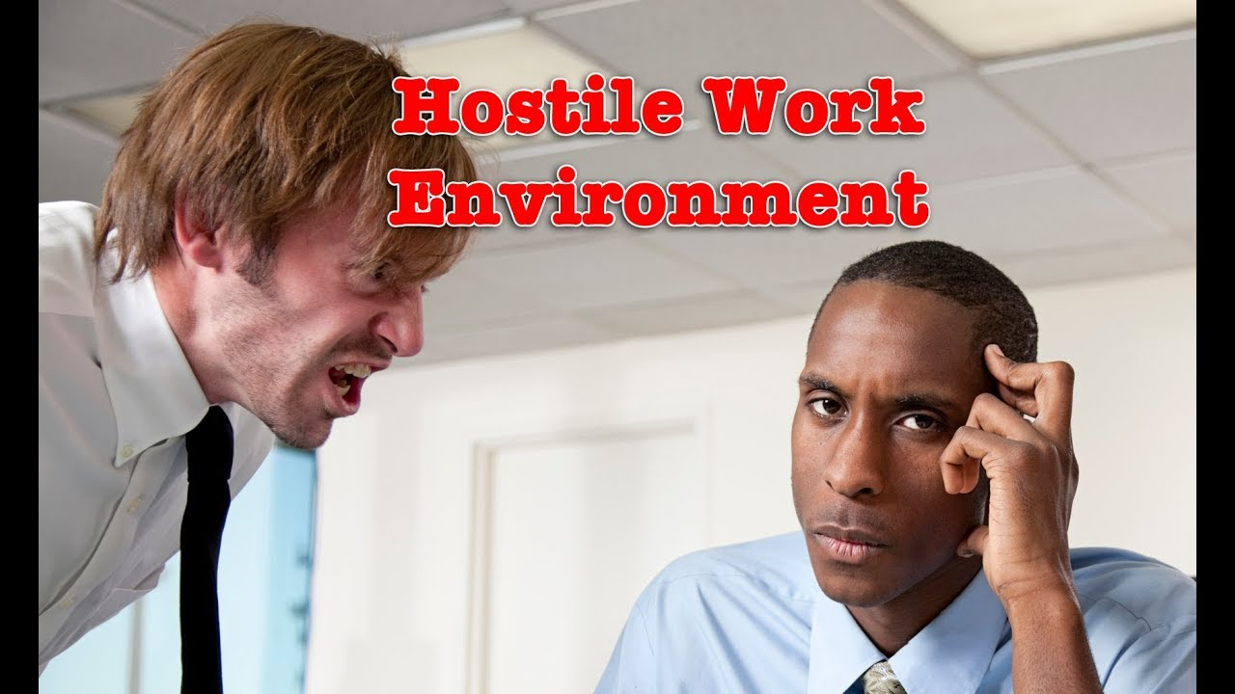

Slide 19
a hostile work environment
is
WHAT
Requires a severe and pervasive pattern of behavior that unreasonably interferes with performance
AND
creates an intimidating, hostile, or offensive environment

Slide 20
DISCRIMINATION and
Petty slights, annoyances, and isolated incidents (unless extremely serious) WILL NOT rise to the level of illegality. TO BE UNLAWFUL, the conduct must create a work environment that would be intimidating, hostile, or offensive to reasonable people.
Notes:
Two theories of liability –
Strict liability for supervisors harassing conduct
Negligence theory – knew or should have known and failed to take action

Slide 21
What is NOT a hostile work environment?
What is NOT harassment?
Having a responsible manager
Stopping behavior that is inappropriate, not work-related, unprofessional or rude
Enforcement of policies, rules and procedures as outlined in Handbook
Being disciplined for a legitimate, non-discriminatory business reason
Expecting employees to do their jobs

Slide 22
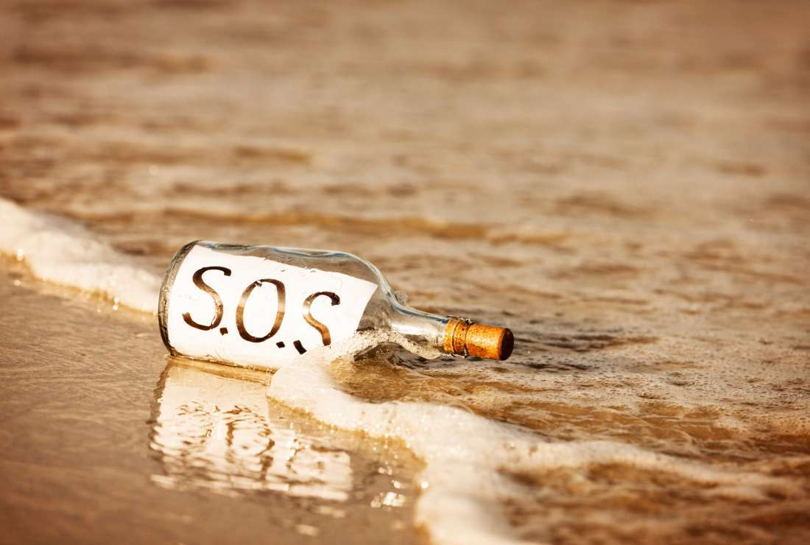
WHAT is YOUR ROLE
Notes:
SOS Means someone help me

Slide 23
Stop Harassment
S
Revisit harassment policies
Implement effective training
Examine workplace culture
Encourage reporting
Be alert and available
Notes:
Quarterback the investigation – usually the one to conduct the investigation, using the following techniques

Slide 24
Obtain Information
O
Identify complaints
When to investigate
Gather evidence
Record retention
Notice of searches

Slide 25
O
Obtain Information
Through the Interview Process
Determine Scope
Prepare Questions
Union or Non-Union
Stay Neutral
Notes:
Form of complaint
Types of evidence to gather before socializing issues more broadly:
Direct evidence – emails, verbatim complaints of harassment, contract issues
Anecdotal evidence - stories
Statistical evidence
Disparate treatment
Disparate impact
Comparative evidence
Circumstantial evidence – inference, intent, motivation
Prima facie case requires
Protected class
Qualified for job
Despite qualifications, was rejected because of protected class
Someone outside of protected class treated more favorably
Record retention – suspend if you see the storm coming (potential spoliation)
Check policies for notice of searches and no right to privacy – emails sent to/from others on company resources are not private if employer disclosed searches policy.

Slide 26
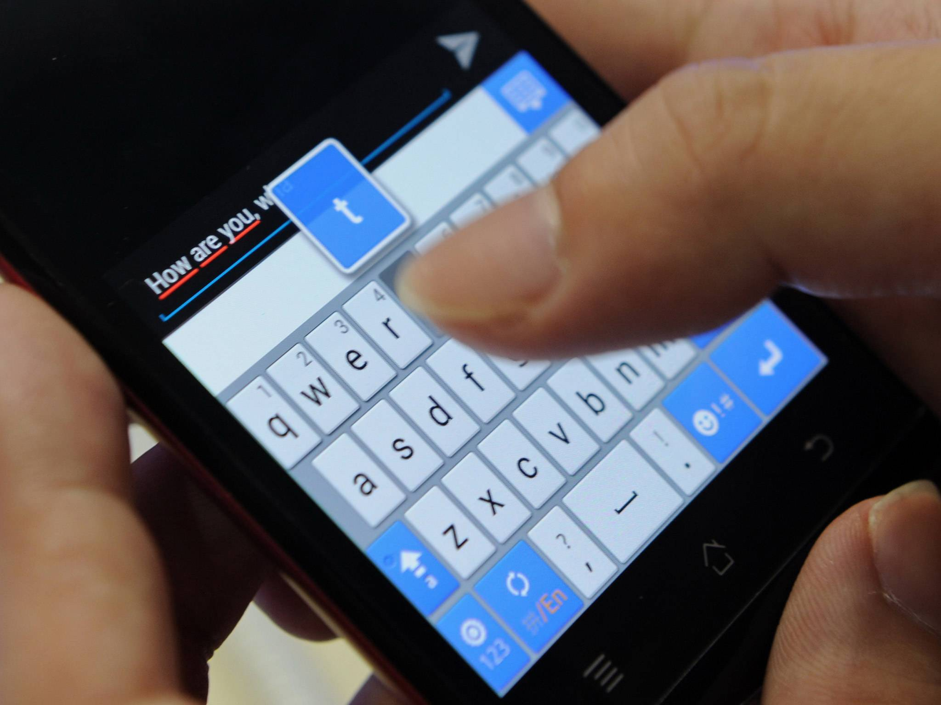
Manager receives information from a coworker who wants to remain anonymous:
Notes:
Scenarios

Slide 27
S
Solve
Notes:
Form of complaint
Types of evidence to gather before socializing issues more broadly:
Direct evidence – emails, verbatim complaints of harassment, contract issues
Anecdotal evidence - stories
Statistical evidence
Disparate treatment
Disparate impact
Comparative evidence
Circumstantial evidence – inference, intent, motivation
Prima facie case requires
Protected class
Qualified for job
Despite qualifications, was rejected because of protected class
Someone outside of protected class treated more favorably
Record retention – suspend if you see the storm coming (potential spoliation)
Check policies for notice of searches and no right to privacy – emails sent to/from others on company resources are not private if employer disclosed searches policy.

Slide 28
Supervisors should understand the Company’s harassment policy and reporting procedures
Supervisors should communicate policy and reporting procedures to all employees reporting to them or under their control
Employees should be directed to report complaints immediately to either the employee's direct supervisor or to the Human Resources Department
Supervisors should report all employee complaints to Human Resources
Supervisors should respond promptly and appropriately to complaints or questions about discrimination. If you're not sure what to do, contact Human Resources
Notes:
Presenter Notes:
[[EMPLOYER] has an anonymous hotline for US-based employees, which is [TELEPHONE NUMBER].]

Slide 29
Although confidentiality will be maintained to the fullest extent possible, supervisors should never guarantee confidentiality of reports or investigations about reports
Supervisors should maintain a respectful workplace and not permit inappropriate behavior to go unchecked. Human Resources should be consulted when uncertain about appropriate activities or behavior
Employees should be models of good behavior and not participate in any harassing behaviors
Human Resources or the employer's legal counsel will conduct investigations
Employees should support the Company in its responsibility to investigate complaints of discrimination
At the conclusion of the investigation, supervisors should work with Human Resources to implement any disciplinary action and work to ensure the workplace is free of harassment

Slide 30
DISCUSSION
MOVE TO DIFFERENT AREA
MOVE TO DIFFERENT SHIFT
DISCIPLINE
TERMINATION (EXTREME CIRCUMSTANCES)
Notes:
Form of complaint
Types of evidence to gather before socializing issues more broadly:
Direct evidence – emails, verbatim complaints of harassment, contract issues
Anecdotal evidence - stories
Statistical evidence
Disparate treatment
Disparate impact
Comparative evidence
Circumstantial evidence – inference, intent, motivation
Prima facie case requires
Protected class
Qualified for job
Despite qualifications, was rejected because of protected class
Someone outside of protected class treated more favorably
Record retention – suspend if you see the storm coming (potential spoliation)
Check policies for notice of searches and no right to privacy – emails sent to/from others on company resources are not private if employer disclosed searches policy.

Slide 31
SEVERITY OF OFFENSE
TIME AT COMPANY
DISCIPLINARY HISTORY

Slide 32
Notes:
Bystander

Slide 33
RIPPED from the Headlines!

Slide 34
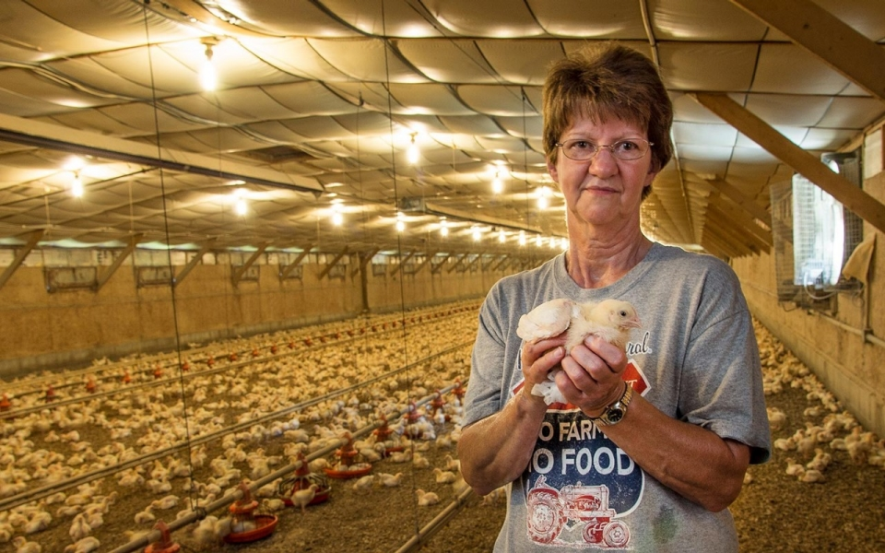
west v. tyson foods, inc.

Slide 35
Let’s Get Real …
Notes:
Documentation

Slide 36
YOU DECIDE ….
Sexual Harassment (who wins?)
Negligent Hiring (Who wins?)
Bullying (who wins?)
How much money to Plaintiff? ($__________)
Notes:
Documentation

Slide 37
Lee P. Geiger, Esq.
Lgeiger@brickergraydon.com
513-629-2830
©2023 BRICKER GRAYDON LLP
ALL RIGHTS RESERVED

