Slide 1
An Update on AI Employment Law Considerations

Slide 2



Presenter
Eric C. Kim
Partner, Labor and Employment Practice

Slide 3


01 How Employers Are Using AI
02 Legal Risks
03 Litigation & Regulatory Developments
04 What’s Next?
AGENDA

Slide 4

How Employers Are
Using AI

Slide 5


Hiring and Recruiting
Preparing job postings and programmatic job advertising
Candidate sourcing and matching
Due diligence – automatically sourcing and summarizing a candidate’s public online presence
Automated resume screening and evaluations
Video interviewing and testing software
Personality tests, playing games to make predictive assessments about an applicant’s characteristics
Use of facial and voice recognition (diction, tone, word choice, facial movements, gestures)
Chatbots for application processing, interview scheduling, and candidate Q&As
Selection of candidates and predictors of success
AI predictions can compare data related to a job applicant to a model of a successful employee

Slide 6

Providing objective evaluations to reduce bias in performance reviews
Continuous, real-time feedback to employees and managers
Identifying patterns or trends in employee performance to highlight areas of strength and weakness
Creating personalized development plans by analyzing employee’s strengths and weaknesses
Performance and Productivity Evaluation

Slide 7

Early detection and prevention through analyzing employee communications to detect negative sentiment or potential conflict triggers
Identifying trends and patterns in past disputes to predict future conflicts and proactively address issues
AI chatbots acting as neutral mediators for employees to voice concerns and offer suggestions for resolution based on company policies
Simulating real-world conflict scenarios to allow employees to practice conflict resolution skills
Dispute Management and Counseling

Slide 8
Evaluating employees who are likely to leave
Evaluating employees with likely leadership potential
Reducing bias in succession planning through looking at objective criteria
Creating personalized career development roadmaps for high-potential employees
Succession Planning Planning

Slide 9
Legal Risks From Using AI in the Workplace

Slide 10
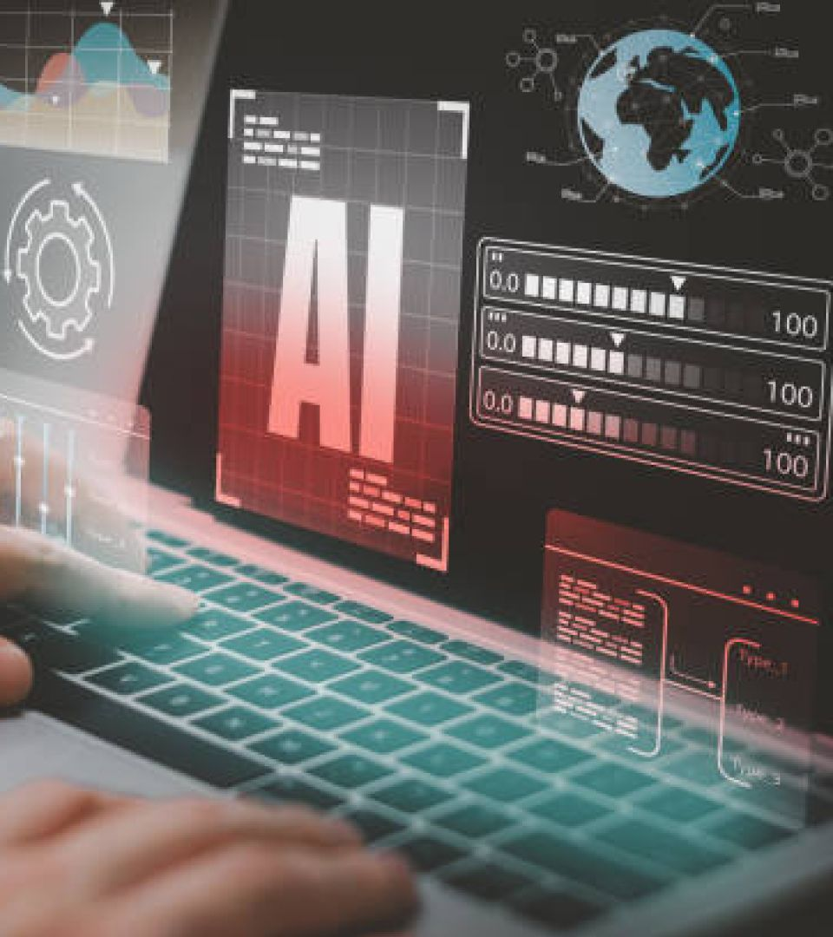
What Is Bias in AI?
Bias in AI is a situation where an algorithm produces results that are biased/prejudiced due to assumptions in the machine learning process.
Examples include:
Gender
Age
Sexual orientation
Race
Disability
Any other factor protected by applicable federal, state, or local laws and ordinances

Slide 11
Sources of Bias in AI
Human Bias
Human biases can affect the data that we produce and collect and can feed into the algorithms we create.
Algorithm Bias
Human Bias
Algorithm Bias
When an algorithm produces results that are systematically prejudiced due to assumptions in the machine learning process.
Data
Bias
Data Bias
Where the AI has been trained on incomplete or imbalanced data that is not representative of the general population.
Biased Outputs
!
Result

Slide 12

Data Bias Example
A tech company used an AI tool to automate its recruiting process by rating applicants’ resumes based on the resumes of past and current employees.
The input data used was biased – The AI system used historical recruitment data from the last 10 years. Males made up the majority of applicants and hired employees.
The output was therefore biased – The recruiting system incorrectly learned that male candidates were preferable. The system favored applicants based on words like “executed” or “captured” that were more commonly found on men’s resumes, and penalized resumes that included the word “women.”

Slide 13
Algorithmic Bias Example
A tech company used an AI tool to automate its recruiting process by rating applicants’ resumes based on the resumes of past and current employees.
The algorithm was biased – The AI system’s algorithm gives applicants with any college degree more points than applicants with no college degree, regardless of whether the degree earned is relevant to the job.
The output was therefore biased – The algorithm’s preference for applicants with college degrees results in Caucasian applicants being rated higher at a disproportionate rate.

Slide 14

Why Is AI Bias Such a Potential Issue?
Is AI Bias Any Worse than Employees Blindly Following a Corporate Policy That Has Been Based on Bias? Arguably Not—But Wait!
AI Has the Potential to Increase Bias Issues, as It Can Undertake Decision-Making on a Vast Scale—Extrapolating Individual or Minor Bias Issues into Potentially Statistically Significant Issues, with Major Consequences.
Some Form of Bias Is Likely to Exist in a Significant Proportion of Decision-Making.
Notes:
Where as before, lets say in an organization of 1,000 employees, 20 HR professionals, recruiters, or managers do not follow policies and act in a bias and potentially unlawful manner that impacts 50 employees or applicants.
AI may eliminate that risk. But if AI makes a mistake – could impact hundreds.
AI may make mistakes less frequently, but when it makes a mistake, it could be on a much larger scale. We’ll get into why that matters from a legal perspective.

Slide 15

Wage and Hour Risk
AI tools for tracking hours worked can make mistakes.
AI tools automating processes and removing discretion and render exempt employees non-exempt.
AI tools incorrectly categorizing time as “non-compensable work hours” based on its analysis of worker activity and resulting in a failure to pay wages for all hours worked.

Slide 16
Failure-to-hire claims are usually individualized and thus not suitable for a class action.
But will the use of AI create a common issue that makes the case a good candidate for a class action?
Risk of Class Actions

Slide 17
The biggest benefit of AI is how it automates decisions and removes individual human error. But that is a double-edged sword.
Before, employers could avoid class actions by citing individualized manager/HR employee discretion or misconduct.
When AI makes a mistake, it arguably applies to a broad population equally.
Risk of Class Actions
Notes:
Since the Dukes v. Walmart case, class actions for systemic discrimination have gone down. If employers have sound policies and training, acts of discrimination can be chalked up to discrete bad actors.
Hard to demonstrate common facts and legal issues predominate individualized issues
If an AI system is creating an adverse impact – that arguably makes the case more appropriate for class action.

Slide 18
Litigation and Federal Guidance

Slide 19
Recent Litigation
Class Action Lawsuit Against AI Recruiting Tool Vendor in Northern District of California
Employment collective action alleging that vendor’s applicant screening tool unfairly discriminates against Black applicants, individuals older than 40, and individuals with disabilities under federal law.
An African American male over 40 who suffers from anxiety and depression, filed a lawsuit, alleging the AI recruiting tool vendor’s algorithmic decision-making tools used in the hiring process discriminated against him and similarly situated applicants based on race, age, and disability.
The named plaintiff claimed the tools, which integrate artificial intelligence and machine learning, were biased and led to his rejection from over 100 job applications despite his qualifications.
The court granted the Plaintiff’s Motion for Conditional Certification of Collective Action.

Slide 20

Recent Litigation (cont’d)
EEOC Lawsuit against AI Education Platform in Eastern District of New York
EEOC alleged that the education platform’s application software used to hire potential tutors automatically rejected female applicants 55 or older and male applicants 60 or older.
The case involved allegations of age discrimination, specifically the automatic rejection of older applicants based on their age, in violation of the Age Discrimination in Employment Act (ADEA)
This matter settled for $365,000 to be placed in a settlement fund for distribution among certain applicants.

Slide 21
Recent Litigation (cont’d)
Class Action Lawsuit Against Pharmaceutical Company in Massachusetts District Court
Employment class action alleging that the pharmacy’s use of an AI-powered lie detector test that analyzed candidates’ facial expressions, eye contact, voice intonation, and inflection unlawfully violated Massachusetts law.
Plaintiff filed a class action lawsuit against the pharmacy alleging it unlawfully subjected him to a lie detector test during a job application process and failed to provide the required notice of his statutory rights under the Massachusetts Lie Detector Statute.
The application process involved a video-interview technology called HireVue, which analyzed candidates' responses using artificial intelligence to assess traits like integrity and honesty, which Baker claimed constituted a lie detector test.
The court denied the Defendant’s Motion to Dismiss for Failure to State a Claim.

Slide 22
Recent Litigation (cont’d)
Class Action Lawsuit Against Law Firm Makes Its Way to Second Circuit
An attorney performing document review argued that a “machine could have provided” the services he performed, entitling him to overtime pay.
A contract attorney filed a collective action against a law firm, alleging violations of the Fair Labor Standards Act (FLSA) overtime provisions.
The attorney worked as a document reviewer in North Carolina for fifteen months, although he was licensed to practice law in California.
His tasks involved reviewing documents for specific search terms, categorizing them, and redacting portions based on protocols provided by the defendants.
The district court dismissed the case, and it was appealed to the Second Circuit, which held that state, not federal law, should define “practice of law” for FLSA purposes, and North Carolina law was applicable.
The court found that the plaintiff sufficiently alleged he did not engage in the practice of law, as his work did not involve exercising legal judgment.
The district court’s dismissal of the plaintiff’s claim was vacated, and the case was remanded for further proceedings.

Slide 23
Recent Litigation (cont’d)
ACLU Targets Consulting Services Group
The ACLU requested that the FTC investigate a consulting group’s AI-powered video interview and cognitive ability assessment screening tools.
The ACLU's complaint to the FTC accuses the developer of deceptive marketing by claiming the tools are "fair" and "bias-free." The ACLU seeks an investigation and an order to halt the sale of these tools until issues are resolved.
The ACLU also filed a charge with the EEOC regarding the consulting group’s AI-powered hiring tools, alleging discrimination.
The tools in question include a personality assessment test, a video interview tool, and a cognitive ability assessment.

Slide 24

Both EEOC and DOL issues guidance advising that employers should proceed with caution when implementing AI systems and tool into the workplace.
EEOC guidance focused on risk of AI systems being bias and disporportionately impacting disabled employees in particular.
DOL guidance focused on potential errors in AI systems used for wage and hour purposes, expressing concern that AI could mistakenly classify certain waiting or idle time as non-compensable when it should be compensable. Guidance stressed the importance of human oversight.
Biden Administration’s AI Guidance from EEOC and DOL

Slide 25
Current Presidential Actions
Trump Administration Course
On Jan. 23, 2025, President Trump revoked President Biden’s Executive Order regarding AI and issued an Executive Order called “Removing Barriers to American Leadership in Artificial Intelligence.”
The goal of this new Executive Order is to sustain and enhance America’s global AI dominance.
Requires agency leads to develop and submit a plan regarding AI within 180 days of the Order.
Requires departments and agencies to revise or rescind all policies created or actions taken under President Biden’s AI Order.

Slide 26
Presidential Action (cont’d)
Trump Administration Course
On July 23, 2025, the White House unveiled its long-awaited AI policy blueprint, “Winning the AI Race: America’s AI Action Plan” (Plan), issued pursuant to Executive Order 14179.
The Plan sets forth a sweeping vision for U.S. leadership in AI and is structured around three core pillars:
Accelerating AI innovation.
Building domestic AI infrastructure.
Leading in global AI diplomacy and security
Other key principles include prioritizing American workers, ensuring AI models reflect objective truth, and protecting AI technologies from foreign adversaries.
Notes:
Available at AI.GOV. 28-page plan.
The overarching message – federal government will not seek to overregulate or regulate AI development and use and will instead promote it.
Talks about how AI should compliment workers, not replace them.
We’re seeing this in action now. EEOC has been including provisions in ESI protocols with parties, giving the EEOC to use company’s submissions to train its AI model. Employers should carefully review such clauses and opt-out if they would like to do so.

Slide 27
Presidential Action (cont’d)
July 23, 2025, Executive Order: Preventing Woke AI in the Federal Government
The EO aims to ensure that AI used by the federal government is free from ideological biases, particularly those related to diversity, equity, and inclusion (DEI).
The EO criticizes DEI for potentially distorting AI outputs by incorporating concepts like critical race theory and systemic racism, which can lead to inaccurate or biased results.
The EO cites examples where AI models have altered historical figures' race or sex and refused to produce certain images, demonstrating the perceived threat of DEI to AI reliability.
Agency heads must ensure that federal contracts for AI models include terms requiring compliance with the “Unbiased AI Principles” of truth-seeking and ideological neutrality.
The Director of the Office of Management and Budget (OMB) is tasked with issuing guidance within 120 days to help agencies implement these principles.
Notes:
Bottom line is Trump Administration is all in on AI and deregulation. Previous version of One Big Beautiful Bill Act included 10-year moratorium on state and local AI legislation to regulate AI.

Slide 28
State and Local AI Laws

Slide 29
New York City AI Law
Enforcement of the New York City AI Law began July 5, 2023.
Makes it unlawful for an employer to use an automated employment decision tool (AEDT) to screen candidates for employment or promotion in New York City unless:
The tool has undergone an independent bias audit no more than one year prior to its use;
A summary of the most recent bias audit is made publicly available on the employer’s or employment agency’s website; and
For NYC residents: The employer notifies the candidate at least 10 business days in advance of the interview that AI will be used, the job qualifications and characteristics that the tool will assess, and instructions for how to request an alternative selection process.
Notes:
This was the first, most prominent regulation for AI in hiring.

Slide 30
New York City AI Law (cont’d)
An AEDT is any process “derived from machine learning, statistical modeling, data analytics, or artificial intelligence, that issues simplified output, including a score, classification, or recommendation, that is used to substantially assist or replace discretionary decision making.”
“Substantially assist” means the AEDT’s output is weighted more than any other criteria in the evaluation set or overrules conclusions derived from other factors, such as human decision-making.
“Employment decision” means “to screen candidates for employment or employees for promotion within the city.”
Employees or candidates who reside in the city must be notified. Notice is not based on where the job is, so companies need to check where candidates reside.
Fines can be issued for each day an employer uses an AEDT in violation of the law or fails to provide notice to candidates as required by the law.
Notes:
Critics of this law argue that it is too narrow. The law only applies when employers use AEDT to “substantially assist” in decisionmaking, which is defined as weighing AI rankings or outputs more than other factors, or using AI to replace human decisionmaking completely.
Employers using AI rankings as only one factor of many, arguably are not covered.

Slide 31

On January 14, 2025, Governor Kathy Hochul announced that New York will expand the New York Worker Adjustment and Retraining Notification (WARN) Act to require businesses with 50+ employees to report AI-driven layoffs.
Update occurred in June 2025, with regulations to NY WARN act requiring such notices. Employers need to report layoffs due to technological innovation or automation” and identifying specific technologies involving, including AI systems.
First of potentially many states to require such notices.
New York: AI Layoffs

Slide 32
Colorado AI Law
On May 17, 2024, Colorado became the first US state to enact comprehensive AI legislation: “Concerning Consumer Protections in Interactions With Artificial Intelligence Systems.”
Similar in structure to the EU AI Act
Applies to both “developers” and “deployers” (i.e., employers)
Targets “high-risk artificial intelligence systems” (which includes those used in “employment or employment opportunity”)
Requires the use of reasonable care to avoid algorithmic discrimination
Satisfying specified provisions establishes a rebuttable presumption that reasonable care was used
Effective February 1, 2026

Slide 33
Illinois AI Law
On August 9, 2024, Illinois enacted a new law that amends the Illinois Human Rights Act, making it a civil rights violation to:
(1) use AI that has the effect of subjecting employees to discrimination or to use zip codes as a proxy for protected classes, and/or
(2) fail to notify employees of the employer’s use of AI.
Effective January 1, 2026

Slide 34
Illinois/Maryland Video Interviews
Illinois
Illinois Artificial Intelligence Video Interview Act (820 ILCS 42/5), enacted in 2020, applies to all employers that use an AI tool to analyze video interviews of applicants for positions based in Illinois.
The law requires:
employers to notify applicants before the interview that AI may be used to analyze their video interview and consider the applicant’s fitness for the position; and
employers to obtain the applicants’ consent to use any AI system to review their interviews.
Maryland
Maryland’s law, enacted in 2020, regulates the use of facial recognition programs in hiring.
The law prohibits an employer from using certain facial recognition services — such as those that might cross-check applicants’ faces against outside databases — during an applicant’s interview process unless the applicant consents.

Slide 35
California
State AI Law?: In 2023 and 2024, California lawmakers failed to pass a comprehensive AI bill regulating AI in employment. The state legislator behind the bill recently announced her intent to reintroduce the bill in 2025. It would impose the following obligations on employers:
Evaluate the impact of any automated decision tool and prepare an annual impact assessment (i.e., a bias audit)
Provide notice to impacted employees regarding its use, and
Form an internal governance program.
Civil Rights Agency Regulations: On March 21, 2025, the California Civil Rights Council filed AI regulations with the Office of Administrative Law, which approved the regulations on June 27, 2025.
The regulations make it unlawful to use AI and automated decision-making systems to make employment decisions that discriminate against applicants or employees in a way prohibited by the California Fair Employment and Housing Act and CA antidiscrimination laws.
Consumer Agency Regulations: On November 8, 2024, the California Privacy Protection Agency (CPPA) released its updated “California Consumer Privacy Act Regulations.” CPPA accepted comments until February 19, 2025, regarding this updated policy.

Slide 36
Texas
On June 22, 2025, Texas Governor Greg Abbott signed the Texas Responsible AI Governance Act (TRAIGA or the Act) into law, marking the final chapter of a bill that received national attention and underwent major changes throughout the legislative process.
As introduced in December 2024, the original draft of TRAIGA proposed a sweeping regulatory scheme modeled after the Colorado AI Act and the EU AI Act, focusing on “high-risk” AI systems and imposing substantial requirements and liability for developers and deployers in the private sector.
However, in March 2025, Texas legislators introduced an amended version that significantly scaled back the bill’s scope.
Many of the original draft’s most onerous requirements — such as the duty to protect consumers from foreseeable harm, conduct impact assessments, and disclose the details of high-risk AI systems to consumers — were either deleted entirely or limited to apply solely to governmental entities.
Still, the enacted version of TRAIGA includes a number of provisions that could impact companies that operate in Texas.
The Act imposes categorical restrictions on the development and deployment of AI systems for certain purposes, including behavioral manipulation, discrimination, and infringement of constitutional rights.

Slide 37
State Guidance
State Attorneys General have issued guidance emphasizing that existing state anti-discrimination laws apply to the use of AI:
New Jersey: Companies can violate New Jersey’s Law Against Discrimination (NJLAD) through algorithmic discrimination even if there is no discriminatory intent, and even if a third party developed the AI tool.
California: Employers may violate California’s existing antidiscrimination laws where the use of AI tools, regardless of intent, has an adverse or disproportionate impact on members of a protected class, or creates, reinforces, or perpetuates discrimination or segregation of members of a protected class.
Oregon: Highlighting the risks associated with using AI, and emphasizing that, despite the absence of a specific AI law in Oregon, a company’s use of AI must still comply with existing laws.
Massachusetts: Clarifying that existing state consumer protection, antidiscrimination, and data security laws apply to emerging technology, including AI systems, just as they would in any other context.

Slide 38
Proposed State Laws – AI and Employment
New York SB 1169: Introduced on Jan. 8, 2025. It aims to regulate the development and use of certain artificial intelligence systems to prevent algorithmic discrimination, requires independent audits of AI systems, and provides for enforcement by the attorney general as well as a private right of action.
Hawaii SB 59: Introduced on Jan. 15, 2025. It requires all users of algorithmic decision-making to notify individuals whose personal information is being used and requires users to submit annual reports to the Department of the Attorney General.
New Mexico HB 60: Introduced on Jan. 22, 2025. It requires developers to provide detailed documentation about the AI systems. Additionally, deployers must implement risk assessment policies, conduct regular impact assessments, and provide notice to candidates regarding the use of AI in decision-making.
Virginia HB 747: This bill creates operating standards for developers and deployers regarding AI use, including providing disclosures and conducting impact assessments. It was introduced in the 2024 Legislative Session but was pushed to the 2025 Legislative Session.

Slide 39
What’s Next and Ways
to Prepare

Slide 40





What’s Next
Potential resurgence of class action discrimination claims
Increased patch work of state and local laws
Scrutiny over AI displacement of workers
Increase in productivity – It’s not all bad!
Notes:
AI layoffs are happening more frequently. Or hiring freezes
Junior and entry-level positions mostly affected
Unclear

Slide 41
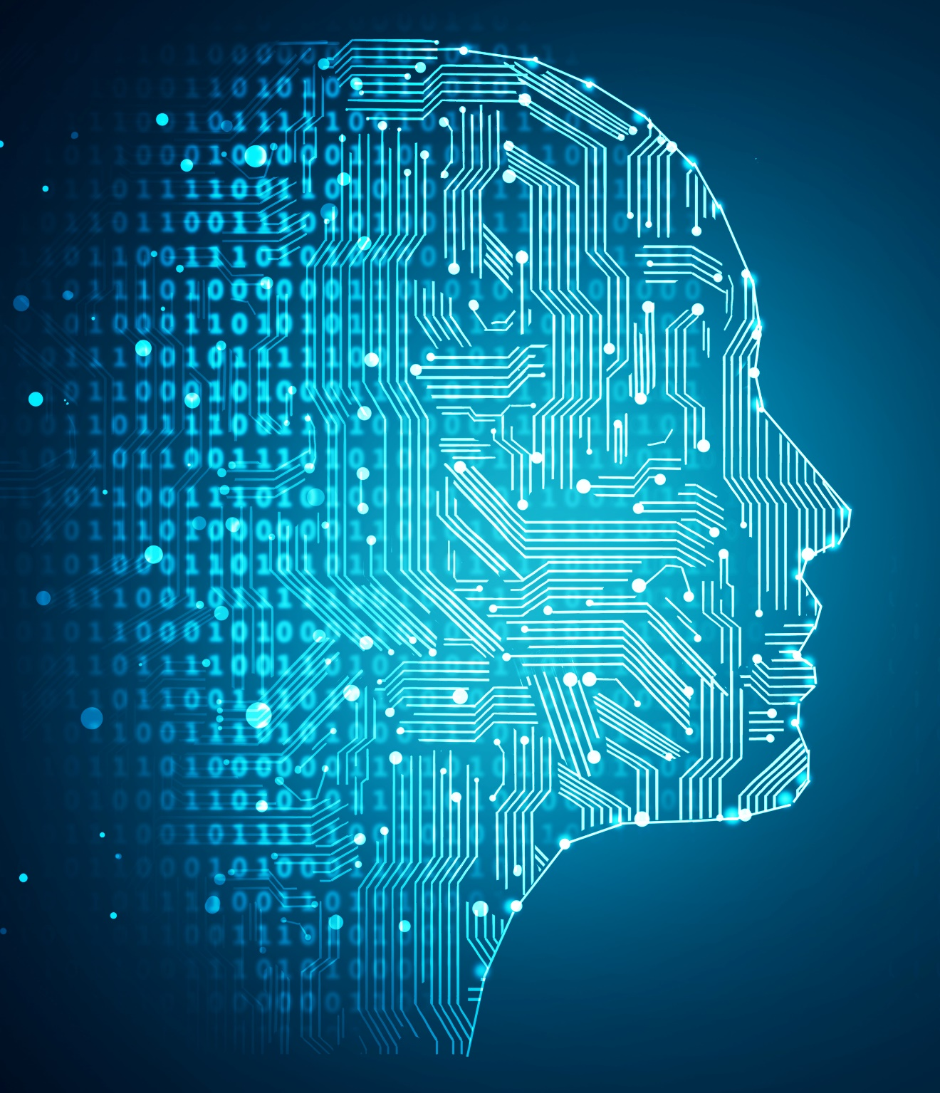
Ways to Prepare
Inform job candidates and employees of AI tools being used in their selection or other employment-related decisions.
Allow candidates to opt out of AI tool use.
On the flip side, consider asking for confirmation that candidates did not use AI to produce application materials, such as writing resumes or cover letters.
Have accommodation plans if the candidate discloses that they have a disability.
Develop AI-Usage Policies.

Slide 42
Ways to Prepare (cont’d)
Be actively involved in selecting the vendor and understanding the tools.
Try to get indemnification from the vendor, or at least representations that their tools are unbiased, and their cooperation in defending against claims.
Make sure the systems are not biased and can be audited.
Conduct regular reviews of the tools to make sure the system continues to not be biased.
Stay informed regarding existing laws and pending legislation where you operate and source candidates (and beyond) to ensure AI tools are consistent with federal, state, and local laws.

Slide 43
Thank You!
© 2025 Morgan Lewis Morgan, Lewis & Bockius LLP, a Pennsylvania limited liability partnership Morgan Lewis Stamford LLC is a Singapore law corporation affiliated with Morgan, Lewis & Bockius LLP. Morgan, Lewis & Bockius UK LLP is a limited liability partnership registered in England and Wales under number OC378797 and is a law firm authorised and regulated by the Solicitors Regulation Authority. The SRA authorisation number is 615176. Our Beijing and Shanghai offices operate as representative offices of Morgan, Lewis & Bockius LLP. In Hong Kong, Morgan, Lewis & Bockius is a separate Hong Kong general partnership registered with The Law Society of Hong Kong. This material is provided for your convenience and does not constitute legal advice or create an attorney-client relationship. Prior results do not guarantee similar outcomes. Attorney Advertising.

