Slide 1



HOT TOPICS In Employee Benefits
PRESENTED BY:
Lyndsey Barnett

Slide 2


ONE BIG
BEAUTIFUL
BILL
DEPENDENT CARE FSA

Slide 3




MAXIMUM INCREASED:
NOT INCREASED FOR INFLATION
PLAN AMENDMENT MAY BE NEEDED
EFFECTIVE FOR 2026 TAX YEAR
General $5000 | now $7500
Married Filing Separate $2,500 | now $3750
DEPENDENT CARE FSA

Slide 4


PERMANENT EXTENSION ALLOWING TELEHEALTH
OPTIONAL FIRST DOLLAR BEFORE DEDUCTIBLE ALLOWED
Retro effective to 1/1/25
TELEHEALTH IN HDHP

Slide 5



NO LONGER DISQUALIFYING COVERAGE
MAY ONLY PROVIDE PRIMARY CARE SERVICES
Fees can’t exceed $150/$300 month
Can pay fees from hsa
EFFECTIVE 1/1/26
DIRECT PRIMARY CARE IN HDHP

Slide 6

STUDENT LOAN ASSISTANCE MADE PERMANENT
MAXIMUM WILL NOW INCREASE FOR INFLATION
PLAN AMENDMENT MAY BE NEEDED
EDUCATIONAL ASSISTANCE

Slide 7


CREATED NEW TAX FAVORED ACCOUNTS
CHILDREN UNDER 18
ANNUAL MAX $5,000 (INDEXED)
INVESTMENTS GROW TAX-FREE
TRUMP ACCOUNTS

Slide 8


Employers may contribute $2,500/YR
MUST ADOPT A PLAN DOCUMENT
NON-DISCRIMINATION RULES
TRUMP ACCOUNTS

Slide 9


Retirement
Plan
Updates
UNCASHED CHECKS

Slide 10




Replacement check:
If same amount (no new 1099)
If increased amount (report excess on 1099)
Taxes owed even if the check is never cashed
Canceling check does NOT reverse the Form 1099-R or trigger a refund
UNCASHED CHECKS

Slide 11




High earners only allowed Roth catch-up
FICA wages >$145K
Can force Roth and can recharacterize if made earlier in year
Effective 1/1/26
ROTH CATCH-UPs

Slide 12



DOL rescinded prior opinion
Removed standard of “extreme care”
Must be in best interest of P&B
CRYTOCURRENCY

Slide 13


Last week the President signed an EO easing access to alternative investments
Directs DOL to reevaluate guidance within 6 months
Directs other agencies to reconsider if changes are necessary
EO ON ALTERNATIVE INVESTMENTS

Slide 14


FAB 2025-02
issued in April
Includes new model notice
New rules on calculating funding status
DB FUNDING NOTICES

Slide 15


HEALTH AND WELFARE UPDATES
MHPAEA REGULATIONS

Slide 16


ERIC filed lawsuit challenging 2024 final regs including:
Comparative analysis requirements
Meaningful benefits
Material difference in access
Fiduciary certification requirement
Departments issued non-enforcement statement in May
MHPAEA REGULATIONS

Slide 17


Relief provides:
Departments will not enforce 2024 final rule
Only applies to new portion of rule
Statutory obligations still exist, including requirement to do NQTL analysis
Relief doesn’t protect plans from action from participants as 2024 rule is still law
MHPAEA RELIEF

Slide 18



NO OFFER
$2,900 INCREASED TO $3,340
AFFORDABILITY
$4,350 INCREASED TO $5,010
AFFORDABILITY %
9.02% INCREASED TO 9.96%
ACA PENALTIES INCREASED

Slide 19


All states have some laws regulating PBMs
States are continuing to pass laws impacting both fully-insured and self-insured plans
Supreme Ct denied cert in Oklahoma case finding partial preemption
District Ct preempts TN law
STATE PBM LAWS

Slide 20
18 states have paid leave laws
3 states have accrued paid time off for any reason
Many other county and municipality leave laws
STATE PAID LEAVE LAWS

Slide 21
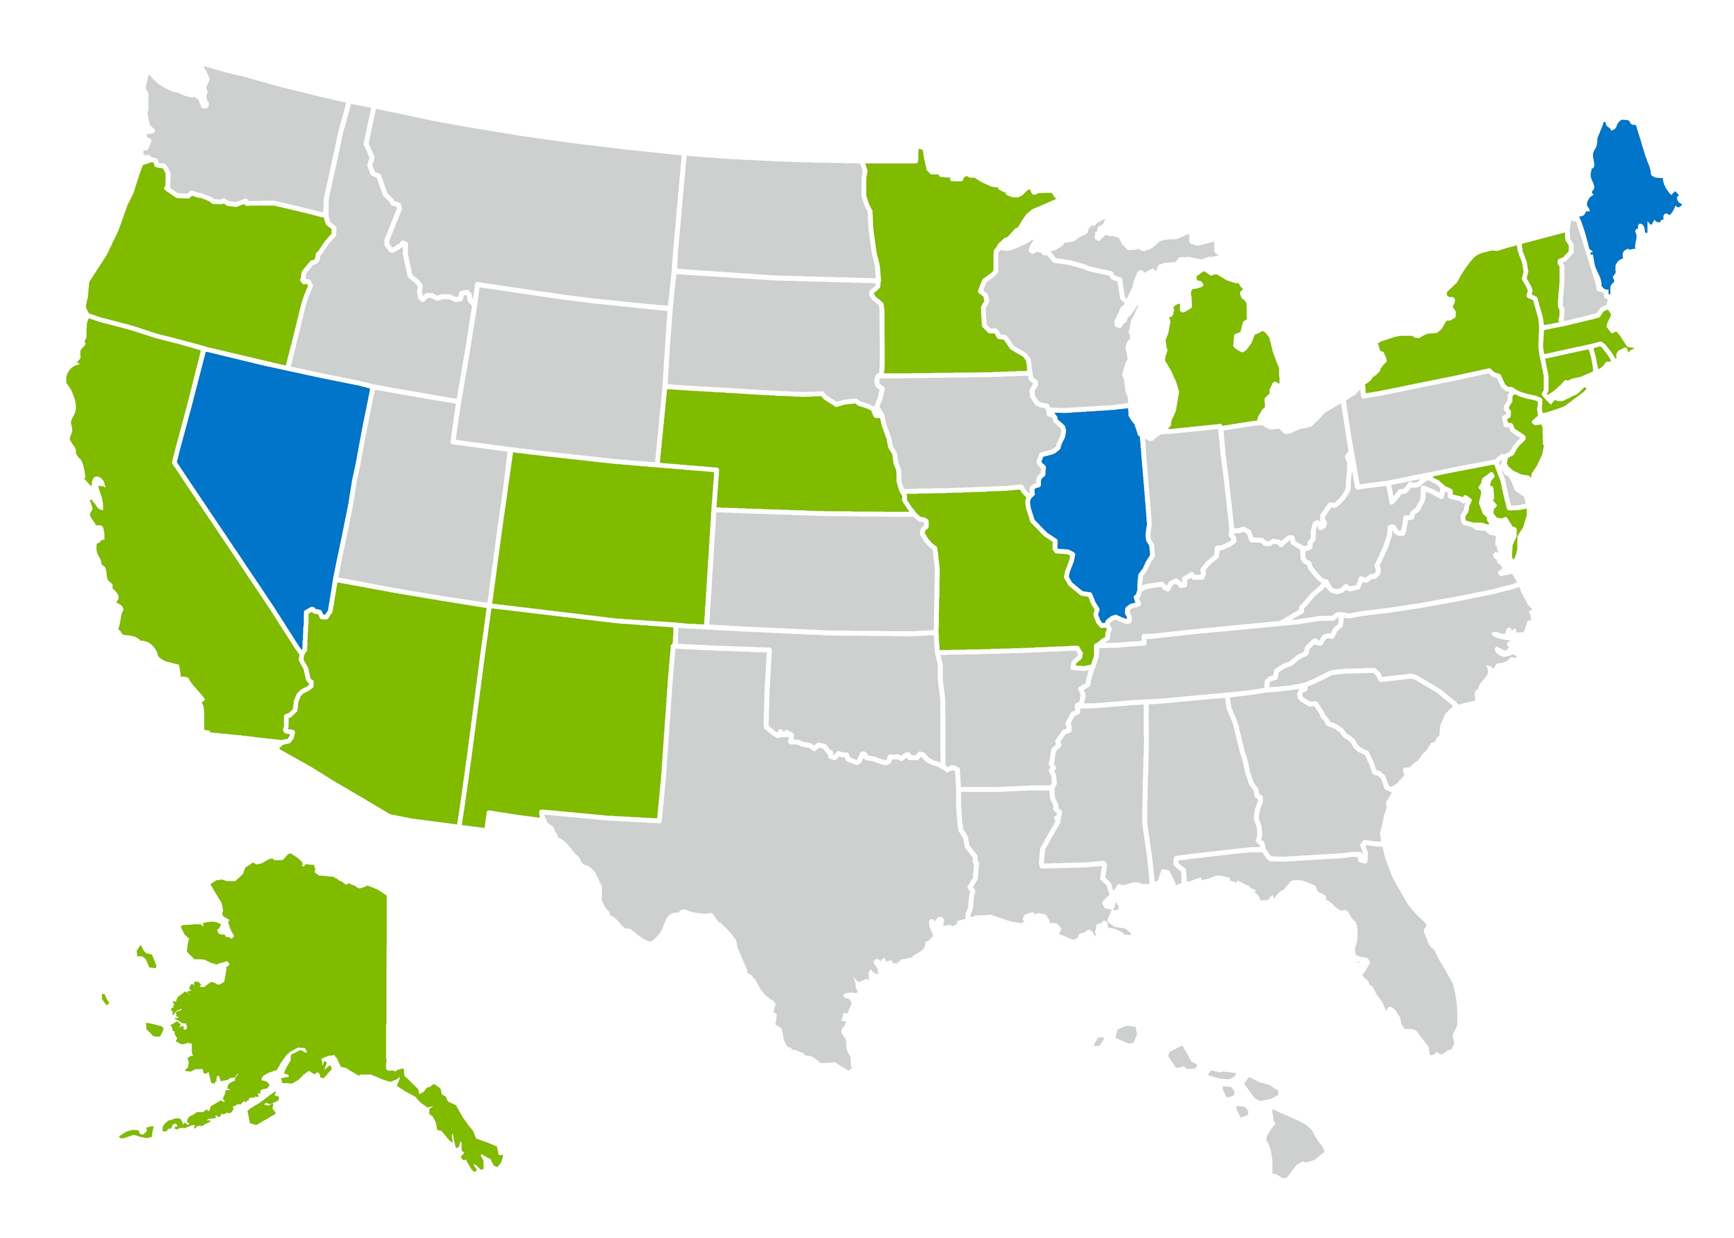
states with paid leave for any reason
states with paid/sick leave including Washington, DC marked with red dot
STATE PAID LEAVE LAWS

Slide 22


HEALTH
PLAN
LITIGATION
TOBACCO SURCHARGE LITIGATION

Slide 23




Rise in class actions over tobacco surcharges
(ERISA/HIPAA)
Courts allowing claims to proceed
(fiduciary duty, notice issues)
Multiple class settlements
(35-62% surcharge refunds)
Heightened DOL scrutiny;
Compliance risks for employers
TOBACCO SURCHARGE LITIGATION

Slide 24

Plaintiff assessed ACA penalty for failure to offer coverage
Alleged lack of authority to issue certification necessary to assess penalty
Court agreed and granted summary judgment
ACA penalty does not have to be paid only in ND of TX
Faulk Co. vs. Becerra (ND TX)

Slide 25



Claim that WF breached fiduciary duty
Alleged high PBM fees
Court dismissed due to no standing
WELLS FARGO CASE

Slide 26

Claim breach for mismanagement of Rx prices
Originally dismissed but no complaint filed in March
Now alleging harm due to higher premiums and costs
JOHNSON & JOHNSON CASE

Slide 27


Claim alleges breach for high PBM pricing
Allege no changes made after benchmark study
Chase’s motion to dismiss denied and case now in discovery
JP MORGAN CASE

Slide 28


RETIREMENT
PLAN
LITIGATION
PLAN LITIGATION

Slide 29
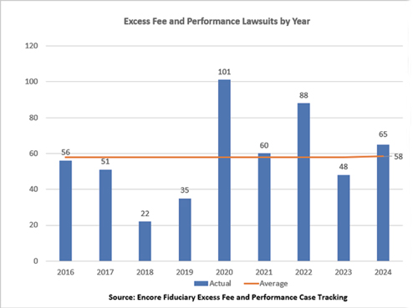
PLAN LITIGATION

Slide 30
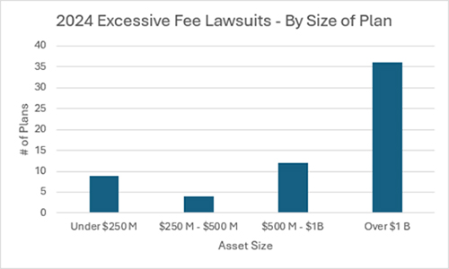
PLAN LITIGATION

Slide 31
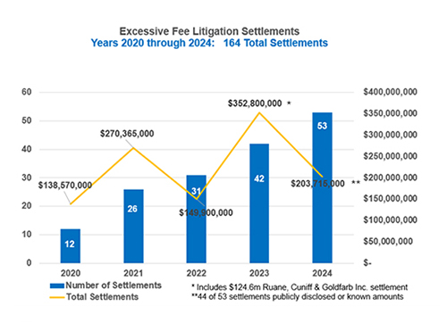
PLAN LITIGATION

Slide 32





Excessive
recordkeeping costs
Not using low-cost funds
Keeping funds with poor performance
Pension Plans
Picking a risky annuity when de-risking or terminating
Having too many actively managed funds
Having too many funds v. having too few funds
COMMON CLAIMS IN LITIGATION

Slide 33


Held plaintiffs don’t need to plead facts to survive motion to dismiss
US Supreme Court Case
April 2025
Only need to prove that a fiduciary:
Caused the plan to engage in a transaction;
Knew or should have known it involved furnishing goods, services, or facilities;
Knew the transaction was with a party in interest
Excessive
Recordkeeping costs
Cunningham v. Cornell University

Slide 34
Several have been dismissed
Several moving forward
Intuit settled for $2m
More than 30 lawsuits filed since fall of 2023
All plans had discretion in the plan document and claim is a breach to use plan assets to offset employer contributions
DOL recently filed an amicus brief in the 9th Circuit HP case in favor of plan sponsor
Forfeiture Litigation

Slide 35


Slide 36


Benefits InSight
https://graydon.law/category/benefits-insight/

Slide 37


Thank You
Lyndsey R. Barnett
lbarnett@brickergraydon.com
513.629.2817

