Slide 1

Mental Health Awareness in the Workplace
August 14, 2025
Justin R. Barnes
Jackson Lewis P.C. Justin.Barnes@jacksonlewis.com
(404) 586-1809

Slide 2
Disclaimer
This material is provided for informational purposes only. It is not intended to constitute legal advice, nor does it create a client-lawyer relationship between Jackson Lewis and any recipient. Recipients should consult with counsel before taking any actions based on the information contained within this material. This material may be considered attorney advertising in some jurisdictions. Prior results do not guarantee a similar outcome. Reproduction of this material in whole or in part is prohibited without the express prior written consent of Jackson Lewis P.C., a law firm focused on employment and labor law since 1958.
©2025 Jackson Lewis P.C.

Slide 3

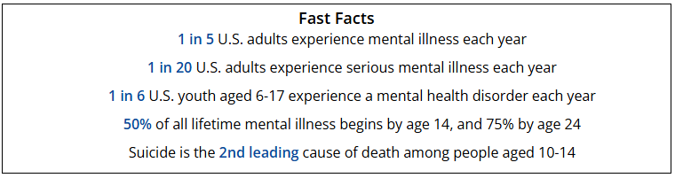
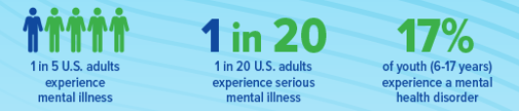
Mental Health Facts in America (1 of 3)

Slide 4
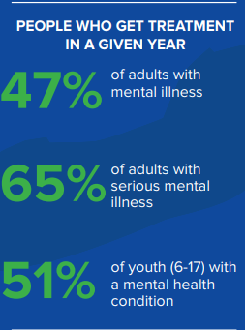
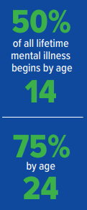

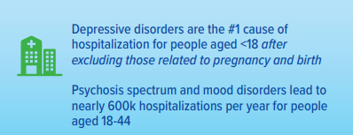
Mental Health Facts in America (2 of 3)

Slide 5
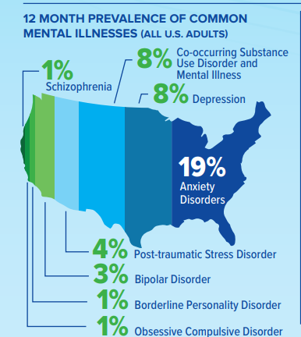
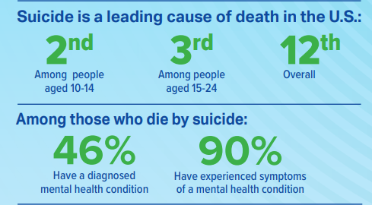
Mental Health Facts in America (3 of 3)

Slide 6
What Do The Mental Health Facts Mean For Employers?
There is a high probability that some of your employees have a mental health impairment.
Employees do not usually tell their employers they suffer from a mental impairment for multiple reasons.
Desire for privacy
Stigma
Desire not to look weak
Fear of losing the job
Employees don’t have to be disabled in order to engage in misconduct or be unfit for a job. However, when an employee with a known mental impairment engages in misconduct or is unable to perform her job, the ADA, FMLA, GINA and other laws may protect the employee.
When a mental health impairment causes misconduct or fears about the ability of the employee to safely perform the job, there are two clear paths and knowing which to take often determines the outcome if legally challenged.

Slide 7
Determine Whether the Mental Health Impairment is Creating A Workplace Misconduct or Fitness For Duty Issue
Path 1:
Path 2:
Does the situation involve workplace misconduct that would make the employee unqualified for the job and result in discipline?
If misconduct occurred, it would result in discipline.
Investigate.
Check comparators/discipline consistently.
Ignore medical issues.
Does the situation involve only whether the employee can effectively perform the job without risk to self or others?
Address situation as a “fitness for duty” issue.
“Medicalizes” the situation.
Evaluation by employee’s healthcare provider and possible second opinion by employer’s doctor.
If you choose the fitness for duty path, you can’t practically go back to termination if the employee passes the evaluation.

Slide 8
Situations Involving Workplace Misconduct
Employers need NOT forgive or excuse misconduct, even if it is caused by a disability, as long as the conduct rule is job-related and consistent with business necessity.
Certain conduct standards will always meet this “job-related and consistent with business necessity” standard, such as prohibitions on violence and threats of violence.
Employers may prohibit insubordination towards supervisors and managers and also require that employees show respect for, and deal appropriately with, clients and customers.

Slide 9
Threat To Self: Suicide Attempts and Comments
Stan is the HR manager at one of your sites. He calls on Monday and says he will be absent today and will not return to work for two weeks because he is receiving inpatient psychological care for having attempted suicide on Friday night at home. Stan’s doctor anticipates a full release to work at the end of the two week program. The Company president says he wants to fire Stan immediately because he has lost confidence in Stan’s ability to make reasonable decisions related to personnel matters, handle confidential information, and multiple other tasks the HR manager must perform.
Should you terminate Stan’s employment?

Slide 10
Can Employer Terminate Employee For Off The Job Suicide Attempt?
Todd (11th Cir. 2021): The ADA does not require an employer to retain an employee who it believes behaved in a threatening and dangerous way, even if the employee’s major depressive disorder is the reason for that behavior.
Chandler (6th Cir. 2005): Employer may not fire an employee for disability-related conduct that is not related to work performance and does not violate some workplace or societal rule. Rather, an employer should tolerate eccentric or unusual conduct caused by an employee’s mental disability, so long as that employee can satisfactorily perform the essential functions of the job.
Making stereotypical assumptions that a person who would attempt to commit suicide can’t take care of themselves and therefore can’t be trusted to make reasonable decisions at work gives rise to a potential “regarded as” disabled claim.

Slide 11
Threat To Self: Suicidal Comments At Work And Concerns About Ability to Perform Job Duties
Mary, a nurse at your hospital, made comments to her co-worker that she was depressed, hopeless, and wondered aloud, “maybe I’d be better off if I wasn’t here, maybe I should just put a gun to my head.” Several co-workers have also raised concerns about Mary’s apparent inability to focus on simple tasks like raising a hospital bed for a patient.
Should you send Mary for a fitness for duty exam to determine if Mary can safely continue to perform her job?

Slide 12
Can Employer Require Fitness for Duty Exam If Employee Comments About Committing Suicide and Demonstrates Difficulty Performing Job Duties?
Barnum (6th Cir. 2016): Employer placed employee on leave of absence, required a fitness for duty exam, and required employee to allow employer to speak with doctor regarding his decision that employee was fit to return to work. Employee was permitted to return to work but sued her employer anyway.
Court held that employer did not regard employee as disabled and was permitted to require examination when there were numerous concerns expressed about employee’s ability to concentrate and at least one report of suicidal comments. Based on this, a reasonable person would have cause to inquire whether the employee was capable of performing her job.
Notes:
Barnum v. Ohio State Univ. Med. Cntr, 642 Fed Appx 525 (6th Cir. 2016).

Slide 13
Threats to Self: Requiring Psychiatric Treatment
López-López (1st Cir. 2020): After employee, a teacher, received complaints that her behavior was frightening the children she taught, she was called into a meeting with manager and HR. At meeting, employee suffered a “temporary nervous breakdown” and said that she wanted to kill herself. School administrators took her to a mental health facility, where she was involuntarily admitted. After treatment, including outpatient treatment, during a period of paid leave, employee returned to work. Employee’s claims of discrimination and retaliation failed.
“[A]n employer may require an employee to undertake medical treatment as a condition of employment if the employer had a legitimate reason for imposing such a requirement.”

Slide 14
Threats To Others: Reports That Employee Threatened To Harm Others
Shortly after Paul returned from a four month leave of absence for treatment related to bi-polar depression, co-workers reported that Paul was making inappropriate and offensive remarks of an ethnic, racial, and/or sexual nature. You initiated an investigation into Paul’s comments. During the investigation, another employee reported to you that Paul called some of his co-workers “rats” and said he “would kill the rats.” You placed Paul on paid leave pending investigation into the alleged threats. Paul denied making the comments, but you interviewed all the relevant employees and several employees corroborated the claim.
Should you fire Paul for his threats or send him for a fitness for duty exam?

Slide 15
Can Employee Be Terminated For Making Death Threats?
Duncan (S.D. Ohio, 2018): Court found that employer was aware of the disability because of employee’s history and his symptoms were obvious manifestations of a disability.
Court upheld the termination stating employers can take action based on egregious or criminal conduct, i.e. making death threats to co-workers, regardless of underlying disability.
Even if the employer were wrong, it had the benefit of the honest belief rule because it conducted a thorough investigation and reasonably relied on the particularized facts that were before it at the time the decision was made.
Employer’s investigation was not required to “leave no stone unturned.”
Notes:
Duncan v. GE Int’l, 2018 US Dist LEXIS 160622 (6th Cir. 2018)

Slide 16
Threat To Others: Comments About Bringing Weapons To Work
George was diagnosed eight years ago with major depressive disorder, which he controlled with medication and treatment. After a dispute with his supervisor, George recently told a co-worker that he would like to show up at the workplace with a shotgun and “blow the heads off” his supervisor and another manager. The co-worker reported the comments to you. Two other co-workers reported similar experiences with George. You suspended George, barred him from company property, and notified the police. After the police verified George’s statements, he was taken into custody and took two months of FMLA leave for mental health treatment. You terminated George as a result of his threats before he could return to work.
George claimed that his termination violated the FMLA and ADA. Is George’s argument viable?

Slide 17
Can Employee Be Terminated For Threatening To Bring Shotgun To Work?
Mayo (9th Cir. 2015): Court held that repeated threats of violence in the workplace demonstrated that the plaintiff was not a qualified individual under the ADA because his violent threats in reaction to stress meant that he could not perform an “essential function” of his job.
Court also held that returning plaintiff to his role under different supervision was not a “reasonable accommodation” that his employer should be expected to make. While emphasizing the individual rights protected by the ADA, the Court stated that the law “do[es] not require employers to play dice with the lives of their workforce.”

Slide 18
Threat To Others: Bizarre, Disruptive Behavior At Work
You have received a steady stream of employee concerns about an administrative support employee, Joan. Multiple employees have shared with you various personal accounts in which Joan has snapped and screamed at her co-workers, gave blank stares and intimidating looks, ranted, constantly mumbled to herself, repeatedly banged drawers in her office, and had mood swings. Co-workers report that she sometimes glares and growls at them, she keeps a log of every conversation, is rude, angry, abrasive, and aggressive. Some co-workers have said they fear she will "go postal" or "blow up at any time." Today, just before quitting time, Joan burst into your office, her eyes darting back and forth, and pointed a finger at you while growling incoherently about approaching a co-worker to ask her about God, the Bible, and the Ten Commandments. Her behavior is highly disruptive, unprofessional and keeps everyone on edge.
Should you investigate and, if appropriate, fire Joan for unprofessional, disruptive and threatening behavior, or send her for a fitness for duty exam?
Notes:
Painter v. Ill. DOT, 715 Fed. Appx. 538 (7th Cir. 2017)

Slide 19
Can Employee Be Terminated For Bizarre, Disruptive Behavior At Work That Made Her Unsuitable For Job?
Painter (7th Cir. 2017): Employer sent employee for fitness for duty exam which declared that she suffered from a personality disorder and was possibly paranoid but was fit to return to work. Employee returned to work, started engaging in similar behavior, and was sent for another fitness for duty exam. Conflicting examination reports were issued and on the 5th examination, employee was declared paranoid and unsuitable to return to work based on the highly disruptive behavior caused by her paranoia. Employee was terminated.
Court held that employer did not violate the ADA when it required an employee to undergo series of fitness for duty exams based on paranoid and disruptive behavior at work.
Court held that preventing employees from endangering their coworkers is a business necessity: "a safe workplace is a paradigmatic necessity of operating a business." Employers need not retain workers who, because of a disability, might harm someone; such a rule would force an employer to risk a negligence suit to avoid violating the ADA.
Notes:
Painter v. Ill. DOT, 715 Fed. Appx. 538 (7th Cir. 2017)

Slide 20
Can Employer Require Fitness For Duty Exam When It Has Concerns About Workplace Safety?
Baker (10th Cir. 2025): Employee quit, claiming constructive discharge, rather than take fitness for duty exam after reports of rash behavior and alarming emails to his coworkers. Employer’s concerns about employee’s observed and self-reported struggles justified request for fitness for duty exam. Employee’s refusal to take the test or produce medical documentation doomed his claim.
Baldwin (11th Cir. 2023): Employer did not violate the Rehabilitation Act when ordering a fitness for duty examination after employee mishandled a firearm while driving and shot himself in the finger. Court held employer’s concern about workplace safety is a legitimate basis for requiring a medical exam, especially when the employee handles a firearm in their professional role.

Slide 21
Requesting Medical Information To Determine If Employee Can Safely Perform The Job
An employer’s request for medical information or a medical exam of an employee must be “job-related and consistent with business necessity” which means the employer must show a reasonable belief, based on objective evidence that:
1) an employee’s ability to perform essential job functions will be impaired by a medical condition; or
2) an employee may pose a direct threat due to a known or suspected medical condition.
Employers must maintain confidentiality and narrowly tailor medical exams or inquiries.
Employers should include GINA safe harbor notice on requests for information.

Slide 22
Requiring Fitness for Duty Exams To Ensure Employee Can Safely Perform The Job
Make sure you have the facts to justify the fitness for duty exam.
If you have enough risk to justify a fitness for duty exam, you have enough risk to remove employee from workplace or at least the position while conducting the fitness for duty exam.
The EEOC would prefer you work with employee’s treating physician first.
If necessary, then request an independent examination by healthcare provider chosen by employer.

Slide 23
Taking Action Based On Employee’s Ability To Safely Perform the Job
Risks of harm that are present for a disabled employee in every day life are not enough. The risk of harm need not be eliminated as long as it can be reduced to an acceptable level with a reasonable accommodation.
Example: Evening security guard’s risk of harm to self related to choking or dying from epileptic seizure could be reasonably reduced by using cameras at the security desk and panic buttons.
A good faith belief that an employee poses a risk of harm is not enough unless it is grounded in medical or other objective scientific information.
Example: Forklift driver who experienced dangerously high blood pressure on post-conditional offer test and follow up test was properly suspended while employee got blood pressure under control.
Notes:
Crumpley v. Associated Wholesale Grocers (Kansas 2018) (ER could reduce risk of harm of epileptic seizures to security guard by installing cameras and panic buttons which would reduce plaintiff’s chance of choking, aspirating or dying from a seizure. These are all risks EE faced at home).
2. Horton v. The Hilshire Brands Company (N.D. Ala. 2018) Forklift driver claimed disability discrimination when he was suspended after he was tested twice for dangerously high blood pressure uncovered in post-conditional offer physical and follow up testing. The employer was justified in relying on pre-employment exams and several blood pressure readings, along with “well-known and significant risks” associated with high blood pressure and the particular requirements of operating a fork lift.

Slide 24
When The Condition Raises A Direct Threat To Ability to Safely Perform the Job
An employer need not employ individuals with disabilities if they pose a “direct threat.”
This is a high standard and requires an individual assessment.
A “direct threat” means a “significant risk of substantial harm that cannot be eliminated or reduced through reasonable accommodation.”
A finding of “direct threat” must be based on the best available objective medical evidence and/or most current medical knowledge.
Factors to consider in making direct threat determinations:
Severity of harm.
Likelihood of harm.
Imminence of harm.

Slide 25
How does one know whether a safety risk rises to a “direct threat”?
Only when a court or jury decides a case!
Until then, employers can only do their best to make informed, fact-based decisions that is based on objective medical evidence which relies on current medical knowledge
In other words … the process employers follow is critical in defending direct threat decisions

Slide 26
John Hopkins Study + NIMH Findings
3^{x}
3rd
6^{x}
Attorneys are three times more likely to suffer from depression than the general public
Suicide is the third leading cause of death for attorneys (after cancer and heart disease)
Suicide rate is six times the rate of the general population

Slide 27
Substance Abuse / Psychological Disorders
21–36%
Qualify as problem drinkers*
28%
Have depression
19%
Have anxiety disorder
23%
Have stress disorder
2016 Study of 12,825 Attorneys Across U.S.
Men have higher proportion of positive screens
Attorneys in private firms experience highest rates of problem drinking and depression
*Of licensed, employed attorneys

Slide 28
Substance Abuse / Psychological Disorders
13-19%
Contemplated suicide
33%
Have depression
68%
Reported having anxiety
9%
Struggle with prescription drug abuse
ALM and Law.com’s 2025 Study of over 3,100 Legal Professionals
American Addiction Center’s 2025 Report
20%
Report having a substance abuse issue
75%
Began their substance abuse in law school

Slide 29
The Struggle Starts in School
96% of law students experience significant stress compared to 70% of medical students and 43% of grad students
21% of students with clinical depression symptoms before law school, 50% after the first year, 52% after the third year
75% of attorneys with substance abuse issues said it started in law school
Over 11% of law students have seriously contemplated suicide
Fears over job prospects, bar admission, and social stigma inhibit seeking help

Slide 30
Recommendations
Work-Engagement
Challenge (v. Stress)
Resilience
Mindfulness Meditation
Leadership Development
Conflict Management
Periods to Recover from Stress
Sleep – average 4 hours/night for 4-5 days as impaired as if awake for 24 hours – equivalent of being legally drunk

Slide 31
Other Strategies to Improve Lawyer Well-Being
L.E.A.R.N.
Small
Steps

Slide 32

L is for Laughter
Relaxes the body
Boosts immune system
Releases endorphins
Connects us
Seek out opportunities
Don’t take yourself too seriously

Slide 33

EA is for Exercise Aerobically
Every study = positive effects
Latest: 150 min. of moderate exercise/week
Exercise “snacks”
Increase breathing & heart rate
Intensity: 5 or 6 out of 10

Slide 34

R is for Recreation
Healthy people have many interests and hobbies
Too little balance
Go outside and play
Impact of nature

Slide 35

N is for Nutrition
Mindful eating
Chew 25+ times
More plants, less meat
The Game Changers – Netflix Documentary

Slide 36

S is for Sleep
7½ to 8½ hours per night
Matthew Walker – “Why We Sleep”
TED Talk
Deprivation reduces natural killer cells
Leaky pipe analogy

Slide 37

S is for Self-Reflection
Know Thyself
Understand what your stress triggers/signals
Develop tools for stress
Self-care first
Explore meditation
Small bites
Reach out for support
Drowning/swamped/buried

Slide 38
Three Most-Asked Questions Regarding Workplace Violence
Do people just suddenly snap?
Are there warning signs of impending violence?
Is workplace violence random?

Slide 39
Do people just suddenly snap?
No, a violent outburst typically stems from a slow burn of unresolved personal problems or multiple stessors such as
Failing personal relationship
Economic hardship
Perceived workplace injustice
Unwillingness to ask for help
Feelings of personal or professional failure

Slide 40
WARNING SIGNS:
How Do I Recognize
Someone Who May Be
At Risk For Violent
Behavior?

Slide 41
Warning Signs
Expressional of irrational beliefs
Verbal, nonverbal or written threats or intimidation
Fascination with weaponry and/or acts of violence
Expressions of a plan to hurt himself or others
Externalization of blame

Slide 42
Warning Signs
Unreciprocated romantic obsession
Persistent behavior or performance problems
Fear reaction among coworkers/clients
Sudden, drastic change in belief systems
Displays of unwarranted anger
New or increased source of stress at home or at work

Slide 43
Warning Signs
Inability to take criticism
Feelings of being victimized
Intoxication from alcohol or other substances
Expressions of hopelessness or heightened anxiety
Violence towards inanimate objects

Slide 44
Warning Signs
Steals or sabotages projects or equipment
Lack of concern for the safety of others
Sudden negative change in personal hygiene and grooming habits
Gives away prized personal possessions

Slide 45
Is workplace violence random?
No, victims are typically targeted because the perpetrator perceives they had something to do with his negative situation
Noted exceptions are acts of violence associated with robbery

Slide 46
Questions?

Slide 47







Thank you.
Focused on employment and labor law since 1958, Jackson Lewis P.C.’s 1,000+ attorneys located in major cities nationwide consistently identify and respond to new ways workplace law intersects business. We help employers develop proactive strategies, strong policies and business-oriented solutions to cultivate high-functioning workforces that are engaged and stable, and share our clients’ goals to emphasize belonging and respect for the contributions of every employee.
More information about Jackson Lewis can be found at jacksonlewis.com.
Justin R. Barnes
Justin.Barnes@jacksonlewis.com
(404) 586-1809

