Slide 1


PREVENT AND DEFEND A Litigation Survival Guide for Managers
Janet Strevel Hayes
Email: JHayes@LewisThomason.com

Slide 2
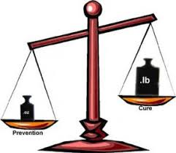
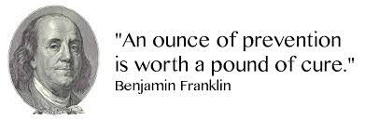
Grandma (and Ben Franklin) were on to something

Slide 3
1. Risk Awareness Quiz 2. Traditional “Best Practices” 3. “Best Practices” for Today’s Hot Issues

Slide 4


Risk Awareness Quiz

Slide 5
Question 1: Legal Defense Costs On average, how much does it cost an employer to defend against an employee lawsuit, regardless of the outcome? A) $5,000 B) $25,000 C) $125,000 D) $1,000,000

Slide 6
Question 2: Jury Awards What is the average jury award in employment law cases that go to trial? A) $50,000 B) $150,000 C) $500,000 D) $1.5 million

Slide 7
Question 3: Settlement vs. Trial What percentage of employment lawsuits are settled before reaching trial? A) 10% B) 25% C) 65% D) Over 95%

Slide 8
Question 4: Time to Resolve On average, how long does it take to resolve an employment lawsuit from filing to resolution? A) 3 months B) 6 months C) 18 months D) 5 years

Slide 9
Question 5: Lost Productivity Suppose employee sues employer for gender discrimination and employee’s attorney subpoenas each female in the office for a discovery deposition. What is the statutory limit on the number of hours of lost time the employer may be forced to suffer for the depositions? A) one hour/employee B) 20 hours total deposition time C) five hours/employee absent court order D) there is no statutory limit

Slide 10
Question 6: Damages List the types of damages that may be available to an employee in an employment law case:

Slide 11
Question 1: Legal Defense Costs On average, how much does it cost an employer to defend against an employee lawsuit, regardless of the outcome? A) $5,000 B) $25,000 C) $125,000 D) $1,000,000

Slide 12
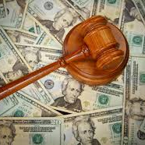
Things to Remember: * Average includes nominal cases that were settled quickly * Average does not include cases where employee is awarded attorney fees ($300-$700/hour) * Some cases require costly expert witnesses
DO NOT UNDERESTIMATE THE HARD COST OF LITIGATION!

Slide 13
Question 2: Jury Awards What is the average jury award in employment law cases that go to trial? A) $50,000 B) $150,000 C) $500,000 D) $1.5 million

Slide 14

Beware of Nuclear Verdicts
“nuclear verdicts” – unexpectedly high jury verdicts exceeding $10 million.
A $58 million jury verdict for a workplace injury – a California man broke his foot while working at a train manufacturing yard.
A $35 million jury verdict for an ADA claim – a truck driver in Nebraska alleged he was not hired because he is deaf.
A $25.1 million jury verdict for unfair pay – a former food and beverage manager in Texas alleged she was paid less than her male colleagues due to the “boy’s club” culture at the company.
An $11.25 million jury verdict for retaliation – a Black fitness instructor in New York alleged she was fired after she complained about a co-worker’s racist and sexually inappropriate comments.

Slide 15
Question 3: Settlement vs. Trial What percentage of employment lawsuits are settled before reaching trial? A) 10% B) 25% C) 65% D) Over 95%

Slide 16
Question 4: Time to Resolve On average, how long does it take to resolve an employment lawsuit from filing to resolution? A) 3 months B) 6 months C) 18 months D) 5 years

Slide 17
Question 5: Lost Productivity Suppose employee sues employer for gender discrimination and employee’s attorney subpoenas every female employee for a discovery deposition. What is the statutory limit on the number of hours of lost time the employer may be forced to suffer for the depositions? A) one hour/employee B) 20 hours total deposition time C) five hours/employee absent court order D) there is no statutory limit

Slide 18
Question 6: Damages List the types of damages that may be available to an employee in an employment law case: 1. Economic Damages – Back Pay and Possibly Front Pay Back pay = lost wages and out of pocket costs (i.e. COBRA premiums) Front pay = compensates for future impact of no job – not always available 2. Compensatory Damage Mental anguish/pain and suffering (probably requires an expert) 3. Punitive Damages Punishment damages designed to deter future misconduct (may be capped based on size of employer) 4. Fee Shifting Huge leverage for settlement; not capped based on size of award

Slide 19
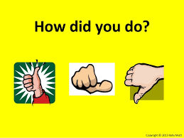
How risk-aware are you?

Slide 20

Four Traditional “Best Practices” (with my caveats)

Slide 21
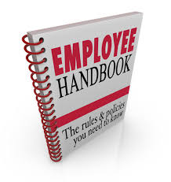
1. Develop and Enforce Clear Workplace Policies
Caveats:
Update annually or at least every 4 4 years
Don’t write it if you won’t apply it

Slide 22

2. Document Everything
Caveats:
Don’t let “great” documentation be the enemy of “good” documentation
Modern technology can be your friend
Weigh the pros/cons of recordings
Just the facts

Slide 23

3. Train Yourself and Train Others
Caveats:
Train all employees in areas required by law (harassment and discrimination)
Train yourself frequently as the legal landscape quickly changes
Train all front-facing supervisors on applicable laws and your policies

Slide 24

4. Investigate Employee Complaints
Caveats:
Sometimes an outside neutral is better
2. Closing out the investigation pays dividends
3. Don’t create a monster

Slide 25

Today’s Best Practices
Things I would Do Today to Protect and Defend Against Claims Tomorrow

Slide 26

Revisit DEI Initiatives

Slide 27

EXECUTIVE ORDER: “Ending Illegal Discrimination and Restoring Merit-Based Opportunity”
“I further order all agencies to enforce our longstanding civil-rights laws and to combat illegal private-sector DEI preferences, mandates, policies, programs, and activities.”
Directed AG to submit recommendations for enforcing civil rights laws against the private sector by May 21.

Slide 28
Attorney General Memo
DOJ team will “aggressively pursue” any recipient of federal funds who has DEI programs that provide racial preferences and universities that allow antisemitism or support transgender policies.
Encourages private individuals to pursue FCA qui tam whistleblower lawsuits and report suspected violations by federal fund recipients.
Private sector employers are not immune from investigations and potential liability if they maintain DEI programs that have an adverse impact on employees who are not in an underrepresented group.

Slide 29

Employer Takeaways:
Focus on merit in all hiring and promotion decisions
Eliminate diversity quotas
Audit public-facing language (websites, press releases, etc.) for any language suggesting preference is given to an underrepresented class (focus on race and gender)
Words to avoid: Diversity, Equity, Inclusion, Cultural Competence
Avoid sponsorship or affiliation with groups that limit admission based on race or gender

Slide 30

Remain Focused on Anti-Harassment and Discrimination Measures

Slide 31
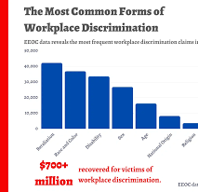
2024 Data
Race and Color (42%)
Disability (38%)
Gender (30%)

Slide 32
What will change in 2025 and beyond?
Reverse Discrimination Claims:
Ames v. Ohio Department of Youth Services (June 5, 2025)
Employees in historically advantaged groups (white males) no longer have to bear a heightened burden to prove discrimination
Consistent with EEOC attack on “illegal DEI”
Opens the door for more discrimination claims from white men
AI Discrimination Claims
AI used for resume screening, video interview analysis and candidate ranking may use algorithms that amplify existing societal biases related to protected classes
Current class action age discrimination claim against “Workday” is pending

Slide 33
Employer Takeaways:
Focus less on diversity in recruiting. Focus more on fair treatment of the diverse employees you have.
Sensitivity to different viewpoints
Creating welcoming environments – Rethink old methods of training and education
2. Proactively assess AI systems for potential bias and prioritize human oversight of any new technologies.

Slide 34
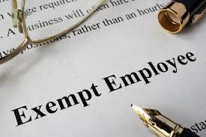
Audit Pay Practices

Slide 35
Wage and Hour Mistakes are Expensive
FedEx Ground – $240 Million Driver Misclassification Settlement (2016)
Walt Disney Co. (Disneyland) – $233 Million Wage Theft Class Action (2024)
G4S (Wackenhut Security) – $130 Million Meal/Rest Break Settlement (2019)

Slide 36
Very Few Employees Qualify as “Exempt”
Salary Level
Old rules are in effect: $684/week ($35,568 annually)
Highly Compensated Employee threshold: $107,432
Salary Basis
Must be paid a salary
Salary cannot be reduced based on quality or quantity of work
Must pay full salary for any week the exempt employee performs any work

Slide 37
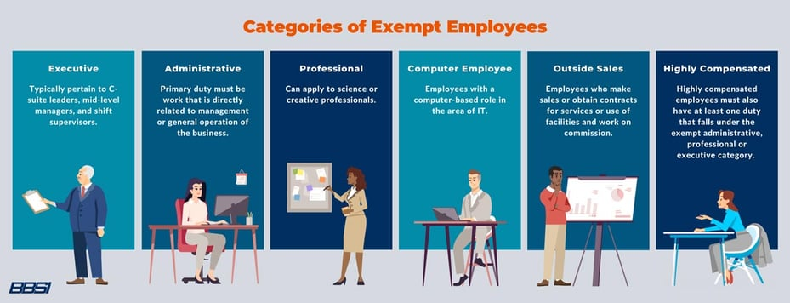
Very Few Employees Qualify as Exempt
Job Duties
Employee is only exempt if his/her job duties fit a specific exemption as defined by law
“White Collar Exemptions”

Slide 38


Slide 39
Questions?
Name: Janet Strevel Hayes
Email: JHayes@LewisThomason.com
KNOXVILLE | MEMPHIS | NASHVILLE
The contents of this presentation are for informational purposes and should not be considered legal advice.
This presentation does not establish an attorney-client relationship.

