Slide 1
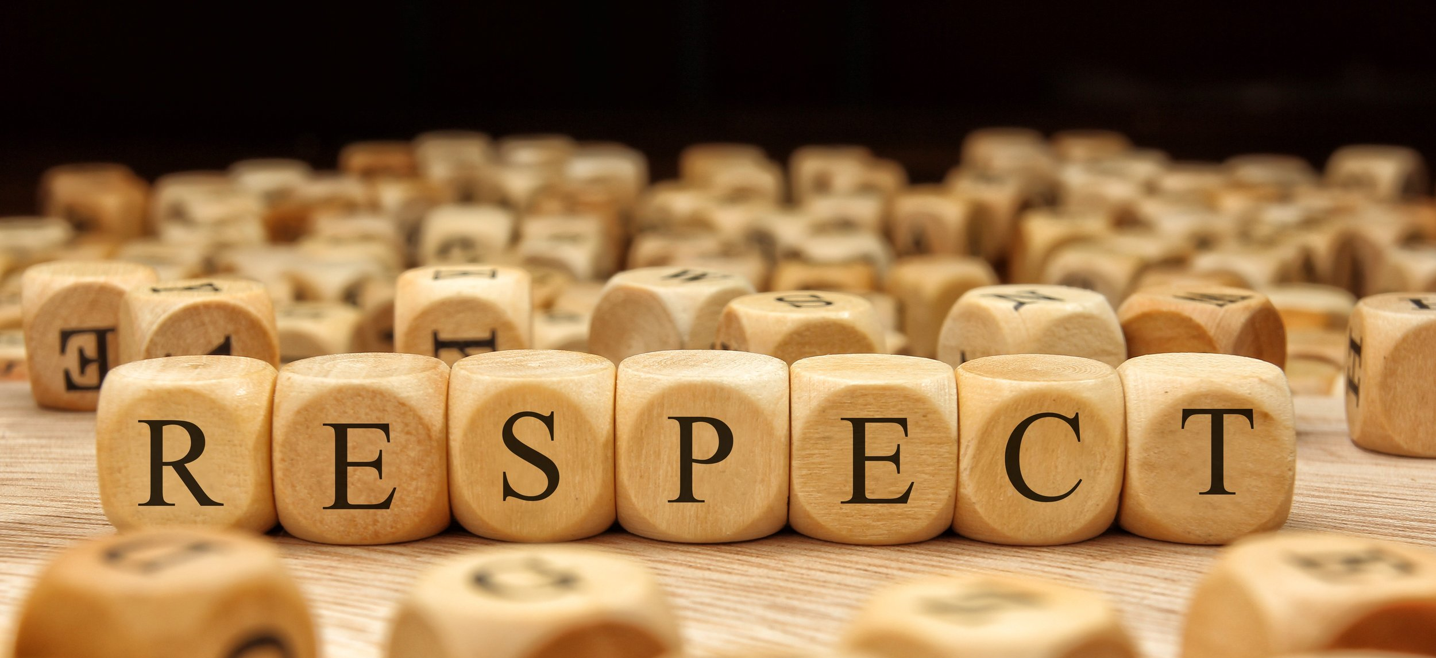
Professionalism in the Workplace:
Why Treating Employees with Respect Matters
Presented by: Luther Wright, Jr.

Slide 2

What is our first and biggest challenge related to Respect?
The ability to see beyond ourselves

Slide 3
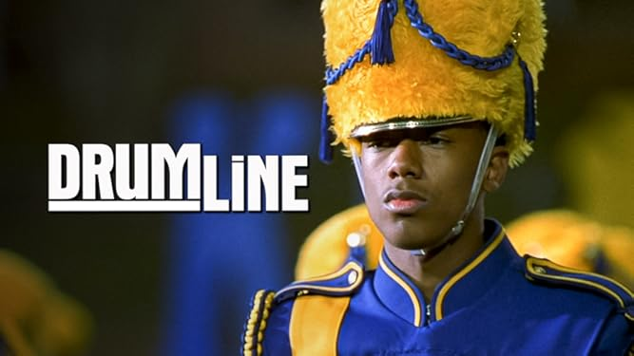
“I like the sound of the band more than the sound of my own drum”

Slide 4
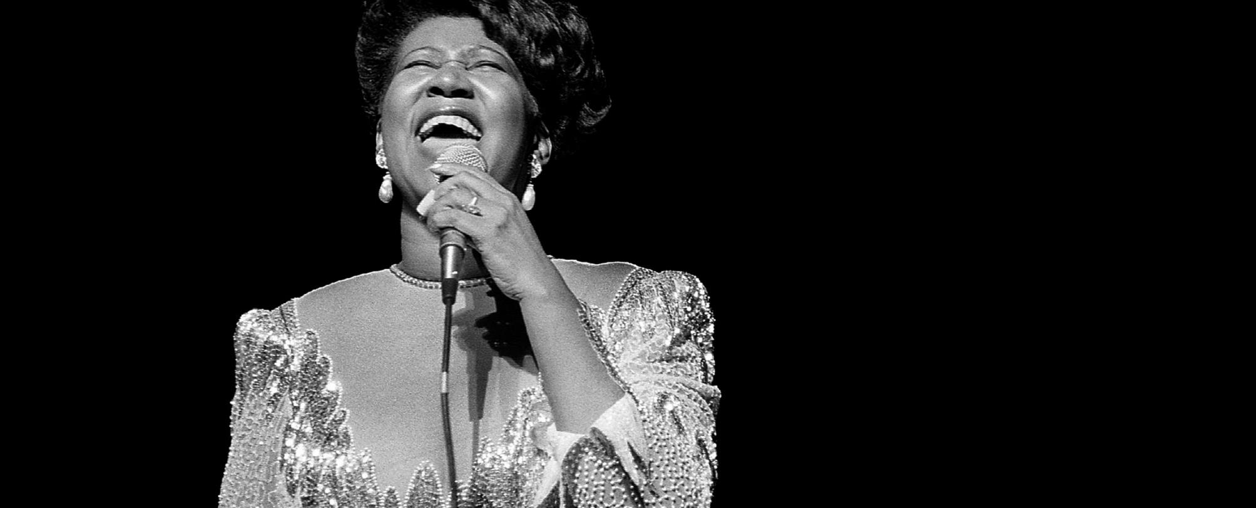
RESPECT (NOUN)
A feeling of deep appreciation for someone or something.
Accepting them for who they are, even when they are different.
Builds feelings of trust, safety, and wellbeing.
It is honoring the feelings, opinions and property of others.

Slide 5
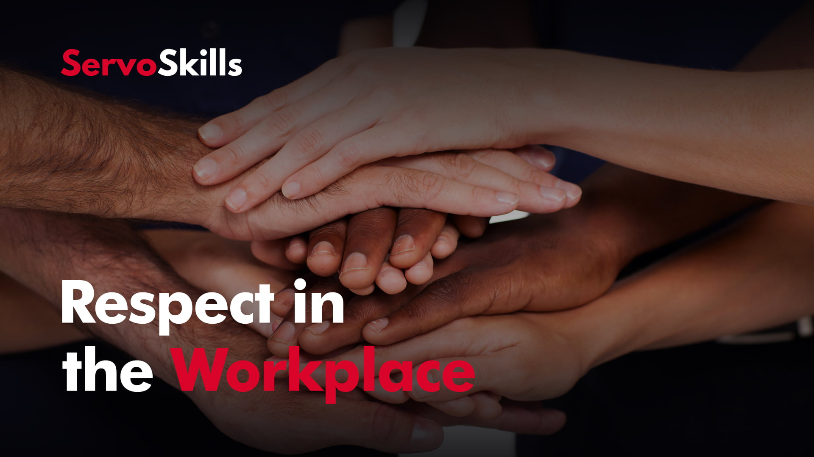
WHY DOES THIS
RESPECT MATTER?
How we treat each other directly reflects who we are
Treating each other poorly damages our organizations and individual reputations
Dealing with the Aftermath

Slide 6

Power Dynamics

Slide 7
Power
Dynamics
Defined
Power dynamics is a term that refers to the ways in which power works in a setting. It refers to the power balance — or lack of balance — between two or more people.
It is usually about the ways that formal authority is distributed and how that affects people’s behavior.
However, power dynamics can also refer to the informal ways that power is exerted in an organization

Slide 8
Power Dynamics Types
Formal (Positional) power is the power designated by official titles, ranks, or positions.
Informal (Social) power is the power that we hold that is not immediately visible or officially assigned. Informal power dynamics can be equally if not more challenging in the workplace. There are four main types of informal power:

Slide 9
Power Dynamics
Four Kinds
Experiential power
power from experience, training and study
may give additional weight to one’s opinion or perspective.
deferring to those with seniority or expertise is a common manifestation of this power
Relational power
gained from connections with others and with keeping track of information tied to these relationships.
this information gives individuals the ability push forward agendas.
It is all about "who you know."

Slide 10
Power Dynamics
Four Kinds
Cultural/Systemic power
one group's ability to establish and directly benefit from institutions, laws, customs, and policies
"it's just the way that things are done" or that it's the "right" or "best" way.
Circumstantial/Majority power
being surrounded by those from a similar identity like race or gender, or based on shared history/experience
it only exists in certain contexts (move to a place where you are not the majority and it vanishes).
Usually seen when you are in the extreme majority

Slide 11
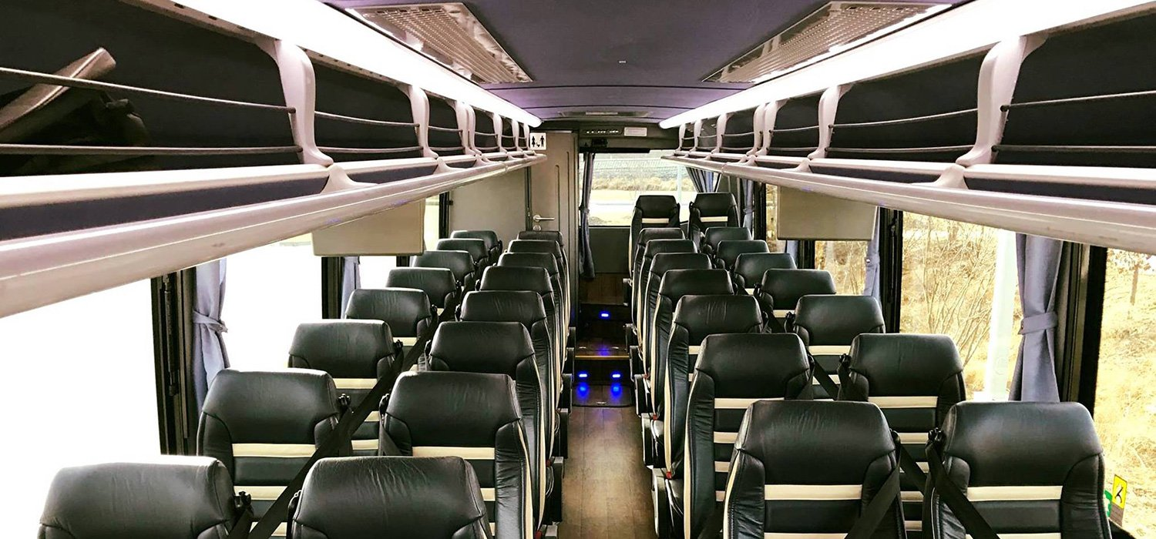
Real Life Scenario
Retreat in 2007 at my prior firm
Firm was run by a Five Person Board
First (and at the time only) Partner of Color in history of 100 person firm
Also only person of color on the bus, leading the bus in “fun”
One of the Firm’s Board members made the following comment to me in front of the entire bus:

Slide 12

“Hey Luther, What do you think you are doing--Get to the back of the bus where you belong”
What Power Dynamics do you see in play?
Any concerns about legal liability or otherwise?
Does this conduct appear to be intentional?
What are your duties if this happens in your organization and you witness or hear about this type of behavior? Why?
How does this incident impact the organization informally?

Slide 13
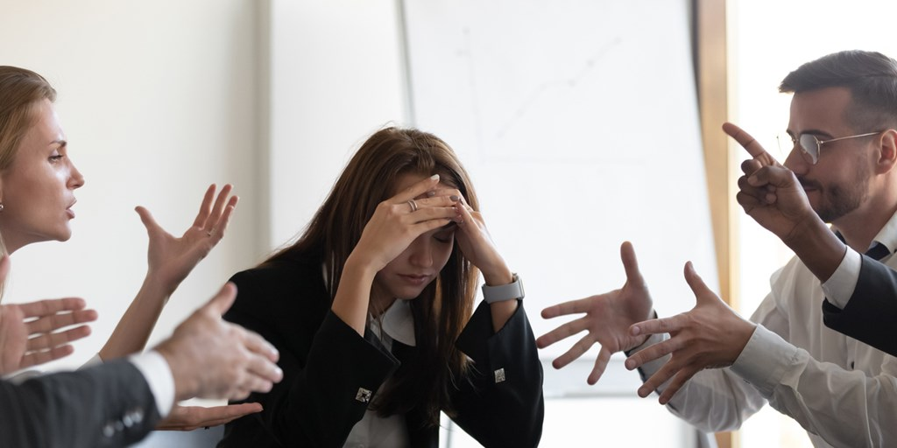
  The Soft Costs of Disrespect

Slide 14
  Work disruption and loss of productivity
  Reduced employee morale
  Loss of good employees who think that leaving is their only option
  Divisiveness amongst employees
  Public embarrassment and damaged reputation

Slide 15

Some Practical Steps to Remember to Display Respectful Leadership

Slide 16
Important
Respect Steps
Avoid even the “appearance of disrespect” by being a better communicator
Leaders must publicly demonstrate that disrespect will not be tolerated
Avoid “symbolic compliance” and lead by example
Promote training opportunities
Encourage “bystander intervention”

Slide 17
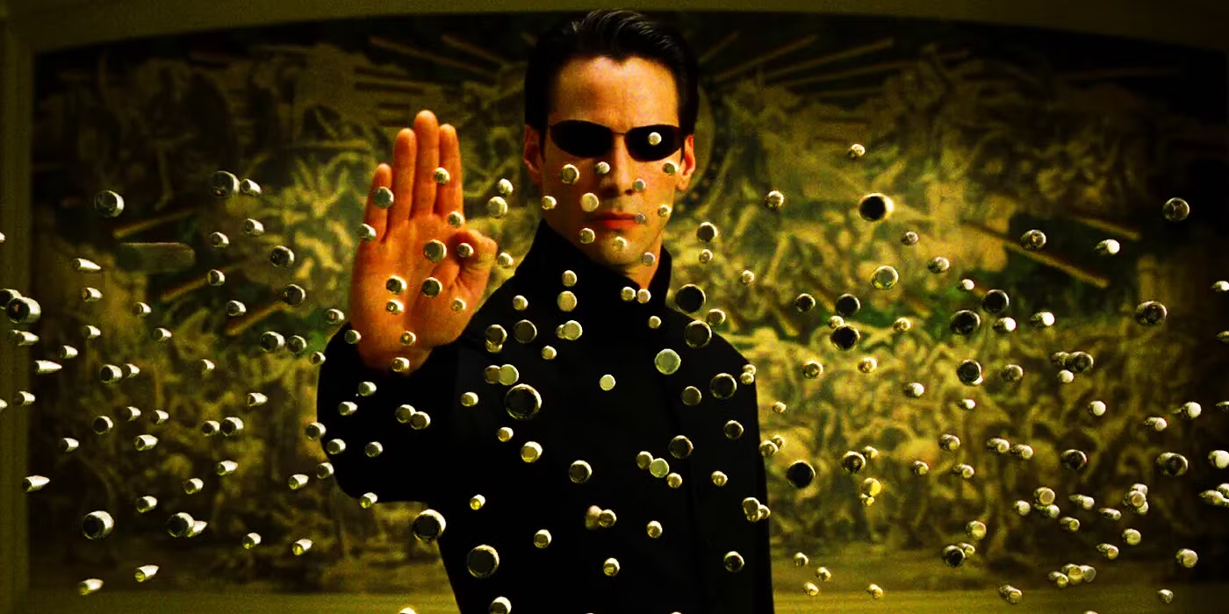
Stopping Verbal and Behavioral Bullets
An Active Bystander (sometimes referred to as an Upstander) is someone who witnesses or hears about a situation and takes action to keep a situation from escalating or to disrupt a problematic situation in the moment.

Slide 18
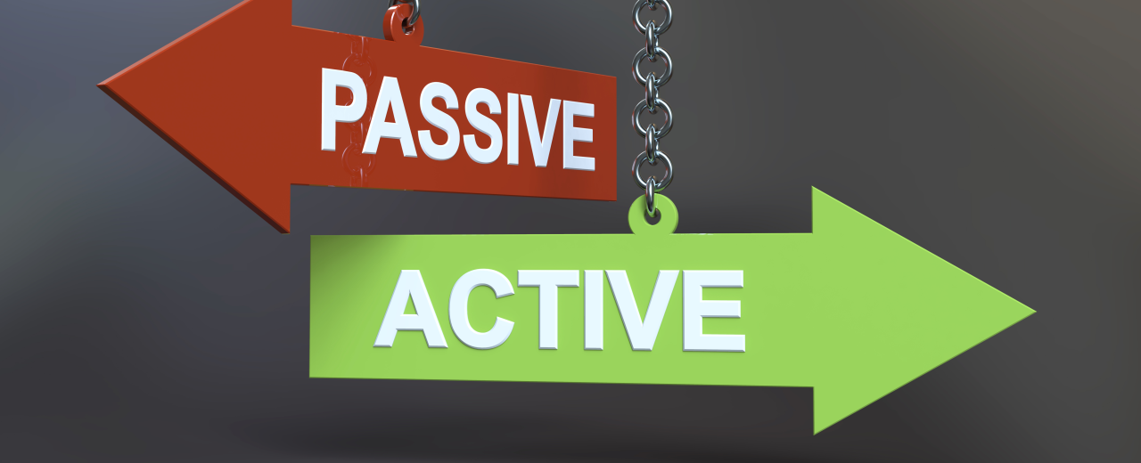
Five Keys to Disrupting Others
Notice the situation
Interpret the situation as a problem
Assume personal responsibility
Know how to help
Step Up/Speak Up!

Slide 19
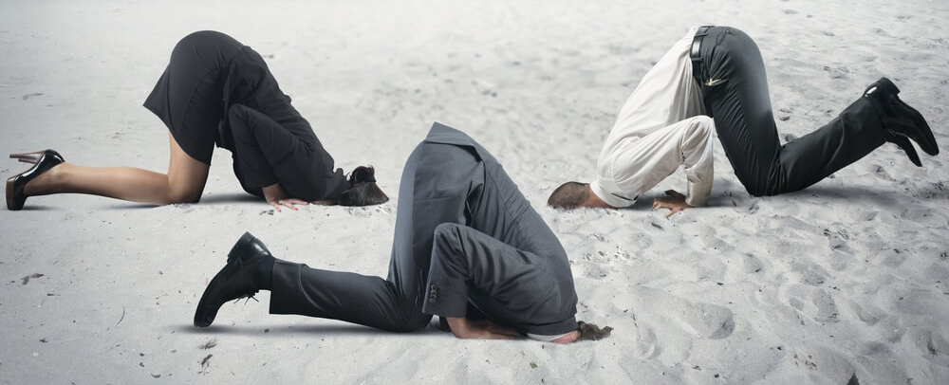
Notice the Situation
  Correctly read the room or event
    Be aware of your surroundings
    Notice if anyone appears uncomfortable
  Does not have to be something you specifically witness

Slide 20

Interpret the Situation as a Potential Issue
  Question any ambiguity
  Examine the situation more deeply even if others appear unconcerned
  Imagine how the recipient feels (this is where sympathy and empathy enter)
  Determine if the situation requires an immediate response and take action
Notes:
·

Slide 21
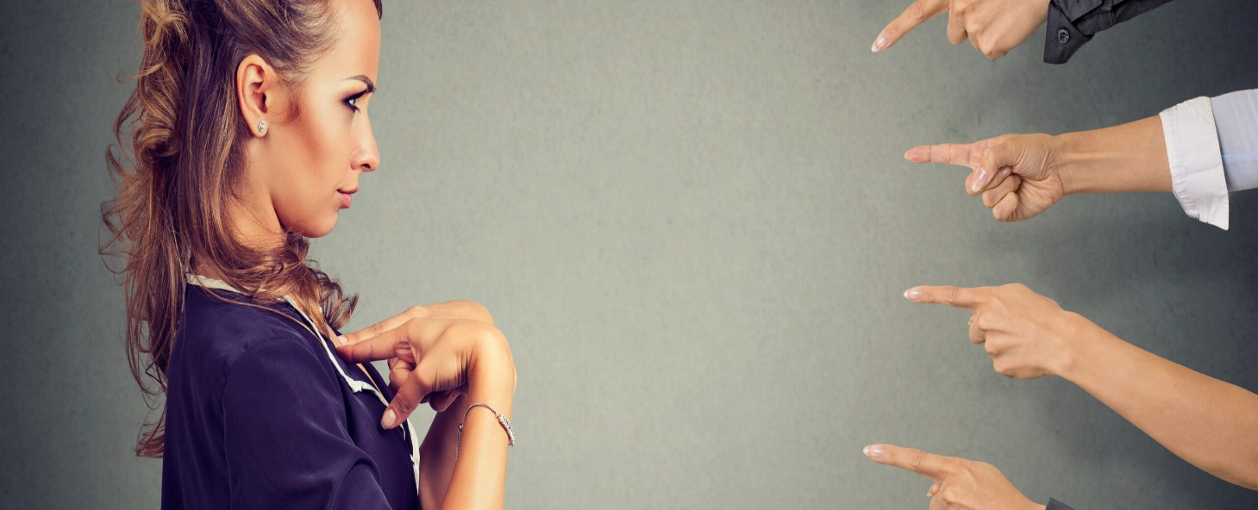
Assume Personal Responsibility
  Acknowledge that you may be the only person available to speak up/address
  Enlist others to intervene with you if necessary (in the moment) or after the fact
  Understand what your organizational policy and the law require from you to fully address the behavior

Slide 22
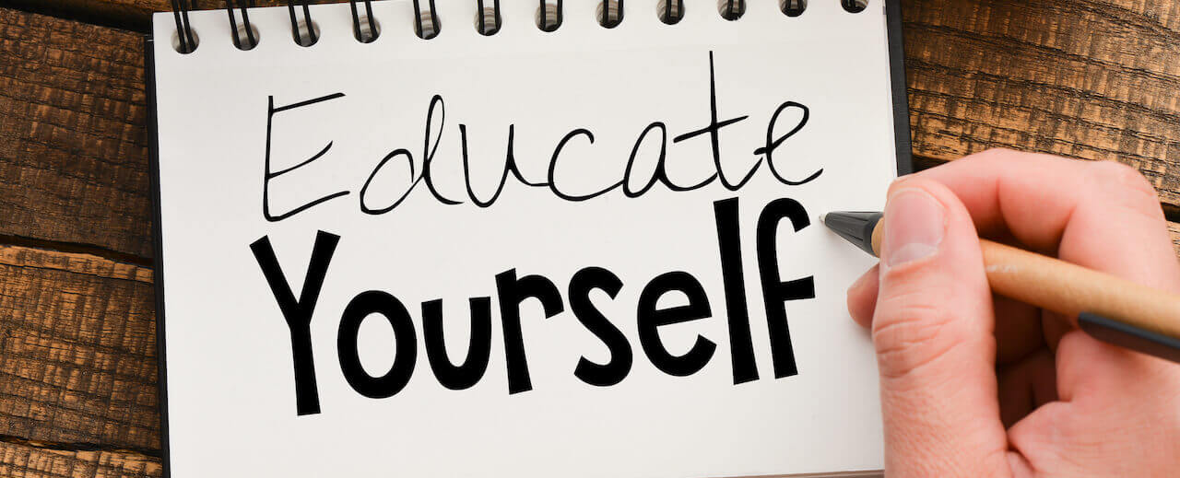
Know How to Help
  Increase your skills and knowledge about how to intervene and resolve issues
  Be fully aware of “Direct” and “Indirect” ways of intervening
  Make sure that your “disruption” does not make the situation worse

Slide 23
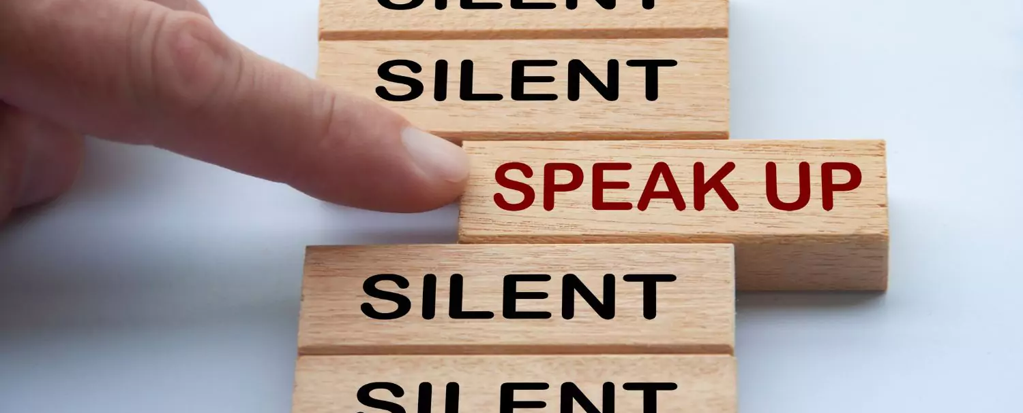
Step Up/ Speak Up!
Notice Power Dynamics
Constantly check/address your own biases
Know when to and how to properly handle the situation
Intervene directly when you can do so safely
Never make excuses for the offender
Never minimize or dramatize the situation

Slide 24
Manage Your Words and Behaviors
Notes:
About 90 percent of the harassment claims I see can be attributed to how we talk to others and failed attempts at humor. I believe that if we can mange these two issues we can make our workplaces more respectful, more productive and less likely to be the subject of a lawsuit.

Slide 25
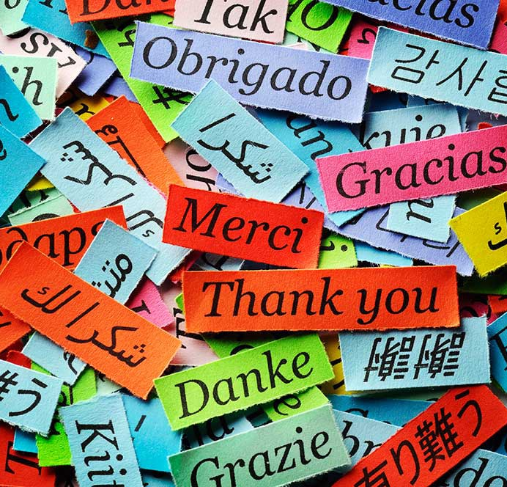
  Language
Respect individual styles
Use common language
Check for meaning
Don’t judge different speech negatively

Slide 26

What?—
A Love Story About Respect

Slide 27
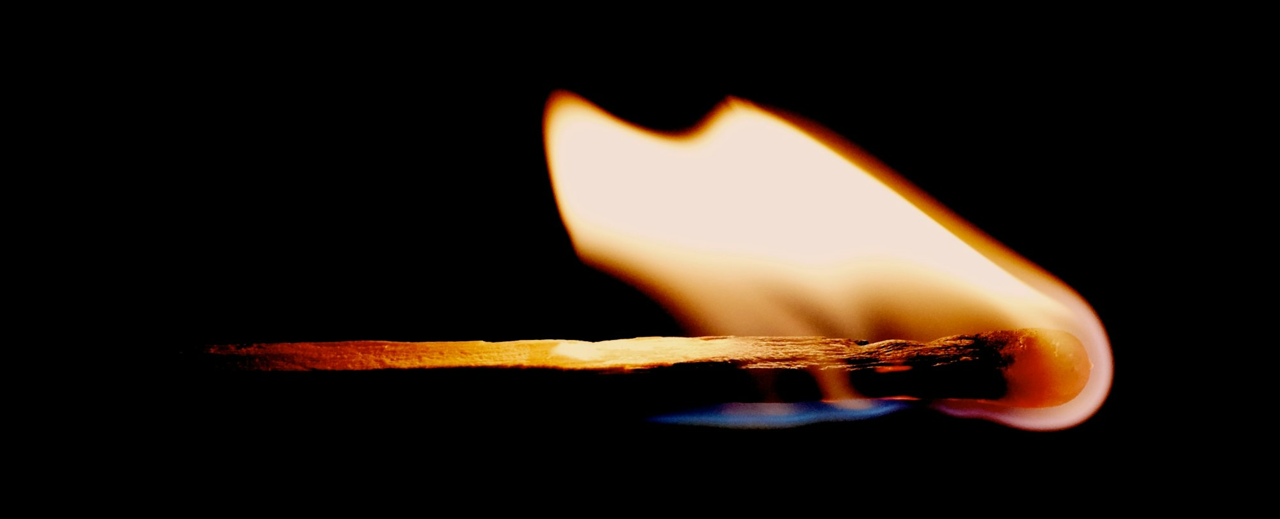
Remember this about intent
A fire does not care how it was started and does not burn differently if started unintentionally . . .

Slide 28
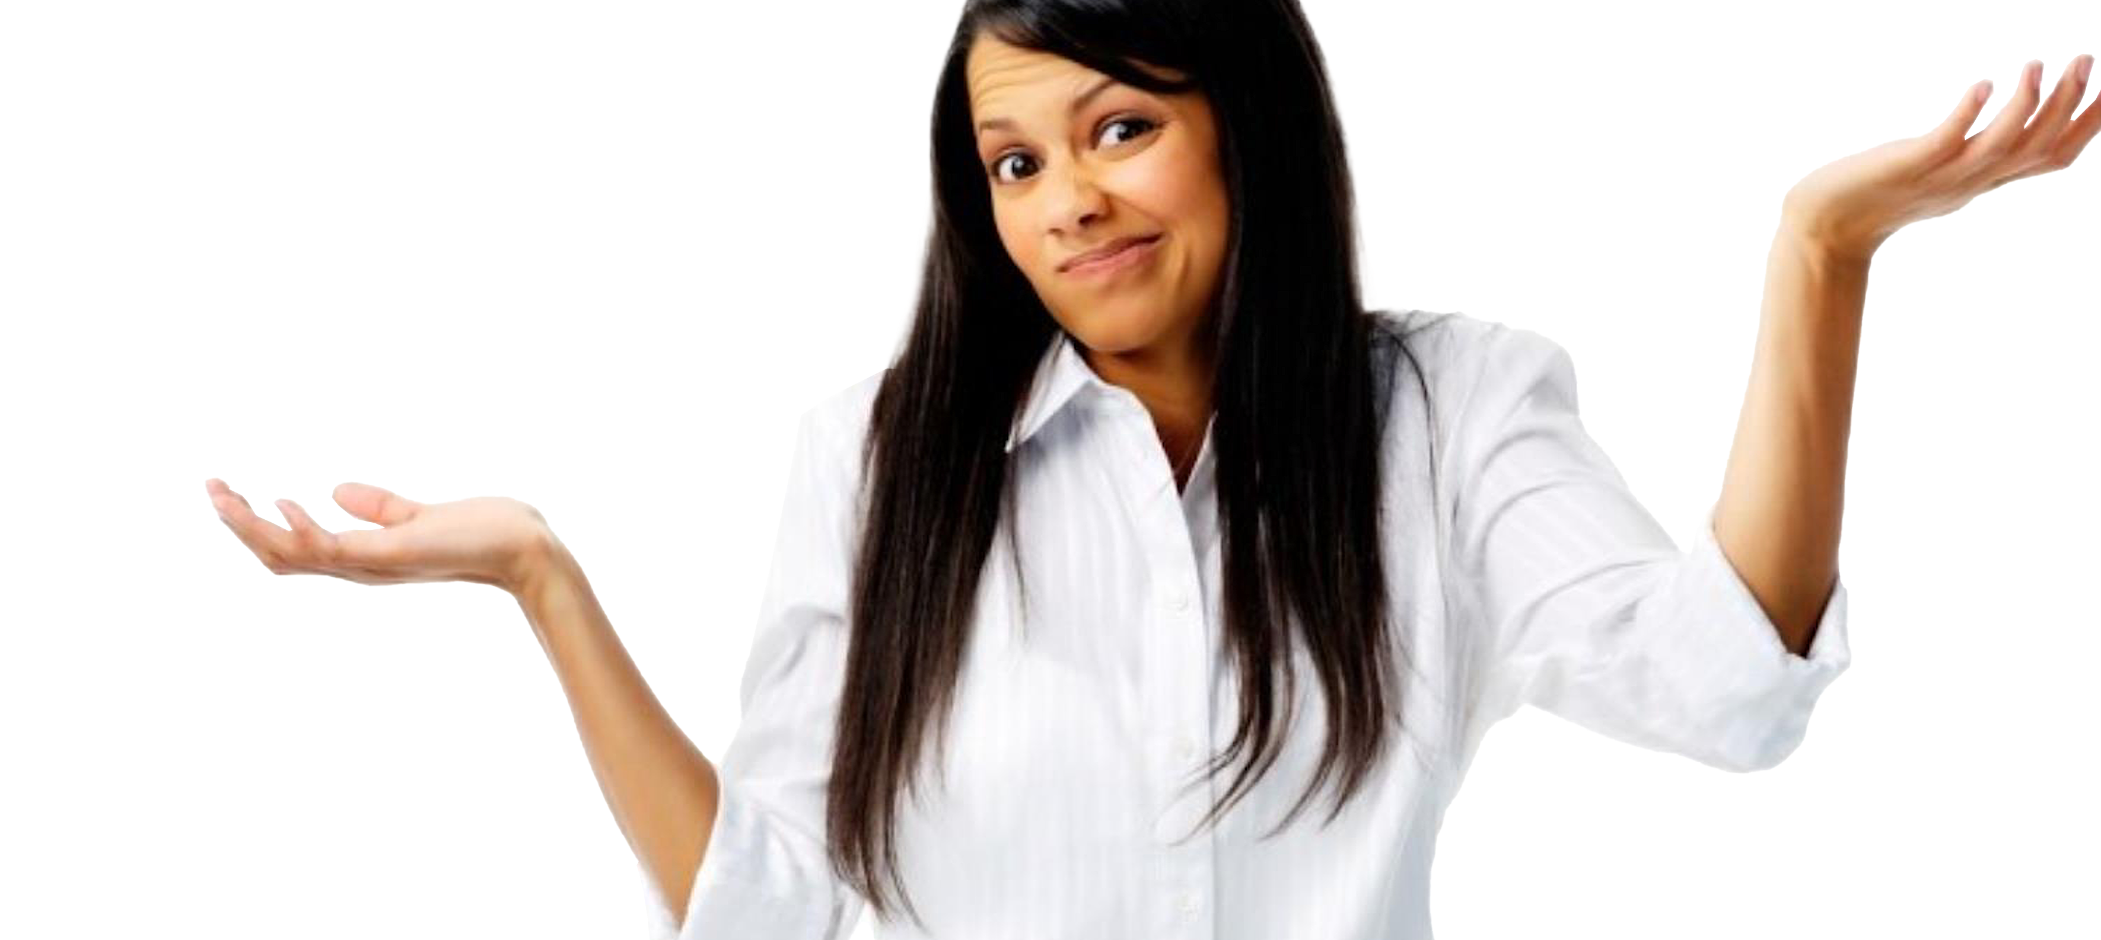
What’s the Big Deal with Disrespectful Words and Actions?
Can add stress to the lives of people, especially those already feeling marginalized
Fosters/ triggers depression and poor mental health
Impacts the emotional and physical well-being of recipients and those who witness
Impacts lives, careers and performance
Erodes organizational culture
Can lead to legal liability and reputational harm

Slide 29
Some Helpful Responses
Restate/Paraphrase/Clarify
Acknowledge the Feelings Behind the Statement/Action and then address the Impact
Challenge the issue and even share your journey (if applicable)
Appeal to the person’s values, sense of empathy and sense of pride
Get the person to explain the thought process
Point out commonalities and value of Respect

Slide 30

Question and Answer

Slide 31
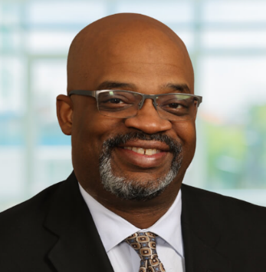
Thank you!
Luther Wright, Jr.
Ogletree, Deakins, Nash, Smoak & Stewart, P.C.
401 Commerce Street, Suite 1200
Nashville, TN 37219
luther.wright@ogletree.com
615-687-2213

