Slide 1
Protected Concerted Activity — Not Just a Labor Law Concern
UT-Battelle
August 2025
EVAN M. ROSEN, Esq.
Jackson Lewis P.C.
(404) 586-1837 • Evan.Rosen@jacksonlewis.com

Slide 2
About Jackson Lewis P.C.

Slide 3
Firm overview
Represents management exclusively in every aspect of workplace law
1,000+ attorneys in 61 locations nationwide.
Wrote the book on responding to Union Campaigns
8,500 labor matters in past 5 years
1,700+ labor negotiations
1,900+ ULP charges
2,900+ labor arbitrations

Slide 4
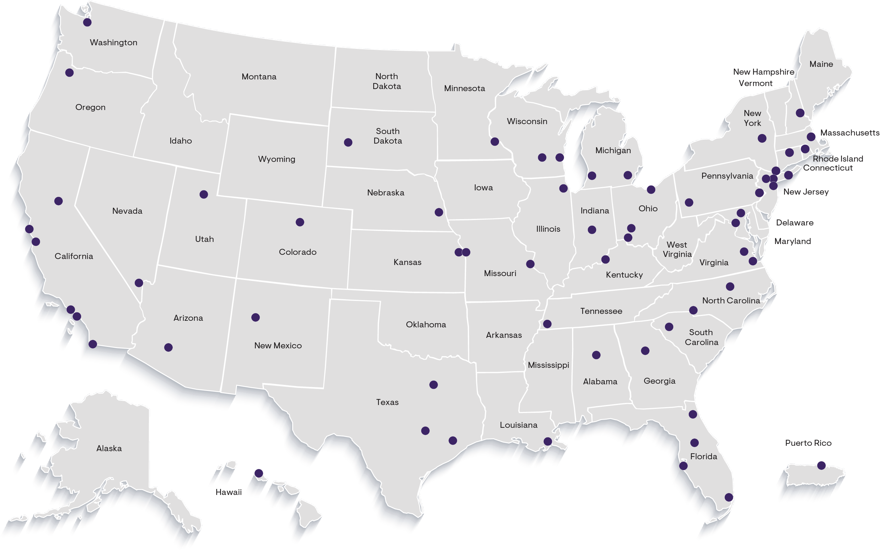
Strategically located to serve employers’ needs
61
Locations Nationwide
1,000+
+
Attorneys

Slide 5
Legal Disclaimer
This presentation has been prepared for informational purposes only. The material discussed during this presentation should not be construed as legal advice or a legal opinion on any specific facts or circumstances. The content is intended for general information purposes only, and you are urged to consult a lawyer concerning your own situation and any specific legal questions you might have.

Slide 6
National Labor Relations Board
Federal agency created by the National Labor Relations Act (NLRA)
Has exclusive jurisdiction over private sector labor relations
Processes election petitions and resolves unfair labor practice (ULP) charges
HQ in D.C. with 26 regional offices (and several sub-regional offices) across the country, each headed by a Regional Director
5 members (currently three vacancies); appointed by the President, with the advice and consent of the Senate, to 5-year terms
NLRB “prosecutor” is its General Counsel, appointed by the President, with the advice and consent of the Senate

Slide 7
Current Labor Board
Trump fired National Labor Relations Board General Counsel Jennifer Abruzzo – this was expected.
Trump also fired Board Member Gwynne Wilcox, which was unprecedented. Wilcox’s removal also leaves the Board without a quorum
Legal challenges are in process regarding Wilcox firing.
The Board now consists of two members: Democrat David Prouty and Republican Marvin Kaplan. Kaplan’s term expires August 27, 2025.
Trump nominated Scott Mayer (Counsel for Boeing) and James Murphy (NLRB attorney who has counseled Republican NLRB members)

Slide 8
Protected Concerted Activity

Slide 9
Let’s start with an example . . .
A group of five employees, led by Ted Trouble, stop working two hours before their shift ends. Instead, they march up to you and loudly complain about “unsafe work conditions” and demand your company take immediate action to address their concerns before they are willing to return to work. They claim the floor is slippery, the equipment is dangerous, and it gets overly hot in the summer months.
Later that evening, Ted Trouble posts the following tweet on X: “This morning me and ten other employees walked off the job due to unsafe working conditions. We have been pressured to work by ABC Corp despite understaffing and health concerns. We believe everyone deserves the right to feel safe at work. #safetyfirst #shameonABC,” Several other employees click the “like” button or comment in support of Ted.
Is this conduct protected?

Slide 10
Protected Concerted Activity
National Labor Relations Act
Section 7
“Employees shall have the right to self-organization, to form, join, or assist labor organizations, to bargain collectively through representatives of their own choosing, and to engage in other concerted activities for the purpose of collective bargaining or other mutual aid or protection”

Slide 11
What is Protected Concerted Activity?
Protected concerted activity: Typically, two or more employees acting together to attempt to improve their terms and conditions of employment (i.e., wages, hours, working conditions).
Employees are protected by the National Labor Relations Act (“NLRA”) against retaliation for concertedly discussing or complaining about terms and conditions of employment.
Section 7 of the NLRA covers protected concerted activity by employees only.
Applies equally to unionized and union-free workplaces.
Applies in the workplace and online.
Further, the Board takes the position that company rules that appear on their face, or that employees would reasonably construe to prohibit Section 7 activity, are unlawful.

Slide 12
How Do We Know Whether An Employee Has Engaged In PCA?
In determining whether employee activity is entitled to the protections of Section 7, the Board looks at the following:
Whether the activity is “concerted”;
Whether the activity is “for mutual aid or protection”;
Whether the activity is protected or has lost the protection of Section 7 by reasons of (1) its means or (2) its objectives.

Slide 13
Who are we talking about?
Who can engage in protected concerted activities “PCA”?
Supervisors, Managers and Executives?
No!
At least two or more employees.
One Single Employee?
Maybe? If acting on behalf of others
The Board has said that certain topics are inherently “concerted” even if only engaged in by one single employee.

Slide 14
Examples of PCA
Union Organizing
Strikes
Picketing and other group protests
Social Media Posts
Complaining about working conditions, wages, hours, benefits, etc.
“Day Without Immigrants”
Filing a lawsuit.
See Krin Transportation, 374 NLRB No. 4 (Dec 2024) – ULP for threatening, interrogating, and discharging employees for filing an FLSA lawsuit.
Cannot take adverse action against employee(s) for engaging in PCA and/or supporting a labor union

Slide 15
Can a lone employee engage in PCA?
Miller Plastic Products Inc. v. NLRB, 23-2689 (3d Circ. 2025)
On March 16, 2020, During a town hall-style meting, Miller Plastic Products announced they were staying open as an essential business
Several employees, including Ronald Vincer, questioned whether they truly were an essential business. Vincer stated that the company’s safety protocols were not sufficient and employees should not be working.
On March 23, Vincer questioned the COO about protocols for returning to work after a Covid-19 exposure, and whether the company should remain open.
March 24, Vincer was fired after Plant Manager saw him speaking on his cell phone on the plant floor. A “poor attitude” was one of the reasons given for termination.
Holding: substantial evidence that Vincer’s protected activity was a motivating factor in the termination. But remanded to NLRB to assess employer’s affirmative defense
PCA Lesson: individual concerns that affect all employees could be PCA, especially when other employees make similar complaints. “Totality of Evidence” test adopted by 3d Cir.

Slide 16
Changes from last year as result of the new Administration
GC Memo 25-5 rescinds dozens of prior Board memos/guidance:
Severance Agreements
“Stay or Pay” provisions
Non-Compete agreements.
Onerous remedies
Electronic Monitoring
Cemex
Private settlement agreements

Slide 17
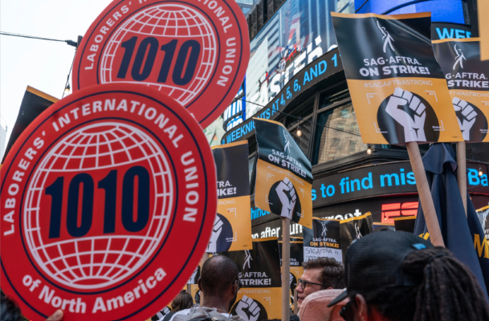
Protected Concerted Activity: Strikes
Labor unions in the US initiated more workplace strikes in 2023 than they have in any single year since 2002.
Over half a million workers were involved in those strikes—more than in the previous three years combined.
The labor-management landscape was dominated by strikes that were high-profile, high-volume, or both.
Strikes remained high in 2024 and into 205.
359 total work stoppages, 31 major work stoppages
271,500 workers involved

Slide 18
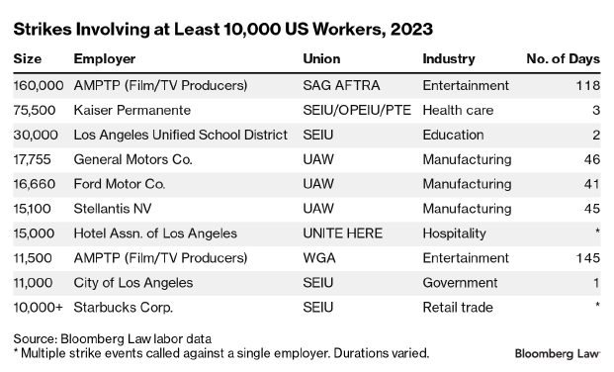
Largest Strikes in 2023

Slide 19
Examples of Strikes in 2024
AT&T (Aug. 2024) – 17,000 workers in AL, FL, GA, KY, LA, MS, NC, SC and TN for 30 days
Boeing (Sept. 2024) – 33,000 workers in WA, OR and CA for 36 days.
North Shore Teachers (Nov. 2024) – 2,000 public school teachers in MA for 15 days
Boston University Graduate Students (Mar. 2024) – 3,000 workers for seven months.
US Dockworkers (Oct. 2024) – 47,000 workers in 36 ports for two days.
Forbes Magazine Editors (Dec. 2024)

Slide 20
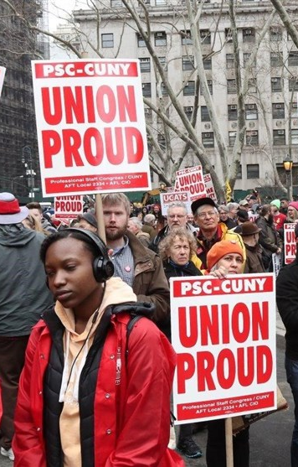
Union Organizing. What is a Labor Union?
A labor union is (typically) a for-profit organization that makes money by obtaining members who pay dues
Following a legal process, labor unions serve as the exclusive bargaining representative of employees with respect to wages, hours and working conditions.
If a Union gets in, the employer is required to negotiate a contract in good faith and cannot make “unilateral changes” to “mandatory subjects of bargaining.”
The process of how unions can organize employees is governed by the National Labor Relations Act and the five-member National Labor Relations Board.
This Photo by Unknown Author is licensed under CC BY

Slide 21

Protected Concerted Act: Organizing
Over 3,286 petitions filed during FY 2024
27% increase from FY 2023
Dramatic increase in Employer-filed “RM” petitions after being asked to voluntarily recognize a union
Stems from Cemex Board decision altering the framework for when employers must recognize a union without an election
Many historically non-union companies were the target, including Starbucks, Amazon, Trader Joe’s, Volkswagen, Delta, etc.
Notes:
During the first six months of Fiscal Year 2024 (October 1–March 31), union election petitions filed at NLRB field offices rose 35% over the same period in Fiscal Year 2023. Notably, this is driven by a spike in employer-filed RM-petitions, after the Board’s Cemex decision, accompanied by an uptick in employee-filed RC-petitions. In total, 1,618 petitions were filed during this time, compared with 1,199 in the first half of Fiscal Year 2023. Of the recent petitions, 1,137 were RC-petitions and 281 were RM-petitions.

Slide 22
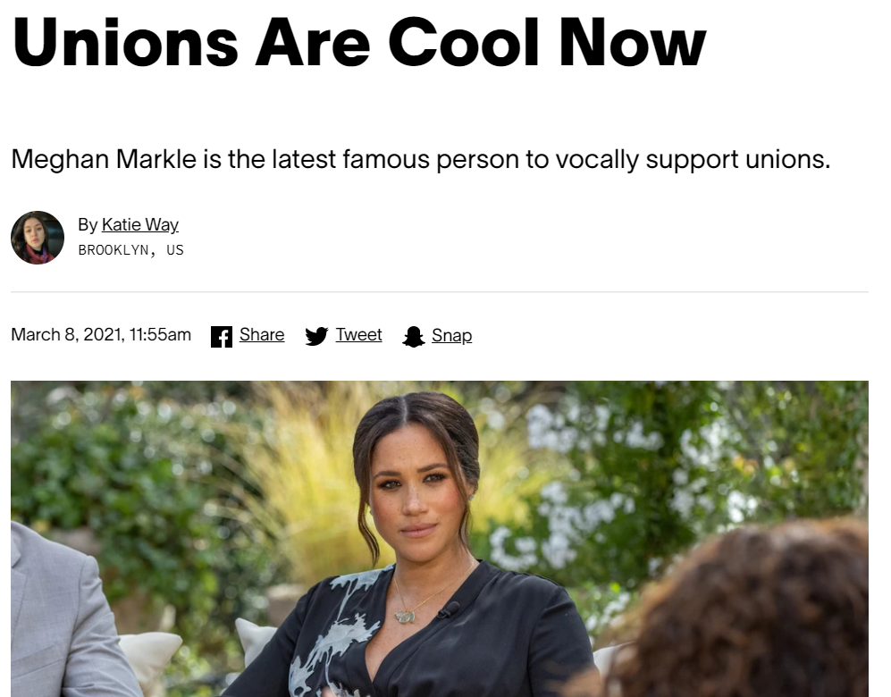
THE NEXT GENERATION OF UNION MEMBERS
Notes:
CHAD

Slide 23

Support for Unions Remains High
Survey: 67% of Americans approve of labor unions
Approval dipped 4% from last year, though it remains at a historically high level
Fifth straight year approval has exceeded long-term average of 62%
Survey: 77% believe unions mostly help rather than hurt union members and 61% say unions help rather than hurt the U.S. economy
But overall union membership dropped from 10% in 2023 to 9.9% in 2024.
Private sector membership dropped from 6% to 5.9%. Unions lost 184,000 members in the private sector.

Slide 24
Unions are Winning
Unions prevailed in 77% of elections in 2024.
Unions have won more than 70% of all elections in each of the past 3 years.
www.nlrb.gov

Slide 25

Caffeinated Organizing
New corporate campaign tactic
Small stores nationally with coordinated union organizing
Social justice and Pay Equity issues
Social media campaigns
Voice in the workplace
Sick leave and safety stemming from COVID
Remote work opportunity
Appeal to Generation Z and Millennials
Pay (inflation)
Health Insurance costs
Predictive Scheduling

Slide 26
A key cause of employee dissatisfaction
Employees expect to have a voice at work, but there is a gap between the amount of influence they expect and what they experience
“The workers we interviewed described a loss of control over their day-to-day work experience ... .”
“More than wage increases, they crave greater respect and a sense of being seen and heard by their increasingly distant employers.”
This is even more relevant after COVID, when many workers had to return to jobs where they had little or no control over their pay and working conditions
The pandemic was described by some as “a crisis of worker voice”
Study by Harvard Kennedy School of Government and MIT Sloan School of Management
Notes:
CHAD

Slide 27
Employee Handbooks & Work Rules
Stericycle - August 2, 2023 – reverts to Obama Board Standard
Rule is presumptively unlawful if it “could” be interpreted to limit employee rights, even if there are alternative interpretations that are consistent with employee rights.
The Board may invalidate the rule even if it was never interpreted or applied in an unlawful manner.
The Board views the rule from the perspective of someone “economically dependent” on the employer who considers engaging in activity protected by the Act, rather than a reasonable employee
Current status unclear in light of new administration and until a quorum exists.

Slide 28
Handbook Policies to Consider
At-will employment policies;
Access (Off-duty employees and third parties)
Confidentiality (wages, personnel info, etc.)
Communications
Corporate Code of Conduct (disparaging the company, boisterous conduct, disrespectful conduct, unprofessional behavior, etc.)
Dress Code (uniform, buttons, etc.)
Non-Harassment, Civility
Confidentiality of Investigations
Non-Disparagement & Gossip
E-Communications & Computers
No recordings
Social Media
Media Communications
Solicitation
Disclaimers – do they work? Unclear.

