Slide 1
Retaliation in the Workplace: What Constitutes Protected Activity and Navigating the Retaliation Trap
Timothy B. McConnell, Esq.
Maynard Nexsen
tmcconnell@maynardnexsen.com

Slide 2
Today’s Agenda
Understanding the Legal Framework of a Retaliation Claim
What is Protected Activity
What is a Retaliatory Action
Managing to Avoid the Retaliation Trap

Slide 3
But First…
Let’s Discuss the following

Slide 4
Discussion Time
You are Steve’s manager. Steve has been employed with the Lab for 9 years. Steve has historically used, at least some, FMLA leave on a yearly basis, and he consistently maxes out his paid time off, even to the point of needing and using time off beyond his allotted PTO time.
Over the past 2 years, Steve's absences have begun to put a significant strain on everyone else in your department, and his fellow team members have begun to express their displeasure with Steve's perceived lack of work ethic. You too have become very annoyed by Steve's inability to work on a regular basis. You have talked to Steve on several occasions about his attendance; however, no formal disciplinary action has been taken to address his absences.
On June 4, after a period of time in which Steve took a full week off for "personal reasons", you felt it was time to meet with him to discuss his attendance issues. During the meeting, you informed Steve that he needed to immediately improve his attendance and gave him a written warning related to his attendance issues and advised him that further attendance issues could result in the termination of his employment.

Slide 5
Discussion Time
Following that meeting, though, Steve does not come into work the next day.
Steve also does not come to work the second day after your meeting with him, but HR informs you that it received a request for FMLA leave from Steve for "depression, anxiety and stress" resulting from the demands of his job and his meeting with you. According to paperwork submitted by Steve, his physician has stated that Steve will need 12 weeks of FMLA leave to recover from his depression, anxiety and stress.
In addition, HR also informs you that Steve has filed a claim for workers' compensation benefits for severe emotional trauma caused by your meeting with him.
Steve’s absence from work will further increase the demands on your department and his co-workers.
Can you terminate Steve's employment?

Slide 6
Retaliation Claims are on the Rise!

Slide 7
Most Employment Statutes Prohibit Retaliation. . .
Title VII
ADAAA
ADEA
EPA
USERRA
FMLA
FLSA
OSHA
Workers’ compensation laws

Slide 8
“Whistleblower” Retaliation
Sarbanes-Oxley (“SOX”) & Dodd-Frank
False Claims Act
National Labor Relations Act
Tennessee Public Protection Act (TPPA)

Slide 9
Retaliation = Fastest Growing EEOC Complaint
Employers generally know how to identify and respond to overt retaliation, but are much less familiar with subtle forms of workplace retaliation or perceived retaliation.
Baseless claims of illegal, unsafe or unethical conduct can easily become successful claims of retaliation if organizations do not appropriately recognize, respond to and resolve retaliatory situations.
Failure to prevent retaliation may result in the loss of millions of dollars in fees and damage awards.

Slide 10
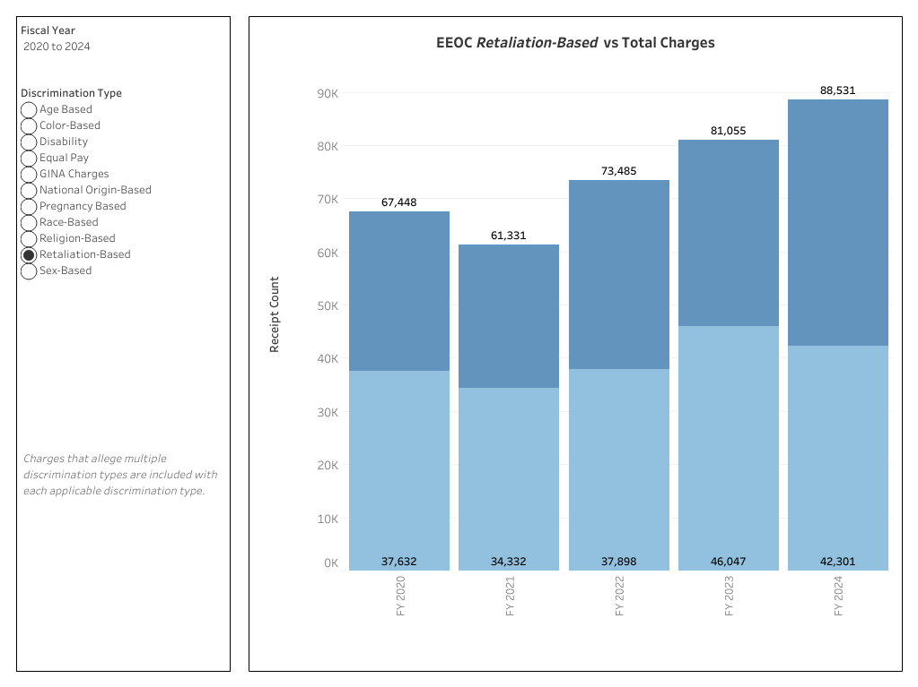

Slide 11
EEOC’s Retaliation Numbers
2023: Retaliation claims comprised 56.8% of the Charges filed under all of the statutes enforced by the EEOC
2024: Retaliation claims comprised 47.8% of the Charges filed under all of the statutes enforced by the EEOC
In 2023, the EEOC recovered $282.9 million for retaliation-based charge, and in 2024, the EEOC recovered $308 million for retaliation-based charges

Slide 12
Legal Framework for a Retaliation Claim
Plaintiff’s prima facie case:
(1) engaged in protected conduct;
(2) employer knew of the protected conduct;
(3) employee suffered an adverse action;
(4) there is a causal connection between the conduct and the action.
If the plaintiff establishes a prima facie case, the burden will shift to the employer to show that it had a legitimate, non-retaliatory reason for its actions
If it does, the plaintiff can then try to show that the reason is pretextual:
Direct evidence of retaliation
Evidence reason offered by employer isn’t true
Evidence others who committed same infraction but didn’t engage in protected activity didn’t suffer same adverse action
Evidence employer advanced inconsistent reasons to justify adverse action

Slide 13
WHAT IS PROTECTED CONDUCT/ACTIVITY?

Slide 14
Protected Activities
"Protected activities" generally involve the employee's exercise of some right under state or federal law.
Examples of such activity include:
Filing a Charge of Discrimination or opposing discrimination;
Complaining in good faith about perceived illegal harassment or discrimination, even if the complaint turns out to be mistaken;
Requesting or taking Family Medical Leave for a qualifying reason;
Filing a claim for workers' compensation benefits;
Requesting the reasonable accommodation of a disability or sincerely-held religious belief;
Whistleblowing/expressing concerns over, or otherwise bringing to light, potential illegalities;
Complaining about terms/conditions of work for more than one person;
Participating in or cooperating w/ investigation into workplace issues; and
Filing a formal claim or complaint related to the company (internally or externally).

Slide 15
What Constitutes Adverse Action?

Slide 16
Tangible Adverse Employment Actions
Discharge
Demotion
Reduced Compensation
Suspension
Denial of a promotion

Slide 17

New (Reduced) Standard (Title VII and applied to ADEA cases)
Burlington Northern & Santa Fe v. White Memphis Case
Supreme Court holds:
The adverse employment action requirement in the retaliation context is not limited to an employer's actions that solely affect the terms, conditions, or status of employment, or only those acts that occur at the workplace.
Must be sufficient to dissuade reasonable person in complainant’s situation from making or supporting a complaint.

Slide 18
Examples:
Transfer (even if no loss/ reduction in pay)
Secretary who complained boss was sexually harassing her moved to another, less prestigious position (not working for town’s highest executive) at same pay rate and benefits
Reassignment of important client account
Suspension (even if paid)
Placed on paid, administrative leave after taking FMLA leave
Change of job duties (even if within job description)
Temporary reassignment to project depriving supervisor of authority
Administrator’s loss of decision making discretionary authority

Slide 19
What is and is not protected?
Anti-retaliation statutes protect an individual from retaliation that produces an injury or a harm, not from all retaliation.
Minor acts of retaliation can amount to an adverse employment action when aggregated and viewed in context.
However, snubbing, petty slights, and minor annoyances do not create such deterrence.

Slide 20
Are write-ups and negative evaluations adverse actions?
A written counseling is not an adverse employment action if it does not have any long-term impact on the terms or conditions of employee’s employment.
In general, a negative performance evaluation does not constitute an adverse employment action unless the evaluation has an adverse impact on an employee's wages or salary.

Slide 21
Causation
Employer awareness of protected activity
“But for” protected activity, adverse action would not have occurred (EEO laws)
Protected activity was “contributing” or “motivating” factor in adverse action (most laws in OSHA’s Whistleblower Protection Program)
Factors:
Temporal proximity
Negative or hostile remarks
Employee treated differently than co-workers
Employer’s reasons for adverse action demonstrably false or shift over time

Slide 22
The Causal Connection – Temporal Proximity
Proximity in time between the protected act and the adverse action can be sufficient evidence to establish an inference of retaliation.
Where an adverse employment action occurs very close in time after an employer learns of a protected activity, such temporal proximity between the events is significant enough to constitute evidence of a causal connection for the purposes of satisfying a prima facie case of retaliation.” Mickey v. Zeidler Tool & Die Co., 516 F.3d 516, 525 (6th Cir. 2008)
How close in time must the two events be?
No bright line rule
If the adverse employment action is taken just days or weeks from when the employer learns of the employee's protected activity – sufficient to establish causation based on timing alone.
But even if enough time passes between the protected activity and the adverse action so as to preclude a finding of causation based on the close timing alone, an employee can still prevail if the employee “couple[s] temporal proximity with other evidence of retaliatory conduct to establish causality.”

Slide 23
Applying what we have learned
Employee alleges that several of his coworkers, and one supervisor, called him a "rat" after he filed a lawsuit against the company; other coworkers gave him "dirty looks" as well and "everybody stopped talking" to him after word about the lawsuit got out.
Does this type of conduct constitute an adverse employment action?
Court held: the scattered comments to which the employee was subjected are insufficient to sustain a retaliation claim. At worst, the employee was spoken to rudely by a supervisor and several coworkers. "As a matter of common sense, this sort of breakdown in personal relations is inevitable once a serious lawsuit has been commenced. The ‘workplace reality’ is that filing a lawsuit accusing a broad swathe of coworkers and supervisors of racism is necessarily going to alienate some of those people. An employer cannot be held liable for retaliation merely because anyone expresses their displeasure at the lawsuit.”
Bright v. Coca Cola Refreshments USA, Inc. (E.D.N.Y., 2014)

Slide 24
Applying what we have learned
Three months after filing a discrimination charge, the employee’s performance rating was lowered from "highly successful" to "successful." However, the employee had no reductions in pay, salary, benefits, or prestige as a result of the lower satisfactory evaluation
Also, after filing a lawsuit, newspaper clippings regarding the lawsuit were anonymously placed on a table in the workplace. Upon learning about the clippings, the employee’s supervisor ordered them removed.
Do these actions constitute retaliation?
Court said no: A lower satisfactory evaluation, by itself, does not provide a material alteration of employment and is not actionable. Petty slights and minor annoyances in the workplace, as well as personality conflicts and snubs by co-workers, are not actionable.
Sutherland v. Missouri Dept. of Corrections, 580 F.3d 748 (8th Cir., 2009)

Slide 25
But compare with…
Comments made by the Chief of Operations, a supervisor two levels above Plaintiff, who went out of his way to include highly detailed information about three infractions by Plaintiff in her evaluation, comments that Plaintiff's own supervisor refused to include in her evaluation.
Plaintiff's evaluations from previous years did not include such specific written feedback.
In light of such atypical scrutiny and written criticism in Plaintiff's evaluation, the court found that a reasonable employee would be dissuaded by such attention.
Bowen-Hooks v. City of N.Y. (E.D.N.Y., 2014)

Slide 26
What about the following…
An employee files an EEOC Charge alleging that she was denied a promotion by her supervisor because of her sex.
One week later, her supervisor invited a few other employees out to lunch. The employee believes that her supervisor excluded her from lunch because of her complaint.
Is this retaliation?
What if the supervisor invites all employees in the department to regular weekly lunches, but begins to not invite the complaining employee?

Slide 27
Final Test
In January of this year, Mary filed an EEOC Charge against her employer alleging that her supervisor was engaging in a hostile work environment based on her age.
The Company responded to the Charge, and Mary remained employed.
In March, Mary requested 12 weeks of FMLA leave due to severe depression and anxiety, and the leave was granted.
Mary’s FMLA leave expired at the end of May, and she was expected to return to work on June 1. However, she did not do so, and after following its ADA process, the Company granted Mary additional leave as a reasonable accommodation until July 1 based on that date being Mary’s anticipated return-to-work date as indicated by her healthcare provider.
Just prior to her anticipated return on July 1, Mary requested a second extension of leave to August 1, again based on her healthcare provider identifying that date as her expected return-to-work date. The Company granted that request.
Mary did not return to work on August 1 and has requested a third extension of leave to September 1.
Also, her EEOC Charge is still pending.
Can the Company terminate Mary’s employment?

Slide 28
10 Tips for Managing to Avoid the Retaliation Trap:
Proactively manage performance, behavior and attendance issues – DON’T WAIT TO BEGIN DOING SO UNTIL AFTER THE EMPLOYEE ENGAGES IN A PROTECTED ACT!!
Make sure you have a legitimate (and documented) reason for taking any adverse actions.
Be consistent!
Patience may be required – time and distance from the protected act.
Develop comprehensive anti-retaliation policies.
Educate and train managers and supervisors on retaliation.
It ain’t personal!

Slide 29
10 Tips for Avoiding the Retaliation Trap:
Take all complaints seriously.
Develop formal procedures to rapidly respond to complaints
Understand the human dynamic at work in these situations:
Defuse but Address: conduct prompt and thorough internal investigations – use this process to defuse the situation while simultaneously addressing it
Tighten the information flow upon formal inquiries

Slide 30

Questions and Comments

