Slide 1
Understanding Mass Arbitration, the Risks it Poses, and Strategies for Managing the Same
August 2025

Slide 2

Thomas Cullen Wallace

Slide 3
Presentation Relevant to Three Categories of Employers
Those who do not have an arbitration program but are considering implementing one
Those who have an existing arbitration program that may be considering modifications to it to account for developments in mass arbitration
Those who are involved in mass arbitration now and are considering strategies for defending against the same

Slide 4
Four Primary Topic Areas
1. What is mass arbitration and how did we get here
2. Considerations for implementing an arbitration program in general
3. Strategies for litigating mass arbitrations
4. Considerations for modifying existing arbitration programs to account for issues that may arise with mass arbitration

Slide 5
What is Mass Arbitration and How Did We Get Here?

Slide 6
What Is Mass Arbitration?
Plaintiffs bring individual arbitration demands—sometimes hundreds or thousands—against a company simultaneously
Mass arbitrations are on the rise
In November 2021, DoorDash announced that it reached individual settlements totaling $85 million to resolve misclassification claims brought by 35,000 DoorDash and Caviar drivers⁽¹⁾
One leading plaintiffs’ firm claims to have secured more than $375 million in settlements for more than 100,000 individual arbitration clients over two years⁽²⁾
Sara Randazzo, Amazon Faced 75,000 Arbitration Demands. Now It Says Fine: Sue Us, Wall St. J. (June 1, 2021).
Id.
\

Slide 7
Problems Presented by Mass Arbitration
Exorbitantly Expensive – under most arbitration plans the employer agrees to pay all arbitration costs, including arbitrator’s fees. So paying for the arbitrator and your outside counsel across hundreds or thousands of matters.
Extreme Strain on Company Resources – (1) company witnesses may have to be deposed and testify at hearings multiple times – this includes preparation sessions and all adds up to time away from work. (2) often required to engage in extensive written and electronic discovery
Extortion – claimants’ lawyers will tell you that it will cost you more in arbitration and attorneys’ fees than it would to merely settle with the claimants

Slide 8
How Did We Get Here
Non-Legal Answer –
Employers fought hard to ensure enforceability of arbitration agreements with class and collective action waivers
But while that fight was going on, social media was on the rise
With the prevalence of social media – plaintiff lawyers no longer need to use the class or collective mechanism to identify and contact potential claints – just send targeted adds or communications via LinkedIn, Facebook, etc.
Legal Answer – in a moment

Slide 9
How Does it Manifest
Generally Speaking -- Common legal theories:
wage and hour claims such as misclassification or off-the-clock allegations
Mass layoffs that give rise to WARN Notice obligations
Systemic discrimination
Typically brought about by:
Plaintiff’s firm advertising or soliciting plaintiffs online, including social media
Court enforcing a class action waiver in an arbitration agreement and plaintiff’s firm tries to replicate failed class action
Demand letter/arbitration filing

Slide 10
Legal Origins of Mass Arbitration
Federal Arbitration Act (FAA)
Passed in 1925 to counteract judicial hostility toward arbitration agreements
Written arbitration agreements “shall be valid, irrevocable, and enforceable, save upon such grounds as exist at law or in equity for the revocation of any contract”
Preempts state laws that contravene its mandate to enforce arbitration agreements, except in limited circumstances
Series of Supreme Court decisions enforcing arbitration agreements
Trend toward expanding arbitration in employment and consumer contexts
Plaintiffs’ bar’s strategic response: filing hundreds or even thousands of individual arbitration claims

Slide 11
Rise of Mass Arbitration: Supreme Court Cases
AT&T Mobility LLC v. Concepcion, 563 U.S. 333 (2011)
Facts:
Consumer plaintiffs brought class action suit against AT&T, alleging that the company had engaged in deceptive advertising and fraud by charging tax on cell phones it advertised as free
Procedural Background:
AT&T moved to compel arbitration under the terms of arbitration agreement; plaintiffs contended that the arbitration agreement violated California law because it disallowed classwide proceedings
Southern District of California denied AT&T’s motion, and the Ninth Circuit affirmed
Holding:
The FAA preempts state laws that prohibit contracts from disallowing classwide arbitration
The California law at issue was incompatible with the FAA because it allowed a party to override an agreement prohibiting class arbitration
The possibility that consumers might not bring individual minor claims does not justify a result that conflicts with the FAA

Slide 12
Rise of Mass Arbitration: Supreme Court Cases
Am. Express Co. v. Italian Colors Rest., 570 U.S. 228 (2013)
Facts:
Class of merchants filed action against American Express, alleging that it violated federal antitrust laws
Procedural Background:
American Express moved to compel arbitration under the FAA, as merchants were subject to an arbitration agreement with a class action waiver
Southern District of New York granted motion to compel arbitration
Second Circuit reversed and remanded, finding that the class action waiver was unenforceable because the plaintiffs had established that “they would incur prohibitive costs if compelled to arbitrate under the class action waiver”
Holding:
FAA does not permit courts to invalidate class action waiver on the ground that the cost of individually arbitrating a federal statutory claim could exceed the potential recovery
Federal antitrust laws “do not guarantee an affordable procedural path to the vindication of every claim,” and do not evince any intention to preclude class action waiver
Requiring a court to determine whether the cost of individual arbitration would be prohibitive, and would “destroy the prospect of speedy resolution that arbitration in general and bilateral arbitration in particular was meant to secure”

Slide 13
Rise of Mass Arbitration: Supreme Court Cases
Epic Sys. Corp. v. Lewis, 138 S. Ct. 1612 (2018)
Facts:
Employees’ contracts with employers required individual arbitration to resolve employment disputes, but they nonetheless sought to litigate Fair Labor Standards Act claims through class or collective actions in federal court
Employees argued that the agreements violated the National Labor Relations Act (NLRA)
Procedural Background:
Western District of Wisconsin denied Epic’s motion to compel arbitration, and the Seventh Circuit affirmed
Holding:
Congress has instructed in the FAA that arbitration agreements providing for individualized proceedings must be enforced
The FAA’s “savings clause” does not suggest otherwise
Nor does the NLRA prohibit enforcement of individual arbitration agreements (including those with class waivers) between employers and employees

Slide 14
Rise of Mass Arbitration: Supreme Court Cases
Henry Schein, Inc. v. Archer & White Sales, Inc., 139 S. Ct. 524 (2019)
Facts:
Archer & White sued Henry Schein, alleging violations of federal and state antitrust laws. Arbitration agreement between the parties expressly incorporated AAA rules, which state that an arbitrator (not a court) decides the question of whether the arbitration agreement applies to a particular dispute
Procedural Background:
Eastern District of Texas denied Henry Schein’s motion to compel arbitration, accepting Archer & White’s argument that in cases where a party’s argument for arbitration is “wholly groundless,” the district court may resolve the threshold question of arbitrability
Fifth Circuit affirmed
Holding:
Arbitration is a matter of contract, and courts must enforce arbitration contracts according to their terms
When the parties’ arbitration agreement delegates arbitrability questions to an arbitrator, “a court possesses no power to decide the arbitrability issue”
The “wholly groundless” exception is inconsistent with the FAA and Supreme Court precedent

Slide 15
Rise of Mass Arbitration: Supreme Court Cases
Lamps Plus, Inc. v. Varela, 139 S. Ct. 1407 (2019)
Facts:
Employee filed class action against employer following data leak. Employment contracts included arbitration agreements
Procedural Background:
District court denied Lamps Plus’s motion to compel arbitrations on an individual basis but compelled arbitration on a classwide basis
Ninth Circuit affirmed
Holding:
The lower courts’ decisions contravened existing Supreme Court precedent, which prohibited forcing a party to submit to class arbitration unless there is a contractual basis for concluding that the party agreed to do so
An agreement that is ambiguous as to class arbitration cannot provide the necessary “contractual basis” for compelling class arbitration
Class arbitration is markedly different from the traditional individualized arbitration contemplated by the FAA, and it undermines the “most important benefits of that familiar form of arbitration.” The FAA therefore requires more than ambiguity to ensure that the parties actually agreed to arbitration on a classwide basis

Slide 16
Rise of Mass Arbitration: Supreme Court Cases
Viking River Cruises, 143 S. Ct. 60 (2022)
Facts:
Plaintiff filed an action against her former employer under PAGA, alleging labor code violations. She sought to bring both individual claims (predicated on code violations she sustained), as well as representative claims (predicated on code violations sustained by other employees)
Her employment contract contained a mandatory arbitration agreement with a class action waiver
Procedural Background:
Viking moved to compel arbitration of Plaintiff’s individual claim and to dismiss her putative classwide claims
Applying the rule set forth by the California Supreme Court in Iskanian v. CLS Transportation Los Angeles, LLC, the California courts denied the motion, holding that categorical waivers of PAGA standing are contrary to California policy, and that PAGA claims cannot be split into arbitrable individual claims and nonarbitrable representative claims
Holding:
The FAA preempts the rule of Iskanian insofar as it precludes division of PAGA actions into individual and nonindividual claims through an agreement to arbitrate
State law cannot condition the enforceability of an arbitration agreement on the availability of a procedural mechanism that would permit a party to expand the scope of the arbitration by introducing claims that the parties did not jointly agree to arbitrate

Slide 17
Should We Have an Arbitration Program?

Slide 18
Class & Collective Action Waivers
Viewed as a real benefit by some employers BUT if a case is susceptible to class or collective treatment:
-- It will likely also be a candidate for a mass arbitratrion
-- It is possible to defeat class or collective action certification, and if do, the matter generally goes away – you lose this possibility in mass arbitration
-- It is possible to defeat or narrow the named-plaintiffs’ claims through a dispositive motion– but (a) arbitrators are notoriously unwilling to grant or even allow motions for summary disposition (b) even a grant of summary judgment from one arbitrator will not have preclusive effect on subsequent arbitrators – the decision should also be confidential and not subject to use in a companion case
-- Global resolution difficult to achieve in mass arbitration context as:
(a) often need each individual claimant to sign a settlement agreement
(b) there is no way to eliminate claims of absent employees who have not yet initiated arbitration—unlike with class action procedures.
Note: can you address class/collective concerns with a stand-alone waiver not tied to arbitration?

Slide 19
Juries
Some employers view arbitration as preferrable because it avoids the risk of large jury verdicts BUT
Arbitrators are not immune to issuing large awards
Unlike with a jury verdict, there is no meaningful way to appeal an arbitrator’s award
Note: can you address jury concerns through a standalone conspicuous jury waiver?

Slide 20
Confidentiality
Employers view confidentiality of arbitration as a benefit because, among other things, it avoids negative publicity BUT
In mass arbitration, claimants’ counsel are going to argue that they are ethically required to share information concerning the arbitration proceedings with their clients and there is no meaningful way to muzzle hundreds or thousands of employees – so there will be leaks, especially if the arbitrations involve a matter of public interest
Arbitration rules may not actually provide with confidentiality protection you expect – See JAMS and AAA Rules for example:
JAMS Rule 26(a) “JAMS and the Arbitrator shall maintain the confidential nature of the Arbitration proceeding and the Award, including the Hearing, except as necessary in connection with a judicial challenge to or enforcement of an Award, or unless otherwise required by law or judicial decision.”
Unless otherwise required by applicable law, court order, or the parties’ agreement, the AAA and the arbitrator shall keep confidential all matters relating to the arbitration or the award.
Note: Do not forget about The Ending Forced Arbitration of Sexual Assault and Sexual Harassment Act

Slide 21
Costs
As addressed above, mass arbitration costs can be exorbitant and the strain on resources can be overwhelming.
Just one final note on this: if you have an arbitration agreement that provides for the splitting of arbitration costs, ensure this is permissible under applicable state law and precedent AND that the arbitration provider you have chosen allows it: JAMS Minimum Standards for Employment Cases
Standard No. 6: Costs and Location Must Not Preclude Access to Arbitration
An employee's access to arbitration must not be precluded by the employee's inability to pay any costs or by the location of the arbitration. The only fee that an employee may be required to pay is JAMS' initial Case Management Fee. All other costs must be borne by the company, including any additional JAMS Case Management Fee and all professional fees for the arbitrator’s services. In California, the arbitration provision may not require an employee who does not prevail to pay the fees and costs incurred by the opposing party.

Slide 22
Responding to Mass Arbitration Threats

Slide 23
Court Challenges to Mass Arbitration Filings: Mass Arbitrations Are “De Facto Class Actions”
In some cases, rejected as a question for arbitrators:
E.g., Adams v. Postmates, 414 F. Supp. 3d 1246 (N.D. Cal. 2019) (“Adams I”), aff’d Adams v. Postmates, 823 F. App’x 535 (9th Cir. 2020) (agreement delegated gateway questions of arbitrability to the arbitrator, including argument that mass arbitration claims “improperly constitute an attempt to arbitrate on a classwide basis” and did not comply with requirement for individual demands)
On the merits:
Adams v. Postmates, Inc., 2020 WL 1066980 (N.D. Cal. Mar. 5, 2020) (“Adams II”) (“The mere fact that Petitioners filed over 5,000 demands within a short span of time does not transform those individual demands into a de facto class arbitration, as Postmates posits.”)
Postmates Inc. v. 10,356 Individuals, 2020 WL 1908302 (C.D. Cal. Apr. 15, 2020) (“While Plaintiff likens the efforts by Defendants’ counsel to class arbitration by emphasizing that Defendants are represented by the same counsel and filed many demands at the same time with similar allegations, here, Defendants have filed individual demands in their own names, and are thus not ‘rais[ing] serious due process concerns by adjudicating the rights of absent class members of the plaintiff class.’”)

Slide 24
Court Challenges to Mass Arbitration Filings: Challenging Arbitration Fees as Excessive/Improper
Uber Techs., Inc. v. Am. Arb. Ass’n, Inc., 204 A.D.3d 506 (1st Dep’t 2022)
Uber: “AAA is, “manipulating the arbitral process to prop up baseless claims of ‘reverse discrimination,’ and thus the court should grant relief from AAA’s demand that Uber pay $100 million in fees ($10 million due in weeks).”
Court: “While Uber is trying to avoid paying the arbitration fees associated with 31,000 nearly identical cases, it made the business decision to preclude class, collective, or representative claims in its arbitration agreement with its consumers, and AAA’s fees are directly attributable to that decision.”
Adams II, 2020 WL 1066980
Court: “Postmates’ obligation to tender $10 million in filing fees as a result of those arbitration demands is a direct result of the Fleet Agreement—which Postmates drafted and which Postmates required each courier to sign as a condition of working for Postmates. It strains credulity for Postmates to argue that the amount of filing fees due constitute irreparable harm when that ‘harm’ is entirely of its own making.”

Slide 25
Court Challenges to Mass Arbitration Filings: Attempts to Delay/Foreclose Mass Arbitrations Through Class Settlements
Abernathy v. DoorDash, Inc., 438 F. Supp. 3d 1062 (N.D. Cal 2020) (in denying motion to stay arbitration claims pending approval of class action settlement, stating:
“The irony, in this case, is that the workers wish to enforce the very provisions forced on them by seeking, even if by the thousands, individual arbitrations, the remnant of procedural rights left to them. The employer here, DoorDash, faced with having to actually honor its side of the bargain, now blanches at the cost of the filing fees it agreed to pay in the arbitration clause. No doubt, DoorDash never expected that so many would actually seek arbitration. Instead, in irony upon irony, DoorDash now wishes to resort to a class-wide lawsuit, the very device it denied to the workers, to avoid its duty to arbitrate. This hypocrisy will not be blessed, at least by this order.”)
Arena v. Intuit Inc., No. 3:19-cv-02546-CRB (N.D. Cal. Mar. 5, 2020) (refusing to approve proposed class settlement that purported to settle all claims against Intuit, including those in arbitration; Intuit’s arbitration agreement was “the petard” and Intuit was being “hoisted by [its] own petard.”)

Slide 26
Court Challenges to Mass Arbitration Filings: Attempts to Send Mass Arbitration Demands to Small Claims Court
Intuit Inc. v. 9,933 Individuals, 2021 WL 3204816 (Cal. Ct. App. July 29, 2021) (finding that arbitration provision’s “plain” text only gave consumers—and not Intuit—“the right to take a case to small claims court”)
This issue can be remedied (more on this later ...)

Slide 27
Arbitrate
Defending mass arbitrations presents logistical challenges:
Coordinating strategy across all individual arbitrations
Inconsistent decisions from individual arbitrators
Tracking and adhering to individual deadlines
Tracking and ensuring compliance with individual arbitrators’ procedures and preferences
Consistency across discovery responses, document review and production, witness identification, and depositions
Hearing locations

Slide 28
Arbitrate: Potential Strategies to Promote Efficiency
Strategic staffing: e.g., “core” team to decide strategy across arbitrations, smaller “case” teams to run individual arbitrations
Template documents (e.g., template case management orders to be used across all arbitrations)
Global discovery agreements
Use of documents or depositions across cases
Use of arbitrators’ opinions across cases
Streamlined motion practice:
Prohibit dispositive motions?
Page limits?
Require reasoned opinions?

Slide 29
Mitigating Risk of Mass Arbitration

Slide 30
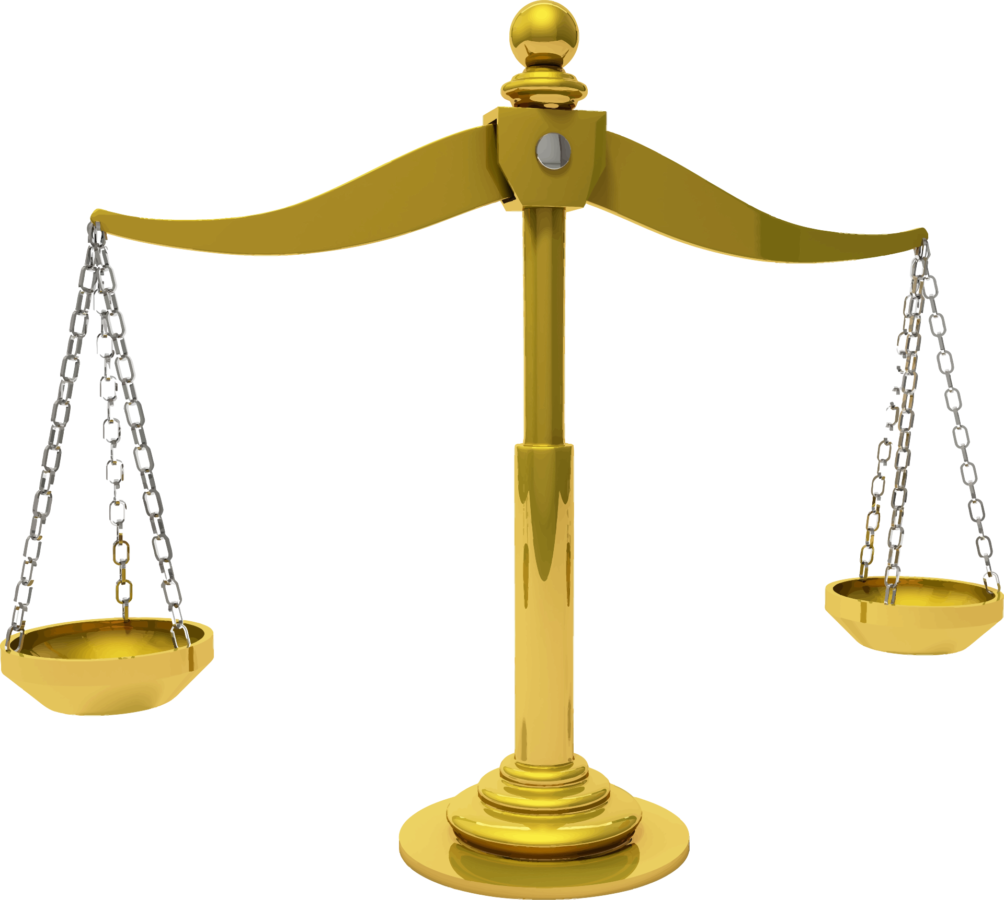
Mitigating Risk with Agreement Revisions
Revisions should balance goals of:
providing utmost protection against mass arbitration, and
avoiding conscionability challenges (procedural and substantive)

Slide 31
Revisions to Consider
Require exhaustion of pre-arbitration dispute resolution
Require individualized verified claims
Shift payment of certain fees to claimants
Enhance fee-shifting features (mutual) addressing, e.g., frivolous claims, offers of judgment
Preserve small claims court as a venue—in either party’s sole discretion
Permit claim batching, nonbinding “bellwethers,” coordinated proceedings, etc.
But see MacClelland v. Cellco P’ship d/b/a Verizon Wireless, No. 22-16020 (9th Cir.)
Designate a suitable arbitration provider

Slide 32
Designating an Arbitration Provider
AAA (Supplementary Rules for Multiple Case Filings; Multiple Case Filings Fee Schedule)
ADR Services (Mass Employment/Consumer Arbitration Fee Schedule)
CPR (Employment-Related Mass Claims Protocol)
Fed Arb (Framework for Mass Arbitration Proceedings ADR-MDL)
New Era (Expedited/Mass Arbitrations Protocol)
Challenges to mass arbitration protocols, e.g.:
McGrath v. DoorDash, Inc., 2020 WL 6526129 (N.D. Cal. Nov. 5, 2020)
Pandolfi v. Avia Games, Inc., 2024 WL 3558853, at *9 (N.D. Cal. July 26, 2024)
Heckman v. Live Nation Entertainment, Inc., 2024 WL 4586971 (9th Cir. Oct. 28, 2024)

Slide 33
Biography
Cullen represents employers across industries in complex employment-related litigation, including wage and hour class and collective actions; expedited proceedings concerning enforceability of restrictive covenants; mass arbitrations; and discrimination, retaliation, and harassment matters initiated under various state and federal laws. Cullen also frequently defends employers across jurisdictions in high-stakes cases involving novel issues related to the enforceability of arbitration agreements in the context of class action and injunction proceedings.
Thomas Cullen Wallace
Houston / Dallas
+1.713.890.5722
+1.214.466.4000
cullen.wallace@morganlewis.com

