Slide 1

Comparing Public & Private Sector Employer Requirements Under the 1st Amendment & the NLRA
Chris W. McCarty
Lewis Thomason, P.C.
Knoxville, TN

Slide 2
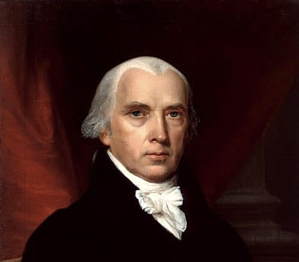
“The people shall not be deprived or abridged of their right to speak, to write, or to publish their sentiments; and the freedom of the press, as one of the great bulwarks of liberty, shall be inviolable.”
~ James Madison

Slide 3
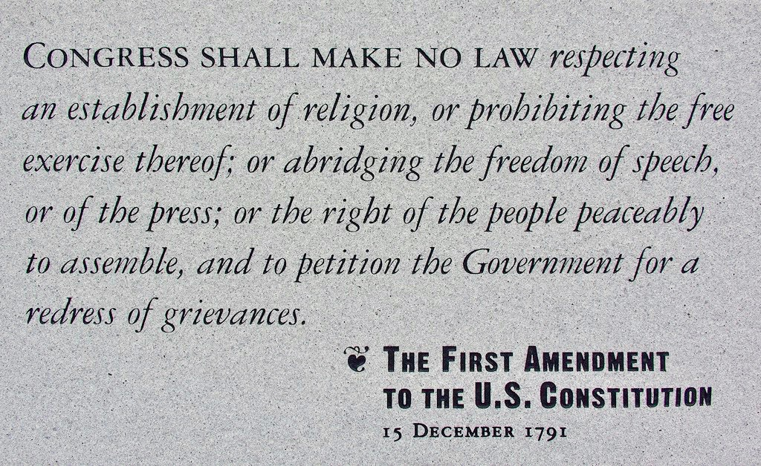

Slide 4
Who can be sued under 1st?
Public
Entities
Who can’t be sued under 1st?
Private
Entities

Slide 5
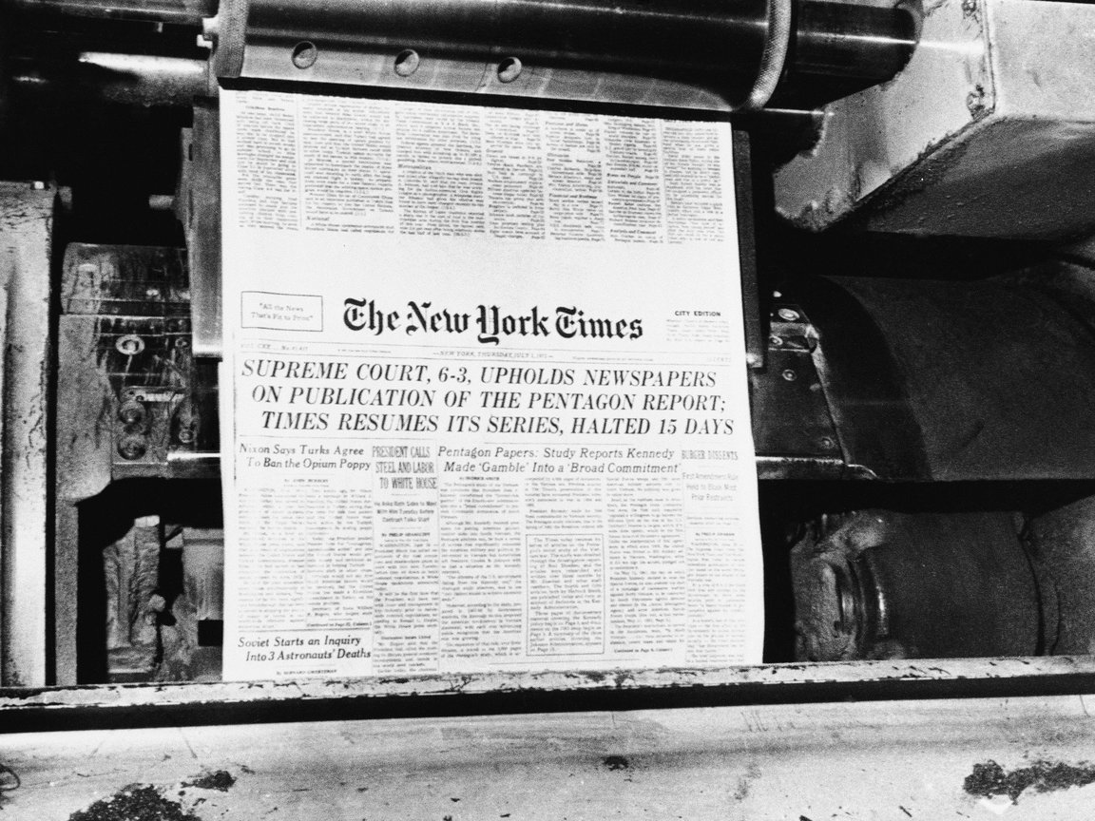
1st Amendment: Prior Restraint
Prior restraint occurs when a governmental agency somehow prohibits speech or other expression before the speech happens.

Slide 6
New York Times Co. v. United States 1971
In 1967, Secretary of Defense Robert McNamara commissioned a secret government study on American involvement in Vietnam. The project comprised 47 volumes containing more than 7,000 pages. The work was labeled classified.
In early 1971, Daniel Ellsberg, a RAND Corporation employee who had worked on the project, secretly made copies of the documents and passed them to reporters for the New York Times. On June 13, 1971, after several months of review, the Times began to publish these so-called “Pentagon Papers.”
After the first three installments were published, the Nixon administration, citing national security concerns, obtained a restraining order barring further publication of the Papers. When the Second Circuit Court of Appeals affirmed the order, the Times sought emergency relief from the United States Supreme Court.

Slide 7
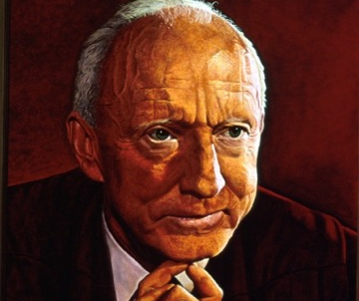
In a 6-3 decision, the Court dissolved the restraining order and allowed the Times to continue with publication of the Pentagon Papers.
But, when addressing the question, the Court’s majority splintered into six concurring opinions:
Justice Hugo L. Black argued that “only a free and unrestrained press can effectively expose deception in government” and rejected any prior restraints on the press.

Slide 8
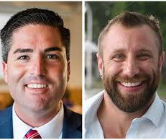
Lindke v. Freed 2024
A public official who prevents someone from commenting on the official's social-media page engages in state action under 42 U.S.C. § 1983 only if the official both (1) possessed actual authority to speak on the state's behalf on a particular matter, and (2) purported to exercise that authority when speaking in the relevant social-media posts.

Slide 9

Prior Restraint: Typical Defenses
National Security | Incitement of Violence | Obscenity
Fair Trial Protection | School-Sponsored | Permits / Neutrality

Slide 10

1st Amendment: Governmental Retaliation
Governmental retaliation occurs when a governmental entity (or official) takes adverse action against an individual in response to his/her exercise of First Amendment rights.

Slide 11

McLaughlin v. Sullivan County Board of Education
This is a case I handled through a jury trial before the United States District Court for the Eastern District of Tennessee (Greeneville).
Disclaimer: To be clear, I am not in any way comparing anything I have handled to the Pentagon Papers case… I just have access to the exhibits in this case, and thought you would find this case to be illustrative (and maybe a tad entertaining).

Slide 13
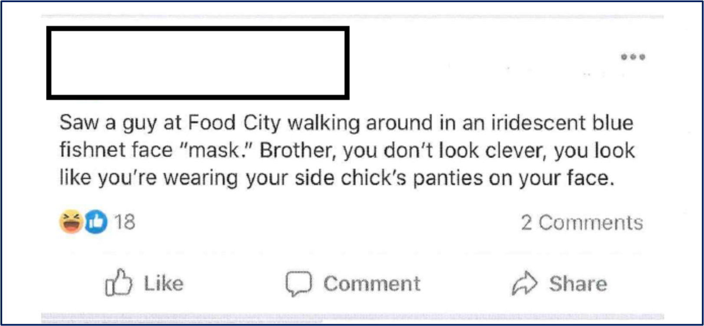

Slide 14

The Question at MSJ Stage
As Judge Corker summarized it:
“The determination of whether speech is protected is a question of law. Leary, 228 F.3d at 737. For McLaughlin's speech to be protected, he must show that he spoke ‘as a citizen addressing matters of public concern[,]’ Garcetti v. Ceballos, 547 U.S. 410,417 (2006), and that his interest in commenting on such matters outweighs ‘the interest of the State, as an employer, in promoting the efficiency of the public services it performs through its employees.’ Pickering v. Bd. of Educ., 391 U.S. 563, 568 (1968) ("the Pickering balancing test").”

Slide 15

So… what do you all think???
Should the teacher’s interest in commenting on such matters on social media have outweighed the school system’s interest in promoting the efficiency of the public services it performs through its employees (i.e., promoting professional behavior and civil discourse amongst those who are hired to be role models for kids)?

Slide 16
WE LOST (AT MSJ)
Again from Judge Corker:
“Each of McLaughlin's posts, as detailed above, addressed his opinion on matters of widespread political and social debate-the compensation of nurses at the height of the pandemic, the importance of wearing masks amid the pandemic, the sitting President's authority to delay the presidential election, and his personal opposition to a presidential candidate. Despite the inclusion of arguably offensive language, his statements are encompassed within the core value of the First Amendment. See Snyder v. Phelps, 562 U.S. 443,461 (2011) (‘As a Nation we have chosen ... to protect even hurtful speech on public issues to ensure that we do not stifle public debate.’). Therefore, McLaughlin's statements in the posts at issue are entitled to special protection.”

Slide 17
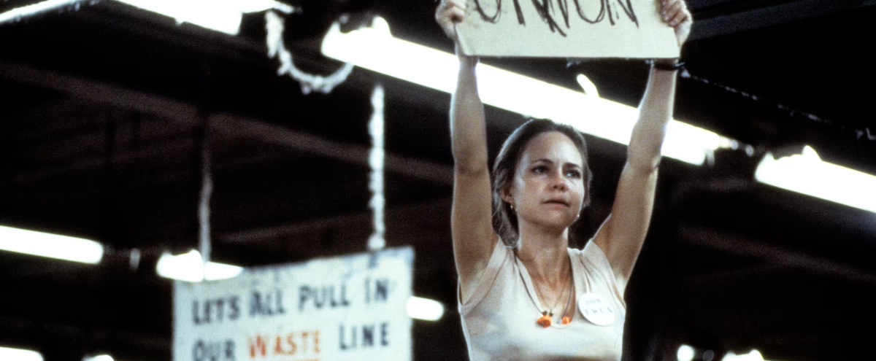
The National Labor Relations Act: Speech in the Private Sector

Slide 18
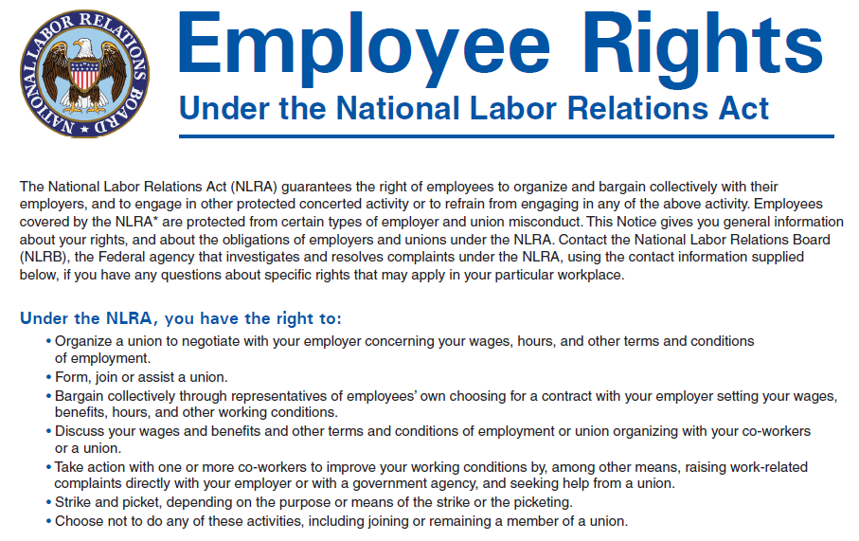

Slide 19
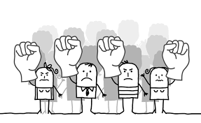
Section 7 of the NLRA
Section 7 guarantees employees "the right to self-organization, to form, join, or assist labor organizations, to bargain collectively through representatives of their own choosing, and to engage in other concerted activities for the purpose of collective bargaining or other mutual aid or protection," as well as the right "to refrain from any or all such activities."

Slide 21

Example
Triple Play Sports Bar & Grille Case
Centered on a Facebook ‘like’ of a co-worker’s disparaging / profane post criticizing their manager’s inability to manage paycheck tax situation.
NLRB ruled even a Facebook “like” in that context was a protected concerted activity, and the 2nd Circuit Court of Appeals affirmed.

Slide 22

Questions?
Chris W. McCarty
cmccarty@lewisthomason.com
865-546-4646 (Knoxville Office)

