Slide 1

2026 Tennessee Legal Ethics Update
Professor Alex B. Long
University of Tennessee
Winston College of Law

Slide 2

Introduction
Program Format & Question Lineup

Slide 3
Today’s Program
Scenarios that Raise Attorney Ethics Issues
Tennessee Rules of Professional Conduct
Polling – Pick the Best Answer
Discussion

Slide 4

Practice Question

Slide 5

Question 1: Practice
Judge Ryan Nelson of the Court of Appeals for the Ninth Circuit is facing criminal charges for which of the following actions?
Ramming his car into another car in a parking lot.
Taking a man’s glasses and stomping on them in a parking lot.
Buying beer for underaged teenagers in a parking lot.
Throwing his cell phone at a man in a parking lot.

Slide 6
Question 1: Practice
Judge Ryan Nelson of the Court of Appeals for the Ninth Circuit is facing criminal charges for which of the following actions?
Ramming his car into another car in a parking lot.
Taking a man’s glasses and stomping on them in a parking lot.
Buying beer for underaged teenagers in a parking lot.
Throwing his cell phone at a man in a parking lot.
The Video

Slide 7

Today’s Lineup
Artificial Intelligence. Foolish Lawyers
Disclosing Adverse Authority (and Correcting Opposing Counsel’s Mistakes)
Responding to Online Client Reviews
Criticizing Judges vs. Intimidating Judges
The Ethics of Tricking Witnesses
ABA Ethics Opinion 522: Lawyer’s Obligation to Disclose Information About Grounds for a Judge’s Disqualification
ABA Ethics Opinion 520: A Lawyer’s Obligation to Convey Information to a Former Client or Successor Counsel

Slide 8

Artificial Intelligence. Foolish Lawyers.

Slide 9


Slide 10


Slide 11


Slide 12
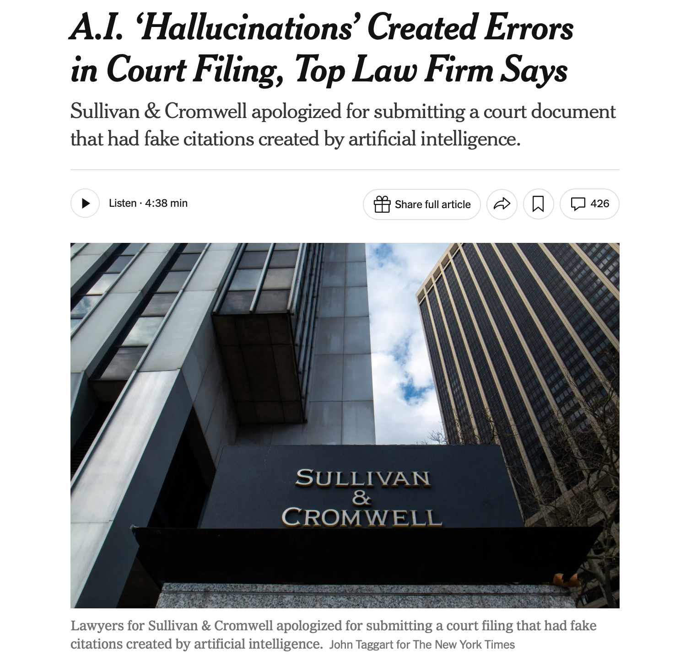

Slide 13
Competence

Slide 14

The Duty of Competence Regarding Technology
TRPC Rule 1.1: A lawyer shall provide competent representation to a client. Competent representation requires the legal knowledge, skill, thoroughness, and preparation reasonably necessary for the representation.

Slide 15
The Duty of Competence Regarding Technology
ABA Model Rule 1.1: A lawyer shall provide competent representation to a client. Competent representation requires the legal knowledge, skill, thoroughness, and preparation reasonably necessary for the representation.
Comment 8: “To maintain the requisite knowledge and skill, a lawyer should keep abreast of changes in the law and its practice, including the benefits and risks associated with relevant technology”

Slide 16
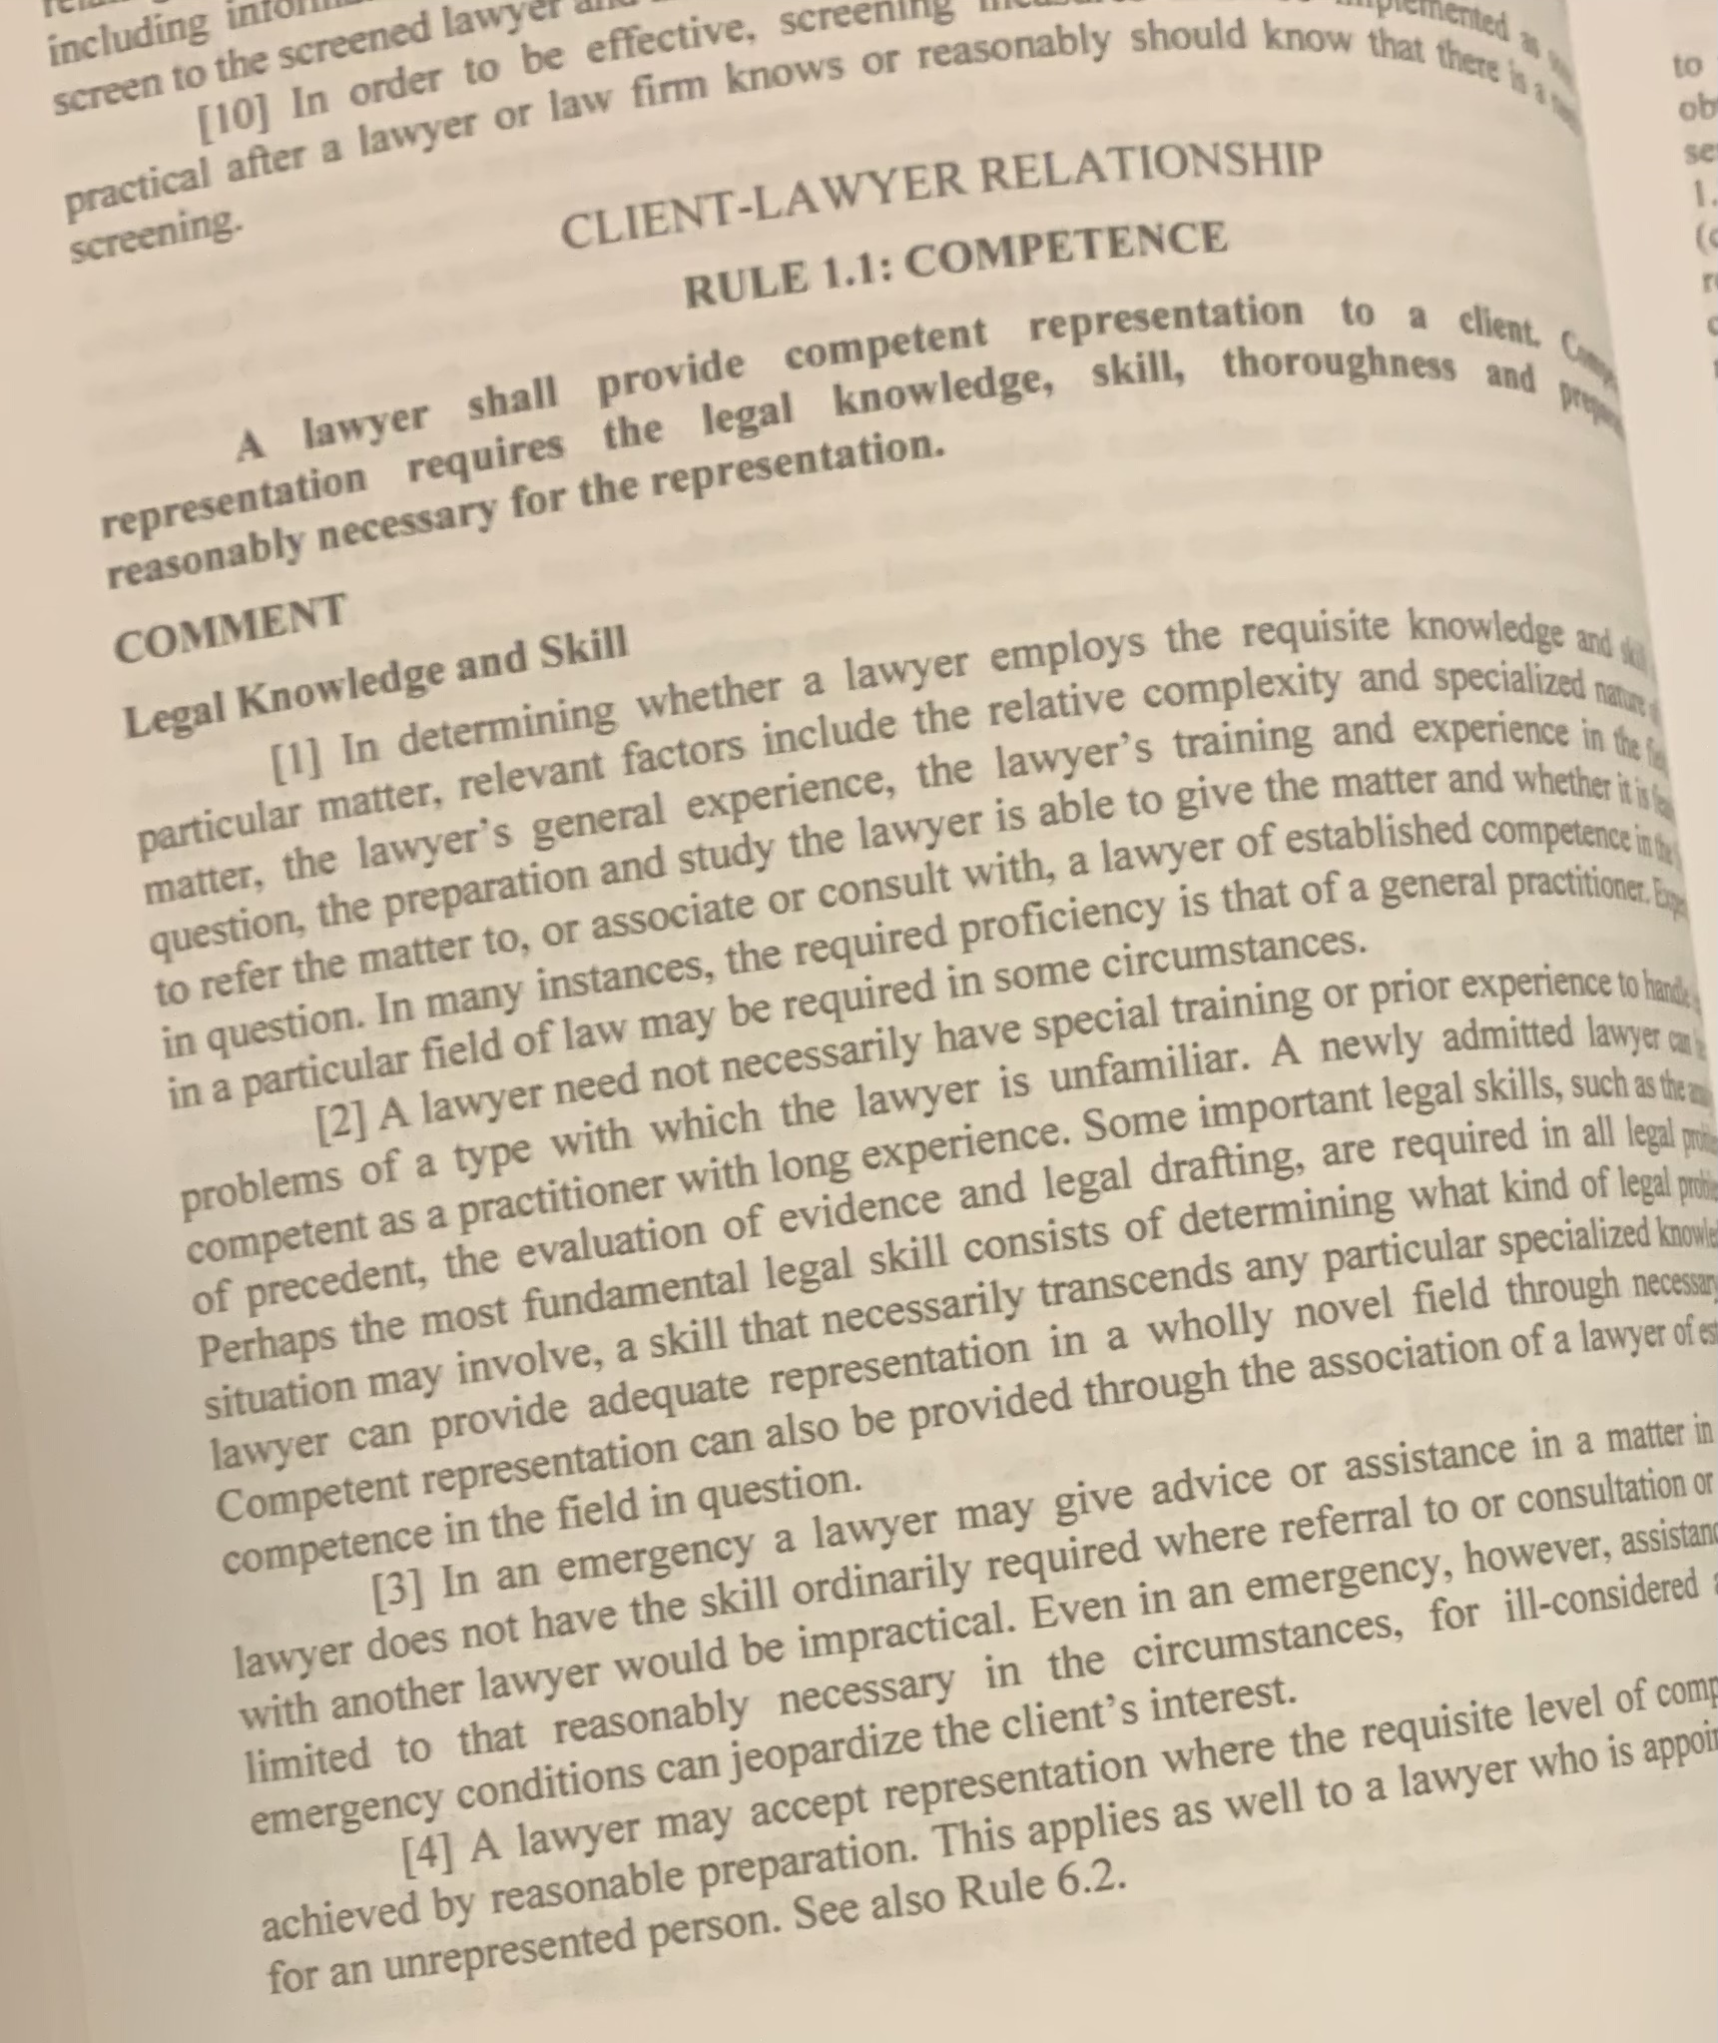
The Duty of Competence Regarding Technology
“To competently use a GAI tool in a client representation, lawyers need not become GAI experts. Rather, lawyers must have a reasonable understanding of the capabilities and limitations of the specific GAI technology that the lawyer might use.”
  ABA Formal Op. No. 512

Slide 17
The Duty of Competence Regarding Technology
“This means that lawyers should either acquire a reasonable understanding of the benefits and risks of the GAI tools that they employ in their practices or draw on the expertise of others who can provide guidance about the relevant GAI tool’s capabilities and limitations.”
  ABA Formal Op. No. 512

Slide 18

ABA Ethics Opinion
Formal Opinion No. 512 (July 2024)
“[A] lawyer’s reliance on, or submission of, a Generative AI tool’s output—without an appropriate degree of independent verification or review of its output—could violate the duty to provide competent representation as required by Model Rule 1.1.”

Slide 19


Slide 20
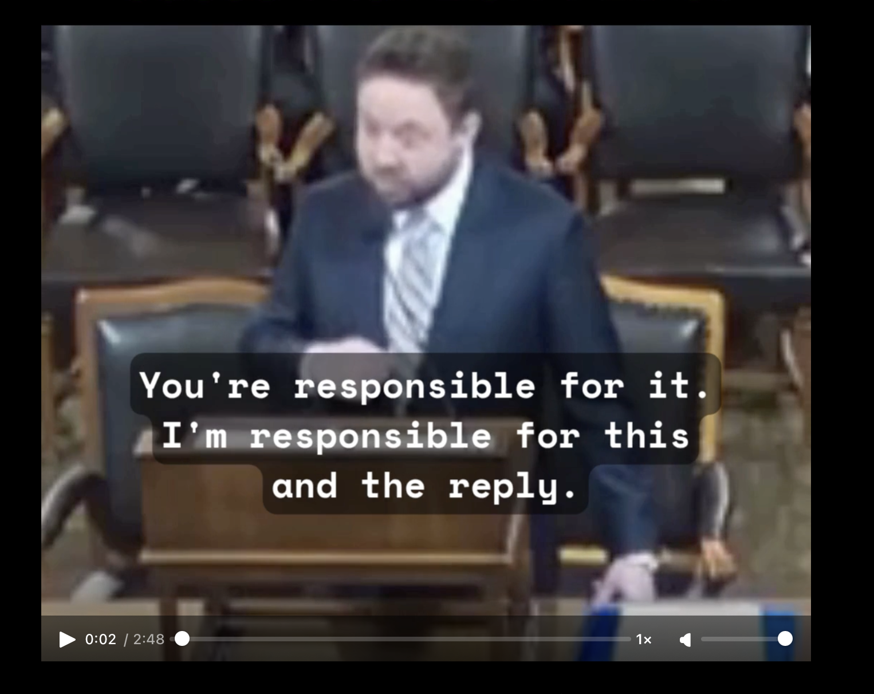
The Duty of Competence Regarding Technology
Landbert v. City of New York (appellant)

Slide 21
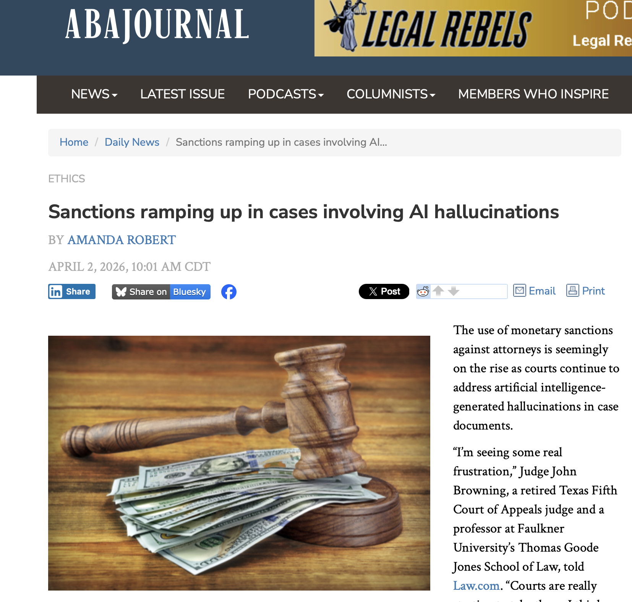
Notes:
As one recent example, Senior Judge Walter H. Rice of the U.S. District Court for the Southern District of Ohio imposed a collective sanction of $7,500 against two attorneys for AI hallucinations, Law.com reports. He also found them in contempt and referred them to the Ohio Supreme Court’s Office of Disciplinary Counsel for “the most egregious violations of Rule 11” that he’d seen on the bench. In another recent case, the 6th Circuit at Cincinnati imposed a total sanction of $30,000 against two attorneys for more than two dozen fake case citations. It also dismissed the case because of “the pervasive misconduct” that rendered it “almost entirely frivolous.”

Slide 22
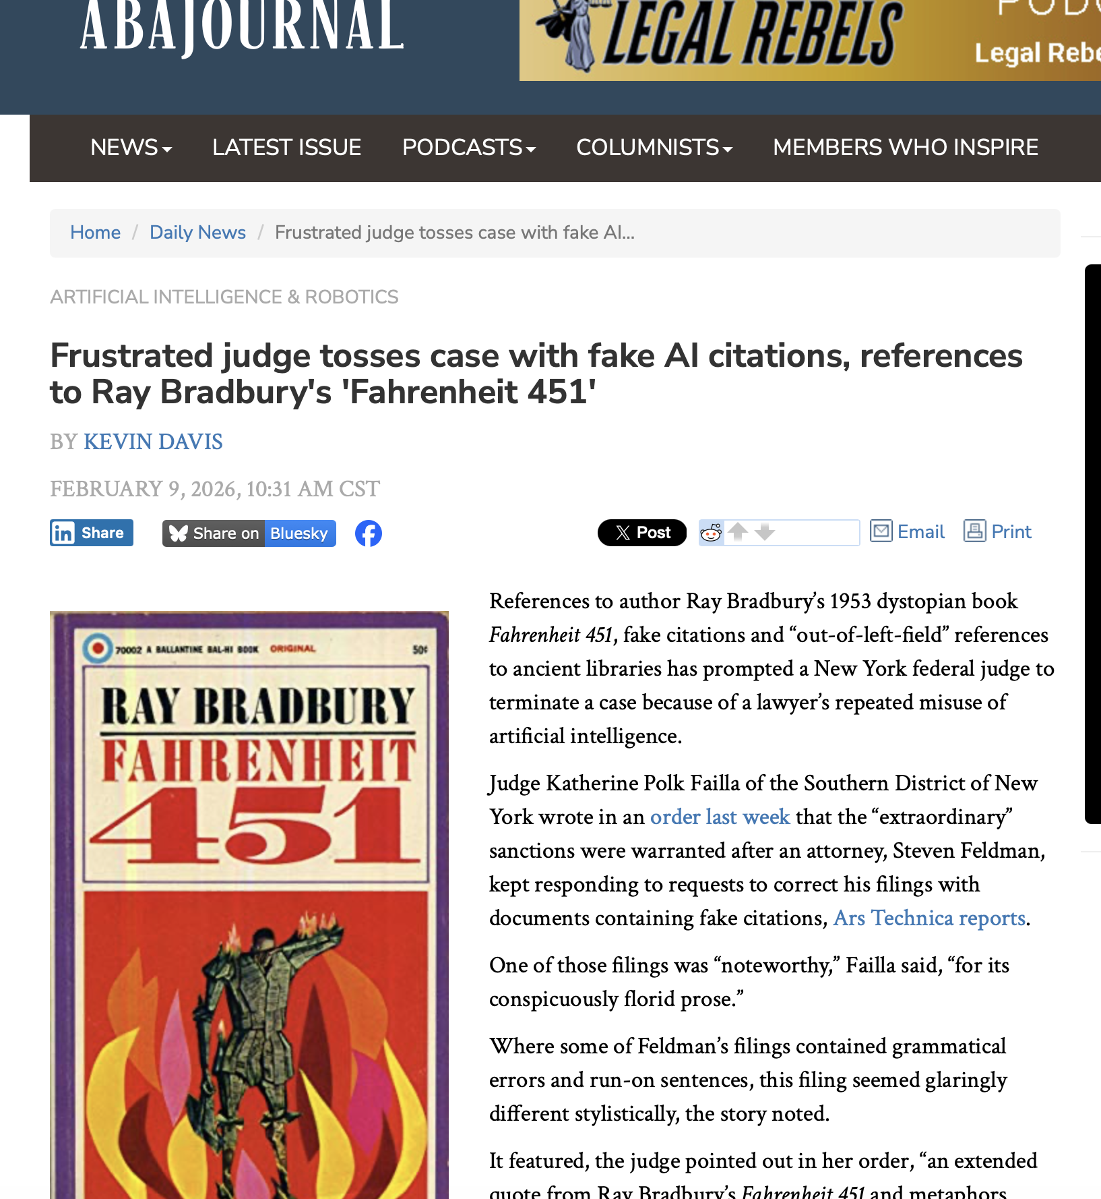
Notes:
In one case, a lawyer submitted a brief with “conspicuously florid prose” and extended quotation from Ray Bradbury’s Fahrenheit 451. The court noted that the brief appeared to contain notably distinct styles of writing, which apparently made the judge suspicious about the possible use of AI. Courts are starting to impose some interesting sanctions.

Slide 23
Monetary Sanctions
Byoplanet International, LLC v. Knecht, 0:25-cv-60646, 2025 WL 3091094 (S.D. Fla. Aug. 21, 2025)
Solo practitioner
Lawyer uses AI multiple times. AI hallucinates multiple cases.
Judge imposes sanctions: pay Defendants’ counsel “for all time spent responding to any filing in which generative AI was used to develop hallucinated cases and fabricated quotations.”
  Defendants’ alleged fees: $85,567.75
  Court says they are reasonable and orders Lawyer to pay

Slide 24
Disgorgement of Fees
In re Baby Boy, 2025 WL 2046315 (Ill. Ct. App. July 21, 2025)
Appointed counsel
Lawyer uses AI to draft brief. AI hallucinates multiple cases. Lawyer did not verify accuracy.
Ethics violations:
  1.1 (competence)
  3.1 (frivolous claims)
  3.3 (candor towards the tribunal
  8.4(c) (dishonesty)
Monetary sanction: disgorgement of attorney’s fees received as appointed counsel (almost $7,000)

Slide 25
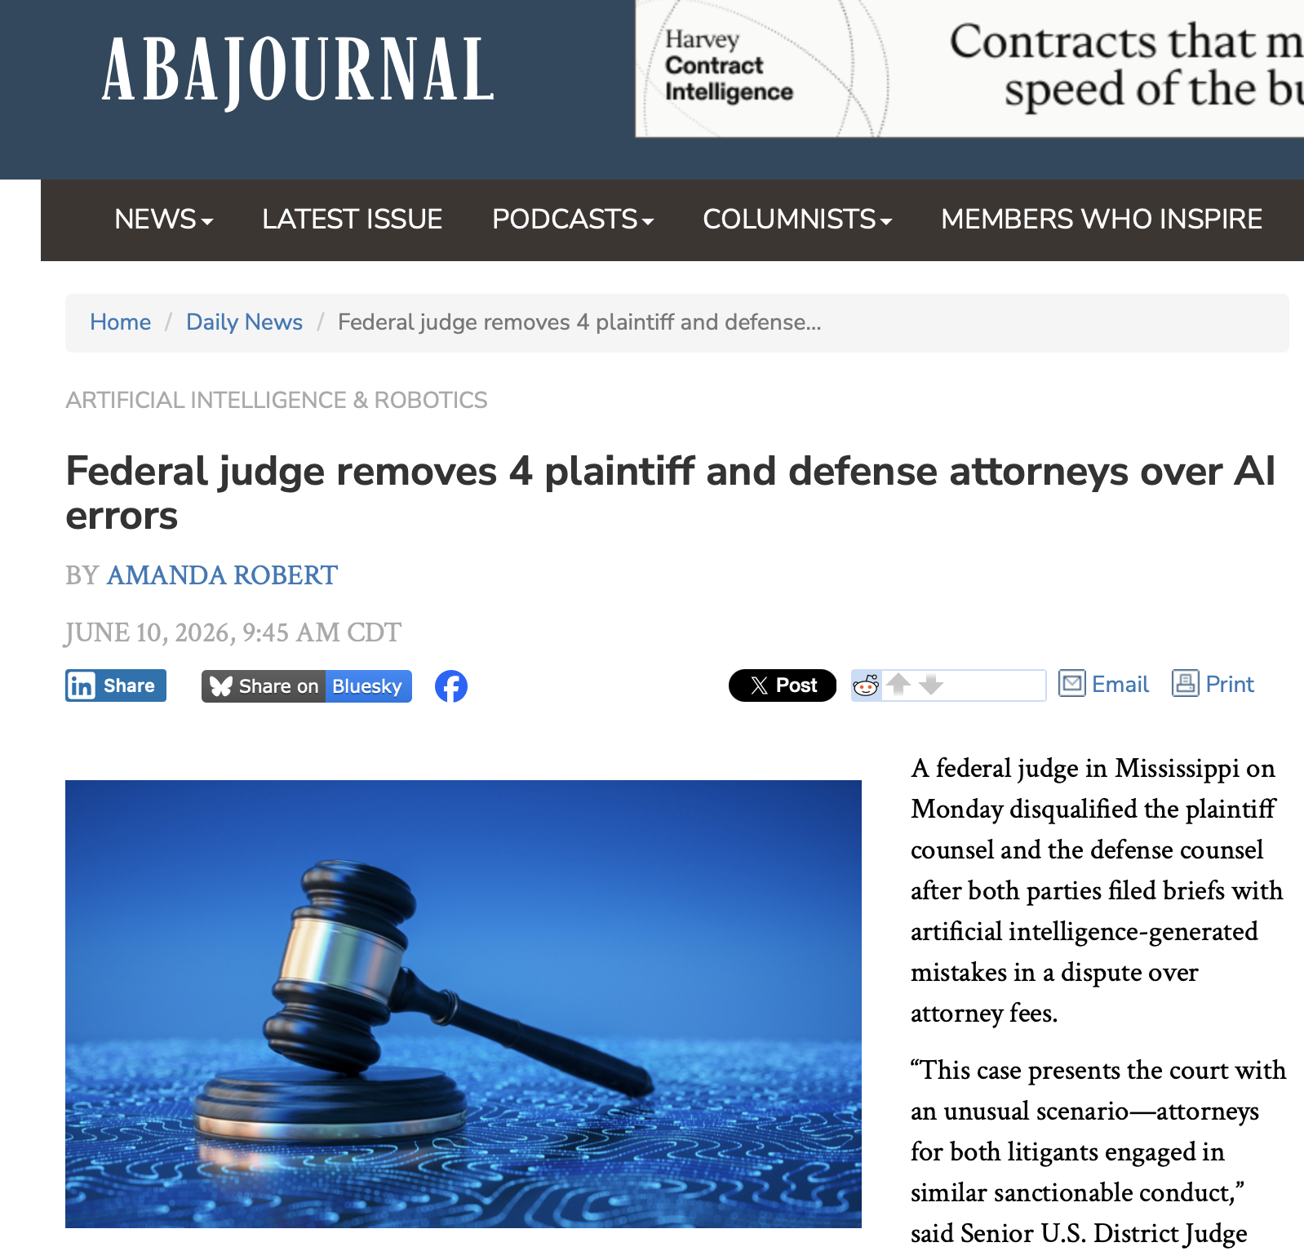
Notes:
And in one recent case, a federal judge disqualified both sets of lawyers from representing their clients after both filed AI-written briefs with fake citations, both of whom had been admitted on a pro hac vice basis.

Slide 26
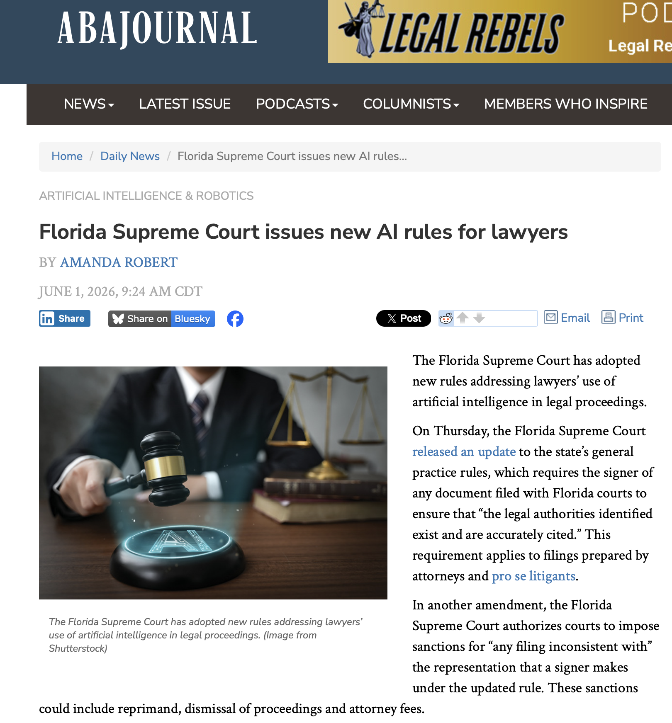
Notes:
Several courts have adopted court rules to deal with the problem. The Florida Supreme Court amended its statewide rules requiring certification that any cases cited in a brief that has been submitted have been verified to exist. The new rule also expressly allows courts to impose sanctions in the case of hallucinated cases.

Slide 27
AI Sanctions Database
https://www.damiencharlotin.com/hallucinations
Notes:
If you want to keep up with all of these events, here is a database that tracks all of these cases.

Slide 28
Confidentiality

Slide 29

The Duty of Confidentiality
TRPC Rule 1.6: Confidentiality of Information
(a) A lawyer shall not reveal information relating to the representation of a client unless:
(1) the client gives informed consent;
(2) the disclosure is impliedly authorized in order to carry out the representation; or
(3) the disclosure is permitted by paragraph (b) or required by paragraph (c).

Slide 30
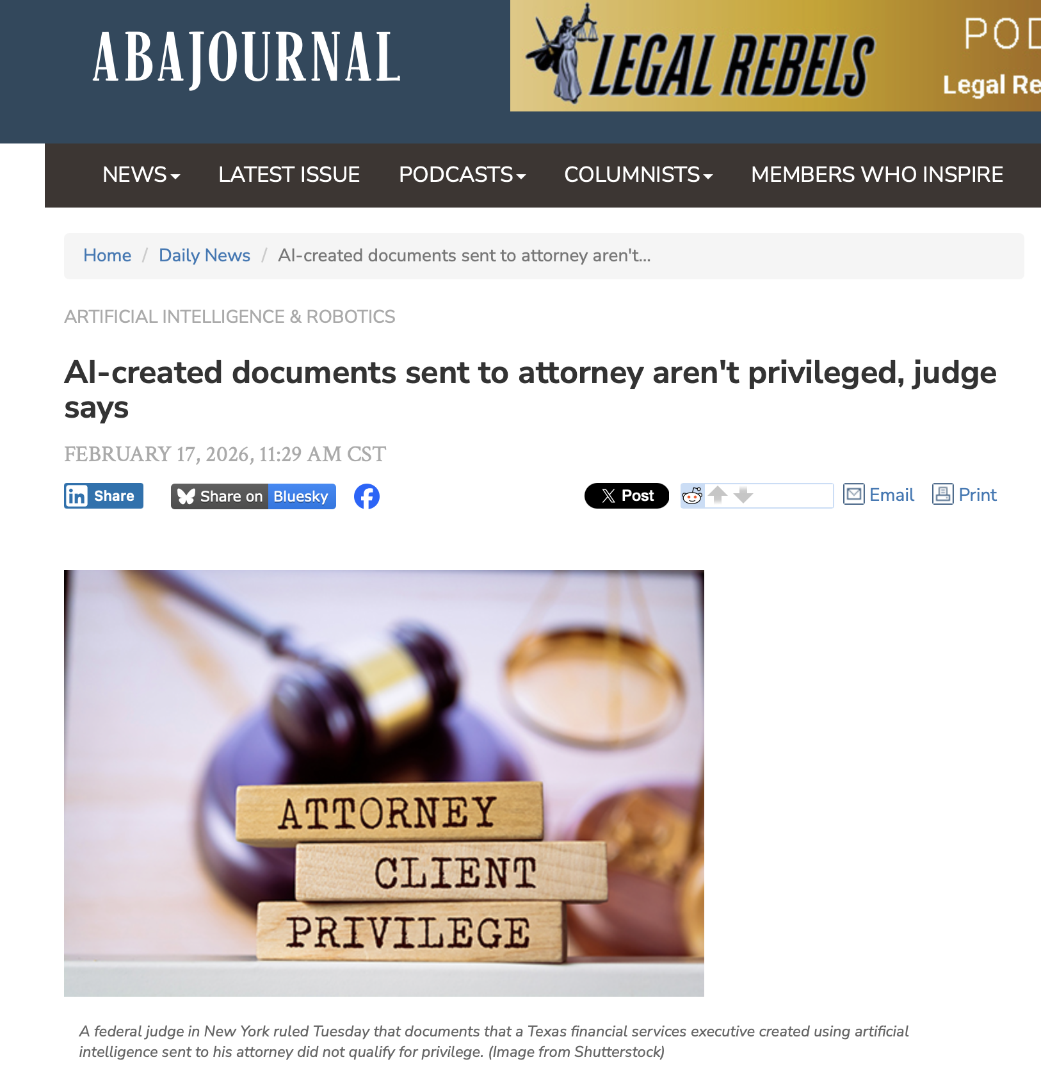

Slide 31

Claude is not a Lawyer
Notes:
According to its designers, Claude “is an artificial intelligence, trained by Anthropic … to be safe, accurate, and secure.” Aside from bestowing upon Claude a human name, its designers routinely refer to Claude in human terms in their marketing. But Claude is not a human being, let alone a lawyer. And a recent decision from a federal judge in New York makes clear that this reality has implications for the applicability of the attorney-client privilege and a lawyer’s duty of confidentiality when dealing with Claude and other forms of AI.

Slide 32
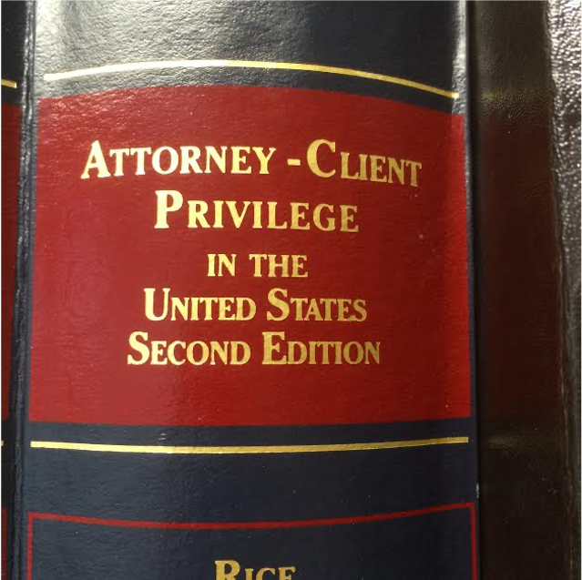
Claude is not a Lawyer
Notes:
In November 2025, Bradley Heppner was arrested on charges of securities and wire fraud in New York. Prior to his arrest, Heppner had retained legal counsel and used Claude to prepare reports outlining his defense strategy and potential legal arguments, which Heppner intended to provide to his lawyers. During the arrest, federal agents seized electronic devices containing these documents. Heppner’s lawyers asserted that the documents were covered by the attorney-client privilege because they incorporated information conveyed to their client by Claude during the course of the representation for the purpose of receiving legal advice from counsel. In February, a federal court rejected this argument.

Slide 33
Claude is not a Lawyer
Notes:
In order for the attorney-client privilege to apply, there must be a communication, made in confidence between privileged parties, for the purpose of providing or receiving legal advice. Rakoff noted that all privileges are based on the existence of a “trusting human relationship,” such as a relationship between a client and a lawyer, who is subject to professional discipline. Despite the marketing statements of Claude’s designer that Claude is a “trusted assistant,” Claude is neither a lawyer nor human.

Slide 34
Supervisory Responsibility

Slide 35
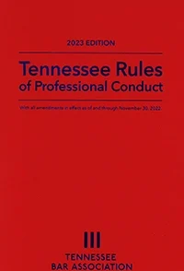
TRPC Rule 5.1: Responsibilities of Partners, Managers, and Supervisory Lawyers
(a) A partner in a law firm, and a lawyer who individually or together with other lawyers possesses comparable managerial authority in a law firm, shall make reasonable efforts to ensure that the firm has in effect measures giving reasonable assurance that all lawyers in the firm conform to the Rules of Professional Conduct.
(b) A lawyer having direct supervisory authority over another lawyer shall make reasonable efforts to ensure that the other lawyer conforms to the Rules of Professional Conduct.

Slide 36
TRPC Rule 5.3: Responsibilities Regarding Nonlawyer Assistants
(a) a partner, and a lawyer who individually or together with other lawyers possesses comparable managerial authority in a law firm, shall make reasonable efforts to ensure that the firm has in effect measures giving reasonable assurance that the nonlawyer's conduct is compatible with the professional obligations of the lawyer;
(b) a lawyer having direct supervisory authority over a nonlawyer shall make reasonable efforts to ensure that the nonlawyer's conduct is compatible with the professional obligations of the lawyer

Slide 37
12July 2024) ABA Ethics Op. 512 (2024) ono. 512 (July 2024)
Responsibilities of Managerial and Supervisory Lawyers:
  establish clear policies regarding the law firm’s permissible use of GAI,
  make reasonable efforts to ensure that the firm’s lawyers comply with their professional obligations when using GAI tools
  ensure that subordinate lawyers are trained on use of AI as well as ethics and risks

Slide 38
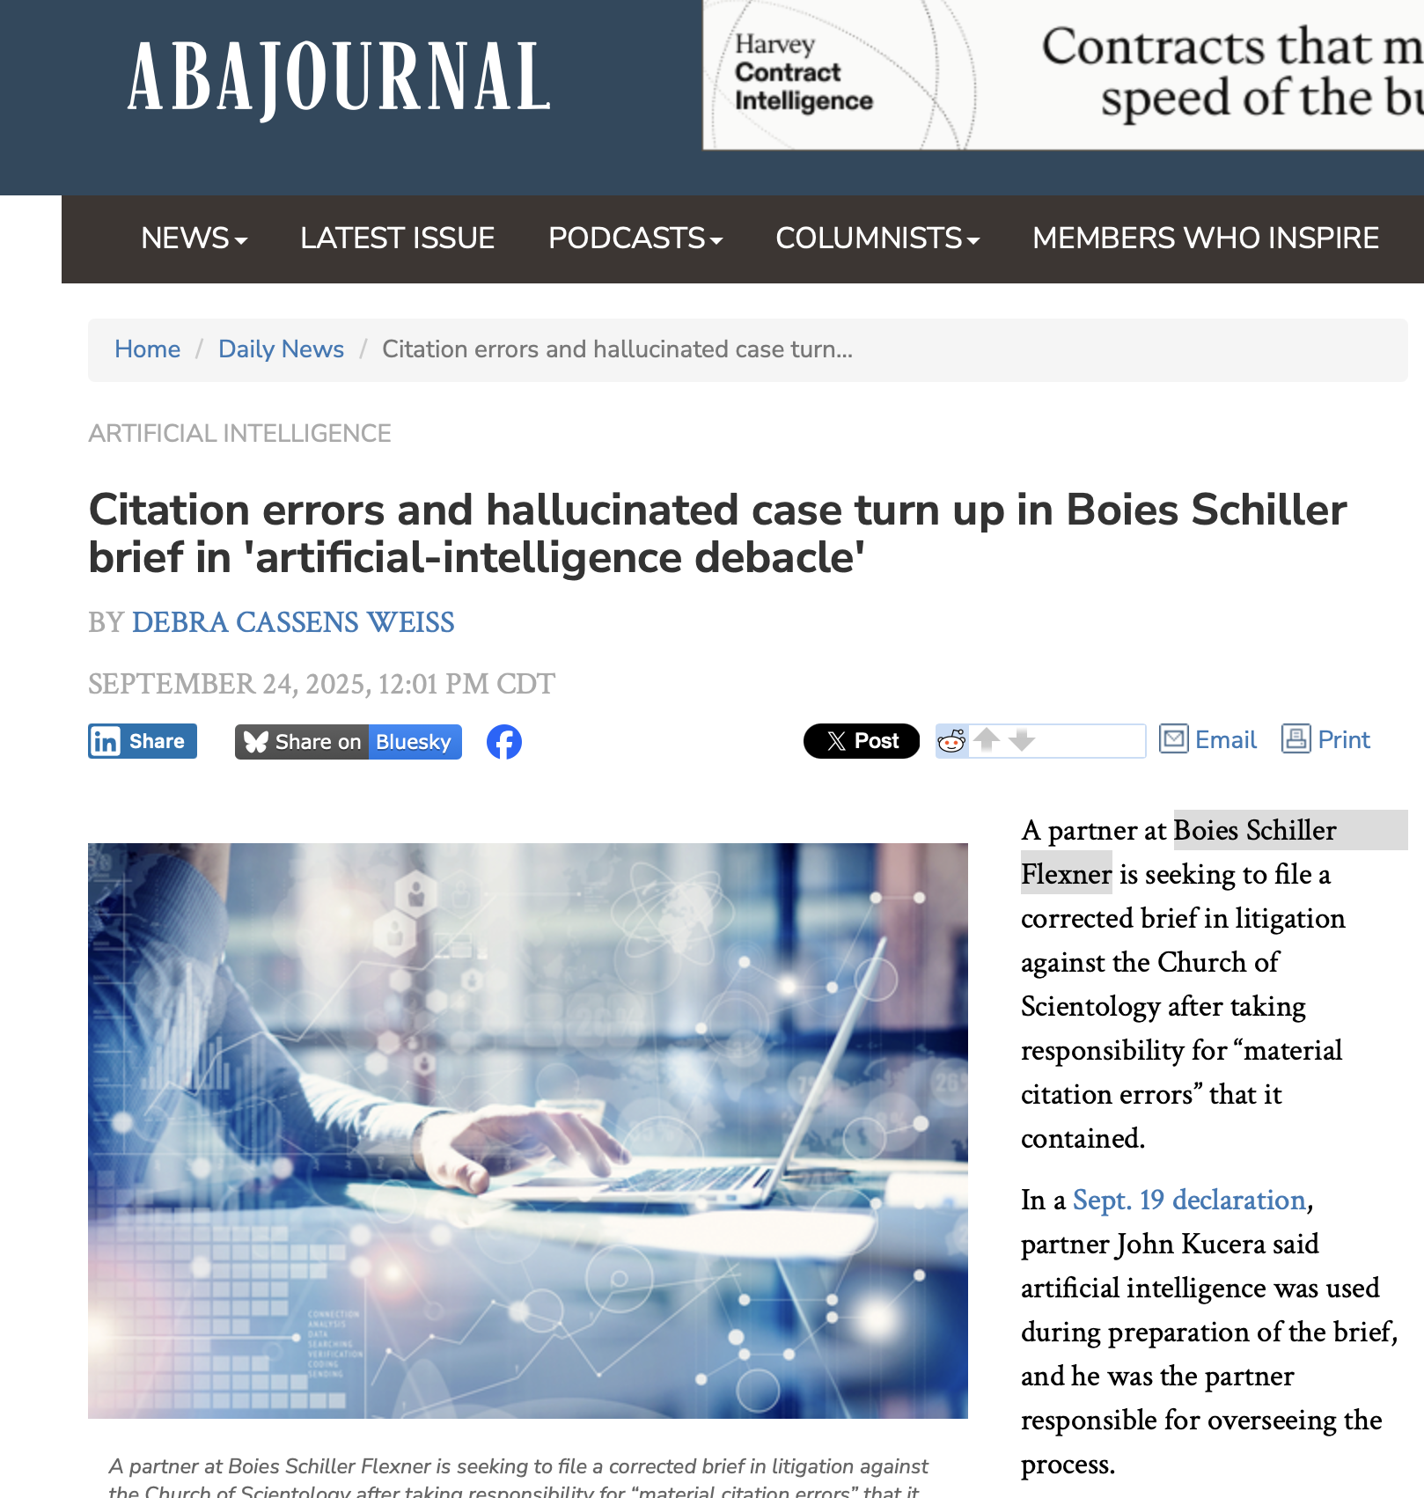
Notes:
So, in every case in which a lawyer in a firm submits a brief that contains hallucinated cases to a court, there is a question of whether the firm as a whole has procedures in place to prevent this from happening and whether supervisory lawyers are adequately supervising more junior attorneys. In this case, a partner in Boies Schiller submitted such a brief and fell on his sword, saying it was all his fault. But the incident raises a question as to what procedures the firm had in place to prevent this sort of thing from happening.

Slide 39
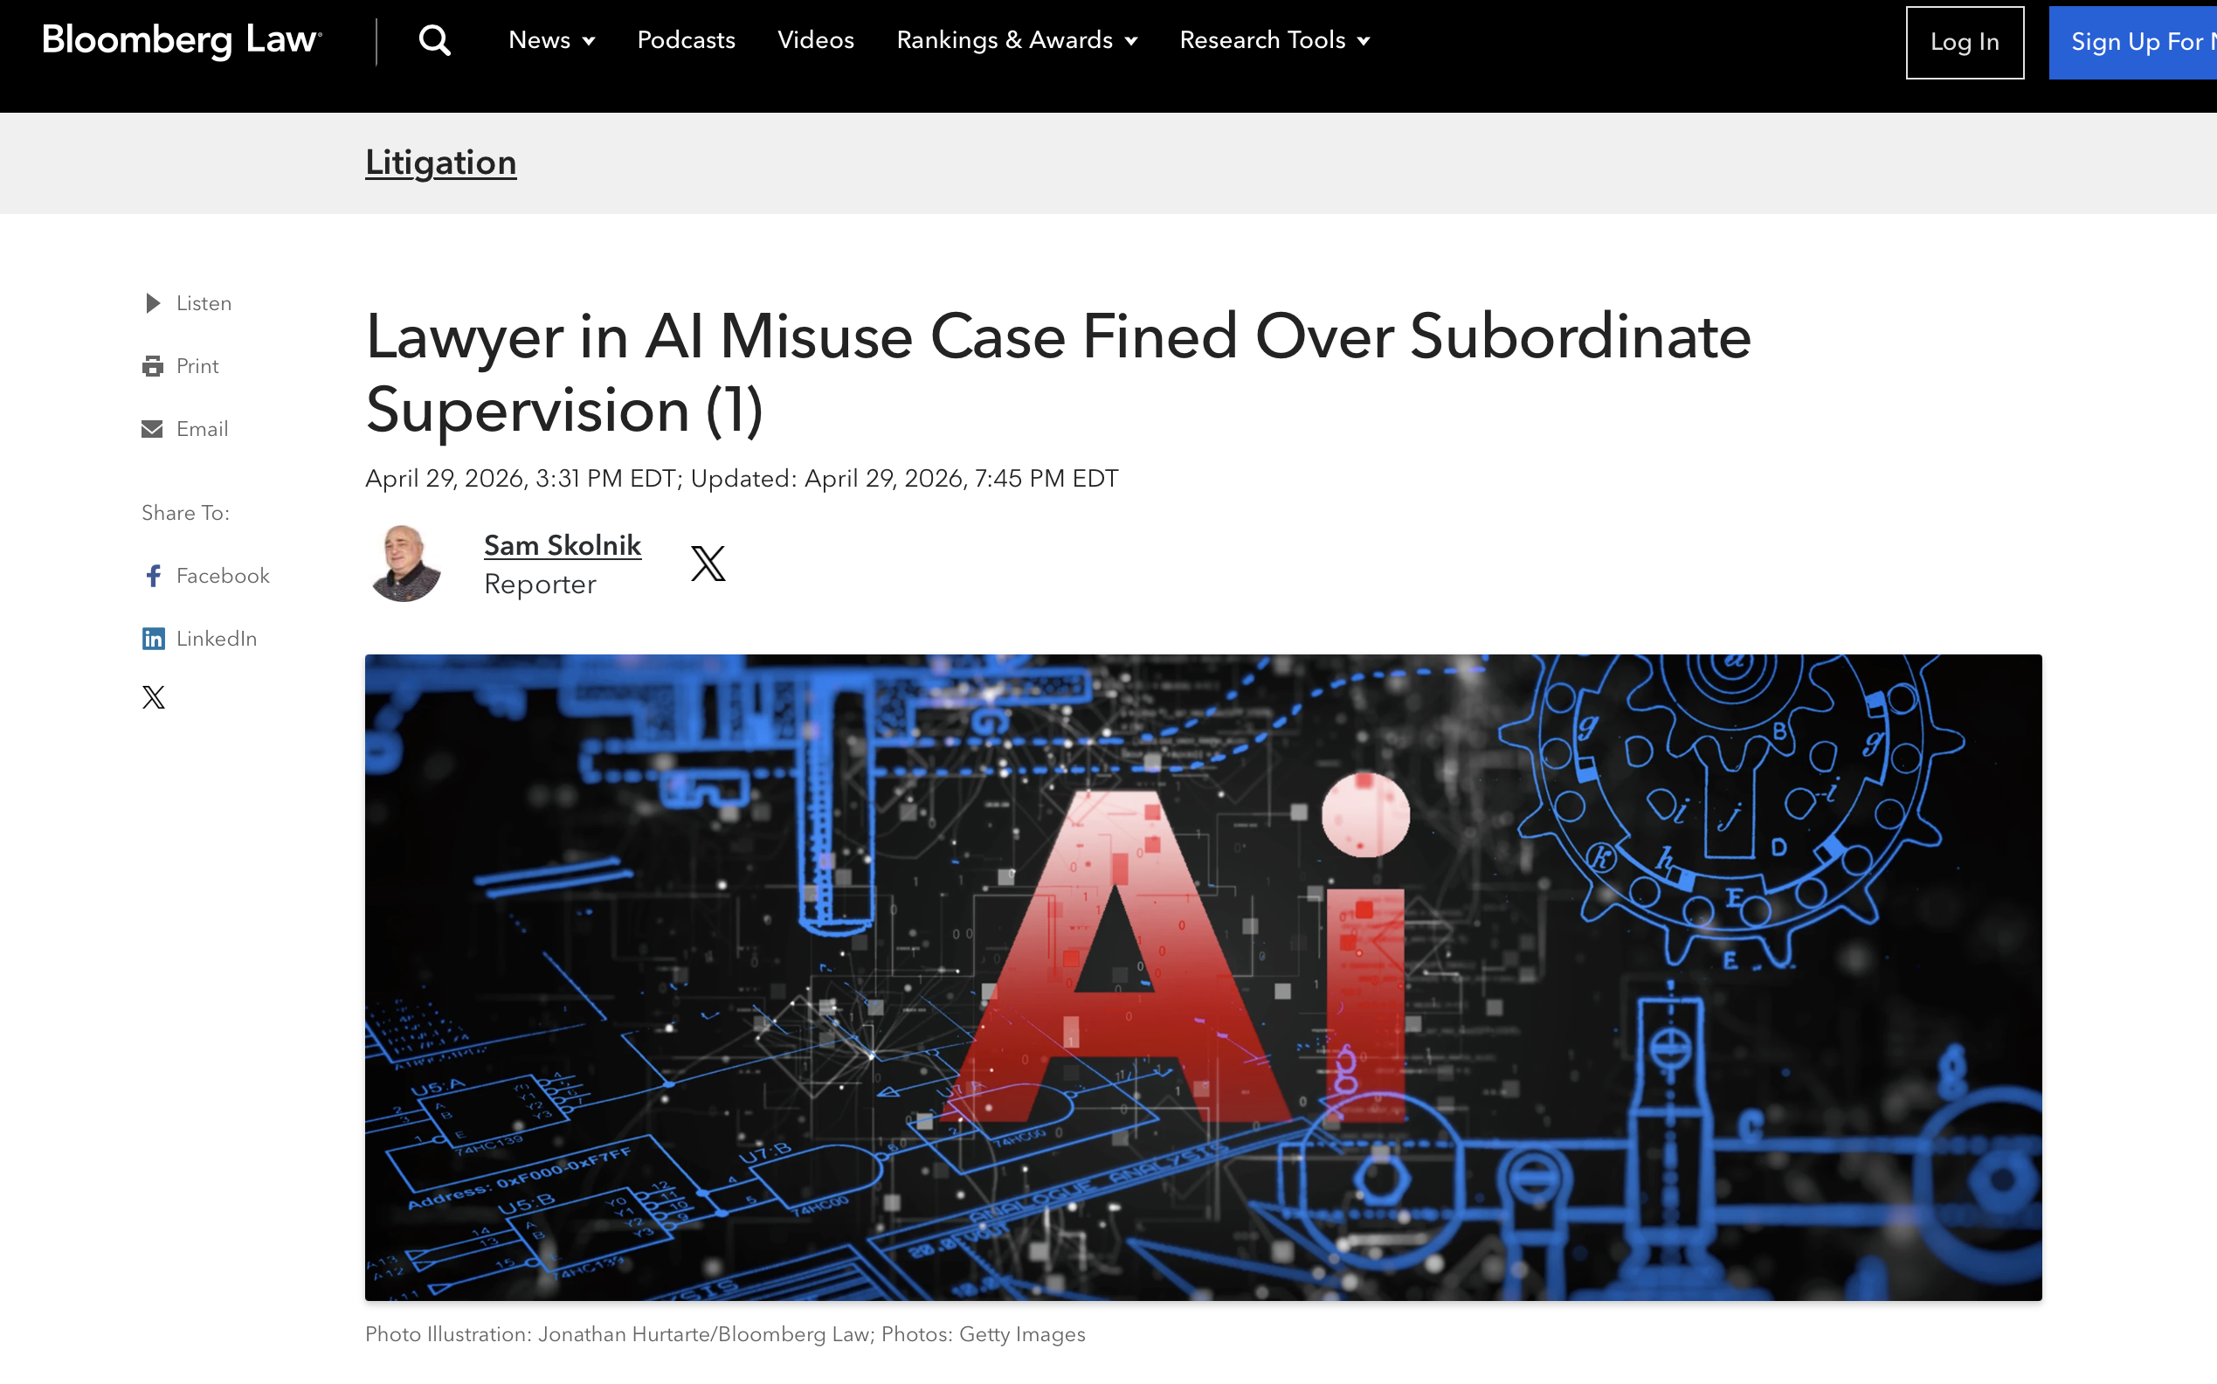
Notes:
Earlier this spring, a judge sanctioned a partner in a law firm over the partner’s failure to properly supervise a subordinate attorney who submitted filings with hallucinated cases. The judge ordered the lawyer to pay $1,001 as a personal sanction, and to circulate the order to all attorneys and paralegals in Webb’s firm. Webb also must complete four hours of continuing legal education,, including two hours on supervision of junior attorneys/staff, and at least another two in the area of “ethical/professional use” of AI in legal practice, according to the order.

Slide 40

Disclosing Adverse Authority (and Correcting Opposing Counsel’s Mistakes)

Slide 41

Disclosing Adverse Legal Authority
Hypo: While drafting a brief to be filed in federal court in Knoxville you notice that opposing counsel failed to cite a decision from a federal district court in Memphis that is adverse to the opposing client’s legal position. But you note that the facts of the other case are arguably distinguishable from the present case.
Did opposing counsel have an obligation to cite this decision?

Slide 42

Disclosing Adverse Legal Authority: TRPC Rule 3.3(a)(2)
A lawyer shall not knowingly … fail to disclose to the tribunal legal authority in the controlling jurisdiction known to the lawyer to be directly adverse to the position of the client and not disclosed by opposing counsel;

Slide 43
Disclosing Adverse Legal Authority: TRPC Rule 3.3(a)(2)
(1) the lawyer must know that the authority exists (but knowledge may be inferred from the circumstances)
(2) the adverse authority must be from within “the controlling jurisdiction.”
  In federal court, the “controlling jurisdiction” is the circuit in which the district court sits
  See Matthews v. Kindred Healthcare Inc, 2005 U.S. Dist. LEXIS 38295 (W.D. Tenn.) (Dec. 7, 2005) (admonishing lawyer for failing to cite decisions from other courts within the district that had ruled against the defendant on the same legal issue)
(3) the authority must be “directly adverse.”
(4) the lawyer must disclose the authority to the tribunal

Slide 44
Disclosing Adverse Legal Authority
Hypo: While drafting a brief to be filed in federal court in Knoxville you notice that opposing counsel cited several non-existent cases. You reasonably surmise that opposing counsel had relied on generative artificial intelligence for research but failed to verify the sources produced.
Do you have an obligation to inform the court about these hallucinated cases?

Slide 45
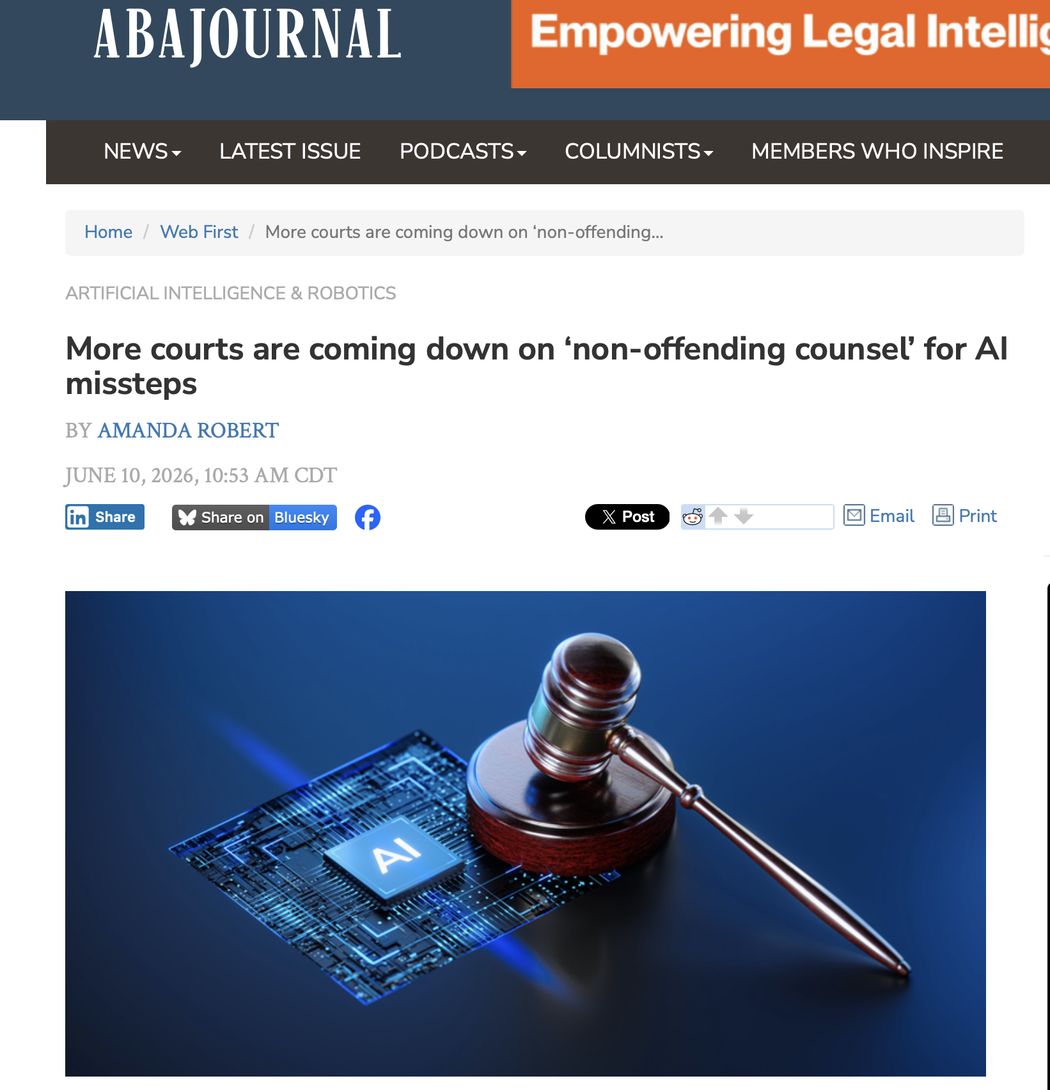
Notes:
In one case from California, Lawyer 1 sent a letter to Lawyer 2 that cited two hallucinated cases. Lawyer 2 didn’t catch the problem and submitted to the court a proposed order and findings of fact that cited hallucinated cases as if they were real. The trial court adopted them. Lawyer 2 later appealed and claimed the trial court had erred by citing and relying on the fake cases, to which the appeals court agreed. But the appeals court also held that Torres had forfeited that claim because his counsel had not only failed to object to or notify the trial court of the fabricated citations but had drafted and submitted a proposed order containing them.

Slide 46
Disclosing Adverse Legal Authority
Hypo: While drafting a brief to be filed in federal court in Knoxville you notice that opposing counsel cited several non-existent cases. You reasonably surmise that opposing counsel had relied on generative artificial intelligence for research but failed to verify the sources produced.
Do you have an obligation to inform the court about these hallucinated cases?
Notes:
In that case, the offending lawyer didn’t catch the first lawyer’s mistake and submitted the fact cites without checking them. But does a lawyer have an obligation to check opposing counsel’s cites and notify the court if the cites turn out to be fake>. According to one court, the answer is yes.

Slide 47
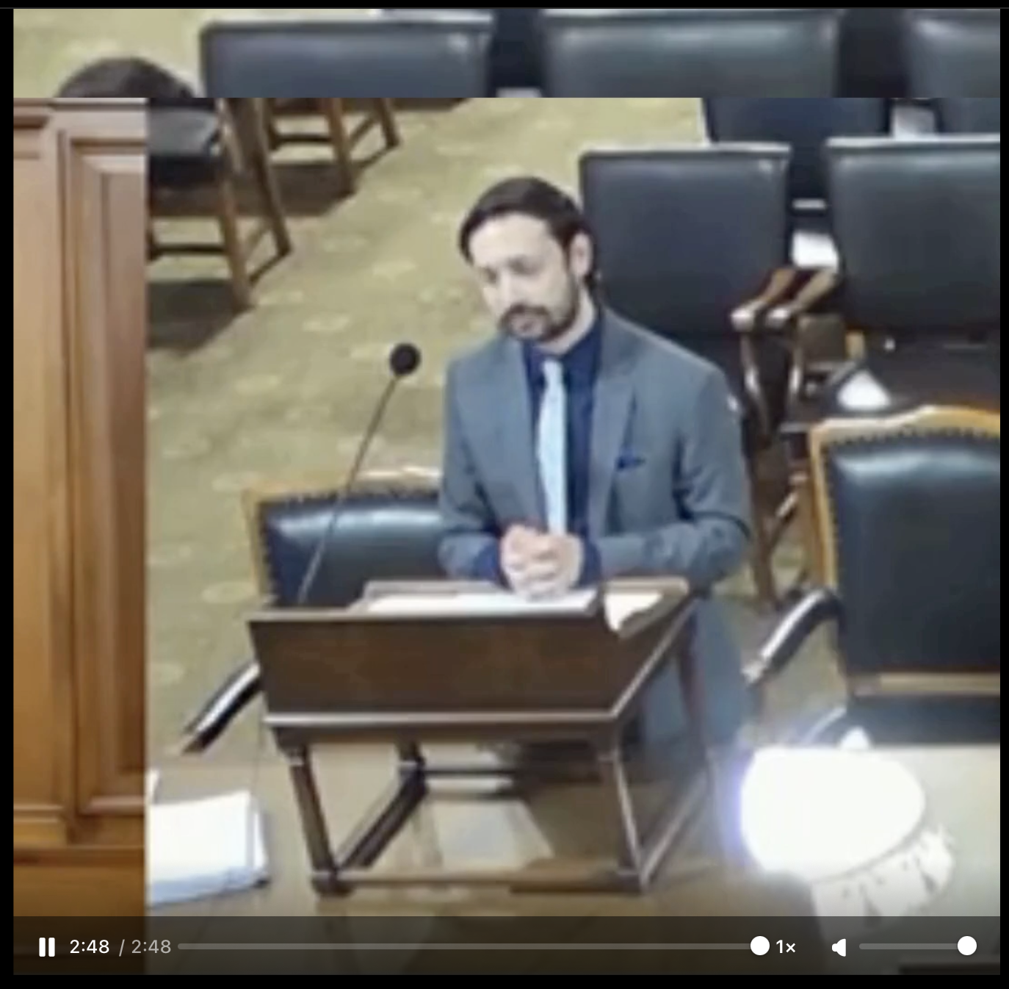
Landberg v. City of New York, 2026 NY Slip Op 03433 (June 30, 2026)
Appellate Oral Argument - Appellee
Notes:
The court ultimately ordered that the lawyer pay a sanction of $2,500 to the Lawyers' Fund for Client Protection of the State of New York. A recent decision from a California court took a similar view of an attorney’s obligations in imposing a $10,000 sanction on the lawyer who submitted a brief with hallucinated cases but awarding no attorney’s fees to the other lawyer who failed to call his opponent’s mistake to the court’s attention.

Slide 48

Responding to Online Reviews

Slide 49

Online Client Reviews
People v. Bernadette Teresa Gonzales. 24PDJ094. August 29, 2025 (Colorado)
  former client posted a negative and disparaging review of Lawyer on her firm’s Facebook page.
  Said she was a “horrible lawyer” who “doesn’t do her job and is a nasty rude person.”

Slide 50
Online Client Reviews
People v. Bernadette Teresa Gonzales. 24PDJ094. August 29, 2025 (Colorado)
  Lawyer posted a public reply
  “Be careful of this woman and her family,” Gonzales wrote. “She is a terrible mother. She allows her kids to damage other people’s property and then blames everyone else. She does not like hearing the truth about her lack of parenting nor the worthless child she raised. Just another dysfunctional family raising entitled children.”

Slide 51
Confidentiality: TRPC Rule 1.6(b)
b) A lawyer may reveal information relating to the representation of a client to the extent the lawyer reasonably believes necessary …
(5) to establish a claim or defense on behalf of the lawyer [a] in a controversy between the lawyer and the client, [b] to establish a defense to a criminal charge or civil claim against the lawyer based upon conduct in which the client was involved, or [c] to respond to allegations in any proceeding concerning the lawyer's representation of the client.
TRPC Rule 1.9(c) prohibits a lawyer from disclosing confidential information about a former client to the disadvantage of a client unless permitted by the Rules.

Slide 52
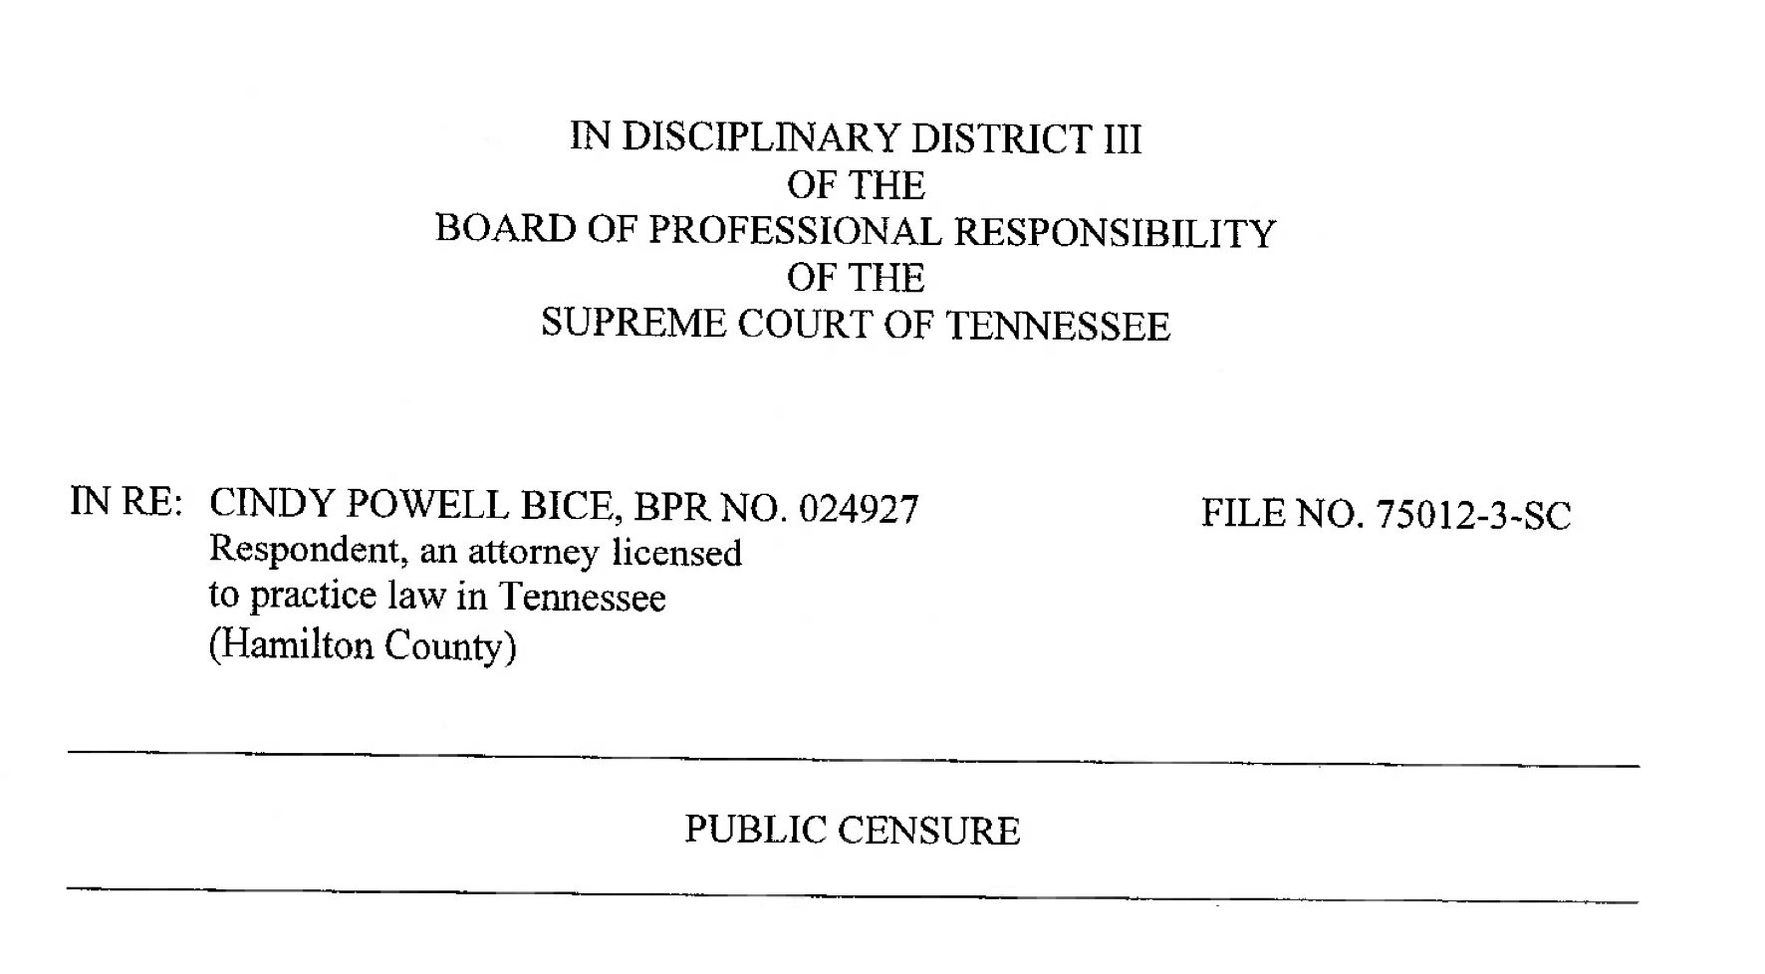

Slide 53
Online Client Reviews: Ethics Opinions
In response to a negative online review, Lawyer posted a public response with:
  Detailed confidential information relating to the representation
  Information about client’s failure to pay fee
  Information about a contempt action filed against the client for failure to pay child support

Slide 54
Online Client Reviews: Ethics Opinions
Does this qualify as a “controversy between the lawyer and the client?”
  Colorado Ethics Op. No. 136 (2019): the self-defense exception may apply even absent a formal proceeding.
  State Bar of Ariz., Ethics Op. 93-02 (1993): the self-defense exception applies to a client’s public allegations against a former lawyer appearing in a book
  TRPC Rule 1.6, cmt. 10: “Paragraph (b)(5) does not require the lawyer to await the commencement of an action or proceeding that charges [wrongdoing]

Slide 55
Online Client Reviews
Assuming the reviews qualify as a “controversy between the lawyer and the client,” was the lawyer’s disclosure of confidential client information appropriate?

Slide 56
Was the lawyer’s disclosure of confidential client information appropriate?
Yes
No

Slide 57
What sanction is appropriate?
Public reprimand
Public reprimand plus completion of 3 CLE hours regarding client confidentiality
Suspension for less than 60 days
Suspension for more than 60 days.

Slide 58
What sanction is appropriate?
Public reprimand
Public reprimand plus completion of 3 CLE hours regarding client confidentiality
Suspension for less than 60 days
Suspension for more than 60 days.

Slide 59

Responding to Negative Client Reviews
Client posts negative review of Lawyer on Facebook. Lawyer responds:
  “Be careful of this woman and her family,”
  “She is a terrible mother. She allows her kids to damage other people’s property and then blames everyone else. She does not like hearing the truth about her lack of parenting nor the worthless child she raised. Just another dysfunctional family raising entitled children.”
  People v. Bernadette Teresa Gonzales. 24PDJ094. August 29, 2025.

Slide 60
What sanction is appropriate?
Public reprimand
Suspension for less than 60 days
Suspension for more than 60 days.
Disbarment

Slide 61
What sanction is appropriate?
Public reprimand
Suspension for less than 60 days
Suspension for more than 60 days.
Disbarment

Slide 62
Negative Online Client Reviews: What Can I Do?
Los Angeles County Bar Association Op. 525 (2012): An attorney “may say no more than is necessary to rebut the public statement made by Former Client.”
Pa. Bar Ass’n Formal Op. 2014-200: “A lawyer’s duty to keep client confidences has few exceptions and in an abundance of caution I do not feel at liberty to respond in a point-by-point fashion in this forum. Suffice it to say that I do not believe that the post presents a fair and accurate picture of the events.”

Slide 63

Criticizing Judges vs. Intimidating Judges: Reguli v. Board of Professional Responsibility (July 2026)

Slide 64
Criticizing Judges vs. Intimidating Judges: Reguli v. Board of Professional Responsibility (July 2026)
Lawyer arranged for a non-lawyer to speak at a TN General Assembly Subcommittee hearing in which the non-lawyer made a series of allegedly false statements about a judge.
The judge filed a disciplinary complain against the lawyer.
The lawyer then …

Slide 65
Criticizing Judges vs. Intimidating Judges: Reguli v. Board of Professional Responsibility (July 2026)
Goes on Facebook and (1) criticizes judge and (2) posts judge’s cell phone and email address
  Which triggers a series of harassing texts and emails from others
Helped set up a website (judgesharonguffee.com) that was “replete with falsehoods” and called for the judge’s removal

Slide 66
TRPC Rule 8.2: Judicial and Legal Officials
A lawyer shall not make a statement that the lawyer knows to be false or that is made with reckless disregard as to its truth or falsity concerning the qualifications or integrity of the following persons: (1) a judge; (2) an adjudicatory officer or public legal officer[.]

Slide 67
TRPC Rule 4.4: Respect for Rights of Third Persons
(a) In representing a client, a lawyer shall not use means that have no substantial purpose other than to embarrass, delay, or burden a third person, or use methods of obtaining evidence that violate the legal rights of such a person.

Slide 68
What sanction is appropriate?
Public reprimand
Suspension for less than 60 days
Suspension for more than 60 days.
Disbarment

Slide 69
What sanction is appropriate?
Public reprimand
Suspension for less than 60 days
Suspension for more than 60 days.
Disbarment

Slide 70
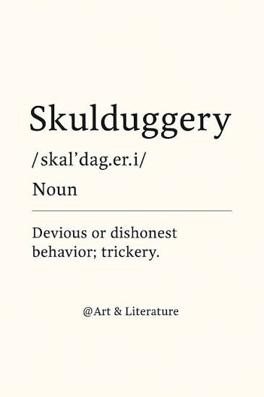
The Ethics of Tricking Witnesses

Slide 71

Deception & Trickery
United States v. Thoreen, 653 F.2d 1332 (9th Cir. 1981).
  Lawyer tricks witness into misidentifying defendant (when identification of defendant was not at issue in the case)
  Contempt of court
  Zealous advocacy or misconduct?

Slide 72
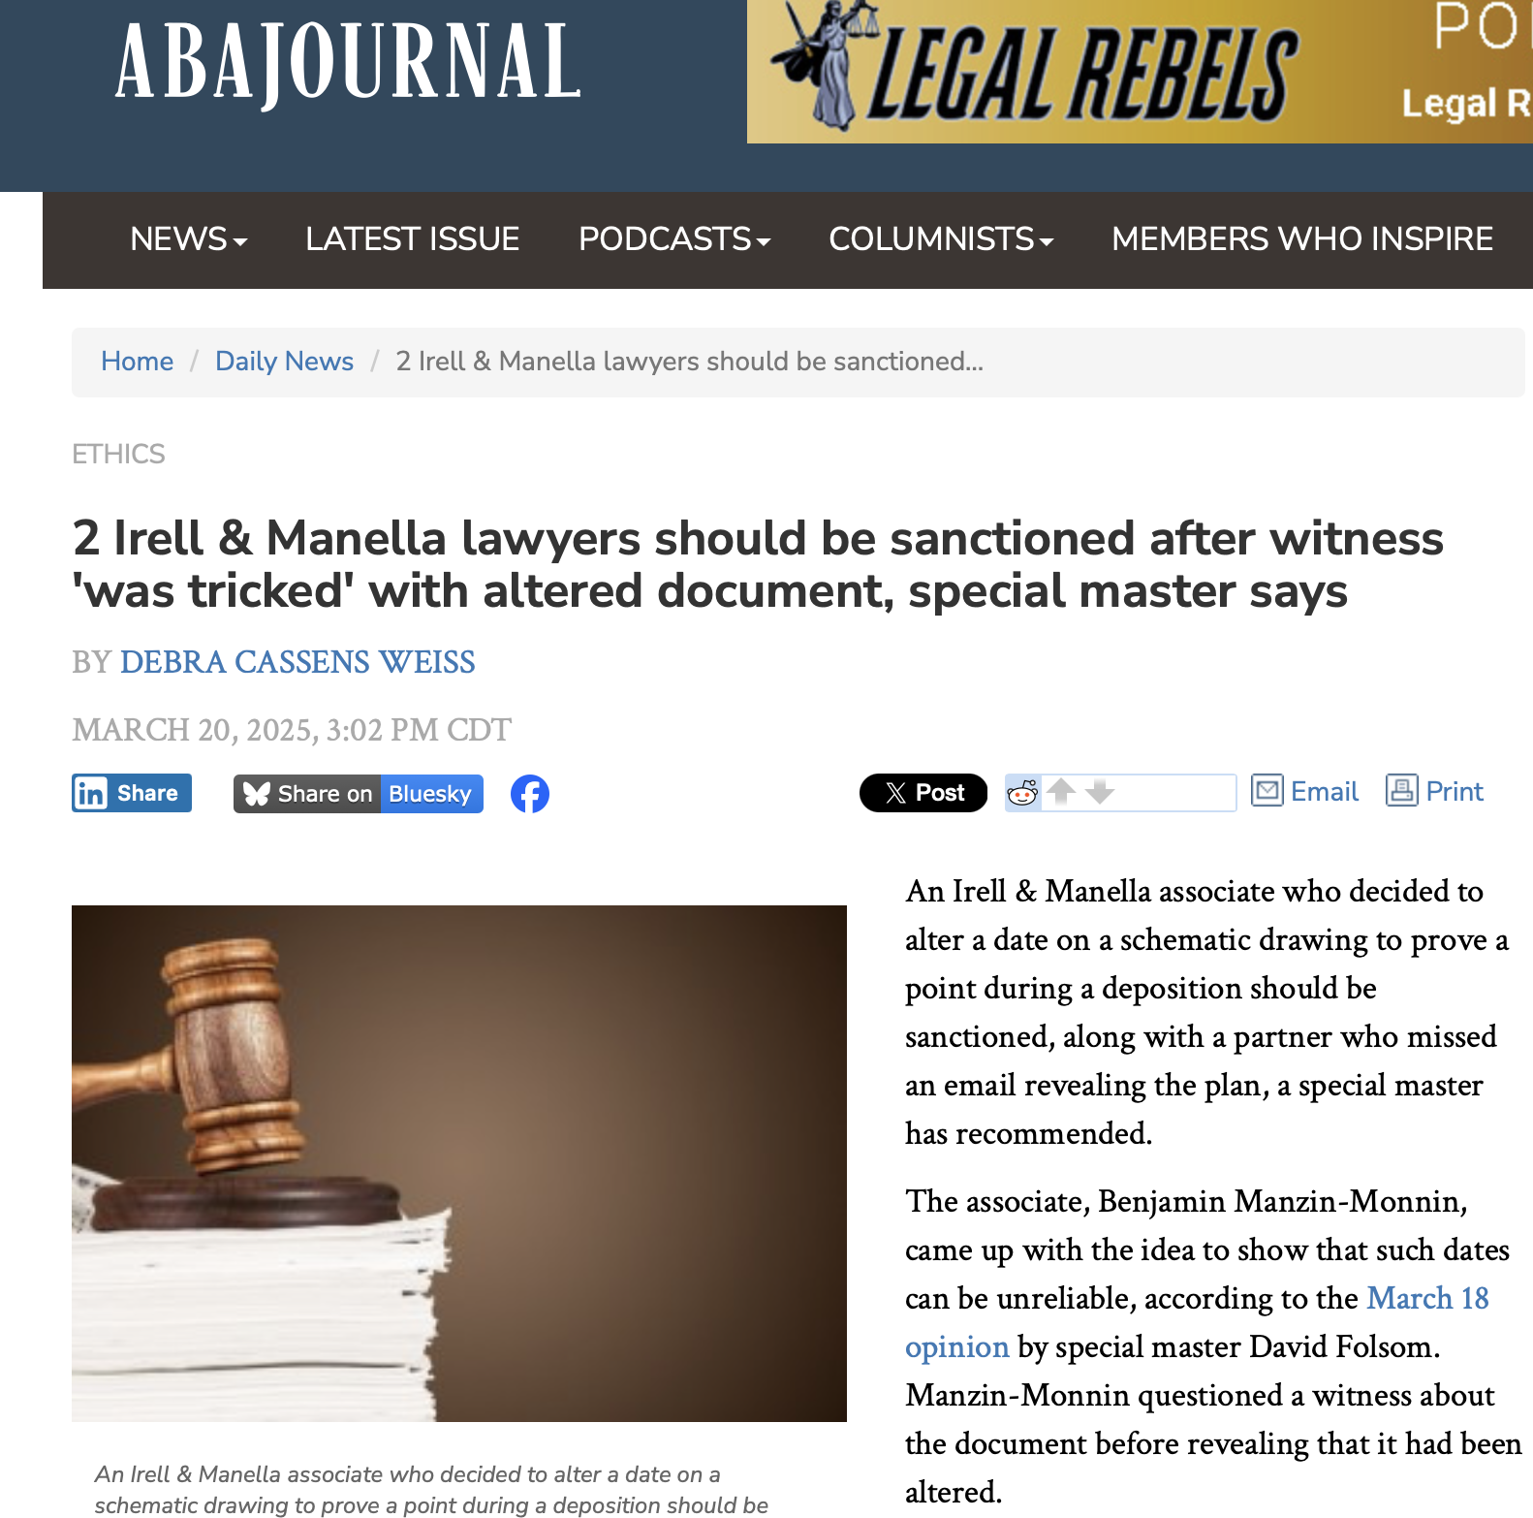
Notes:
An associate altered a date on a schematic drawing and showed the altered drawing to a witness at a deposition without telling the witness it had been altered. He did so in order to prove that the dates on such documents can be unreliable. He then showed the witness the actual document. The associate had mentioned his plan to do this in an email to a partner, which the partner never read. There are multiple possible rule violations.

Slide 73
Potential Rule Violations
• Rule 3.3(a)(1): “A lawyer shall not knowingly make a false statement of material fact or
law to the tribunal.”
• Rule 3.3(b): “A lawyer shall not knowingly offer or use evidence that the lawyer
knows to be false.”
• Rule 3.4(b): “A lawyer shall not falsify evidence.”
• Rule 8.4(c): “A lawyer shall not engage in conduct involving dishonesty, fraud, deceit
or misrepresentation.”
• Rule 5.1(c)(2): “A lawyer shall be responsible for another lawyer's violation of these rules
if the lawyer has managerial authority in the law firm in which the other lawyer practices,
or has direct supervisory authority over the other lawyer, and knows of the conduct at a
time when its consequences can be avoided or mitigated but fails to take reasonable
remedial action.”

Slide 74
Notes:
Court sanctioned the two lawyers: (1) the lawyers had to pay fees and costs incurred by the special master and the other party in connection with the sanctions motion; (2) he firm’s client was stripped of an hour of trial time in its patent infringement case; (3) the two lawyers had to attend 30 hours of ethics training; and (4) the entire firm had to undergo an in-house ethics training session.

Slide 75
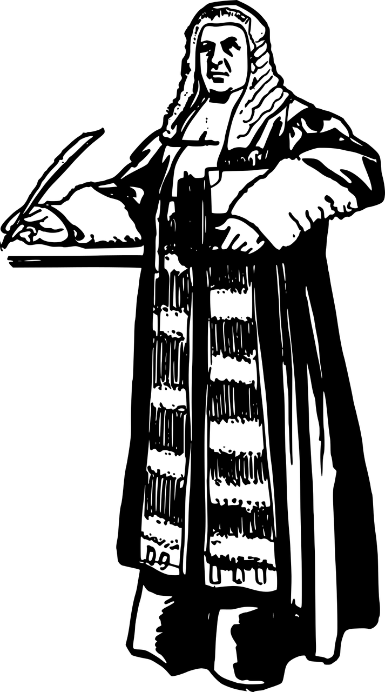
ABA Ethics Opinion 522: Lawyer’s Obligation to Disclose Information About Grounds for a Judge’s Disqualification

Slide 76

ABA Ethics Opinion 522: Lawyer’s Obligation to Disclose Information About Grounds for a Judge’s Disqualification
A lawyer learns that co-counsel for another party in a consolidated civil action has engaged the judge’s spouse’s law firm for related consulting work on discovery strategy. depositions.
As a partner in the firm, the spouse is likely to benefit financially from the engagement. So, recusal on the part of the judge would be required.
Does the lawyer have an obligation to notify the judge about these facts?

Slide 77
ABA Ethics Opinion 522: Lawyer’s Obligation to Disclose Information About Grounds for a Judge’s Disqualification
under ABA Model Rule of Professional Conduct 8.4(d), lawyers are prohibited from engaging in conduct that is "prejudicial to the administration of justice."
when a lawyer knows of information reasonably likely to trigger a judge’s disqualification obligation under the Model Code of Judicial Conduct, the lawyer has an affirmative duty to speak up.
Limitation: “Absent the client’s informed consent or an applicable exception to the duty of confidentiality, … the duty to disclose information reasonably likely to require recusal is subject to the duty of confidentiality under Model Rule 1.6(a) when that information is “relating to the representation of a client.”

Slide 78
ABA Ethics Opinion 522: Lawyer’s Obligation to Disclose Information About Grounds for a Judge’s Disqualification
A lawyer learns that co-counsel for another party in a consolidated civil action has engaged the judge’s spouse’s law firm for related consulting work on discovery strategy. depositions.
As a partner in the firm, the spouse is likely to benefit financially from the engagement. So, recusal on the part of the judge would be required.
Does the lawyer have an obligation to notify the judge about these facts?

Slide 79
ABA Ethics Opinion 520:A Lawyer’s Obligation to Convey Information to a Former Client or Successor Counsel

Slide 80
ABA Ethics Opinion 520: A Lawyer’s Obligation to Convey Information to a Former Client or Successor Counsel
Lawyer represented a client in the sale of a business. After negotiations began, the client became dissatisfied with the lawyer’s services and obtained successor counsel, who then requested the file from the lawyer. When reviewing the file, successor counsel could not determine why a specific term had been omitted from the most recent draft of the proposed terms of sale, and the client cannot recall any discussion with the lawyer about it.
Successor counsel calls Lawyer to learn about the omission of the term. Must Lawyer answer Successor counsel’s questions?

Slide 81
TRPC Rule 1.16: Declining or Terminating Representation
(d) A lawyer who is discharged by a client, or withdraws from representation of a client, shall, to the extent reasonably practicable, take steps to protect the client's interests.

Slide 82
ABA Ethics Opinion 520: A Lawyer’s Obligation to Convey Information to a Former Client or Successor Counsel
Model Rule 1.16(d) requires a lawyer to respond to requests for information from former clients or successor counsel in certain limited circumstances when doing so is necessary to protect client interests and reasonably practicable.
Ordinarily, such a request will require a response when the requested information was acquired by the lawyer during the course of the representation, is unavailable from other sources, and is important to the client’s interests in the matter in which the lawyer formerly represented the client.
Rule 1.16(d) does not require a lawyer to take steps to acquire new information, generate written responses, or provide further legal services to the client in response to a request for information.

Slide 83
ABA Ethics Opinion 520: A Lawyer’s Obligation to Convey Information to a Former Client or Successor Counsel
Lawyer represented a client in the sale of a business. After negotiations began, the client became dissatisfied with the lawyer’s services and obtained successor counsel, who then requested the file from the lawyer. When reviewing the file, successor counsel could not determine why a specific term had been omitted from the most recent draft of the proposed terms of sale, and the client cannot recall any discussion with the lawyer about it.
The lawyer must answer successor counsel’s questions about the omission of the term, to the extent that the lawyer is able to do so, because the information requested is important to a full understanding of the status of the ongoing transactional matter and it is reasonably practicable for the lawyer to provide the information.

Slide 84
2026 Tennessee Legal Ethics Update
Professor Alex B. Long, University of Tennessee College of Law

