Slide 1

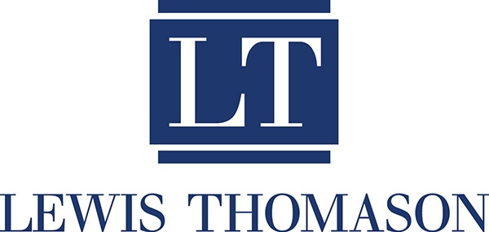
AI in the Workplace a/k/a “AI for Dummies”
Janet Strevel Hayes
Email: JHayes@LewisThomason.com

Slide 2
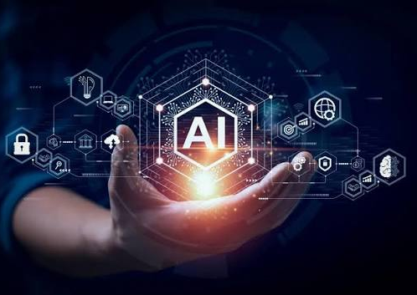
What is Artificial Intelligence?
Technology that enables computers to perform tasks that typically require human intelligence.
Understanding language
Recognizing patterns
Learning from experience
Solving problems
Generating content

Slide 3

Who Uses AI?

Slide 4


Slide 5
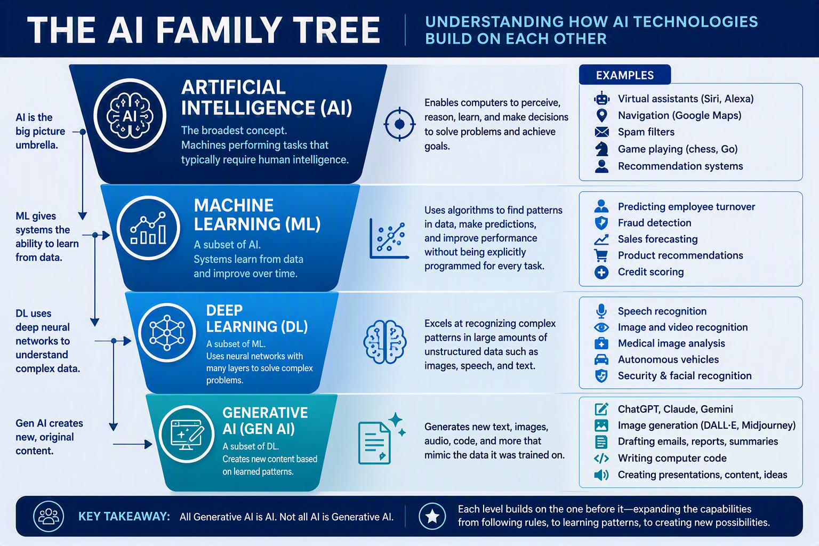
The AI Family Tree

Slide 6

Imagine you receive 10,000 emails
Traditional AI = Sorts emails using rules
Machine Learning = Learns which emails are important.
Deep Learning = Understands context and language
Generative AI = Drafts responses and summaries

Slide 7
What We Know about AI in the Workplace
Increased productivity
Faster drafting and research
Better data analysis
Improved customer service
Administrative efficiency

Slide 8
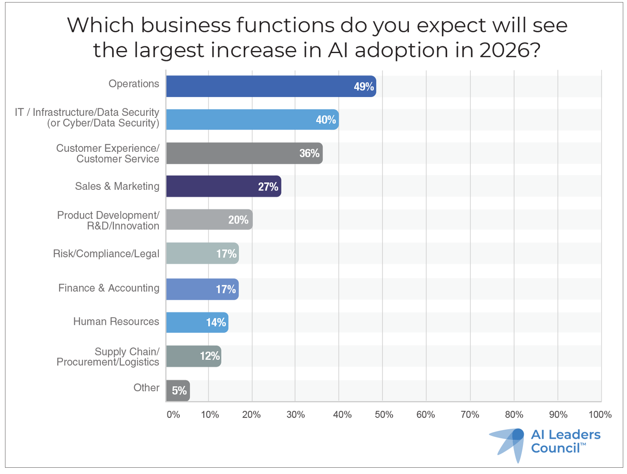

Slide 9
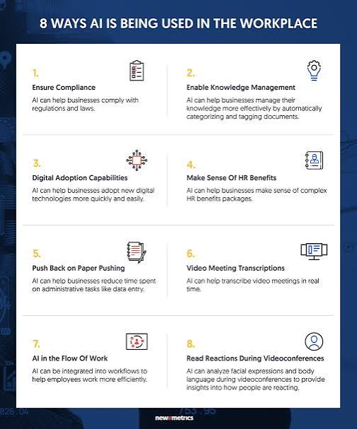
Ways AI is Being Used in the Workplace

Slide 10

AI in EDUCATION
AP Top Headlines
New York school pauses plan to deploy humanlike AI robot teacher after backlash
by: PHILIP MARCELO, Associated Press
Posted: Jul 28, 2026 / 06:08 PM CDT
Updated: Jul 28, 2026 / 06:13 PM CDT
HEADLINE:
Salamanca schools to introduce AI-powered robot assistant, leadership assures no teacher replacements

Slide 11
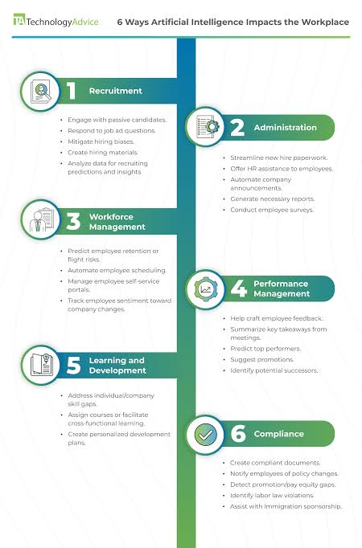
AI in Human Resources

Slide 12
Five Issues and Concerns Surrounding AI in the Workplace

Slide 13
Five Significant Concerns
1. Confidentiality
2. Discrimination and Bias
3. Inaccurate or Hallucinated Outputs
4. Intellectual Property and Copyright Risks
5. Privacy and Employee Monitoring Concerns

Slide 14
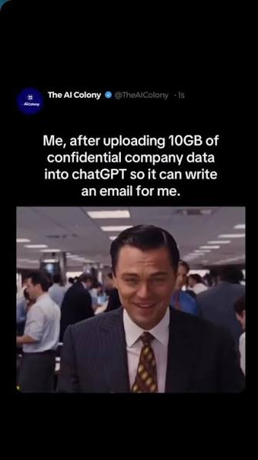
Issue #1: Confidentiality
Many employees treat AI like a trusted coworker.
Some of the AI employees use may be hosted on systems outside the employer’s control – yet employees are uploading confidential, proprietary, privileged, or personal information.

Slide 15
Real World Example of Confidentiality Concerns
Samsung’s ChatGPT Data Leak (2023) – Samsung engineers uploaded confidential source code and internal meeting information while seeking assistance solving technical problems. Samsung ultimately banned use of public generative AI tools on company systems while it evaluated safeguards.
There was no hack - employees voluntarily shared information.

Slide 16
Pending Litigation
Privacy Litigation Against Open AI: 2026 proposed class action alleges that user interactions with Chat GPT were shared with third-party technologies while users expected the information to remain confidential. Allegations remain unresolved.
AI Training Data Litigation: Several lawsuits against AI developers challenge how information is stored and used for AI training. Active litigation (and regulatory scrutiny) surround how information submitted to AI is later used.

Slide 17
Is it likely the most dangerous lawsuit has not yet been filed?
Scenario: HR manager uploads:
Complaint investigation notes
Sexual harassment interviews
Medical restrictions
Disciplinary records
Notes from discussion with counsel
Terminated employee later discovers the upload. What claims might arise?

Slide 18
Invasion of Privacy?
Negligence?
ADA privacy violations?
HIPPA-related allegations (if covered entities are involved)?
Privilege waiver arguments?
Breach of contract?
Defamation?
Critical Point: Most organizations have not fully considered these risks. We worry about technology stealing information. We need to worry about employees voluntarily giving it away.

Slide 19
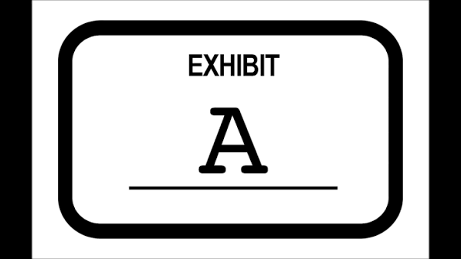
Takeaway #1
Always consider “How will my chat look if it becomes Exhibit A?”

Slide 20
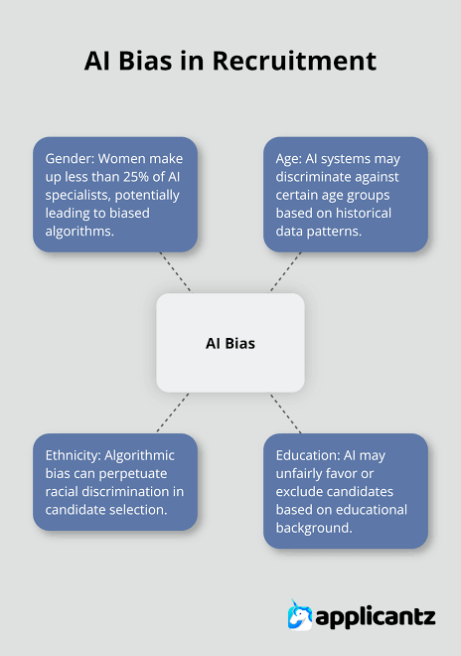
Issue 2: Discrimination and Bias
Probably the largest employment-law risk
Remember, employers can be liable for “disparate impact” even when no human intended to discriminate

Slide 21
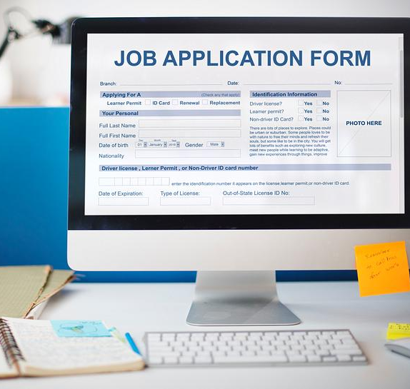
Hiring Process
Artificial intelligence is increasingly used in hiring to screen large numbers of applicants efficiently.
Employers rely on algorithms to identify top candidates quickly, but these systems could replicate or amplify discriminatory hiring practices.
There is a concern that anti-discrimination laws such as Title VII, the ADA, the ADEA, etc. adequately address the issues created by AI hiring tools.

Slide 22

Hirevue Investigation (2019)
Factual Background:
  HireVue used AI video analysis to evaluate candidates based on facial expressions, tone, and word choice to generate employability scores.
Issue:
  Whether AI analysis of biometric data creates discriminatory hiring practices, particularly against non-native speakers, disabled candidates, and minorities. (FTC Investigation)

Slide 23
Hirevue Investigation cont…
Holding:
  After an EEOC complaint, HireVue discontinued its facial analysis feature in 2021 but continues using other forms of AI assessment.
Significance:
  Highlighted risks of bias in biometric and behavioral AI analysis
  Increased scrutiny over transparency and fairness in AI hiring
  Demonstrated that AI tools can have discriminatory effects even without intent

Slide 24

EEOC v. iTutorGroup
(employer liability)
Factual Background
  iTutorGroup used recruiting software that allegedly automatically rejected female applicants over 55 and male applicants over 60.
  Over 200 applicants were affected.
Issue
  Whether an employer violates anti-discrimination laws when its AI system excludes applicants based on age.
Holding
  Settled in 2023—company paid $365,000, revised hiring practices, and agreed to oversight by the EEOC.
Significance
  First major enforcement case targeting AI hiring bias
  Established that employers cannot avoid liability by blaming third-party AI vendors
  Reinforced that ADEA and Title VII apply to algorithmic decisions

Slide 25

Mobley v. Workday, Inc.
(technology vendor as agent of employer)
Factual Background:
  Derek Mobley, an African American man over age 40 with disabilities, applied to over 100 jobs through companies using Workday’s AI hiring platform and was rejected each time.
  He alleged that Workday’s algorithmic screening tools used AI and machine learning to evaluate applicants and systematically excluded candidates based on race, age, and disability.
Issue:
  Whether a third-party AI vendor (Workday) can be held directly liable under federal anti-discrimination laws for discriminatory hiring outcomes caused by its algorithmic screening tools.

Slide 26
Mobley v. Workday, Inc. cont…
Holding:
The court granted in part and denied in part Workday’s motion to dismiss (July 12, 2024):
Rejected the claim that Workday was an “employment agency”
Allowed claims to proceed under the theory that Workday may act as an“agent” of employers, and thus can be liable for discrimination
Impact:
Marks one of the first major cases to expand liability to AI vendors, not just employers
Introduces the “agency theory” for AI tools in hiring
Signals that both employers and software providers may be responsible for biased AI outcomes
Considered a landmark case shaping the future of AI employment law

Slide 27
Takeaway #2
You cannot outsource discrimination liability to a software vendor.

Slide 28
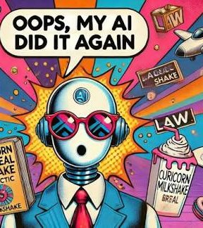
3. Inaccurate or Hallucinated Outputs
AI systems frequently generate information that sounds convincing but is entirely wrong.

Slide 29
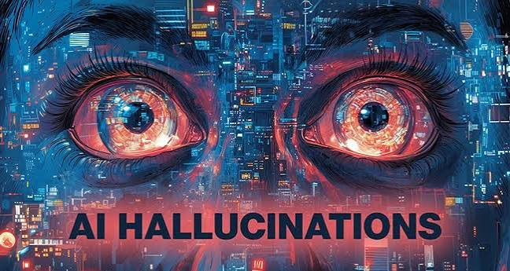
Hallucinations or Fraud?
Mata v. Avianca (2023):
Facts: Attorneys submitted a brief containing fictitious cases generated by ChatGPT. The chatbot also invented fake quotes and internal citations. Attorneys sanctioned
Whiting v. City of Athens (2026):
Facts: Tennessee attorneys submitted over two dozen fake citations generated by AI. Sixth Circuit Court of Appeals ordered them to pay double costs, attorney fees and $15k each in punitive damages.

Slide 30
If not Discrimination, what about the FCRA?
Kistler v. Eightfold (2026)
Factual Allegations: AI hiring platform (used by Microsoft, Starbucks, Chevron and others) scraped social media profiles, location data, internet activity, and tracking data. Candidates were given score from 0-5. Lower ranked applications were rejected prior to human review.
Legal Allegations: The AI scores functioned as “consumer reports” and applicants were rejected without FCRA protections. (not given copy of the reports and never given a chance to dispute errors)

Slide 31
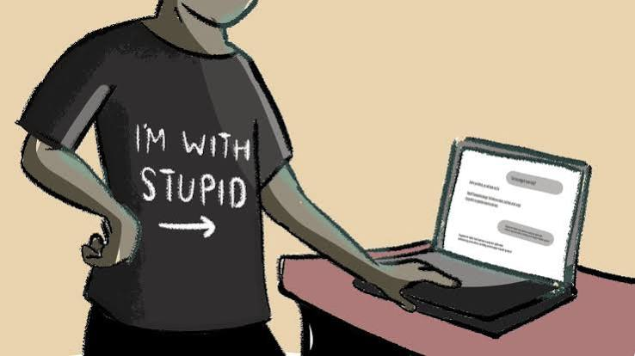
Takeaway #3
AI’s Confidence Currently Exceeds AI’s Abilities

Slide 32
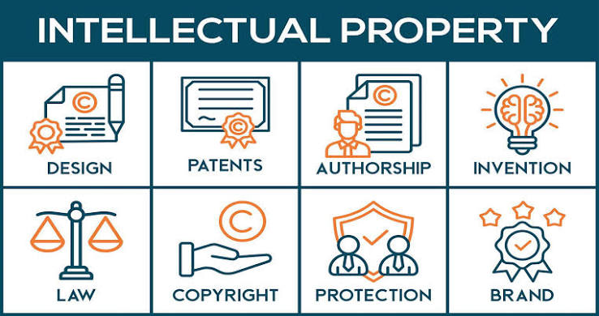
4. Intellectual Property and Copyright Risks

Slide 33
Employee uploads confidential or proprietary information
Ex: Engineer copies source code for the company’s proprietary software into ChatGPT and asks “Can you improve this code and make it more efficient?”
Issues:
Loss of trade secret protection?
Violation of customer contracts?

Slide 34
AI Generates Material That Infringes Someone Else’s Copyright
Ex: Marketing employee asks AI to “Create a brochure in the style of Disney” or HR employee asks AI to “Write a training manual using content similar to this handbook.”
Issues:
Copyright infringement claims?
Reputational harm?

Slide 35
Employer Assumes AI-Generated Content Belongs to the Company
Ex: Marketing department uses AI to create website copy, advertisements, and images. The company assumes it owns a copyright in everything generated.
Issues:
Current US Copyright law generally requires human authorship for copyright protection. AI-generated works may not qualify.
Competitor may be able to copy AI-generated material and employer will have limited protection.

Slide 36
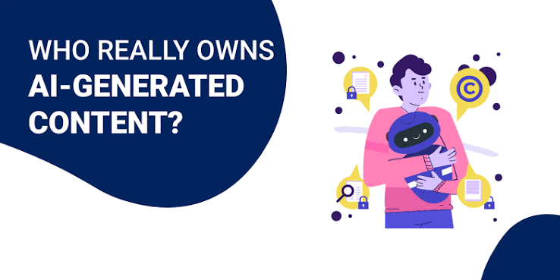
Takeaway #4
Do not assume AI-generated content is either legally safe to use or automatically owned by your company.

Slide 37
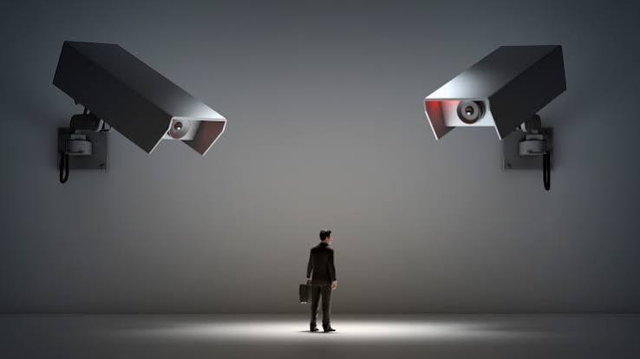
4. Privacy and Employee Monitoring

Slide 38
What can AI Monitor?
Modern AI tools can analyze much more than traditional workplace monitoring systems:
Email activity
Video communications and meetings
Keystrokes and mouse movements
GPS and location data
Badge swipes and building access
Sentiment and tone analysis of communications
Productivity metrics

Slide 39
Where are legal risks?
Lack of transparency (significant concern when monitoring becomes automated or difficult for employees to understand.)
Inadvertent collection of sensitive data (medical data, religious practices, family responsibilities)
Incorrect conclusions (productivity scores, behavioral profiles and attrition predictions can lead to decisions based on flawed assumptions rather than actual performance)

Slide 40
Takeaway #5
The legal risk is not that AI monitors employees; the legal risk is when employers rely on AI-generated conclusions without transparency and human verification/judgment

Slide 41
Government Concerns
Predictive Policing
Mass Human Surveillance

Slide 42

Major Concerns with Predictive Policing
Bias & Discrimination
  Reflects unequal policing patterns
Lack of Transparency
  Algorithms often not explainable, no way to gauge where info is coming from
Low Accuracy
  Some systems show <1% success rate
Constitutional Concerns
  1st Amendment (protest locations often flagged and over-polticed)
  4th Amendment (unreasonable searches and seizures)
  14th Amendment (equal protection)

Slide 43
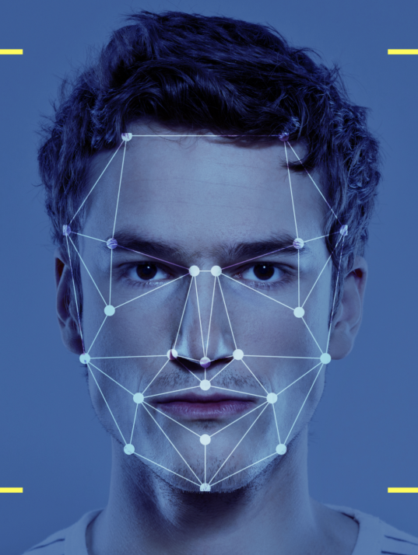
Mass Human Surveillance
AI enables governments and companies to monitor large populations in real time at unprecedented levels
Tools like facial recognition, data tracking, and predictive algorithms can track human behavior and movement
This raises risks of violations of privacy and civil liberties
Individuals could be monitored without consent or awareness
Could lead to abuse of power or targeting of certain groups
This Photo by Unknown Author is licensed under CC BY-ND

Slide 44
QUESTIONS?
Janet Strevel Hayes, J.D.
Lewis Thomason

