Slide 1
FMLA
From Full Leave, to Intermittent, to Retaliation
A comprehensive guide for HR & Management
Employment Law Seminar

Slide 2
FMLA AT A GLANCE
12
50+
12
1,250
Weeks of
Protected Leave
Employees to
Qualify
Months of
Employment
Hours Worked
to Qualify
Per 12-month period
Within 75-mile radius
Prior to leave
In the past 12 months
The Family and Medical Leave Act (FMLA) of 1993 entitles eligible employees of covered employers to take unpaid, job-protected leave for specified family and medical reasons.

Slide 3
QUALIFYING REASONS FOR FMLA LEAVE
01
Birth & Bonding
02
Adoption / Foster
Birth of a child and to care for the newborn within the first year
Placement of a child for adoption or foster care within a year
03
Serious Health Condition
04
Family Care
Employee's own serious health condition that renders him/her unable to perform essential job functions
To care for a spouse, child, or parent with a serious health condition
05
Military Exigency
06
Military Caregiver
Qualifying exigency related to covered member's active duty
To care for a covered servicemember with a serious injury or illness (up to 26 weeks rather than only 12)

Slide 4
FULL CONTINUOUS LEAVE
Key Characteristics
Employer Obligations
Single uninterrupted block of time
Most predictable form of FMLA leave
Easier to schedule coverage & plan for employers
Must provide 30-day advance notice, when possible
Medical certification required within 15 calendar days, when possible / reasonable
Job restoration rights upon return
Maintain health benefits throughout leave
Designate leave as FMLA-qualifying within 5 business days
Provide Notice of Eligibility & Rights (Form WH-381)
Provide Designation Notice (WH-382)
Should not require employee to use PTO concurrently (unless policy requires it)
Restore to same or equivalent position
Cannot count FMLA leave in attendance policies, i.e. no negative connotations
Communicate clearly — document all interactions, requests, etc.

Slide 5
INTERMITTENT LEAVE
Intermittent leave is taken in separate blocks of time or by reducing the normal weekly or daily work schedule — and is often the most challenging form of FMLA to manage practically.
When It Applies
Chronic serious health conditions (e.g., migraines, asthma, Crohn's disease) | Pregnancy-related conditions | Post-surgery recovery with recurring appointments | Caring for a family member with a chronic condition(s)
Employee Notice Requirements
Must give notice as soon as practicable (typically same day or next day) | 30-day advance notice when leave is foreseeable | Must follow call-out procedures if they don't conflict with FMLA | Must provide enough information for employer to recognize FMLA trigger, but not full access
Employer Rights & Tracking
Track leave in the smallest increment used for other leave (min: 1 hour) | May temporarily transfer employee to alternate position during intermittent leave | Require recertification every 6 months or when circumstances change | Request fitness-for-duty certification upon return from each absence (if policy applies)

Slide 6
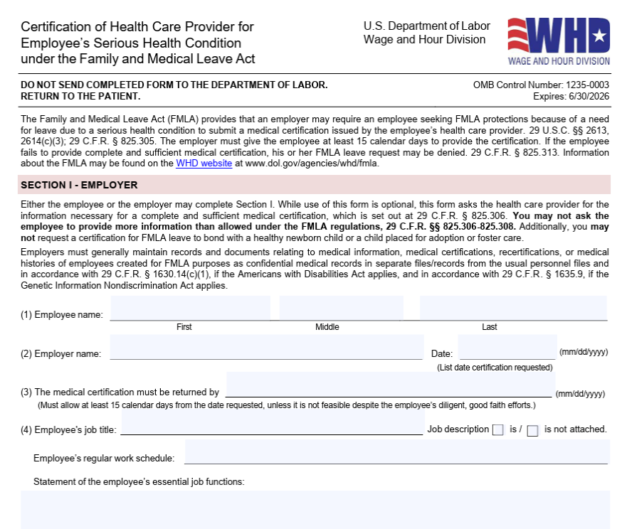

Slide 7
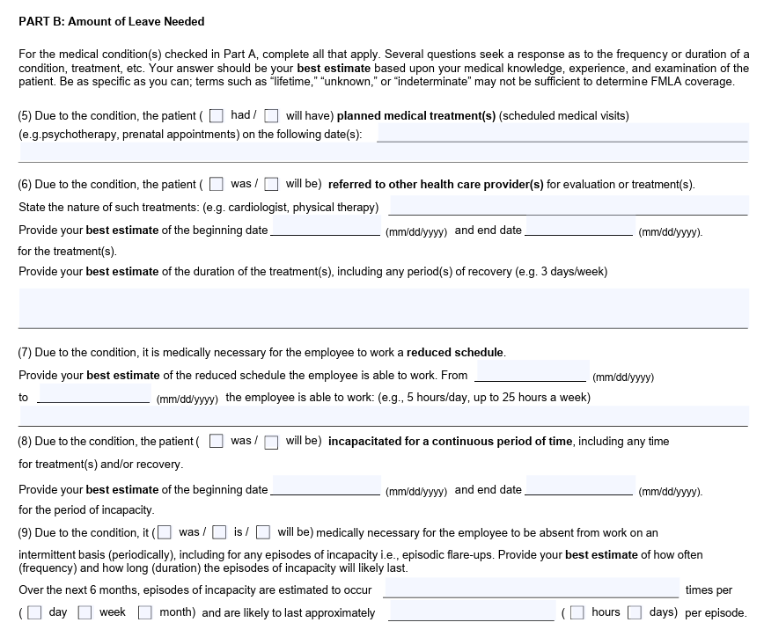

Slide 8
MANAGING INTERMITTENT LEAVE: BEST PRACTICES
✓ DO
✗ DON'T
Document every absence with date, time, and reason provided
Track running tally of FMLA hours used vs. available
Require employee to follow standard call-out procedures
Request recertification when pattern changes significantly
Communicate absence impacts professionally and neutrally
Consult HR/Legal before taking any adverse action(s) against employee
Count FMLA absences in attendance or discipline records
Require more notice than 'as soon as practicable’ (BE REASONABLE)
Deny leave based on operational inconvenience alone
Contact the healthcare provider directly (Likely ADA and/or HIPAA violation)
Express frustration or hostility about usage
Fail to designate qualifying absences as FMLA

Slide 9
FMLA RETALIATION: UNDERSTANDING THE RISK
Legal Definition: It is unlawful for any employer to interfere with, restrain, or deny the exercise or attempt to exercise any FMLA right. Employers may not retaliate against employees who file complaints or participate in FMLA proceedings. (29 U.S.C. § 2615)
Common Forms of FMLA Retaliation
Termination
Demotion
Negative Reviews
Firing employee during or shortly after FMLA leave (temporal proximity cases)
Reducing role, pay, or responsibilities upon return, or when taking intermittent
Downgrading performance ratings for or related to FMLA absences
Schedule Changes
Exclusion
Hostile Environment
Altering shifts or assignments punitively
Leaving employee out of meetings, projects, or advancement opportunities
Treating employee with hostility or creating a chilling effect

Slide 10
RED FLAGS: SITUATIONS THAT INVITE LITIGATION
⚠ Timing
⚠ Shifting Explanations
Scenario: Employee is terminated within days/weeks of returning from FMLA leave
Scenario: Employer gives different reasons for termination at different times
Risk: Courts view close temporal proximity as strong evidence of retaliation
Risk: Inconsistent rationale is a key indicator of pretext
⚠ Attendance Policies
⚠ Documentation Gaps
Scenario: FMLA absences counted toward discipline or termination thresholds
Scenario: No performance documentation prior to FMLA leave, then negative review upon return
Risk: Per se FMLA violation — automatic employer liability
Risk: Lack of prior discipline strongly suggests the leave was the true motivation
⚠ Manager Statements
⚠ Selective Enforcement
Scenario: Supervisor comments about inconvenience, frequency of absences, or team impact
Scenario: Non-FMLA employees treated differently for same policy violations
Risk: Direct evidence of retaliatory motive — can defeat summary judgment
Risk: Disparate treatment is powerful circumstantial evidence

