Slide 1


Hot Topics in
Employee Benefits
Lyndsey Barnett
Partner
lbarnett@bricker.com
513.629.2817
August 27, 2026

Slide 2
Welfare Plan Topics

Slide 3
HDHP Telehealth Relief
IRS NOTICE 2025-5
RELIEF DOES NOT EXTEND TO
PRE-DEDUCTIBLE
▪ In-person services
▪ Equipment furnished with a telehealth visit
▪ Prescription drugs furnished with a telehealth visit
telehealth coverage
HSA eligibility remains intact
Permanently available • Retroactive to January 1, 2025

Slide 4
Direct Primary Care Arrangements
IRS NOTICE 2025-5
HSA ELIGIBILITY
DPCA FEES
HDHP GUARDRAIL
PRESERVED
HSA-PAYABLE
NOT COUNTED
A DPCA is not treated as
disqualifying coverage
Fees may be paid
from the HSA
Membership fees cannot count
toward the deductible or
out-of-pocket maximum
Relief makes direct primary care compatible with HSA participation—within defined limits

Slide 5
Direct Primary Care Arrangements
FIXED PERIODIC MEMBERSHIP FEE
ANNUAL
$150
$300
billing permitted
individual
family
QUALIFYING CONDITIONS
01
Fixed fee
02
Primary care only
03
Outside services
Sole compensation for the arrangement
The term is not defined
Same fee terms for members and non-members

Slide 6
Fertility Benefits – Excepted Benefit
COVERAGE CONDITIONS
LIFETIME MAXIMUM
▪ Employer must offer a group health plan
▪ Participant does not have to enroll
▪ Benefit addresses diagnosis, mitigation or treatment of infertility or related reproductive health conditions
$120K
REQUIRED NOTICE
Clearly describe the fertility coverage

Slide 7
Dependent Care FSA – Nondiscrimination
PROPOSED REGULATIONS
WHAT THE PROPOSAL CLARIFIES
55%
01
Safe harbor
02
Denominator
Eligibility plus facts and circumstances
Counts only employees who contributed
Average benefits provided to
non-HCEs versus HCEs
03
Low earners
04
Employer impact
Benefits and eligibility cannot
favor highly compensated employees.
Employees below $25K may be disregarded
Favorable testing guidance, but 55% remains difficult
The average-benefits test remains the key pressure point

Slide 8
Dependent Care FSA – Correction
CORRECTION PATH
THROUGHOUT
THE YEAR
AFTER THE
FACT
JANUARY 31
Monitor nondiscrimination
testing
Entire benefit is taxable
to the HCE
Report excess as wages
on Form W-2
Status: proposed
Practical step: continue midyear testing

Slide 9
Expanded Fee Disclosure
WHO MUST DISCLOSE
PREVIOUSLY
NOW
APPLIES TO
Brokers &
consultants
TPAs • PBMs
Stop-loss carriers
Ancillary vendors
ERISA health plans
including excepted
benefits
EFFECTIVE
February 3, 2026

Slide 10
Expanded Fee Disclosure
TIMING
INFORMATION TO BE DISCLOSED
IN ADVANCE
01
Services provided
04
Method & manner
How compensation is paid
Before the contract
is entered
02
Fiduciary status
05
Affiliate payments
Compensation between affiliates
60 DAYS
03
Compensation
To disclose changes after
the provider learns of them
Direct and indirect

Slide 11
PBM Transparency – What’s Coming
REPORTING CADENCE
QUARTERLY
REPORT CONTENTS
2×
Drug costs
Spending
Rebates & discounts
if the plan asks
per year minimum
EFFECTIVE FOR PLAN YEARS
CALENDAR-YEAR PLANS
DOL FORMAT
August 3, 2028
January 1, 2029
Within 18 months
Congressional mandate: PBMs must open the books on drug pricing

Slide 12
PBM Transparency – What You’ll See
PLAN SIZE DETERMINES DETAIL
ALL PLANS RECEIVE
ENFORCEMENT
100+
▪ Plain-language participant summary
▪ Spending by drug class and highest-cost drugs
▪ Use of PBM-owned pharmacies
▪ PBM referral fees paid to brokers or consultants
$10,000
participants receive
drug-level detail
per day late
$100,000
Plan paid
PBM kept
Pharmacy received
for false information
Practical value: stronger leverage at the next PBM contract renewal

Slide 13
Rebate Pass Through
REBATES RETURN TO THE PLAN
CONTRACT STANDARD
100%
NO PASS-THROUGH?
must pass through
The PBM contract is
presumptively unreasonable.
APPLIES TO CONTRACTS
Entered into, renewed, or extended on or after August 3, 2028

Slide 14
Retirement Plan Topics

Slide 15
Most amendments are due in 2026
DECEMBER 31 DEADLINES
2026
2028
2029
Pre-approved 403(b) plans
&
General - SECURE, CARES & SECURE 2.0
Collectively bargained – SECURE, CARES & SECURE 2.0
Governmental – SECURE, CARES & SECURE 2.0
The general 403(b) deadline aligns with the broader CARES and SECURE amendment deadline.

Slide 16
LTC distributions avoid 10% penalty
MAXIMUM DISTRIBUTION
What the distribution can do
Lesser of
$2,600
▪ Pay long-term care insurance premiums
▪ Avoid the 10% early withdrawal penalty
▪ Avoid the three-year repayment requirement
▪ Use issuer statements to substantiate the expense
or 10%
of the vested account
Effective December 28, 2025
Plan amendment due December 31, 2027

Slide 17
New Paper Statement Requirement
DEFINED CONTRIBUTION PLANS
DEFINED BENEFIT PLANS
1 YEAR
3 YEARS
At least one paper statement
each year
One paper statement
every three years
Participant choice remains: another delivery method may be requested

Slide 18
Roth catch-ups change for higher earners
RULE STARTS
2025 WAGE TRIGGER
2026
>$150K
Employees above the threshold must make catch-up contributions as Roth
2026 CATCH-UP LIMITS
AGE 50+
AGES 60–63
ERRORS
$8,000
$11,250
Deemed correction
approach required

Slide 19
Roth Catch Ups – Correction
W-2 Option
Revise W-2
Deadline is following 1/31
1099 Option
In-Plan transfer
Adjusted for earnings
Deadline is following 12/31
Not adjusted for earnings

Slide 20
Roth Catch Ups – Correction
WHEN THE PLAN DOES NOT ALLOW
WHAT THE PLAN MUST DO
IN-PLAN
CONVERSIONS
01
AMENDMENT
02
DOCUMENT
No need to amend the plan to allow in-plan conversions
A correction method must be included in the plan document
The plan can still use a documented correction method.
03
CONSISTENCY
Use the same correction method for all similarly situated participants
DE MINIMIS EXCEPTION
<$250
No correction is required for an affected amount under $250

Slide 21
Alternative Investments
POLICY DIRECTION
ASSET
NEUTRAL
Executive
Order
Fiduciary
discretion
Sets the policy
direction
Proposed regulations focus
on the results
Maximum discretion to
select investments
The framework does not favor one asset class over another

Slide 22
Six factors guide safe harbor review
01
Performance
04
Valuation
SAFE
HARBOR
02
Fees
05
Benchmarking
The factors are
non-exhaustive
03
Liquidity
06
Complexity

Slide 23
Trump Accounts
ONE-TIME FEDERAL CONTRIBUTION
ANNUAL CONTRIBUTION LIMIT
INVESTMENT RULE
$1,000
$5,000
Low-cost U.S. equity
index mutual funds
or ETFs
For children born
1/1/25–12/31/28
Tax-advantaged account
for children under 18
BEFORE 18
AT 18
Withdrawals cannot begin
The account is treated like an IRA

Slide 24
Trump Accounts – Employer Contributions
ANNUAL EMPLOYER LIMIT
HOW IT FITS
$2,500
Counts toward the overall $5,000 annual limit per child.
per employee, tax-free
Written plan document
Discrimination rules apply

Slide 25
Trump Accounts – Payroll deductions
CONTRIBUTION PATHWAY
Employee’s
dependents
Employee election
125 plan
Not the employee
LIMIT & OPTIONS
$2,500
After-tax contributions
also allowed
Discrimination rules
apply under proposed
regulations
Shared annual limit per employee
Amend the 125 plan

Slide 26
New Rollover Forms
NOTICE 2026-49
INTENDED OUTCOMES
01
Streamline
02
Communicate
Issued this month
4
sample
forms
the rollover process
directly between plans
03
Standardize
04
Verify
the data set
data accuracy
Electronic communication and transfer if possible
Next step: check with your recordkeeper

Slide 27

Benefit Litigation Update

Slide 28

155 fiduciary class actions filed in 2025 – near a record high
35 of them – 22% – targeted health plans
Second only to 401(k) plans, which drew 63%
More than a dozen companies were sued multiple times in two years
Most cases settle: 60-65% survive dismissal, then discovery costs drive deals
Participants often recover less than $70 each
2025 ERISA Lawsuits

Slide 29
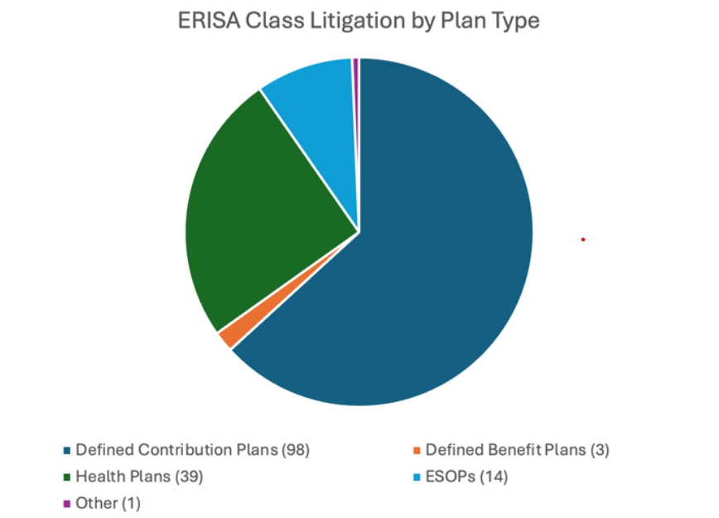
Plan Litigation

Slide 30
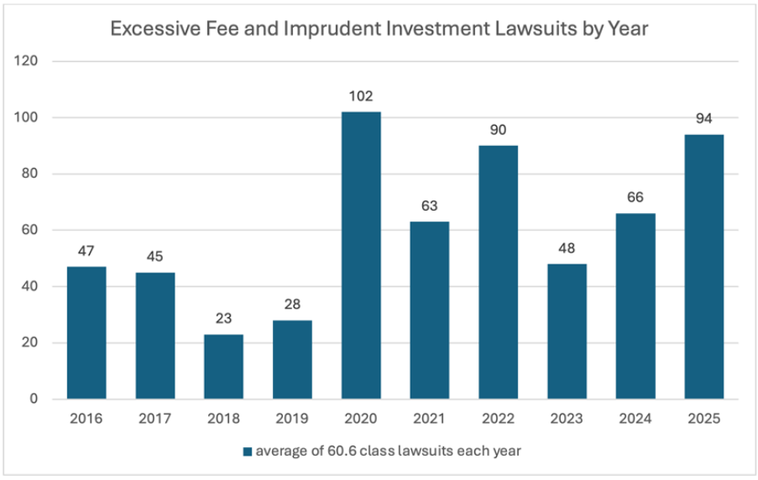
401(k) Plan Litigation

Slide 31
Over 100 cases have been filed
Claim breach for using to offset employer contributions instead of paying plan expenses
Early decisions have largely favored employers
Several employers have settled
8th Cir – first appellate court to rule on issue and found in favor of employer
DOL filed amicus briefs in several cases
Forfeiture
Litigation

Slide 32
Plaintiff firms are moving from the 401(k) market to the health care market
Claim: fiduciaries failed to prudently manage the PBM contract and overpaid for drugs
Key cases – Lewandowski v. Johnson & Johnson, Navarro v. Wells Fargo, and a new case against JPMorgan
Standing has been the sticking point – results so far are mixed
Expect more filings as the new PBM transparency reports arrive
What to do: document your PBM selection and fee review process
Rx Drug & PBM Fee
Litigation

Slide 33
The most common health plan claim filed in 2025
Allegation: the surcharge had no reasonable alternative for quitters to earn the full reward
As many suits in the first three quarters of 2025 as in all of 2024
Courts are letting these cases past the motion to dismiss almost every time
Some allow claims with no proof the participant was actually harmed
What to do: review your wellness program design, alternative standard, and notices
Tobacco Surcharge Litigation

Slide 34
Four class actions filed December 23, 2025 by Schlichter Bogard
Targets included United Airlines, LabCorp, Community Health Systems, and Universal Services of America
At issue: accident, critical illness, cancer, and hospital indemnity coverage
Employers and their brokers were both named as defendants
Claim: failure to monitor broker commissions and negotiate competitive rates
Fiduciary risk applies even though employees pay 100% of the premium
Puts pressure on the DOL safe harbor most employers have relied on
What to do: ask your broker what it earns on every voluntary product
Voluntary Benefit Litigation

Slide 35



Benefits InSight
BLOG
https://graydon.law/category/benefits-insight/

Slide 36


