Slide 1
Labor Law in Transition: Tracking Recent NLRB and Labor Relations Updates
David Broderdorf

Slide 2

David R. Broderdorf
Partner
Washington, DC

Slide 3

Agenda
01
Where are we now?
02
Collective bargaining updates
03
Considerations for non-union workforces

Slide 4
WHERE ARE WE NOW?

Slide 5
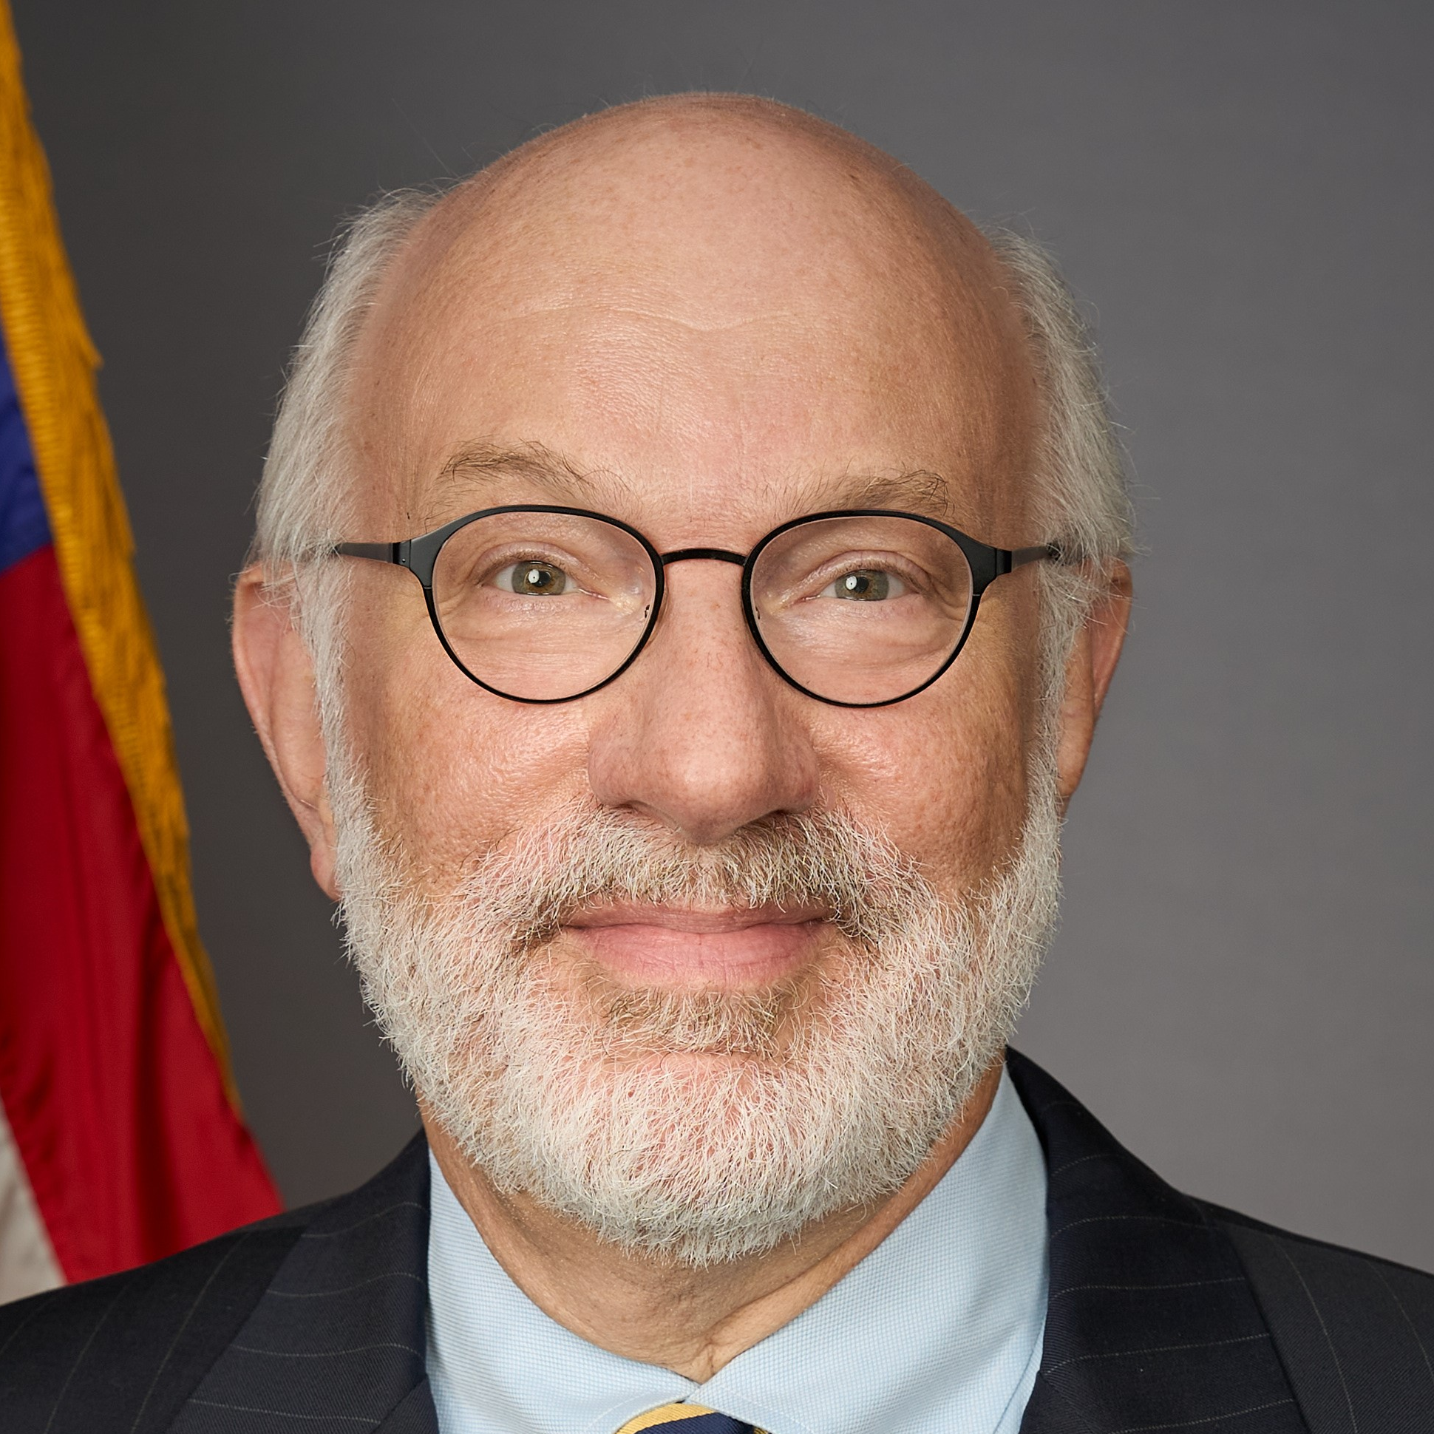

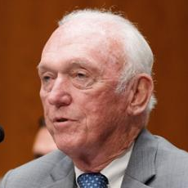
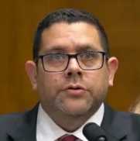
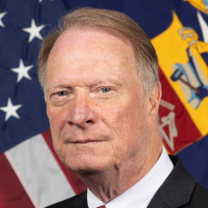
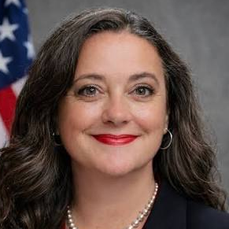
NLRB Political Composition
Big Changes in 2026
DEMOCRATS
REPUBLICANS
David
Prouty
(end of term
8/27/2026)
Vacant
James Murphy
(end of term
12/16/2027)
Scott
Mayer
(end of term
12/16/2029)
Vacant
Crystal Carey
(four-year term)
James Macy
(confirmed for
term ending
8/27/2030)
(confirmed for term ending
8/27/2031)
BOARD MEMBERS
GENERAL COUNSEL

Slide 6
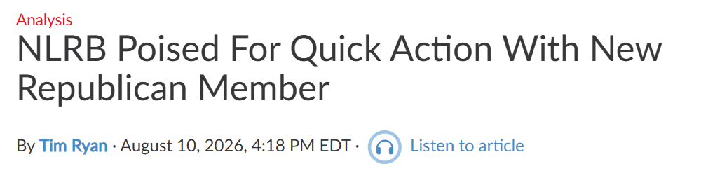
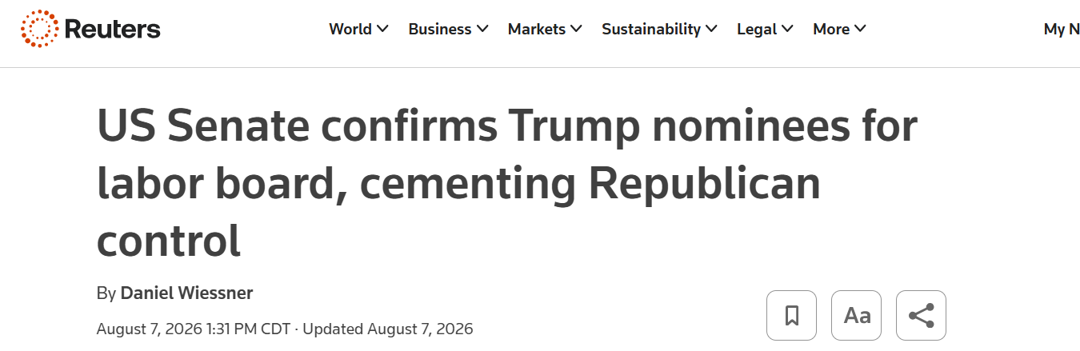
Majority Provides Opportunity For Precedent Shift

Slide 7
Cases Most Likely To Be Reviewed
Cemex Construction Materials Pacific LLC, 372 NLRB No. 157 (2023)
Facts | Holding | Potential Alternative Holding Under Trump Board | Impact on Employers if Overruled
Teamsters claimed majority support and demanded recognition. Employer declined; union sought an election. Numerous ULPs alleged during campaign. | Board substantially altered recognition/election framework. When union demands recognition based on majority support, employer must recognize or promptly petition for an election (~2 weeks). If employer commits ULPs, Board may issue bargaining order without a rerun election. | Restore pre-Cemex election regime: Employer may decline card-based recognition and insist that union petition for election. Bargaining orders reserved for extraordinary circumstances rather than becoming ordinary remedy for election-invalidating ULPs. | Major employer benefit. Reduces risk that campaign conduct converts a lost/invalidated election into mandatory recognition. Restores greater ability to insist upon election and, ordinarily, rerun election after objectionable conduct.

Slide 8
Cases Most Likely To Be Reviewed
Amazon.com Services LLC, 373 NLRB No. 136 (2024)
Facts | Holding | Potential Alternative Holding Under Trump Board | Impact on Employers if Overruled
During union campaign, Amazon required employees to attend meetings at which management communicated its views concerning unionization. | Overruled Babcock & Wilcox and held mandatory/captive-audience meetings violate §8(a)(1). | Reinstate Babcock & Wilcox: Employers may require employees, on paid working time, to attend noncoercive meetings communicating the employer’s lawful views regarding unionization, subject to §8(c) and ordinary prohibitions against threats/promises. | Major employer benefit Restores a central organizing-campaign communication tool. Employers could require attendance rather than relying solely on voluntary meetings. Beware of proliferation of state laws (including CA, IL, MN, NY).

Slide 9
Cases Most Likely To Be Reviewed
Lion Elastomers LLC (Lion Elastomers II), 372 NLRB No. 83 (2023)
Facts | Holding | Potential Alternative Holding Under Trump Board | Impact on Employers if Overruled
Bargaining unit employee engaged in confrontational and insubordinate conduct toward management while engaged in otherwise protected union activity. Employee was disciplined and discharged. | Overruled General Motors and restored setting-specific standards: Applied Atlantic Steel for workplace confrontations; Applied totality-of-circumstances for employee/social-media discussions; Applied Clear Pine Mouldings for picket-line misconduct. | Reinstate General Motors: Board would apply Wright Line to abusive conduct occurring during protected activity and determine whether employer would impose the same discipline for comparable misconduct unrelated to protected activity. | Major employer benefit. More latitude to enforce neutral civility, anti-harassment, anti-discrimination, and workplace-conduct rules against employees engaged in protected activity.

Slide 10
Cases Most Likely To Be Reviewed
Tesla, Inc., 371 NLRB No. 131 (2022)
Facts | Holding | Potential Alternative Holding Under Trump Board | Impact on Employers if Overruled
Tesla required production employees to wear prescribed black “Team Wear.” Employees could add union stickers/insignia but could not substitute union t-shirts for required Team Wear. | Any employer restriction on displaying union insignia or apparel is presumptively unlawful unless justified by special circumstances. Overruled Wal-Mart’s more employer-friendly approach. | Reinstate Wal-Mart: Distinguish a complete prohibition on union insignia from neutral/dress-code restrictions that merely limit the manner of display. Apply more accommodating balancing to neutral dress-code restrictions. | Significant employer benefit. Easier to maintain neutral uniforms, branding, safety, and dress standards while permitting employees some means of displaying union insignia.

Slide 11
Cases Most Likely To Be Reviewed
Stericycle, Inc., 372 NLRB No. 113 (2023)
Facts | Holding | Potential Alternative Holding Under Trump Board | Impact on Employers if Overruled
Employer maintained handbook/workplace rules alleged to chill Section 7 activity. Case became vehicle for reconsidering Boeing work-rule framework. | If a rule reasonably tends to chill Section 7 activity, it is presumptively unlawful. Rule is viewed from perspective of an employee who is economically dependent on employer and inclined to interpret ambiguous rules as restricting Section 7 rights. Employer can rebut by showing a legitimate and substantial business interest that cannot be achieved by a narrower rule. Overruled Boeing and LA Specialty Produce. | Reinstate Boeing or similar balancing/categorical framework weighing potential impact on Section 7 rights against legitimate employer justifications and treating categories of commonplace rules as generally lawful. | Significant employer benefit. Lower risk from handbook provisions concerning confidentiality, workplace conduct, social media, recording, conflicts of interest, investigations, communications, and similar policies. Less need for extensive NLRA carve-outs and hyper-specific drafting.

Slide 12
Cases Most Likely To Be Reviewed
McClaren Macomb, 372 NLRB No. 58 (2023)
Facts | Holding | Potential Alternative Holding Under Trump Board | Impact on Employers if Overruled
Hospital furloughed union employees and offered severance agreements containing broad confidentiality and non-disparagement clauses. | Offering a severance agreement containing provisions that reasonably tend to interfere with Section 7 rights can itself violate §8(a)(1). Overruled Baylor University Medical Center and IGT to the extent those cases declined to scrutinize the agreement’s language itself. | Reinstate Baylor/IGT or a narrower rule under which merely offering a severance agreement containing confidentiality or non-disparagement provisions is generally lawful absent separate coercive circumstances or an actual restriction on protected activity. | Significant employer benefit. Greater ability to use conventional confidentiality and non-disparagement provisions in severance agreements, although statutory carve-outs and other federal/state restrictions would remain important.

Slide 13
NLRB Constitutionality Update
SpaceX challenge to the NLRB’s constitutionality.
The Supreme Court determined constitutionality of FTC Members in Slaughter v. Trump
The Fifth Circuit ruled last July that NLRB and its ALJs are likely unconstitutional, thus allowing employers to stop NLRB complaints from proceeding.
  NLRB Board Members and ALJs have unlawful removal protections;
  NLRB proceedings violate the 7th Amendment right to a jury trial; and
  NLRB unlawfully combines legislative, executive, and judicial functions.
  Applicable to FTC, but broader impact likely to be felt for other administrative agencies
  If President has the authority to remove Board members at-will, what will be the impact on the NLRB after each Presidential election?
  If you have cases in the Fifth Circuit, or the case has a sufficient connection to the Fifth Circuit, consider federal court injunction to block NLRB litigation.
  Other major employers pursued this option (most recently, Volkswagen).
  However, recent district court judge only severed unconstitutional portions.

Slide 14

Appellate Update
Eighth Circuit Home Depot decision (PCA)
  Vacated Board’s decision based on facts of case without addressing broader PCA issues
Sixth Circuit Brown-Forman decision (Board’s adjudicative authority)
  Treats Cemex as “an anomaly” that “attempts to make a general rule that is
  not case-specific and does not further the resolution of the parties’ dispute”
Fifth Circuit Starbucks decision (subpoenas)
  Vacated decision based on Board’s application of incorrect standard for
  issuance of employer subpoena seeking sharing party’s communications
  with the union and other employees
Fifth Circuit Trader Joe’s dissent (Wright Line)
  Enforced Board’s order finding unlawful discharge relying on deference to NLRB consideration of substantial evidence
14

Slide 15
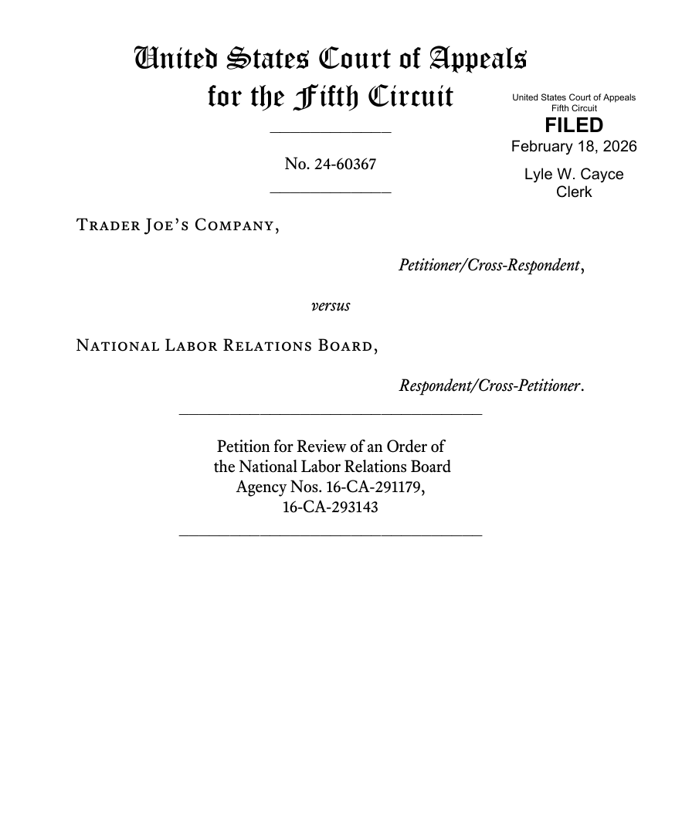
Trader Joe’s – Judge Oldham’s Dissent
“Jill Groeschel was the sort of employee who haunts the nightmares of HR managers everywhere. She berated co-workers and customers with profanity-laden screeds, threatened the lives of her co-workers with heavy equipment, and was the focus of at least a dozen employee complaints. Her conduct obviously violated Trader Joe’s at-will employment policy. Yet the NLRB held that Groeschel’s firing was unlawful— because this California-based, famously-progressive grocery chain harbored some secret animus against people who took COVID seriously? Astonishingly, the majority agrees.”
“The Wright Line test is a legal travesty. The first step places the burden on the Board to uphold its action in federal court in name only. The second step then makes up for it by misallocating the burden to the employer. The Supreme Court deferred to the Board in the old days of Chevron. But today is a new day. And Wright Line should go the same way as the deference regime that blessed it.”

Slide 16
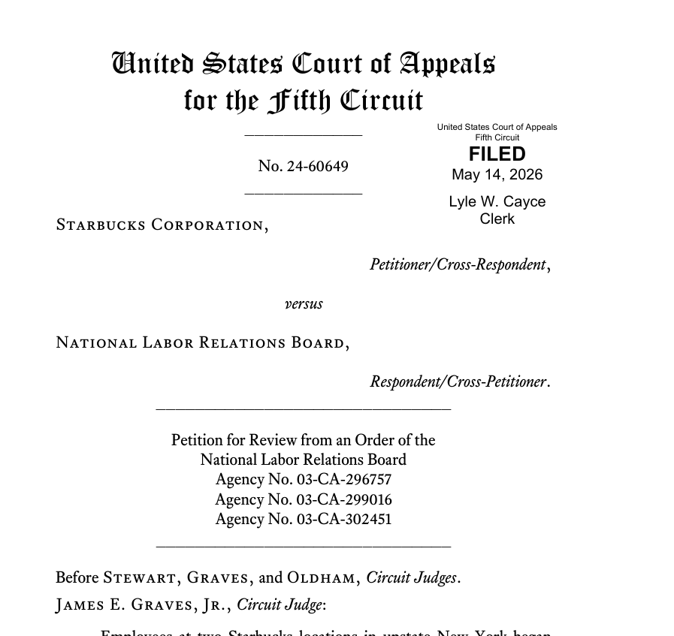
Starbucks (May 14) – Judge Oldham’s Concurrence
“I wholeheartedly agree with my esteemed colleagues that Starbucks’s petition for review must be granted. But I would not remand the matter to the NLRB. The Board has starkly deviated from fairminded, law-based adjudication. See Space Expl. Techs. Corp. v. NLRB, 151 F.4th 761, 778 & n.96 (5th Cir. 2025) (collecting commentary). And this case is yet another example of the Board’s troubling tendencies. Starbucks fired an employee named James Schenk. Why? Because Schenk called his female coworker with a documented medical condition a “dumb f***ing b**ch who can’t even use cleaners” and “useless f***ing [person].” And Schenk called his store manager a “chicken s**t,” a “f***ing c**k[]sucker,” a “f***ing stupid[]” “lizard brain,” and a “[f]***ing [p]***y” who “can suck my f***ing d**k.” ROA.763–66, 979, 1049–50. If a company in this country cannot choose to fire someone for this sort of unhinged abuse, then Heaven help us.”

Slide 17
Appellate Update
D.C. Circuit Hospital Menonita De Guayama decision (successorship bar)
  The D.C. Circuit found the NLRB exceeded its statutory authority in creating the successorship bar.
  Reconsidered in light of Loper Bright.
  “[T]he Hospital’s challenge is not about the reasonableness of the successor bar as a policy judgment. Rather, the Hospital has maintained that the successor bar is inconsistent with the Act and therefore the Board has no statutory authority to impose it.”
  “The Board’s general authority to enforce unfair labor practices cannot justify suspending statutory protections in the collective bargaining relationship.”
17

Slide 18
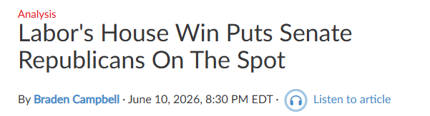
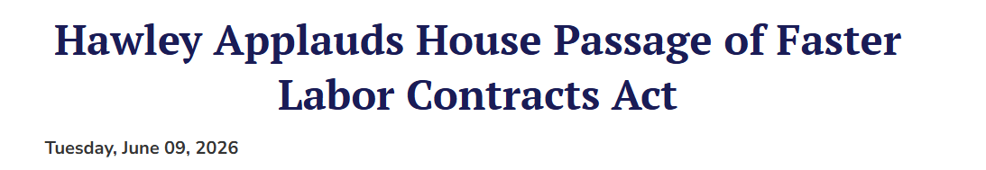
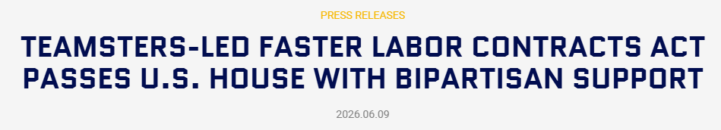
Faster Labor Contracts Act

Slide 19
Faster Labor Contracts Act
Amend Section 8(d) to accelerate “time-to-contract” following certification or recognition of a bargaining representative.
Require parties to meet and begin bargaining within 10 days after the employer receives a written bargaining request from a newly certified or recognized representative, unless the parties agree to a longer period.
If there is no agreement within 90 days after bargaining begins, either party may request assistance from the FMCS.
If mediation does not produce agreement within 30 days after the mediation request, FMCS must refer the dispute to a three-person arbitration panel: one union-selected; one employer-selected; and one neutrally selected by mutual agreement.
Arbitration panel’s decision is binding for two years.
Passed the U.S. House of Representatives on June 9, stalled in Senate.

Slide 20
COLLECTIVE BARGAINING UPDATES

Slide 21
2025 Wage Data

Slide 22
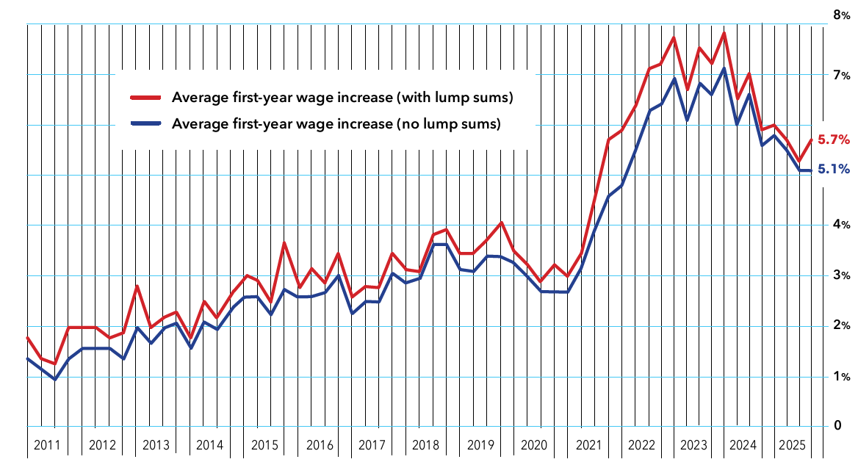
2025 Wage Data – First-Year Wage Increases
Notes:
Source: Bloomberg Union Wage Data 2025

Slide 23
2025 Wage Data – Annual Wage Increase
 | First-Year Increases |  | Second-Year Increases |  | Third-Year Increases
*Percentages in black are WITHOUT lump sum *Percentages in green are WITH lump sum | Average (Avg.) | Weighted Average (W.A.) | Second-Year Avg. | Second-Year W.A. | Third-Year Avg. | Third-Year W.A.
All Industry Sectors | 5.4% (5.7%) | 4.8% (5.6%) | 4.5% (4.5%) | 4.5% (4.7%) | 4.5% (4.5%) | 4.6% (4.7%)
Private Manufacturing | 6.6% (7.6%) | 7.2% (8.2%) | 5.5% (5.6%) | 5.0% (5.1%) | 5.3% (5.4%) | 4.9% (5.0%)
Private Nonmanufacturing | 5.9% (6.2%) | 5.5% (5.7%) | 4.7% (4.7%) | 5.0% (5.0%) | 4.7% (4.7%) | 4.8% (4.9%)
State and Local Government | 4.4% (4.6%) | 3.5% (5.2%) | 3.9% (3.9%) | 3.5% (4.1%) | 3.9% (3.9%) | 3.8% (3.8%)
Notes:
Source: Bloomberg Union Wage Data 2025

Slide 24
2025 Strike Activity

Slide 25
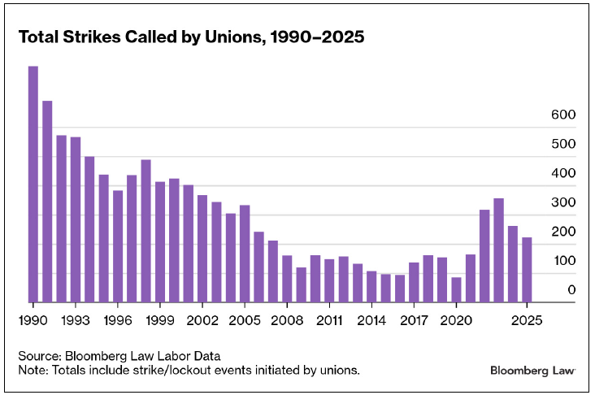
Overall Total Strikes

Slide 26
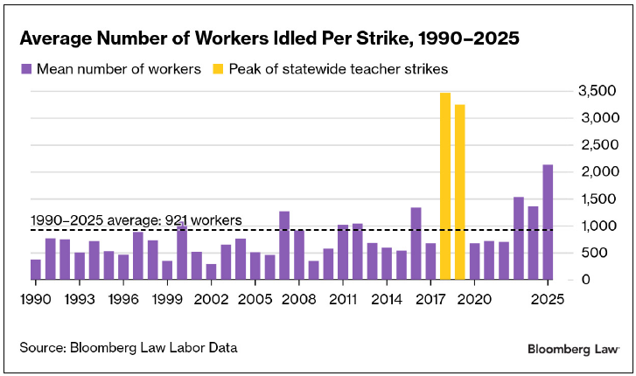
Average Number of Idled Workers

Slide 27
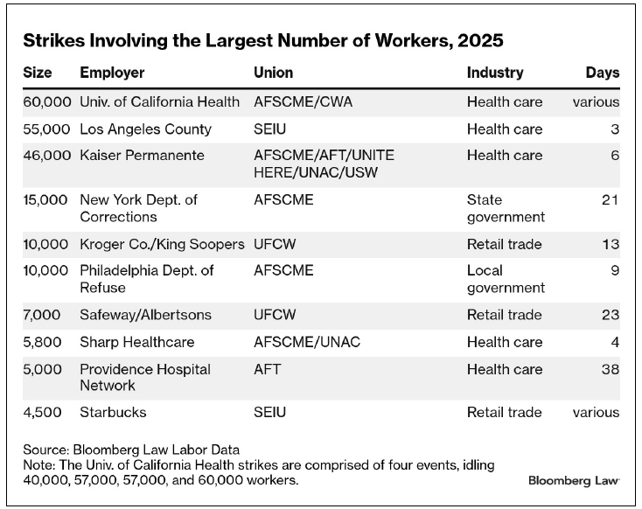
2025 Largest Strikes

Slide 28
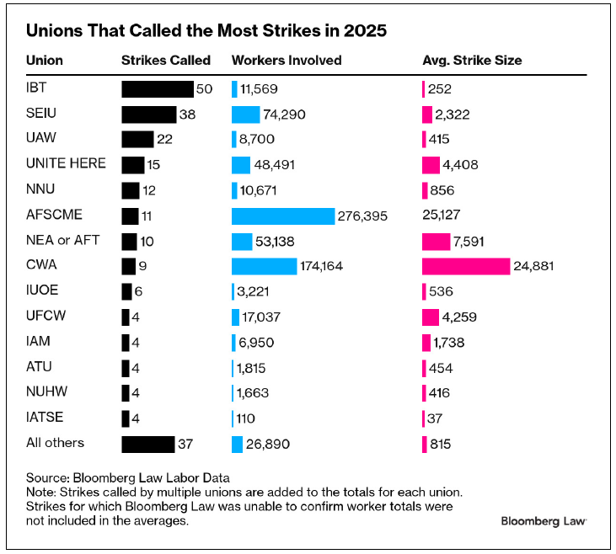
Strike Totals by Union

Slide 29
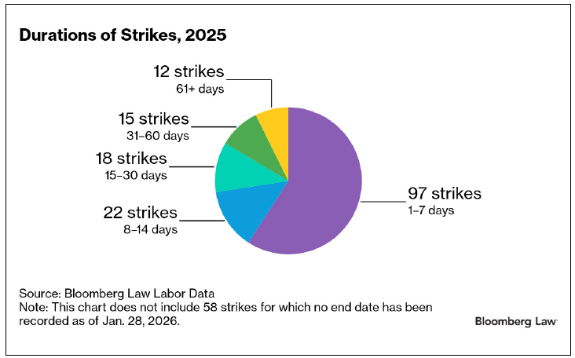
Duration of Strikes

Slide 30
Bargaining Case Studies

Slide 31
1. Sandia National Laboratories
Contract ratified September 19, 2024 with OPEIU Local 251
Sandia National Laboratories are federally funded research and development centers in New Mexico and California
OPEIU represents clerical and administrative workers in Albuquerque, NM
Union characterized increase of 11% during three-year contract as “historic” for bargaining unit
2023 negotiations with the MTC resulted in 23% wage increases over three-year term
  Contract negotiations begin with MTC on August 25, 2026

Slide 32
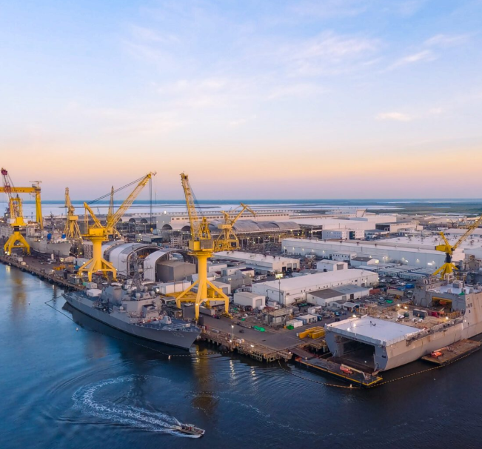
2. Huntington Ingalls
Metal Trades Council (MTC) represents nearly 6,000 workers at Huntington Ingalls’ Shipbuilding facility located in Pascagoula, Mississippi.
First full bargaining cycle in approximately 18 years (prior agreements largely extensions).
MTC pushed for significant improvements to wages, retention, and competitiveness, citing labor shortages and difficulty attracting and keeping skilled workers.
The parties reached a tentative agreement on February 12, 2026, which was ratified on March 12, 2026.
32
Notes:
Ingalls Shipbuilding Workers Secure Historic Pay Rise via New Five-Year Collective Bargaining Agreement – iMarine
This covers roughly 9,000 to 10,000 workers who are critical to U.S. Navy shipbuilding, including aircraft carriers and submarines.
This negotiation took place in a very different labor environment - coming on the heels of the UAW, Boeing, and other high-profile negotiations - so expectations were elevated going in.

Slide 33
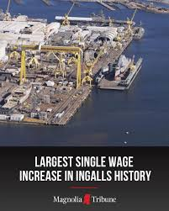
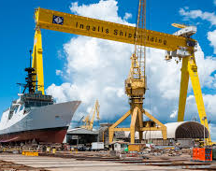
2. Huntington Ingalls/Metal Trades Council (cont’d)
Key Agreement Terms:
  Five-year agreement
  18% immediate across-the-board wage increase
  Total wage growth of approximately 35%–47% over the contract term
  Additional increases of about 10% for high-demand skilled trades
  Maintained healthcare and benefits
  Focus on recruitment and retention improvements
33
Notes:
Ingalls Shipbuilding Workers Secure Historic Pay Rise via New Five-Year Collective Bargaining Agreement – iMarine
This agreement has meaningful economic gains while maintaining operational stability. On wages, the structure is similar to Volkswagen/GM/Ford with larger increases up front, followed by annual raises in later years. There was a focus here on retirement and retention. In the unique dynamics of the defense sector and continuity of production is a key driver in how the negotiations played out.

Slide 34

3. Lawrence Livermore National Laboratory
Contract ratified January 27, 2025
Lawrence Livermore National Laboratory is a federally funded research and development center in Livermore, CA
Workers originally unionized with University Professional and Technical Employees DWA Local 9119 (same as University of California workers), but voted to change affiliation to Building Trades Council of Alamdea County, AFL-CIO
34
34

Slide 35

3. Lawrence Livermore National Laboratory
Key Agreement Terms:
  20% wage increase over five-year contract term
    Year 1: 4.5 percent increase retroactive to January 1 with new step
    Year 2: 3.5 percent increase, with an additional 2% for the specified roles.
    Year 3: 4.0 percent increase, with a mid-term wage survey to assess market competitiveness.
    Year 4: 4.0 percent increase.
    Year 5: 4.0 percent increase.
  Limited supervisor performance of bargaining unit duties
  Increased union access to laboratory
  Paid time for steward activities
35
35

Slide 36
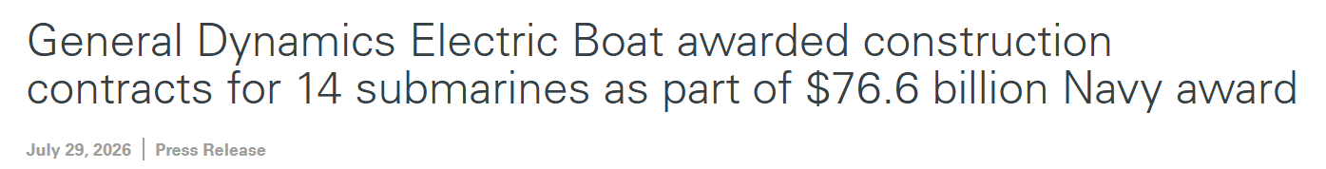
4. General Dynamic Electric Boats
Contract ratified May 28, 2025 with the UAW Local 571 (drafting and engineering group)
General Dynamic Electric Boats builds submarines for the U.S. Navy
Union won 30% wage increases increases over life of the contract

Slide 37

The strong wage package also reflects the goal of special funding Congress approved last December to help submarine shipyards recruit and retain the talented workforce required to execute our nation’s aggressive submarine construction plans.
This has been a challenging, arduous process and all the principals deserve the respect and admiration of the community for their perseverance.
Congressman Joe Courtney

Slide 38

5. General Dynamics Bath Iron Works
Contract ratified March 28, 2026 with the Bath Marine Draftsmen’s Association/UAW Local 3999 (drafting and engineering)
General Dynamics Bath Iron Works full-service shipyard specializing in the design, construction and support of ships for the U.S. Navy.
Employees went on strike starting March 23, 2026
Notably, U.S. Defense Secretary Pete Hegseth visited the facility right before contract negotiations started to tout the need to increase defense manufacturing
Reported wage increases of 10.5%, 5%, 5% and 5%, raising total pay by 28% over the life of the contract.
38

Slide 39
We had hoped the company took to heart the statements made by Secretary Hegseth here at GD BIW on February 9th because, our membership certainly did…[General Dynamics] continues to make record profits off our labor.
Union President Trent Vella

Slide 40
6. United Launch Services/IAM
United Launch Services given a new contract valued at $5.3 billion from Space Systems Command on April 4, 2025.
  United Launch Services is a subsidiary of United Launch Alliance.
United Launch Alliance is an aerospace manufacturer and defense contractor.
Contract ratified on April 28, 2025 with United Launch Alliance
However, terms of the agreement are less staggering than previous examples:
  An equity adjustment plus general wage increases of 4% in year one, 3.5% in year two, 3.5% in year three, and 3% in the final year of the deal.
  Pay progression rate improvements, which shortens time between minimum and maximum pay.
  Improvements in paid time off.
  401(k) improvements.

Slide 41
2026 Takeaways and Trends

Slide 42
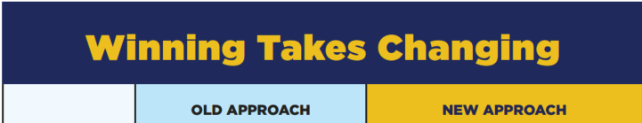
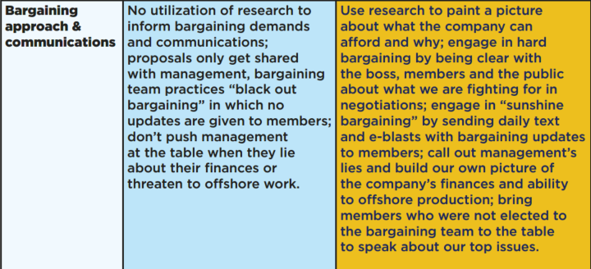
UAW Approach to Communications

Slide 43


Who Is the audience?
Traditional Alternative Approach:
  bargain with the committee
  avoid direct employee interaction including direct dealing claims
2026 Alternative Approach:
  communicate directly with employees to influence bargaining at the table, especially where the committee lacks control
  social media has created an extended audience
43

Slide 44
Are Strikes Unavoidable?
Traditional Approach: Max out offering in the Last Best and Final Offer (LBFO) to avoid strike entirely. This strategy focuses on resolution before disruption.
2026 Alternative Approach: View short duration strike as acceptable outcome. The main goal is to avoid a prolonged strike rather than avoid strike entirely.
The traditional approach aims to prevent any strike by maximizing the LBFO upfront, while the 2026 alternative approach accepts a short strike as a manageable outcome.

Slide 45
“Our country needs a labor movement that is ready to lean in,” [SEIU –USWW President David] Huerta implored, calling for worker solidarity in the labor fights ahead. “We should be preparing now for May Day 2028 to shut the whole thing down. Right now, our union is working to align our contracts with yours. When you go on strike, we’ll go with you!”
UAW 2026 National CAP Conference
Notes:
https://uaw.org/after-two-weeks-holding-the-line-uaw-members-at-ge-aerospace-secure-strong-tentative-agreement-addressing-all-core-issues/

Slide 46
Affordability
Affordability is a major public issue, with many politicians centering campaigns on the theme.
Unions are also emphasizing affordability for members.
  Affordability is included in the “UAW 2026 Guide of Our Issues.”
  “We’ve been told to accept less, sacrifice more, and be grateful for crumbs, while CEOs cash in. It’s an outright class war on workers.”
Notes:
https://uaw.org/wp-content/uploads/2026/01/UAW-2026-Guide-of-Our-Issues-26-01-29.pdf

Slide 47
Affordability
Traditional Approach: Focus on inflation and cost-of-living pressures.
2026 Alternative Approach: Position affordability through total rewards, emphasizing long-term growth and opportunity with the employer.
The traditional approach frames affordability around inflation and immediate cost-of-living pressures, focusing on short-term pay increases. The 2026 alternative approach broadens the message to total rewards, emphasizing long-term earnings and overall value with the employer rather than just near-term wage gains.
Notes:
https://uaw.org/wp-content/uploads/2026/01/UAW-2026-Guide-of-Our-Issues-26-01-29.pdf

Slide 48
Artificial Intelligence (AI)
AI is increasingly top of mind for unions as it impacts job security and work design.
Traditional Approach:
  Addressed under “new equipment and technologies” provisions.
  Focusing on protecting roles by limiting or defining how new technology is introduced.
  Tends to rely on broad, standardized restrictions across the workforce.
2026 Alternative Approach:
  Focus on individual work concerns, protections, and rights specific to each workplace.
  Emphasize flexibility by negotiating a general governance framework (e.g., transparency, fairness, oversight).
  Shift away from rigid restrictions toward adaptable guidelines that evolve with technology.
Notes:
https://aflcio.org/issues/future-work/ai
https://www.law360.com/employment-authority/labor/articles/2470954?nl_pk=92df7f73-da12-42f7-90fd-84036d8ba37a&utm_source=newsletter&utm_medium=email&utm_campaign=employment-authority/labor&utm_content=2026-04-29&read_more=1&nlsidx=0&nlaidx=3
https://docs.house.gov/meetings/ED/ED10/20260415/119139/HHRG-119-ED10-20260415-SD003.pdf

Slide 49

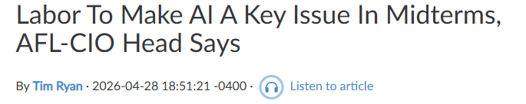
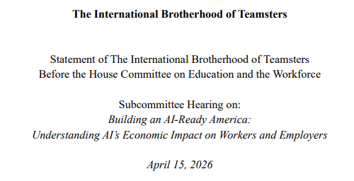
Artificial Intelligence (cont’d)
Notes:
https://aflcio.org/issues/future-work/ai
https://www.law360.com/employment-authority/labor/articles/2470954?nl_pk=92df7f73-da12-42f7-90fd-84036d8ba37a&utm_source=newsletter&utm_medium=email&utm_campaign=employment-authority/labor&utm_content=2026-04-29&read_more=1&nlsidx=0&nlaidx=3
https://docs.house.gov/meetings/ED/ED10/20260415/119139/HHRG-119-ED10-20260415-SD003.pdf

Slide 50
CONSIDERATIONS FOR NON-UNION WORKFORCES

Slide 51
Why Does This Matter Now?
Organizing activity is increasing nationally among professional workforces like Apple, Google, Wells Fargo, etc.
Employee reactions to benefits changes and reorganizations can become a catalyst for organizing activity.
Organizing campaigns often begin quietly before leadership becomes aware.
By the time a campaign is up and running, employee sentiment in favor of the union may already be deeply established.

Slide 52
Who Is Eligible to Unionize?
White-collar and knowledge-worker organizing has expanded significantly.
Younger employees increasingly view collective action favorably.
Risk is heightened for Gen-Z workers based on data demonstrating positive view of unions, ideologies, and connections between labor unions and larger social justice issues.
Small groups be organized by location and/or classification – two or more employees can create a bargaining unit.
“Supervisors” are excluded, but application of supervisory test can create uncertainty (e.g. senior consultant roles).
Titles alone do not determine supervisory status.
Takeaway:
All non-supervisory employees can organize a union, regardless of whether they are salaried and professional employees.

Slide 53
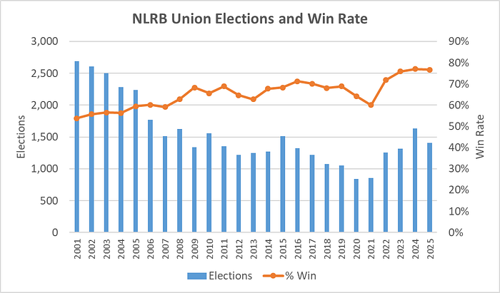
New Organizing Strategy is Generally Successful
2100 RC petitions filed in 2025
1,406 elections in 2025
Of those elections, the Union won 81.9% of the time.
  Slight decline in union win rate compared to 2024 (79.9%)
68% of Americans approve of labor unions
  Union approval has remained steady over the last 5 years
  Around 10% higher for Gen Z

Slide 54
Union Organizing Continues to Increase at Traditionally “Non-union” Employers
Apple
Amazon
Activision/
Microsoft
Ben & Jerry’s
H&M
Applegreen
2020
2021
2022
2023
2024
2025
2026
Starbucks
REI
Barnes & Noble
Whole Foods Market
Patagonia
Trader Joes

Slide 55
Why Organizing Activity Remains Elevated
Workplace Conditions
Current External Environment
  Increased in-office requirements
  Annual wage increases limited
  Schedule changes/uncertainty
  Variable promotion chances
  Lack of employee participation in key employment decisions – “no advocate”
  Tough to access leadership
  Weak internal connections and relationships
  Affordability
  Price increases
  Home purchase barriers
  Political polarization
  AI / job security concerns
  Demographic changes
Notes:
Key Dynamic
Large employers increasingly struggle to maintain local credibility consistently across distributed workforces.
Important Observation
Modern organizing campaigns increasingly convert operational frustration into collective workplace identity.

Slide 56
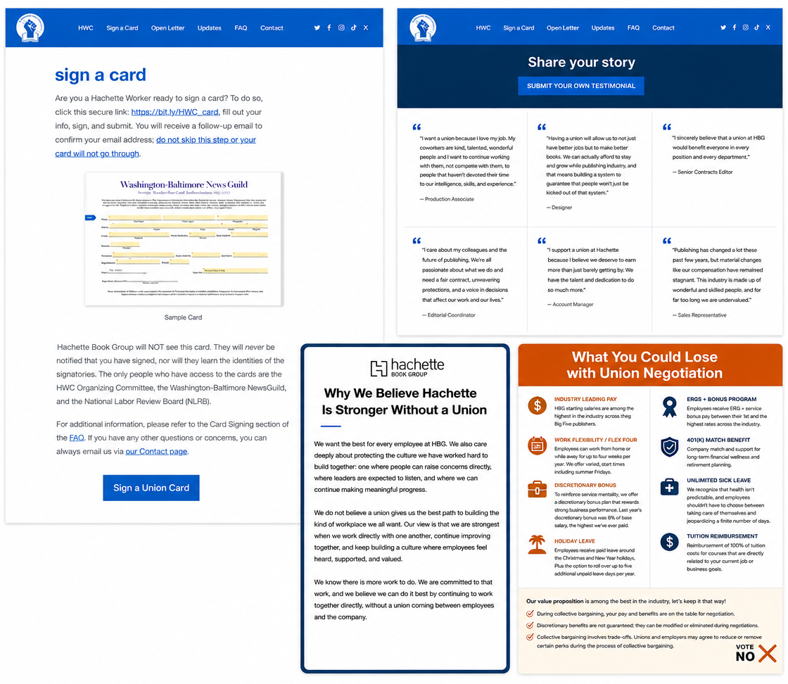
White-Collar Organizing Dynamics
Common Themes
Individual autonomy
Group participation
Corporate excesses
White-Collar Organizing Dynamics
Increased scrutiny of management messaging
Greater focus on institutional consistency
Public credibility became operationally important
Management Problem
Traditional messaging generated resistance
Credibility gaps intensified scrutiny
Institutional alignment became operationally important
Key Reality
In white-collar campaigns, employees often reacted less to traditional labor issues than to perceived gaps between company values, management messaging, and workplace realities.

Slide 57

Encouraging Employee Participation
How are you ensuring that employees feel they can participate in the workplace outside of completing their assigned job duties?
Alternative to collective bargaining is individual and group participation that the Company accepts.
How would you respond to:
  An employee on your team approaches you with a creative idea about a system change that they believe would help streamline the process of onboarding new employees. You know this will require extensive review from other stakeholders.
  An employee continues to press what they perceive
  to be safety concerns in the lab. How do you keep
  them engaged?
57
57

